Slide 1

Understanding Phishing
A comprehensive guide for Advanced, Cybersecurity Analysts
PRESENTED BY
Manish Kumar
Internship Programm -CodeAlpha
July 15, 2026

Slide 2
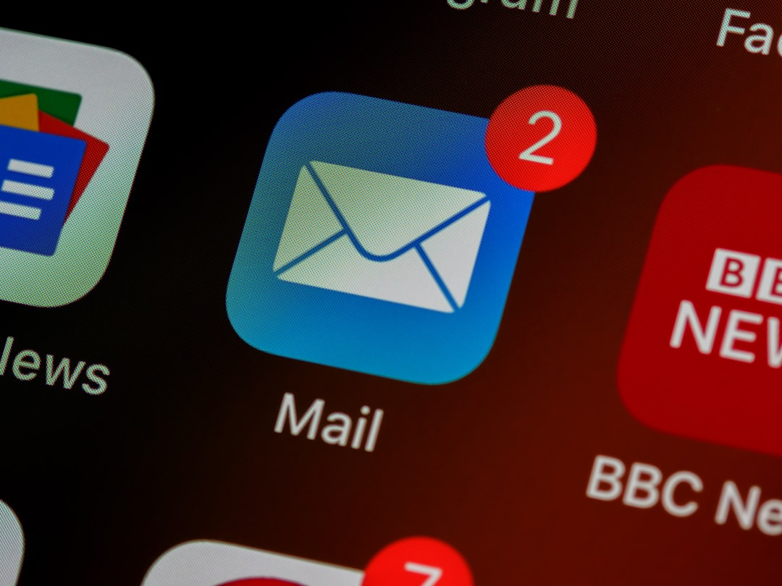
Understanding Phishing
Definition of Phishing
Impersonation Tactics
Phishing is a cyber attack that uses deceptive emails to trick individuals into revealing sensitive information, such as passwords and credit card numbers, often leading to severe security breaches.
Attackers frequently impersonate trusted organizations, utilizing familiar logos and language to create a sense of legitimacy, which increases the likelihood of victims falling for the scam.
Consequences of Phishing
Successful phishing attacks can result in significant financial losses, data breaches affecting millions, and long-lasting reputational damage to organizations, highlighting the need for robust cybersecurity measures.

Slide 3
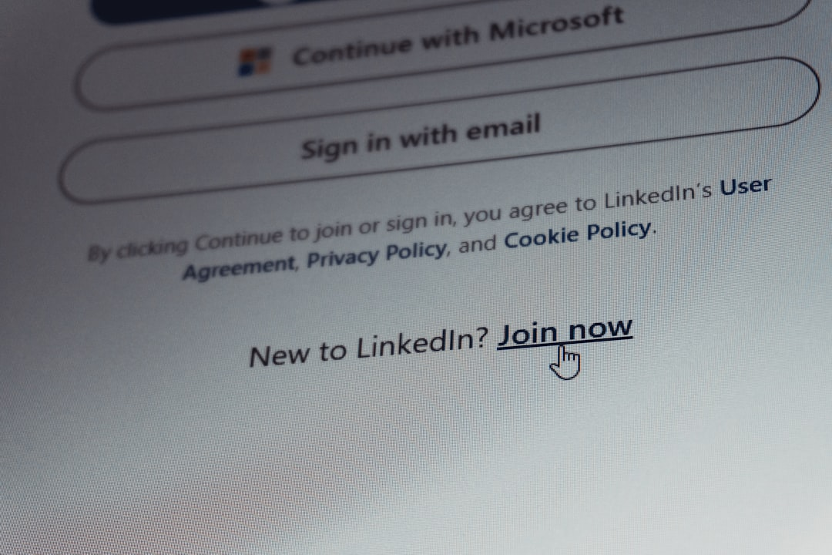
Types of Phishing Attacks
Spear Phishing
Whaling
Spear phishing involves targeted attacks on specific individuals or organizations, often using personal information to increase credibility. Reports indicate a 70% success rate in these tailored attacks.
Whaling targets high-profile individuals, such as executives, leveraging their authority. These attacks often involve impersonating trusted sources, with a 30% higher likelihood of financial loss compared to regular phishing.
Clone Phishing
Clone phishing replicates legitimate emails, replacing links with malicious ones. This technique exploits trust, with studies showing a 50% click-through rate on cloned emails from known contacts.

Slide 4
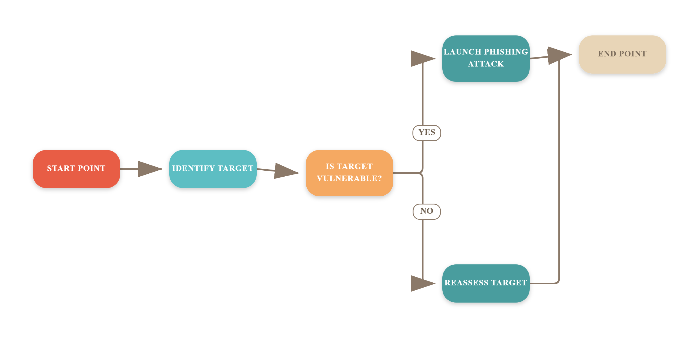
Phishing Attack Lifecycle

Slide 5
Identifying Phishing Emails
Generic Greetings and Grammar
Mismatched URLs and Attachments
Phishing emails often use generic greetings like 'Dear Customer' and contain poor grammar. These indicators suggest a lack of personalization and professionalism, raising red flags for potential scams.
Always check URLs for discrepancies. Phishing attempts may use similar-looking domains. Additionally, be wary of unexpected attachments, which can harbor malware or lead to credential theft.
Urgent Requests for Information
Phishing emails frequently create a sense of urgency, pressuring recipients to provide sensitive information quickly. Legitimate organizations rarely request sensitive data via email, especially under duress.

Slide 6

Phishing Email Examples
Fake Bank Notification
Spoofed Colleague Email
Urgent IT Request
An email mimicking a bank notification prompts users to click a malicious link. This link leads to a counterfeit site designed to harvest login credentials, often using urgency to manipulate victims.
A phishing attempt may involve an email appearing to be from a trusted colleague, requesting sensitive data. Attackers exploit familiarity to bypass skepticism, increasing the likelihood of data compromise.
Phishing emails may impersonate IT departments, demanding immediate password verification. These messages often create a false sense of urgency, compelling users to act without verifying the request's authenticity.

Slide 7
Fake Websites and Their Risks
Mimicking Legitimate Sites
Security Indicators
Phishing websites often replicate the appearance of legitimate sites, using similar URLs and branding to deceive users into entering sensitive information, leading to credential theft.
Always check for HTTPS and valid SSL certificates. Legitimate sites will display a padlock icon in the address bar, indicating a secure connection and protecting user data.
Browser Security Features
Reporting Suspicious Sites
Utilize built-in browser security features, such as warnings for suspicious sites. Modern browsers can detect and alert users about potential phishing attempts and fraudulent websites.
Encourage reporting of suspicious websites to IT security teams. Prompt reporting can help mitigate risks and protect the organization from potential phishing attacks.

Slide 8

Social Engineering Techniques
Exploiting Human Psychology
Common Manipulation Tactics
Attackers leverage cognitive biases, such as trust and compliance, to manipulate victims into divulging sensitive information, making social engineering a potent complement to phishing attacks.
Urgency, fear, and authority are frequently used tactics. For instance, attackers may create a false sense of urgency to prompt immediate action, bypassing critical thinking.
Importance of Employee Training
Training employees to recognize social engineering tactics is crucial. Regular workshops can enhance awareness, reducing the likelihood of successful phishing attempts by up to 70%.

Slide 9
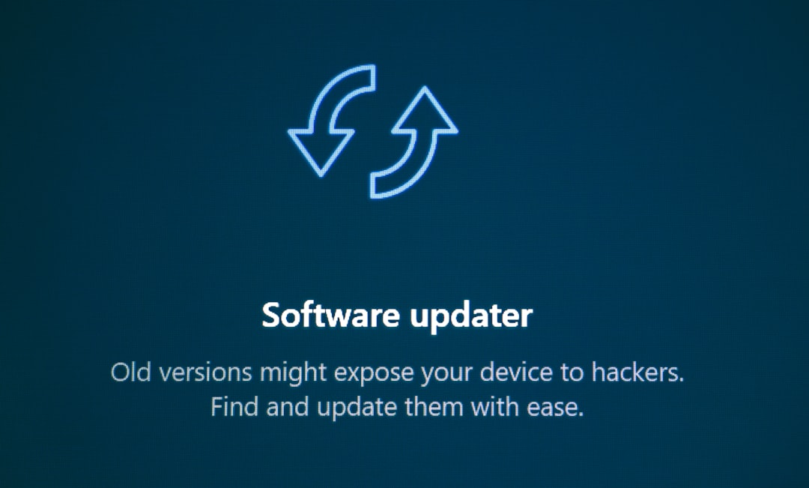
Prevention Tips
Regular Software Updates
Multi-Factor Authentication
Ensure all software, including operating systems and applications, are updated regularly. Vulnerabilities in outdated software are prime targets for phishing attacks, with 60% of breaches exploiting known flaws.
Implement multi-factor authentication (MFA) for sensitive accounts. MFA can block 99.9% of automated attacks, significantly reducing the risk of unauthorized access from phishing attempts.
Employee Education
Conduct regular training sessions to educate employees on identifying phishing attempts. Studies show that informed employees can reduce phishing success rates by up to 70%.

Slide 10
The Alarming Impact of Phishing Attacks
$1.6M
50%
90%
Average Cost
Increase in Attacks
Cyberattacks Start
Phishing attacks cost businesses an average of $1.6 million each
Phishing attacks surged by 50% in 2022 compared to 2021
Over 90% of cyberattacks begin with phishing attempts

Slide 11

Incident Response to Phishing
Report to IT Security Team
Change Compromised Passwords
Immediately notify the IT security team about the phishing incident to initiate a swift response. This ensures that the threat is contained and further damage is mitigated.
Promptly change passwords for any accounts that may have been compromised. This action helps to secure sensitive information and prevents unauthorized access to critical systems.
Analyze Attack Vector
Conduct a thorough analysis of the phishing attack vector to identify vulnerabilities. Understanding how the attack occurred aids in developing strategies to prevent future incidents.

Slide 12
How to Assess Knowledge on Phishing Awareness
1. Define Phishing
Begin by explaining what phishing is, including its purpose and how it targets individuals and organizations.
2. Identify Phishing Types
List and describe at least two types of phishing attacks, such as spear phishing and whaling, to provide context for the quiz.
3. Recognize Phishing Emails
Outline key indicators of phishing emails, such as suspicious sender addresses, poor grammar, and urgent calls to action.
4. Respond to Suspicious Emails
Provide clear instructions on what actions to take if a suspicious email is received, including reporting it to IT.
5. Emphasize Multi-Factor Authentication
Explain the importance of multi-factor authentication in preventing unauthorized access and enhancing security.

Slide 13
Frequently Asked Questions
Q: What should I do if I clicked on a phishing link?
A: Immediately disconnect from the internet, run a full antivirus scan, and change your passwords for any accounts that may have been compromised.
Q: How can I report phishing attempts?
A: You can report phishing emails to your email provider and forward them to organizations like the Anti-Phishing Working Group at reportphishing@apwg.org.
Q: What tools can help detect phishing emails?
A: Email filtering tools, browser extensions like PhishTank, and security software with phishing detection capabilities can help identify and block phishing attempts.
Q: Are there any legal implications for phishing?
A: Yes, phishing is illegal and can lead to severe penalties, including fines and imprisonment for those who engage in such fraudulent activities.

Slide 14
Phishing Statistics and Tips
This infographic visually represents critical phishing statistics, including that 90% of data breaches start with a phishing email. It also highlights essential prevention tips, such as verifying sender authenticity and using multi-factor authentication.

Slide 15
Key Takeaways
Phishing remains a significant threat, with 90% of data breaches linked to phishing attacks. Key takeaways include recognizing phishing signs, implementing robust email filters, and conducting regular training. Moving forward, organizations must prioritize continuous education and incident response planning to mitigate risks effectively. By fostering a culture of cybersecurity awareness, we can significantly reduce vulnerability to these attacks and enhance overall security posture.

