Slide 1

Introduction and Group Members
Volatility-Aware Dynamic Learning-Rate Control for LSTM Using a Fuzzy Controller
Next-Day Direction Prediction of the S&P 500 Using a Hybrid Neuro-Fuzzy Approach.
Financial markets are noisy and non-stationary; one fixed learning rate may not suit calm and highly volatile periods.
A fuzzy controller adjusts the LSTM learning rate from market volatility. The model predicts next-day direction: Up (1) or Down (0).
Course: Soft Computing · Faculty: Dr. Poonam Rani
Aditya (1523)
Krishna (1548)
Ayush Kumar Jha (1573)
Manish Mandia (1576)

Slide 2
Our Idea
LSTM Predictor
Fuzzy Logic Controller
Learns temporal patterns from historical S&P 500 data.
Outputs the probability of an upward move.
Takes market volatility and uses membership functions and IF-THEN rules to set the learning rate during training.
“The LSTM learns market patterns, while the fuzzy controller decides how aggressively the model should update its weights under different volatility conditions.”
The controller changes training, not the model's prediction output directly.
2 / 10

Slide 3
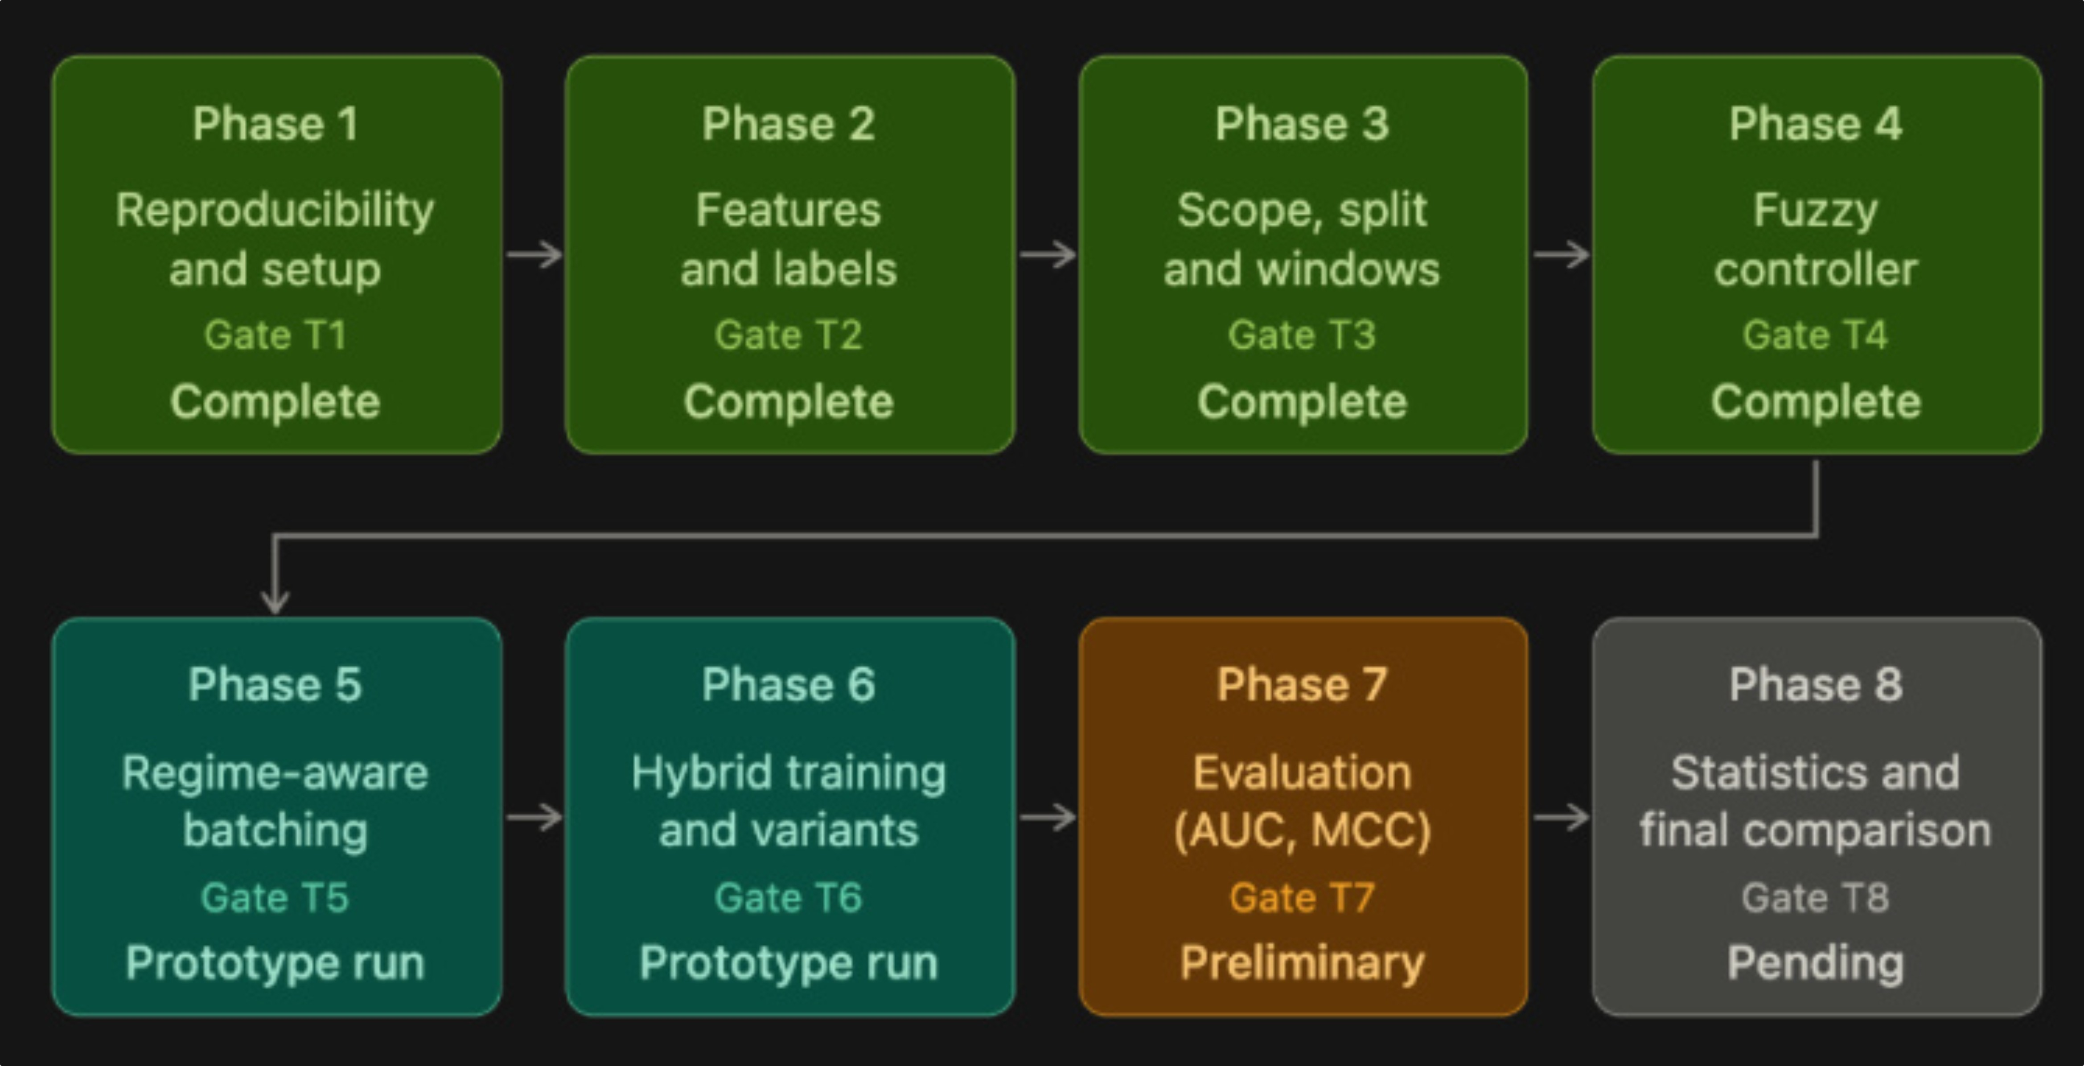
Phase-Wise Diagram
3 / 10

Slide 4
Technology Stack
Component | Technology
Data Acquisition | yfinance · retrieves market data
Data Processing | pandas, NumPy · process the data
Fuzzy Logic | scikit-fuzzy · implements the fuzzy controller
Neural Network | PyTorch · builds and trains the LSTM
Visualization | matplotlib, seaborn · plots and figures
Environment | Python 3.10+, Jupyter Notebook
Implementation runs on Google Colab with GPU.
4 / 10

Slide 5
Existing Research Papers
Paper | Short description | Relevance to our project
Fischer and Krauss (2018), "Deep learning with long short-term memory networks for financial market predictions," European Journal of Operational Research, 270(2), 654–669. | LSTM prediction of directional movements. | Supports LSTM direction prediction; we add volatility-aware learning-rate control.
Lin et al. (2022), "Forecasting the realized volatility of stock price index: A hybrid model integrating CEEMDAN and LSTM," Expert Systems with Applications, 206, 117736. | CEEMDAN and LSTM forecast realized volatility. | Volatility matters; we use it as a control signal, not the prediction target.
Wang, Shao, and Jumahong (2023), "Fuzzy inference-based LSTM for long-term time series prediction," Scientific Reports, 13, 20359. | Integrates fuzzy inference with LSTM. | Our fuzzy controller sits outside the predictor and regulates training.
"Guided neural network learning using a fuzzy controller" (1995), International Transactions in Operational Research, 2(3), 259–272. | Fuzzy-guided learning in simulated textile spinning. | Background for fuzzy learning-rate control; we apply it to market volatility.
Hochreiter and Schmidhuber (1997), "Long short-term memory," Neural Computation, 9(8), 1735–1780. | Introduces LSTM for long-term dependencies. | Theoretical foundation of our predictor.
5 / 10
Notes:
The authors of the 1995 paper are not listed in our report. The comparison concerns the reviewed papers, not an exhaustive claim about all literature.

Slide 6
Research Gap and How We Are Addressing It
Existing Research
Our Approach
The reviewed papers cover LSTM financial prediction, volatility forecasting, fuzzy-LSTM integration, and fuzzy control of neural-network learning rates.
Within these papers, we did not identify an approach using an external market-volatility signal to dynamically control an LSTM's learning rate during training.
1
Collect S&P 500 OHLCV data.
2
Calculate features and 14-day rolling volatility.
3
Classify volatility into Low, Medium, High fuzzy sets.
4
Apply interpretable IF-THEN learning-rate rules.
5
Integrate the learning rate into LSTM training.
6
Compare with a fixed-learning-rate baseline.
Volatility controls training behaviour rather than directly predicting market direction.
6 / 10

Slide 7
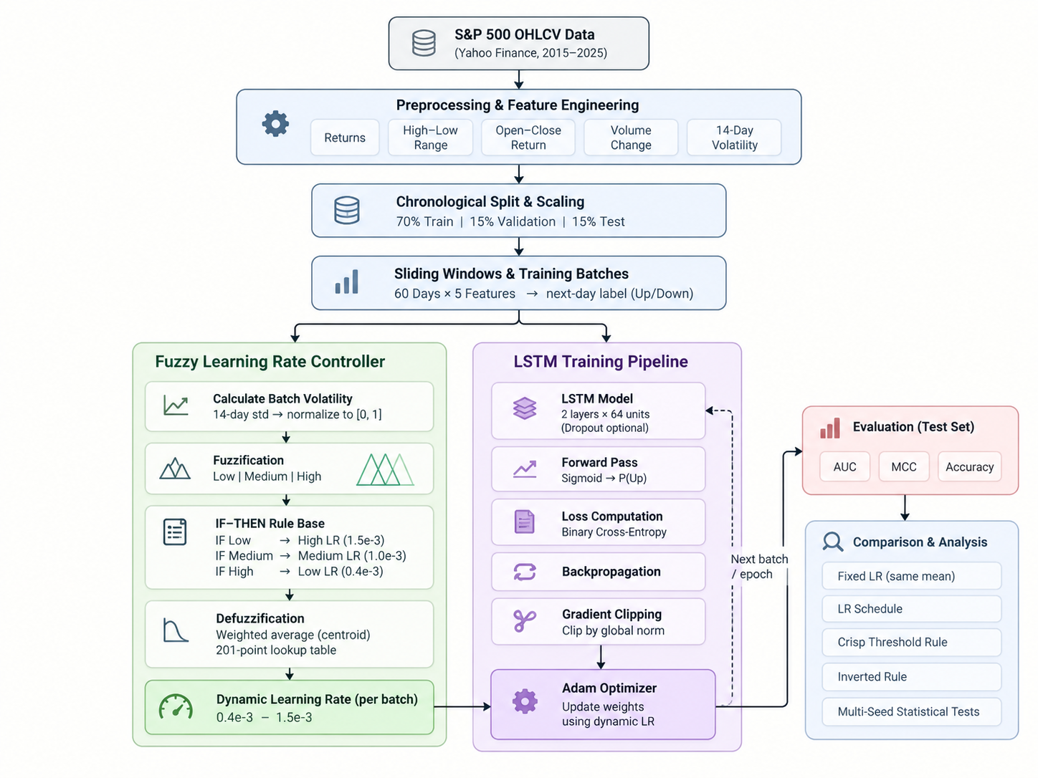
Technical Approach
System Architecture Diagram
7 / 10

Slide 8
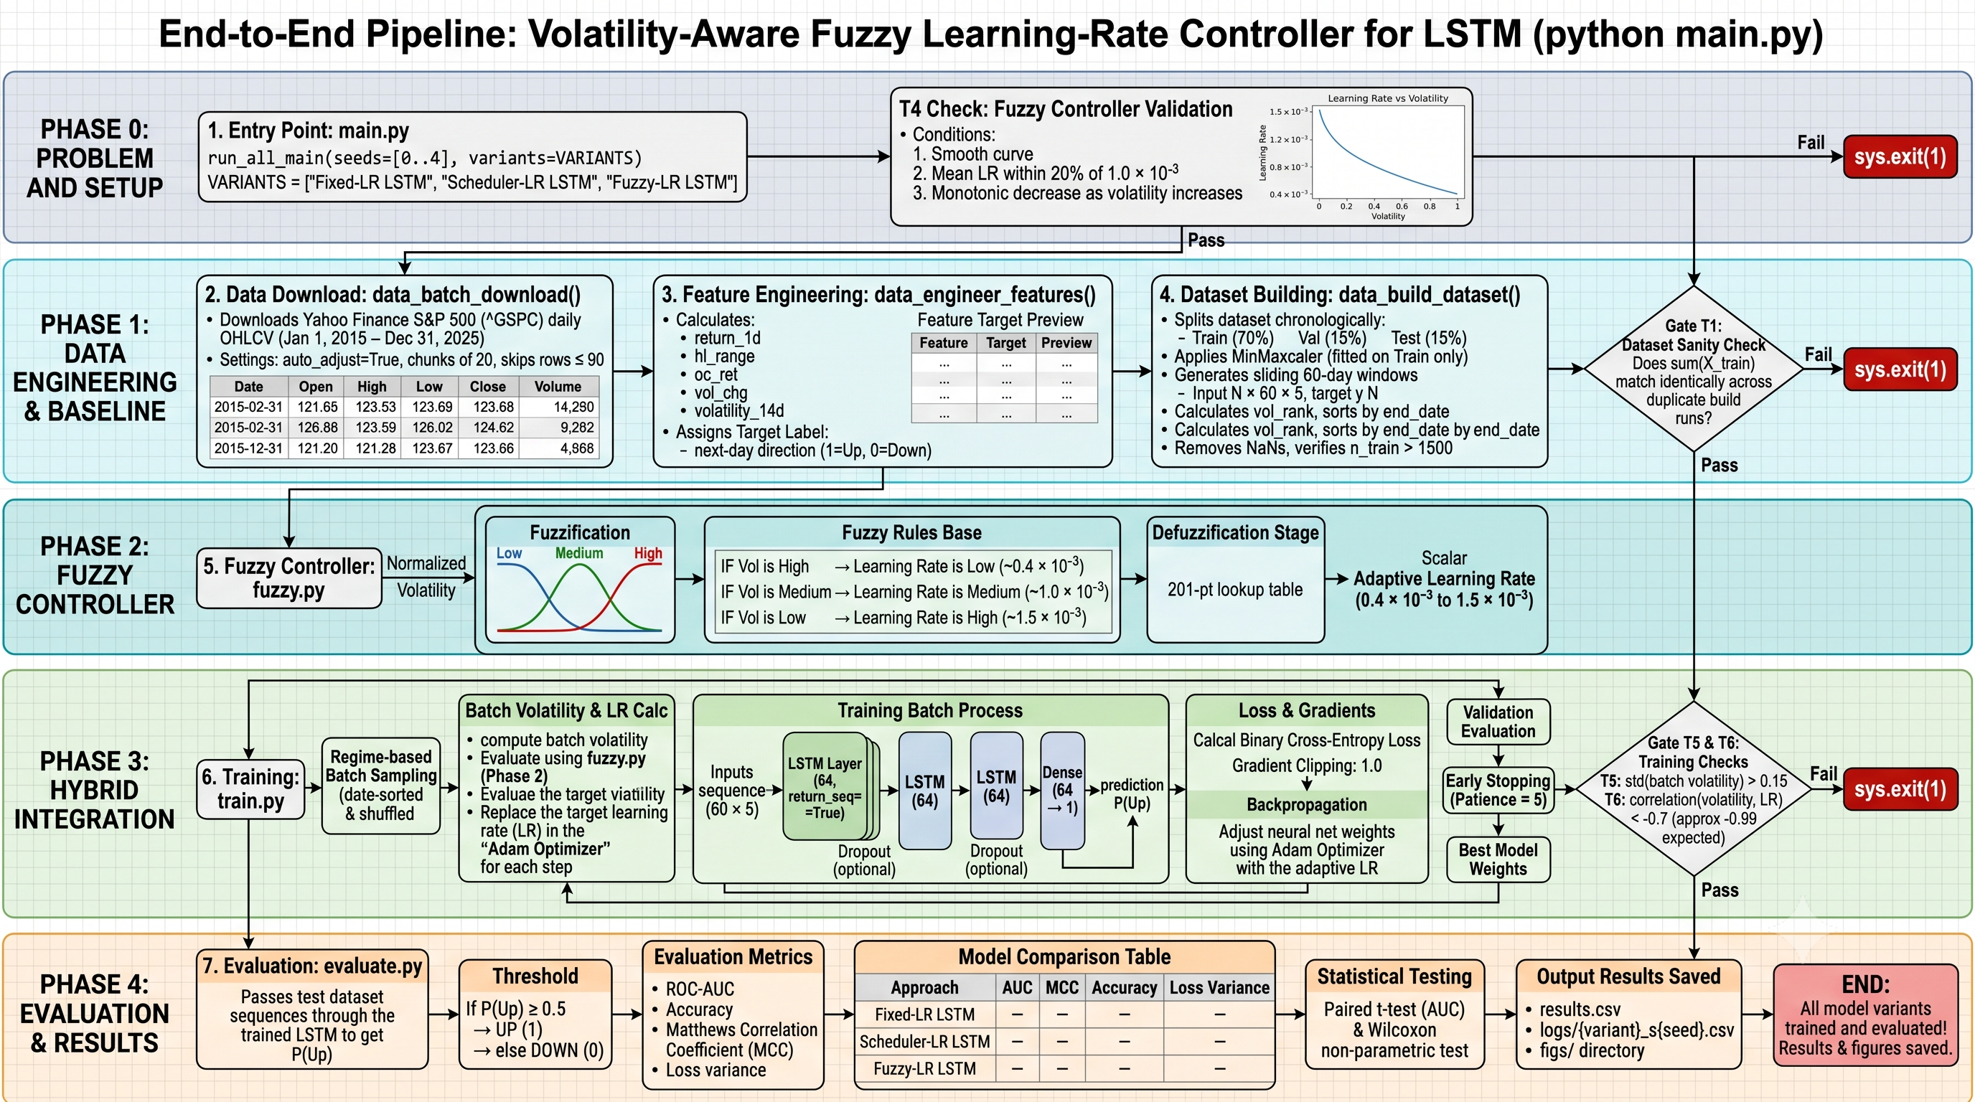
Flow Diagram
Caption
8 / 10

Slide 9
Phases (till 4)
Phase 1
Phase 2
Phase 3
Phase 4
Reproducibility and Setup
Features and Labels
Scope, Split, and Windows
Fuzzy Controller
return_1d, hl_range, oc_ret, vol_chg, volatility_14d
Low/Medium/High membership functions
Low volatility → higher LR; high → lower LR
Membership-weighted rule outputs
201-point LR lookup curve
Fixed Python, NumPy, PyTorch seeds
1 Jan 2015 to 31 Dec 2025
Two builds gave identical checksums
S&P 500 (^GSPC)
Chronological 70/15/15 split
Scaling fitted on training data only
60-day windows, 5 features
Next-day Up/Down labels
Feature validity and label alignment checked
1,863 train · 352 validation · 353 test
Smoothness, monotonicity and fairness vs fixed baseline verified.
T1 PASS
T2 PASS
T3 PASS
T4 PASS
9 / 10

Slide 10
Intermediate Result
Completed results validate data preparation and the fuzzy controller only. Better direction accuracy and lower final training loss remain for evaluation in Phases 5–8.
A. Dataset Preparation Results
B. Fuzzy Controller Results
Criterion | Result
Reproducibility | PASS · identical checksum 202000.3771
Features and labels | PASS
Training windows | 1,863
Validation windows | 352
Test windows | 353
Window dimensions | 60 days × 5 features
Up-day fraction | Train 54.1% Validation 53.4% Test 57.8%
Criterion | Measured result | Status
Maximum LR step | 1.79 X 10^-5 | PASS
Mean fuzzy LR | 9.63 X 10^-4 | PASS
Fixed baseline LR | 1.00 X 10^-3 | PASS
Monotonicity | Higher volatility never gives a higher LR | PASS
LR range | 0.4 X 10^-3 to 1.5 X 10^-3 | PASS
Mean fuzzy LR is within 20% of the baseline; the mapping is smooth and monotonically decreasing.
The test set has more Up days than training. Always-Up would score 57.8%, so accuracy alone is insufficient.
10 / 10

