Slide 1

INTRODUCTION · GROUP MEMBERS
Volatility-Aware Dynamic Learning-Rate Control for LSTM Using a Fuzzy Controller
Next-day direction prediction of the S&P 500 with a hybrid neuro-fuzzy approach.
Financial markets are noisy and non-stationary; one fixed learning rate may not suit calm and highly volatile periods.
A fuzzy controller adjusts the LSTM learning rate from market volatility. The model predicts next-day direction: Up (1) or Down (0).
Aditya (1523) · Krishna (1548) · Ayush Kumar Jha (1573) · Manish Mandia (1576)
Course: Soft Computing · Faculty: Dr. Poonam Rani
Fuzzy-Controlled LSTM · Soft Computing
1 / 10

Slide 2
CONCEPT
Our Idea
LSTM Predictor
Fuzzy Logic Controller
Learns temporal patterns from historical S&P 500 data.
Outputs the probability of an upward move.
Takes market volatility and uses membership functions and IF–THEN rules to set the learning rate during training.
“The LSTM learns market patterns, while the fuzzy controller decides how aggressively the model should update its weights under different volatility conditions.”
The controller changes training, not the model's prediction output directly.
Fuzzy-Controlled LSTM · Soft Computing
2 / 10

Slide 3
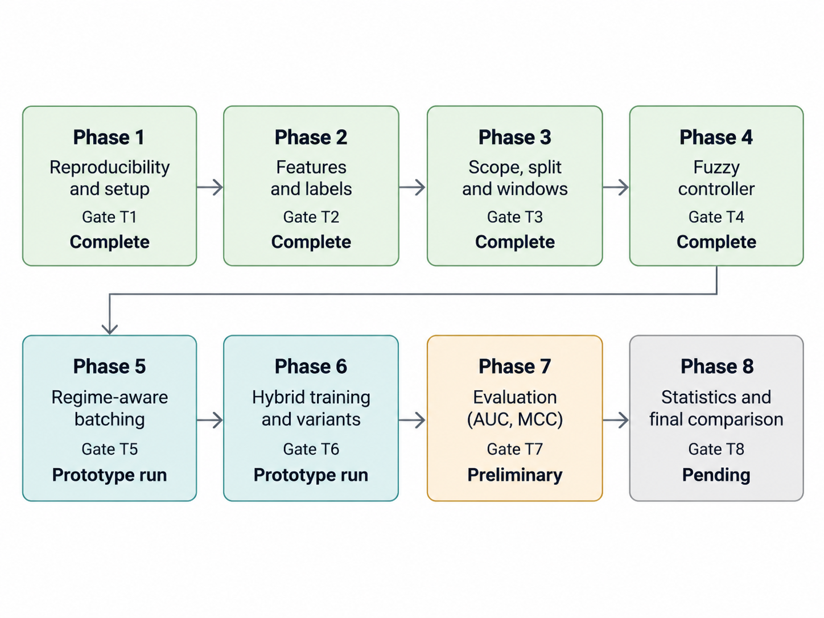
ROADMAP
Phase-Wise Diagram
Fuzzy-Controlled LSTM · Soft Computing
3 / 10

Slide 4
IMPLEMENTATION
Technology Stack
Component | Technology
Data Acquisition | yfinance · retrieves market data (auto_adjust=True)
Data Processing | pandas, NumPy · feature engineering, scaling, windows
Fuzzy Logic | scikit-fuzzy · Mamdani FIS cross-check; NumPy lookup in training
Neural Network | PyTorch · builds and trains the LSTM
Visualization | matplotlib · plots and figures
Environment | Python 3.10+ · run_all.py pipeline (main.py runner)
Batch download (—chunked, per-ticker), stationary features only, scaler fit on training split.
Fuzzy-Controlled LSTM · Soft Computing
4 / 10

Slide 5
LITERATURE
Existing Research Papers
Paper | Short description | Relevance to our project
Fischer and Krauss (2018), “Deep learning with LSTM networks for financial market predictions,” EJOR, 270(2), 654–669. | LSTM prediction of directional movements. | Supports LSTM direction prediction; we add volatility-aware learning-rate control.
Lin et al. (2022), “Forecasting the realized volatility of stock price index: CEEMDAN + LSTM,” ESA, 206, 117736. | CEEMDAN and LSTM forecast realized volatility. | Volatility matters; we use it as a control signal, not the prediction target.
Wang, Shao, and Jumahong (2023), “Fuzzy inference-based LSTM for long-term time series prediction,” Sci. Rep., 13, 20359. | Integrates fuzzy inference with LSTM. | Our fuzzy controller sits outside the predictor and regulates training.
“Guided neural network learning using a fuzzy controller” (1995), Int. Trans. Op. Res., 2(3), 259–272. | Fuzzy-guided learning in simulated textile spinning. | Background for fuzzy learning-rate control; we apply it to market volatility.
Hochreiter and Schmidhuber (1997), “Long short-term memory,” Neural Comp., 9(8), 1735–1780. | Introduces LSTM for long-term dependencies. | Theoretical foundation of our predictor.
Fuzzy-Controlled LSTM · Soft Computing
5 / 10

Slide 6
MOTIVATION
Research Gap and How We Are Addressing It
Existing Research
Our Approach
The reviewed papers cover LSTM financial prediction, volatility forecasting, fuzzy-LSTM integration, and fuzzy control of neural-network learning rates.
Within these papers, we did not identify an approach using an external market-volatility signal to dynamically control an LSTM's learning rate during training.
1
Collect S&P 500 OHLCV data (2015–2026).
2
Calculate stationary features + 14-day rolling volatility.
3
Classify volatility into Low / Medium / High fuzzy sets.
4
Apply interpretable IF–THEN learning-rate rules.
5
Integrate the dynamic rate into LSTM training.
6
Compare against fixed-rate and control variants (5 seeds).
Volatility controls training behaviour rather than directly predicting market direction.
Fuzzy-Controlled LSTM · Soft Computing
6 / 10

Slide 7
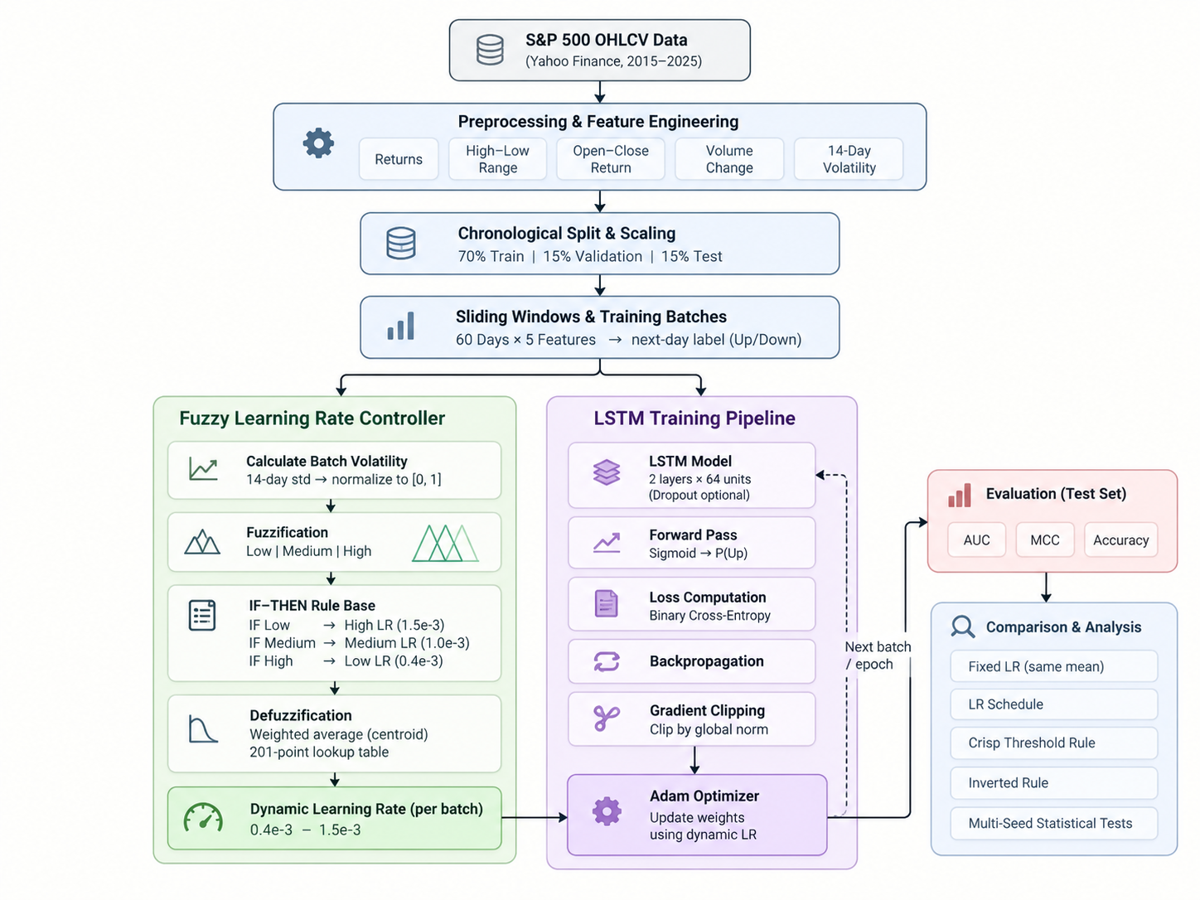
TECHNICAL APPROACH
System Architecture Diagram
Fuzzy-Controlled LSTM · Soft Computing
7 / 10

Slide 8
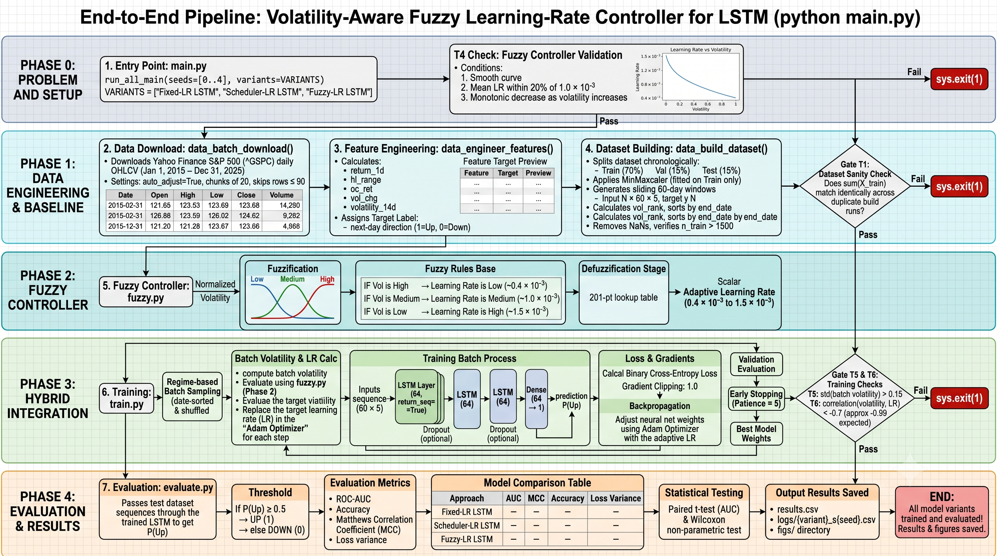
PIPELINE
Flow Diagram — python main.py end to end
T4 fuzzy gate → data download → features → dataset + T1 check → Mamdani control → regime-aware training (T5/T6) → evaluation → paired statistics.
Fuzzy-Controlled LSTM · Soft Computing
8 / 10

Slide 9
PROGRESS
Phases (till 4)
PHASE 1
PHASE 2
PHASE 3
PHASE 4
Reproducibility and Setup
Features and Labels
Scope, Split and Windows
Fuzzy Controller
• Fixed Python, NumPy, PyTorch seeds
• 1 Jan 2015 – 30 Sep 2026 (^GSPC)
• Two builds gave identical sums
• return_1d, hl_range, oc_ret,
• vol_chg, volatility_14d
• Next-day Up/Down labels,
• label alignment checked
• S&P 500 (^GSPC)
• Chronological 70/15/15 split
• Scaling fit on train only
• 60-day windows × 5 features
• 1,995 train · 380 val · 381 test
• Low/Med/High Ruspini sets
• Low vol → higher LR, and reverse
• Mamdani: min/max + centroid
• 201-pt lookup, skfuzzy-checked
T1 PASS
T2 PASS
T3 PASS
T4 PASS
Fuzzy-Controlled LSTM · Soft Computing
9 / 10

Slide 10
EVIDENCE
Intermediate Result
Completed results validate data preparation and the fuzzy controller only. Direction accuracy and training-loss evaluation follow in Phases 5–8.
A. Dataset Preparation
B. Fuzzy Controller
Criterion | Result
Reproducibility | PASS · identical sum 217426.6097
Features and labels | PASS
Training windows | 1,995
Validation windows | 380
Test windows | 381
Window dimensions | 60 days × 5 features
Up-day fraction | Train 53.3% · Val 57.1% · Test 55.1%
Criterion | Measured | Status
Maximum LR step | 1.03 × 10⁻⁵ | PASS
Mean fuzzy LR | 1.00 × 10⁻³ | PASS
Fixed baseline LR | 1.00 × 10⁻³ | PASS
Monotonicity | Higher vol never raises LR | PASS
LR range | 0.4 × 10⁻³ – 1.6 × 10⁻³ | PASS
Test has more Up days than train: always-Up scores 55.1%, so accuracy alone is insufficient.
Mean LR is within 20% of baseline; the Mamdani mapping is smooth, monotone decreasing, Ruspini-exact.
Fuzzy-Controlled LSTM · Soft Computing
10 / 10

