Slide 1
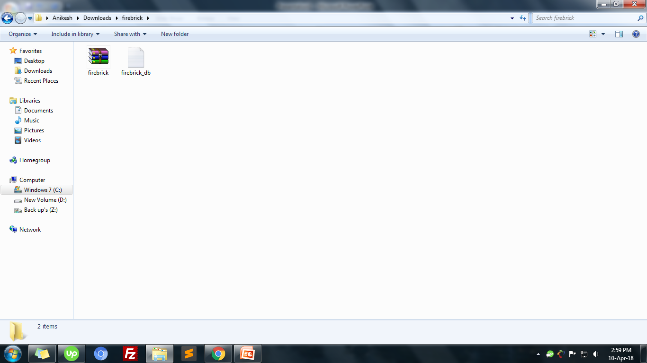
Copy zip file into your server and then extract it
Then, open firebrick folder inside modal folder find connection.php file
Firebrick->modal->connection.php

Slide 2
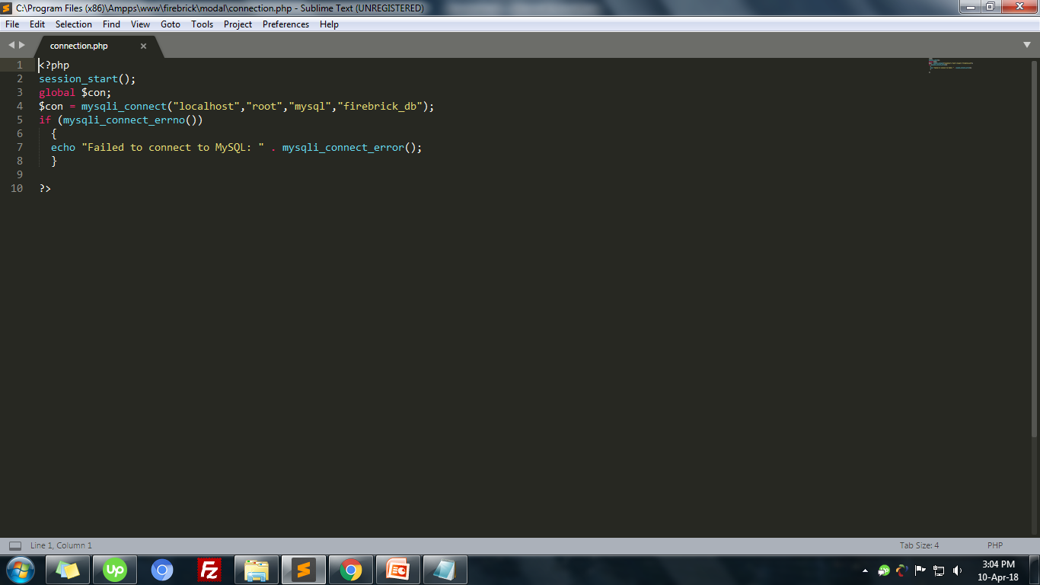
mysqli_connect(" hostname ",“username",“password",“database_name");
Here, you can insert
Saved filed
And then, export Sql file in your database server i.e. firebrick_db.sql
For run: www.yourdomainname.com/firebrick

