Slide 1

Banking Dashboard Project
Risk Analytics & Interactive Power BI Dashboards

Slide 2


The Challenge: Lending Risk in Banking
Creditworthiness Assessment
Banks face significant challenges evaluating loan applicants, making accurate credit decisions critical to portfolio health.
Default Risk & NPAs
Incorrect lending decisions lead to high default rates and non-performing assets, eroding profitability.
Financial Losses
Substantial losses accumulate from poor risk assessment across loan portfolios at scale.
Need for Data-Driven Tools
Decision-makers require interactive analytics to evaluate applicant profiles and make informed, defensible lending decisions.

Slide 3

Project Objectives
What This Project Delivers
1
Interactive Power BI Dashboards
Presenting key banking metrics and KPIs for real-time decision support.
2
Portfolio Segmentation
Analyse loan and deposit portfolios by gender, income band, nationality, occupation, and banking relationship type.
3
Risk Pattern Identification
Distinguish clients likely to repay from higher-risk profiles to minimise lending risk.
4
Consolidated KPI View
Total Clients, Total Loan, Total Deposit, Business Lending, and account balances in one unified view.

Slide 4
Data Foundation
Dataset Architecture
Client Demographics
Account Types
Multiple interlinked tables connected through primary and foreign keys, forming a robust relational data model.
Loan products, deposits, checking, savings, foreign currency
Income band, nationality, occupation, gender
Key Tables
Banking Relationship
Client-Banking
Gender
Investment Advisor
Period
Advisor Relationships
Transformations
Engagement Timeframe, Engagement Days, Income Band binning, Processing Fees
Institution advisor linkage and relationship type mapping

Slide 5

Core KPIs & Calculations
3,000
4.38bn
Total Clients
Total Loan
DISTINCTCOUNT of Client ID across the full portfolio
Bank Loan + Business Lending + Credit Cards Balance
3.77bn
SUMX
Total Deposit
Total Fees
Bank Deposit + Savings + Foreign Currency + Checking Accounts
Total Loan × Processing Fees rate per client record
Engagement Length is calculated as SUM of Engagement Days — capturing client tenure across the full banking relationship lifecycle.

Slide 6
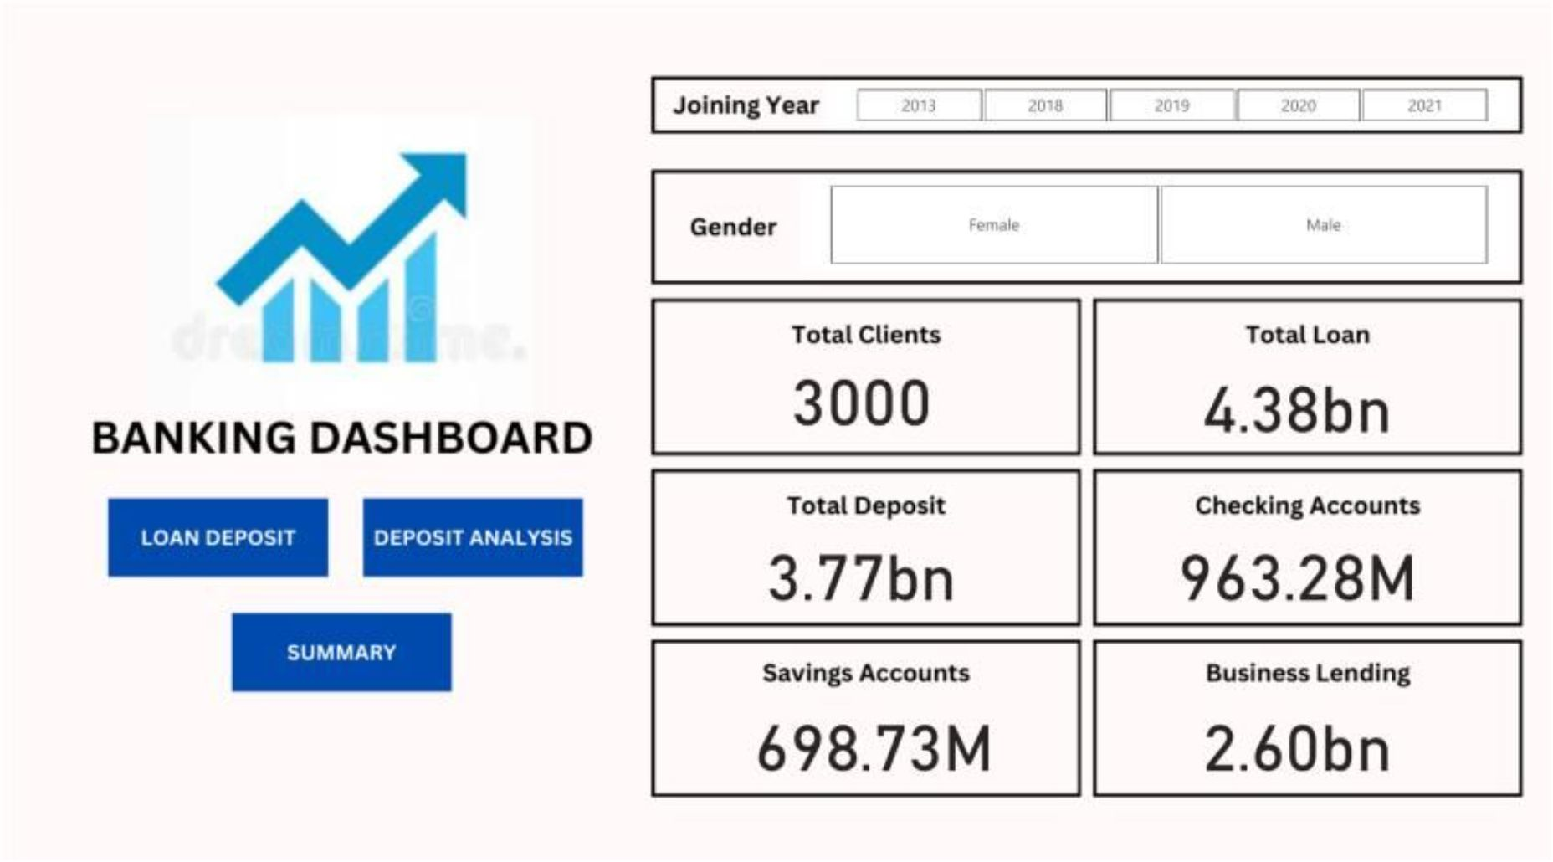
DASHBOARD
Portfolio at a Glance
Metric | Value
Total Clients | 3,000
Total Loan | 4.38bn
Total Deposit | 3.77bn
Business Lending | 2.60bn (59% of loan book)
Checking Accounts | 963.28M
Savings Accounts | 698.73M
Filters available: Joining Year, Gender, Banking Relationship, and Institution Advisor for granular drill-down.

Slide 7
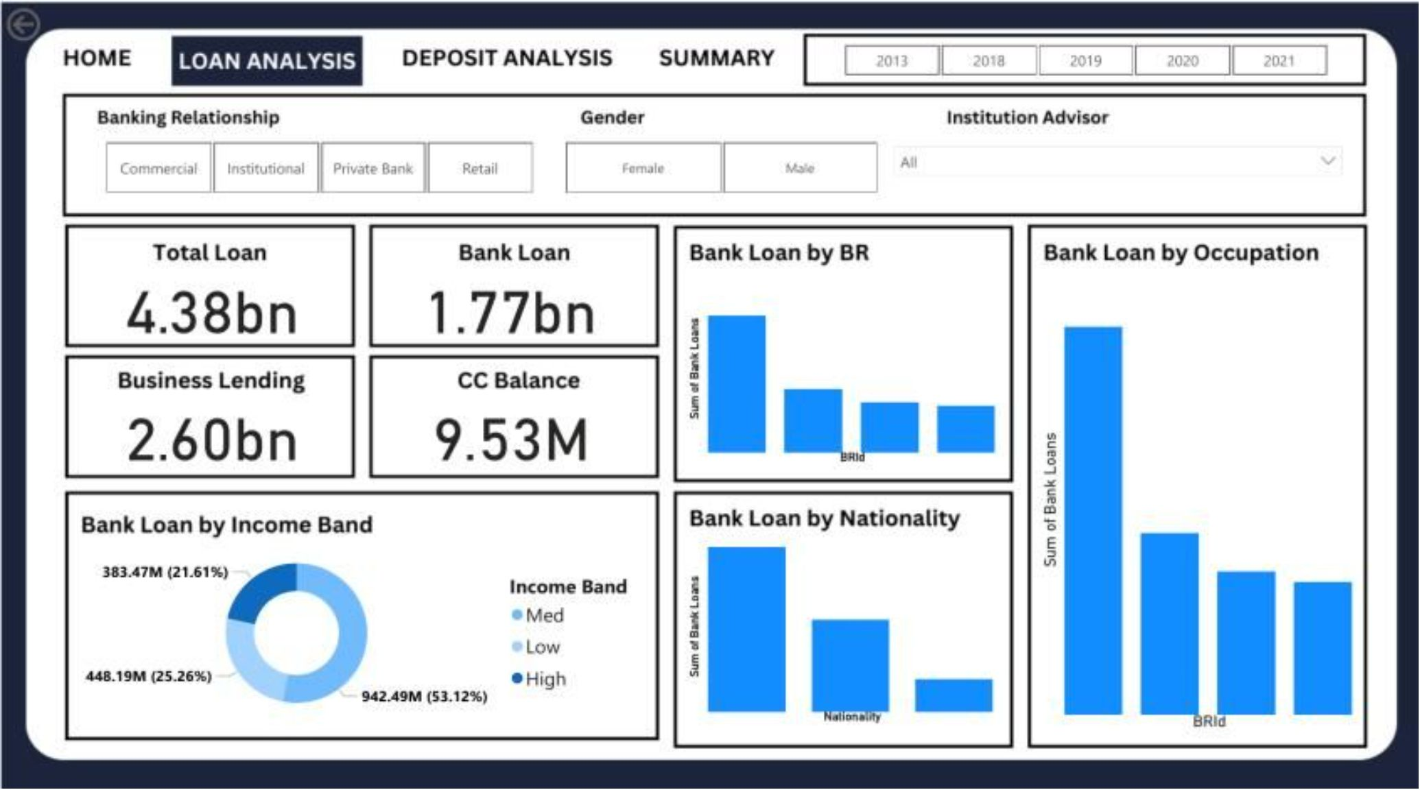
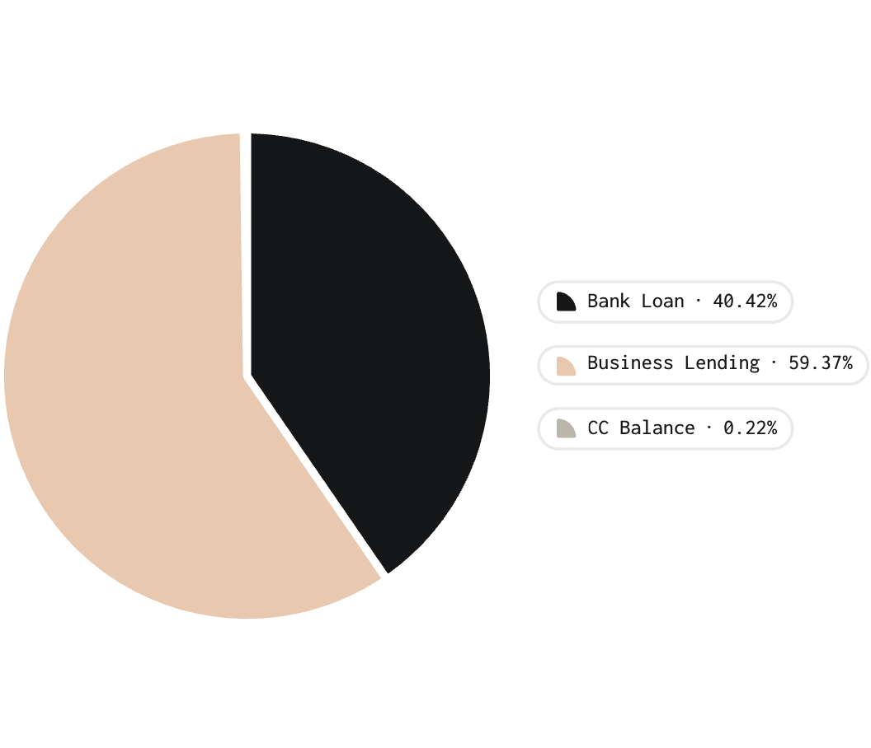
Loan Analysis Dashboard
Loan Portfolio Breakdown
Bank Loan by Income Band: High 53.12% (942.49M) · Low 25.26% (448.19M) · Mid 21.61% (383.47M)
High Income Band accounts for the largest share. Distribution by Banking Relationship and Occupation highlights concentration risk areas for targeted review.

Slide 8
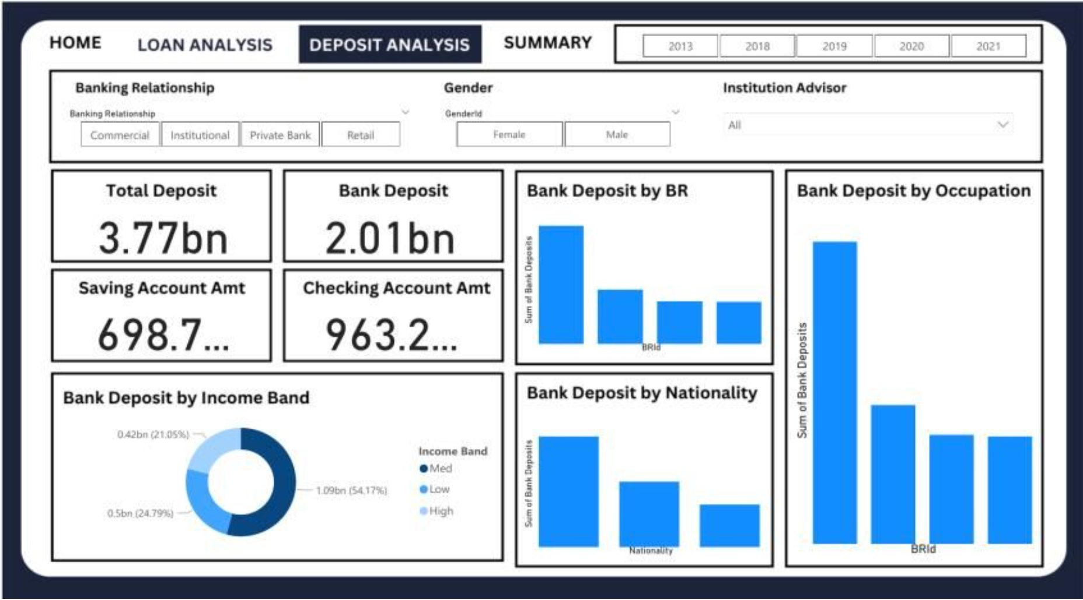

Deposit Analysis Dashboard
Deposit Portfolio: 3.77bn Total
High Income Band dominates deposits. Patterns by Banking Relationship, Occupation, and Nationality inform targeted product design and retention strategies. Filters: Banking Relationship, Gender, Institution Advisor.
High Income
Low Income
Mid Income
54.17% — 1.09bn
24.79% — 0.50bn
21.05% — 0.42bn

Slide 9





Impact & Business Value
Empowered Decision-Making
Lending decisions grounded in applicant profiles and clear risk indicators — reducing reliance on intuition.
Faster Lending Decisions
Clear visibility into loan and deposit portfolios accelerates the credit review and approval process.
Better Risk Assessment
Concentration analysis by relationship type, occupation, and nationality surfaces hidden risk pockets before they escalate.
Data-Driven Strategy
Supports client acquisition, product design, and retention strategies rooted in real portfolio behaviour.

Slide 10


Future Recommendations
Next Steps for Deeper Insight
Advisor-Level Monitoring
Track total loan amounts and portfolio metrics segmented by individual investor and advisor to surface performance gaps.
Relationship Type Analysis
Analyse which banking relationship types attract more clients and refine acquisition strategies accordingly.
Targeted Risk Review
Identify nationalities and income bands with the highest bank loan concentrations for proactive credit risk review.
Time-Series & Product Trends
Extend analysis to product-level and time-series trends to enable proactive, forward-looking risk management.

