Slide 1
Customer Shopping Behavior Analysis
A data-driven examination of 3,900 transactions across product categories, customer segments, and purchasing patterns
3,900
18
Total purchase records analyzed
Data dimensions per transaction
$233,081
3 Segments
Total revenue across all segments
Loyal, Returning, and New customers

Slide 2

Project Overview
Objective
Analytical Focus Areas
Analyze customer shopping behavior using transactional data from 3,900 purchases across various product categories. Uncover insights into spending patterns, customer segments, product preferences, and subscription behavior to guide strategic business decisions.
Spending Patterns
Average purchase amounts by gender, shipping type, and discount usage
Customer Segmentation
Loyalty tiers and subscription behavior across the customer base
Product Performance
Top-rated items and discount dependency by product category

Slide 3
Dataset Summary
Dataset Dimensions
Key Feature Groups
3,900
Customer Demographics
Purchase Details
Item Purchased, Category, Purchase Amount, Season, Size, Color
Total Rows
Age, Gender, Location, Subscription Status
Individual purchase records
18
Shopping Behavior
Discount Applied, Promo Code Used, Previous Purchases, Frequency of Purchases, Review Rating, Shipping Type
Columns
Features per transaction
37
Missing Values
In Review Rating column only

Slide 4
Data Preparation & Cleaning
A structured pipeline was applied to transform raw transactional data into an analysis-ready dataset, culminating in PostgreSQL integration for scalable querying.
01
02
Data Loading
Initial Exploration
Imported the dataset using pandas for initial inspection
Used df.info() to check structure and .describe() for summary statistics
03
04
Missing Data Handling
Column Standardization
Imputed missing values in Review Rating column using the median rating of each product category
Renamed columns to snake_case for better readability and consistency
05
06
Feature Engineering
Consistency Check & DB Integration
Created age_group column by binning customer ages and purchase_frequency_days from purchase data
Verified redundancy between discount_applied and promo_code_used; dropped the latter. Loaded cleaned DataFrame into PostgreSQL.

Slide 5
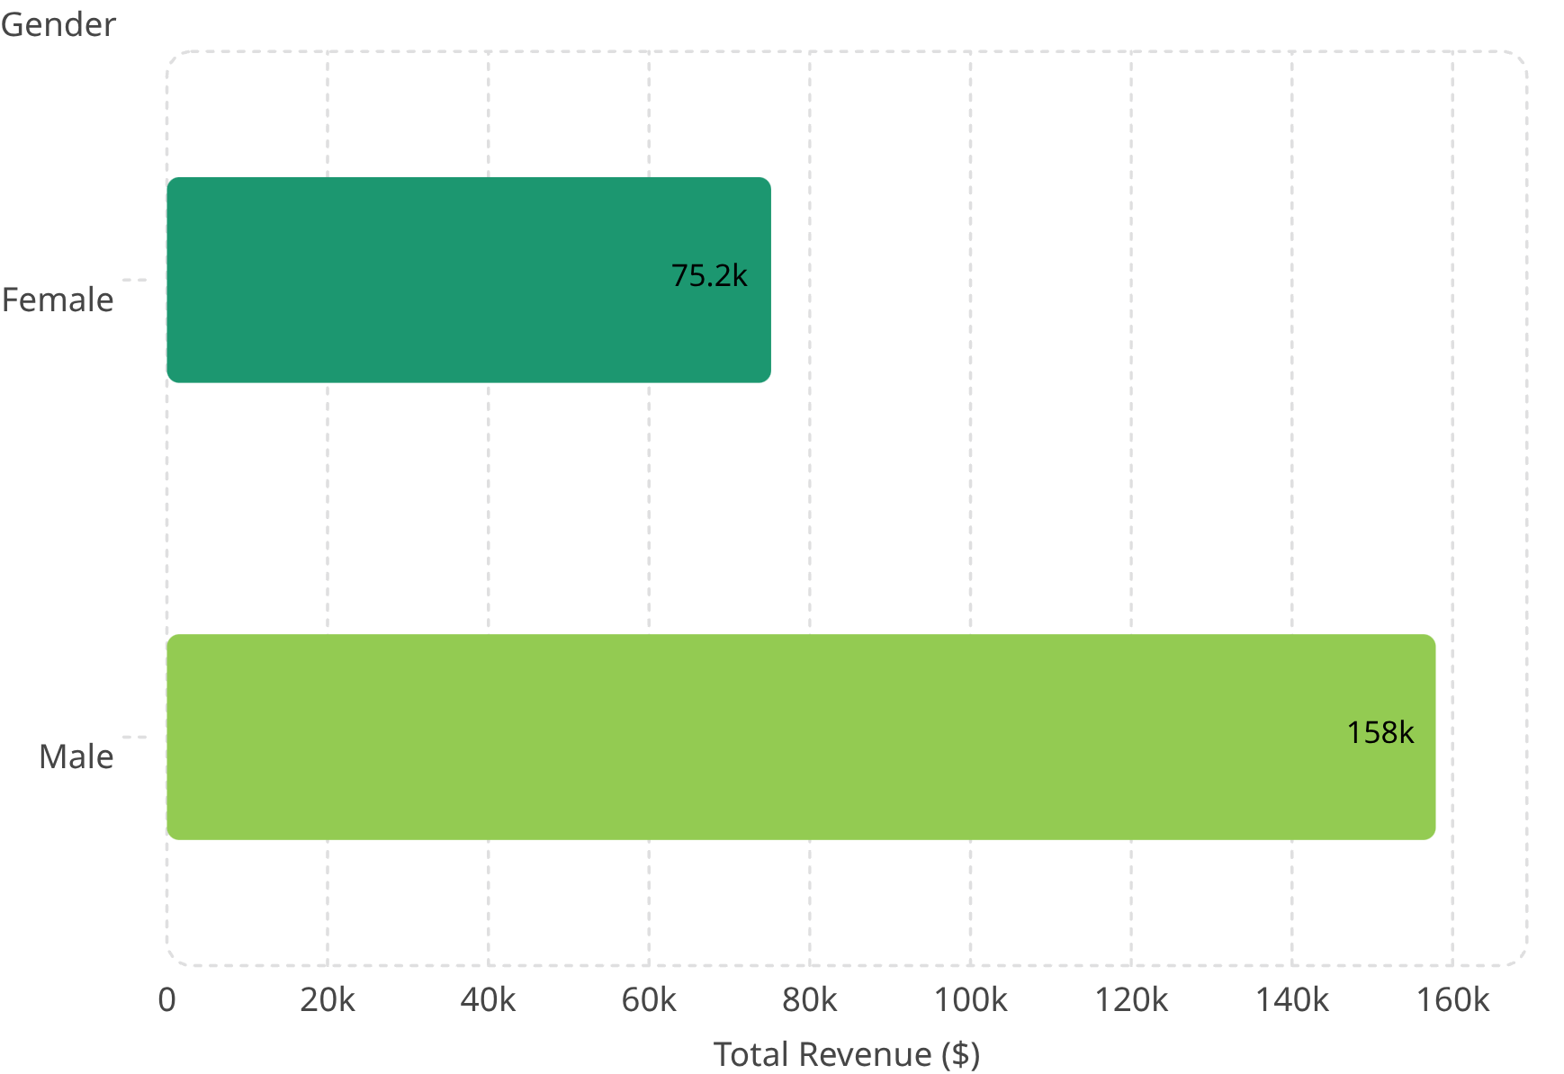


Revenue by Gender
Male customers account for a substantially larger share of total revenue, contributing more than double the revenue of female customers across the 3,900-transaction dataset.
Key Findings
Male Revenue
$157,890 — 67.7% of total revenue
Female Revenue
$75,191 — 32.3% of total revenue
Revenue Gap
$82,699 difference between segments — a 2.1× multiplier

Slide 6

High-Spending Discount Users
Segment Definition
Sample High-Spending Discount Users
839 customers who applied discounts yet still spent above the average purchase amount — representing a high-value cohort that responds to promotions without sacrificing basket size.
Customer ID
Purchase Amount ($)
Customer 2
$64
Customer 3
$73
Strategic Implication
These customers demonstrate that discount usage does not necessarily erode revenue. Targeted promotions for this segment can drive volume while maintaining above-average spend per transaction.
Customer 4
$90
Customer 7
$85
Customer 9
$97
839 total customers in this segment — all spent above the dataset average purchase amount despite discount application.

Slide 7
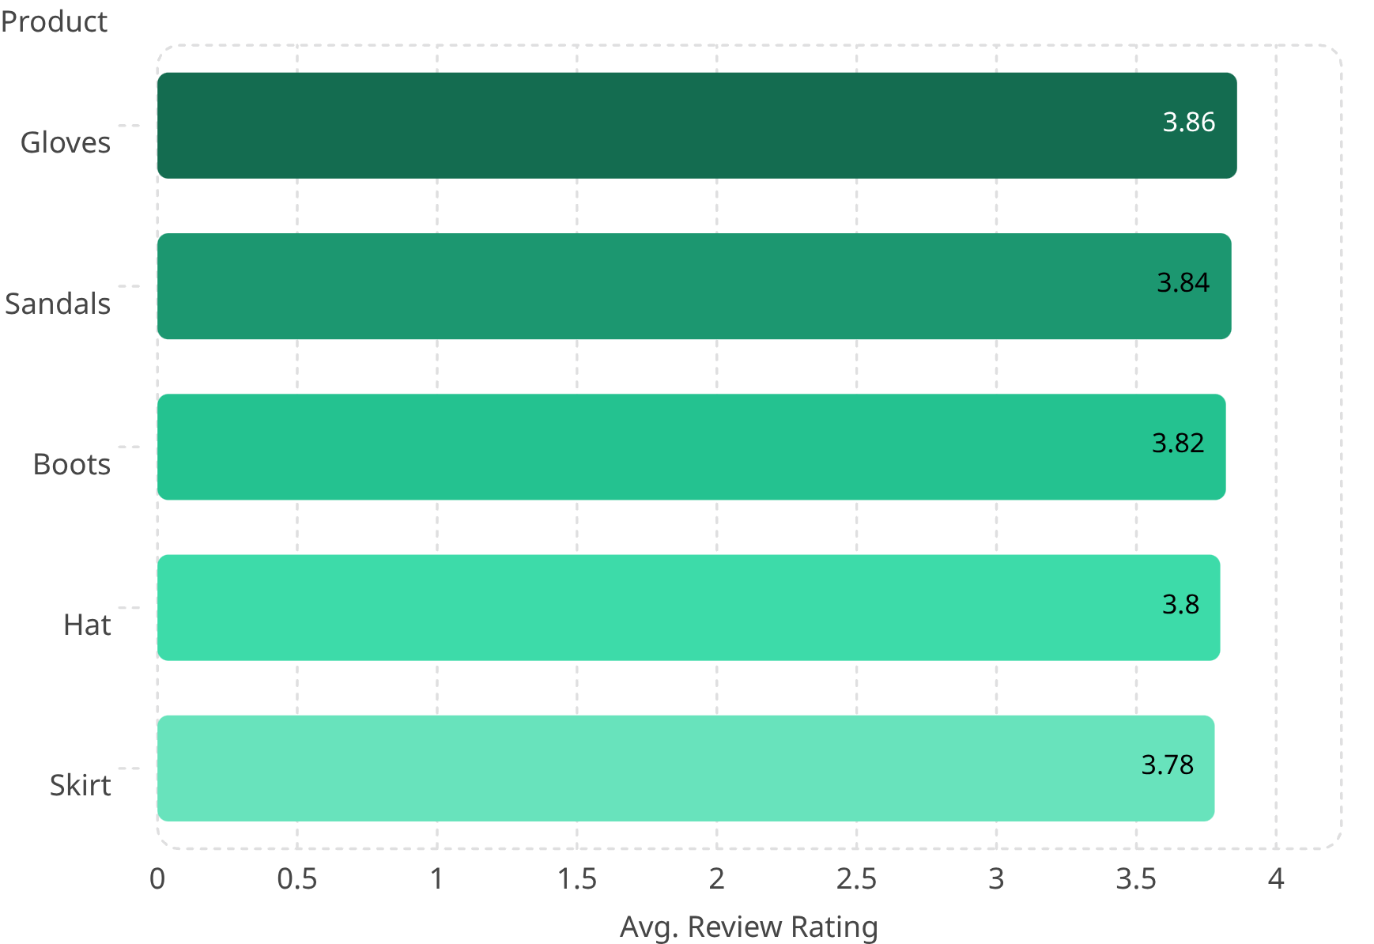
Top 5 Products by Rating
Average review ratings across the top-performing products are tightly clustered between 3.78 and 3.86, indicating consistent but moderate customer satisfaction across the product catalog.
Ratings Breakdown
🥇 Gloves
🥈 Sandals
Rating: 3.86 — Highest rated product
Rating: 3.84
🥉 Boots
Hat
Rating: 3.82
Rating: 3.80
Skirt
Rating: 3.78 — 5th place, 0.08 pts below leader

Slide 8
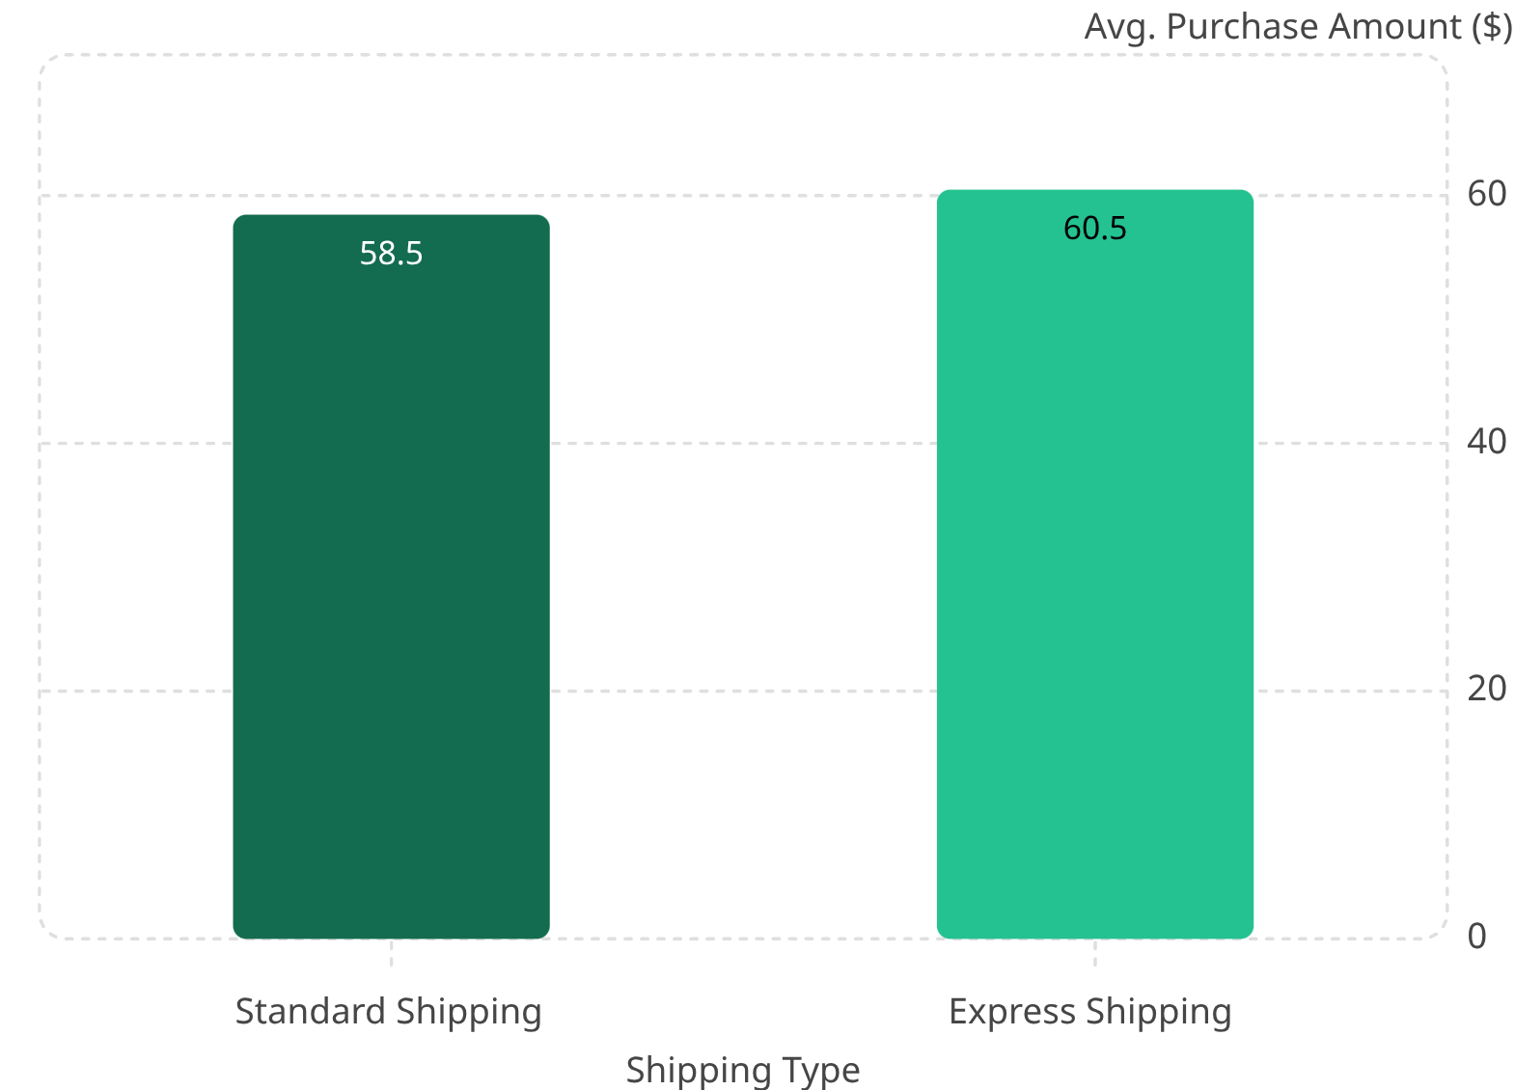


Shipping Type Comparison
Customers who select Express Shipping spend marginally more on average than those using Standard Shipping, suggesting a mild correlation between shipping urgency and purchase value.
Comparison Summary
Standard Shipping
Average purchase amount: $58.46
Express Shipping
Average purchase amount: $60.48
Difference
$2.02 higher average spend for Express customers — a 3.5% premium

Slide 9
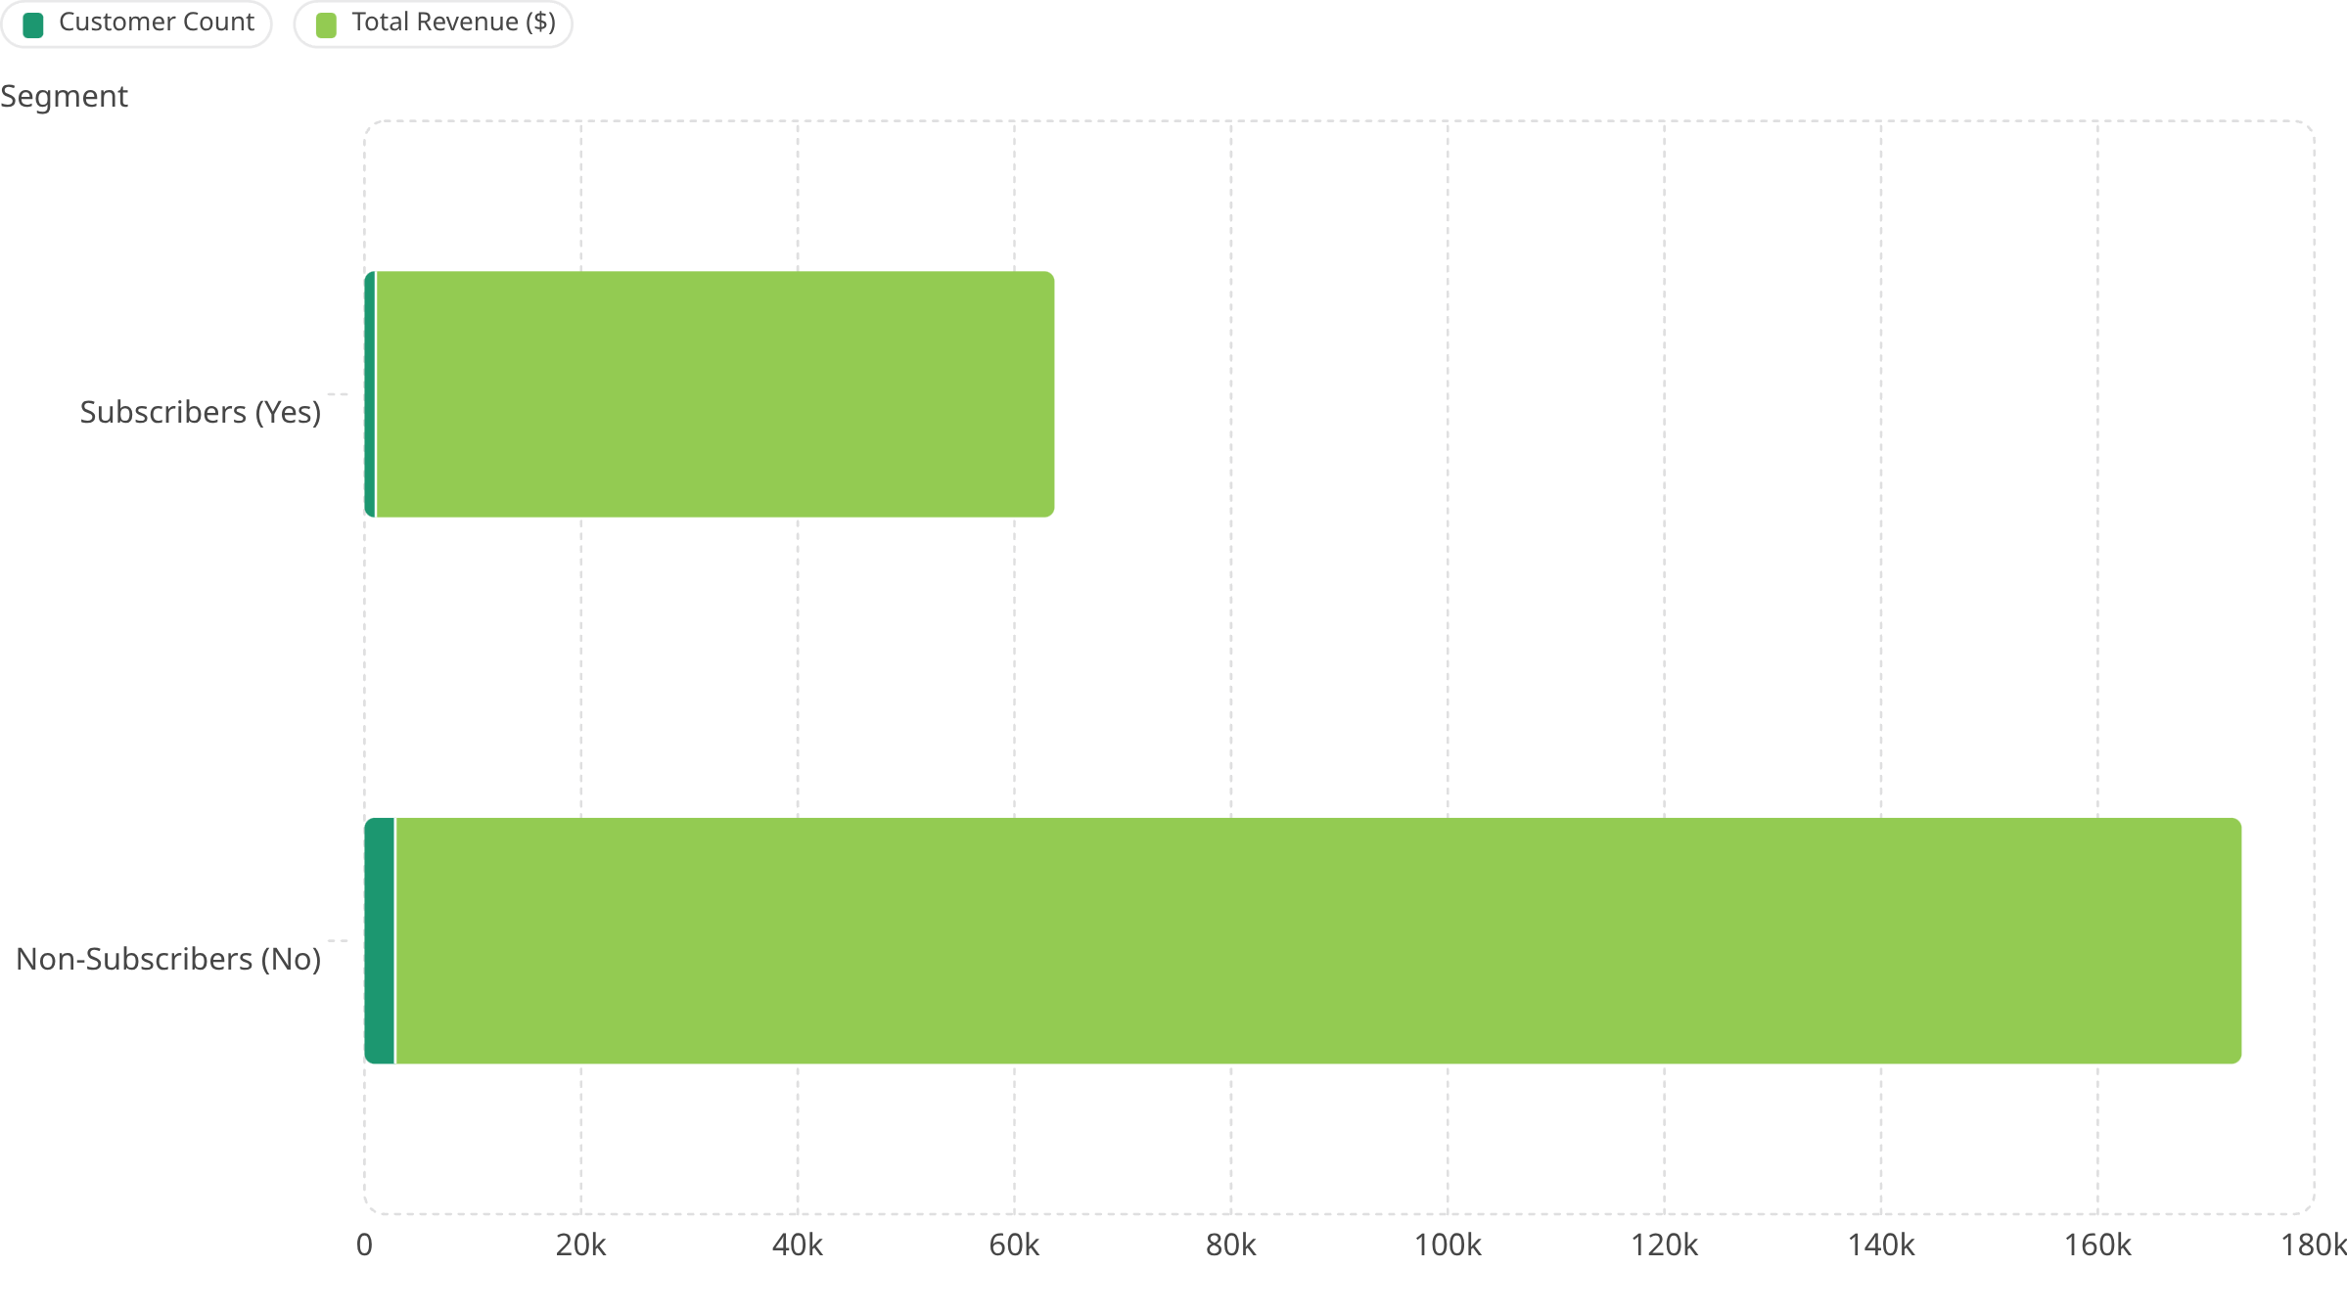
Subscribers vs. Non-Subscribers
Despite subscribers representing only 27% of the customer base, their average spend per transaction is nearly equivalent to non-subscribers — indicating strong per-customer value even at lower volume.
Subscribers
Non-Subscribers
Avg Spend Gap
1,053 customers · $59.49 avg spend · $62,645 total revenue
2,847 customers · $59.87 avg spend · $170,436 total revenue
Only $0.38 difference in average spend — subscribers and non-subscribers purchase at near-identical rates per transaction

Slide 10
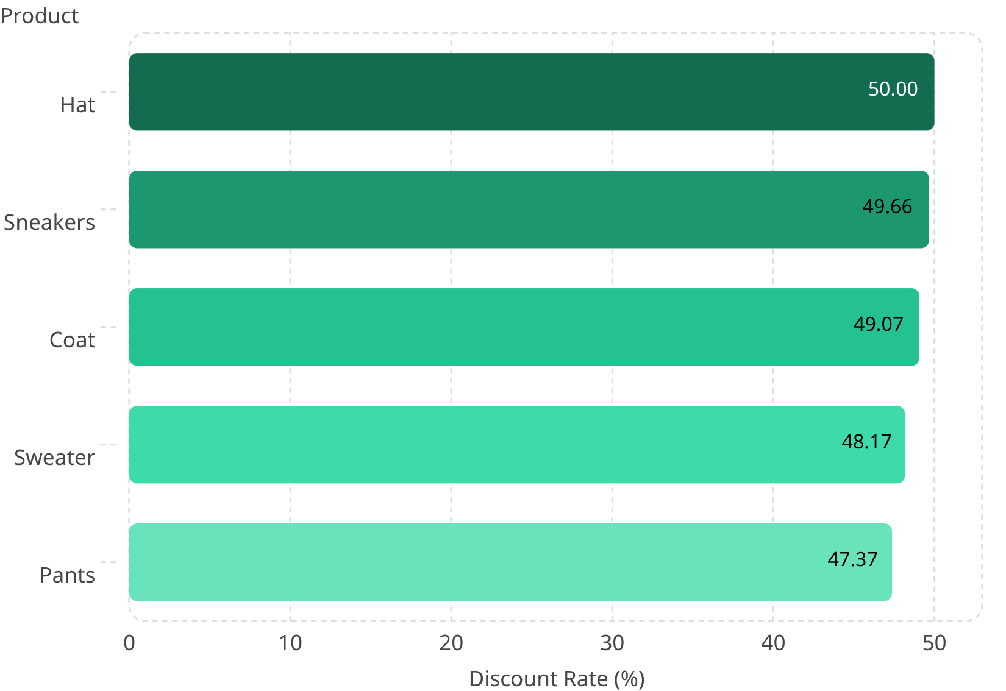


Discount-Dependent Products
Several key product categories show discount application rates approaching 50%, suggesting that nearly half of all purchases in these categories are driven by promotional pricing — a potential margin risk.
Discount Dependency Risk
Hat — 50.00%
Sneakers — 49.66%
Highest discount rate in the dataset — exactly 1 in 2 purchases use a discount
Near-parity with Hat; strong promotional dependency
Coat — 49.07%
Sweater — 48.17%
Seasonal item with high discount reliance
Close to half of all purchases discounted
Pants — 47.37%
Lowest of the top 5, yet still nearly 1 in 2 transactions

Slide 11
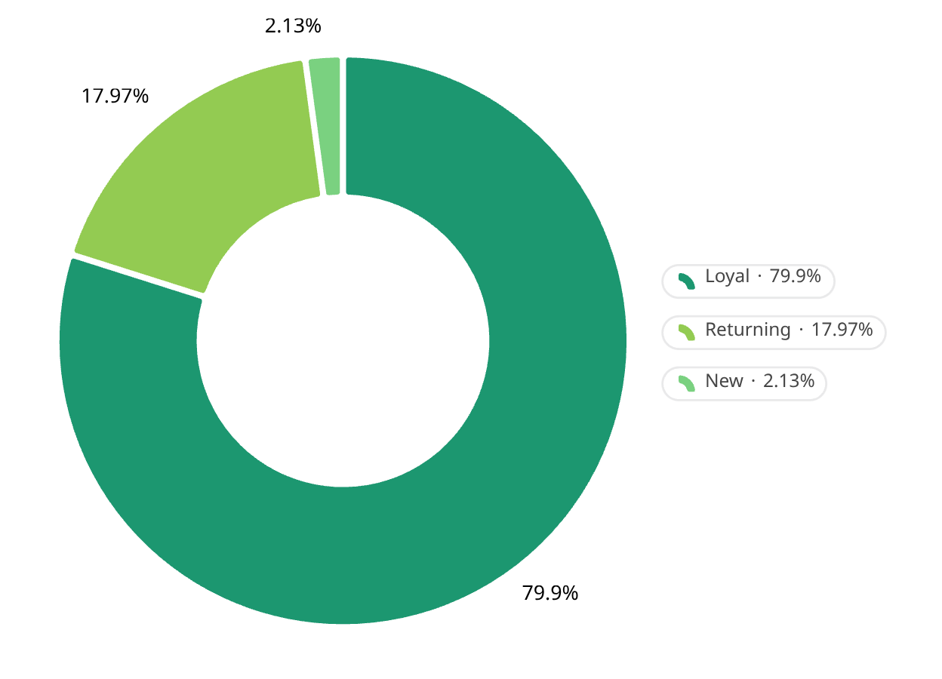

Customer Segmentation
The customer base is overwhelmingly composed of Loyal customers, with Returning and New customers representing a small but strategically important minority for growth and retention initiatives.
Segment Breakdown
3,116
Loyal Customers
79.9% of total base — the dominant segment driving sustained revenue
701
Returning Customers
18.0% of total base — re-engaged buyers with conversion potential
83
New Customers
2.1% of total base — early-stage acquisition requiring onboarding focus
Loyalty concentration is high — retention strategies should prioritize the Loyal segment while acquisition efforts target New customer growth.

