Slide 1

AI MELT-SHOP INTELLIGENCE
METALLISENSE
Catch raw-material problems at the gate, not in the furnace — then correct every heat with explainable, self-improving AI.
Pre-Melt Gate · Deviation Analysis · Correction Planner · Adaptive Strategy Optimizer
01

Slide 2
WHY THIS MATTERS
Defects are found after the metal is melted
After
0%
₹21,000
MELTING
REFINING
PER TONNE
A bad charge shows up only at the first spectrometer reading — energy, time and metal are already spent.
An induction furnace cannot remove excess Cu, Cr, P or S. Only a different charge fixes it.
Lost when an SG-iron heat is downgraded to grey iron (illustrative selling prices).
02

Slide 3






THE SOLUTION
One heat, one flow: from truck to tap
Raw Material Stock
›
Yard Inspection
›
DRI QA Lab
›
Pre-Melt Gate
›
3 AI stages
›
Tap approval
Lots + ledger
XRF / LIBS gun
Maker–checker
GO / WARN / HOLD
Deviation → Correction → Strategy
Mechanical properties
Each stage unlocks the next. The gate's predicted melt-down chemistry flows automatically into the AI stages — no retyping, no synthetic data.
03

Slide 4
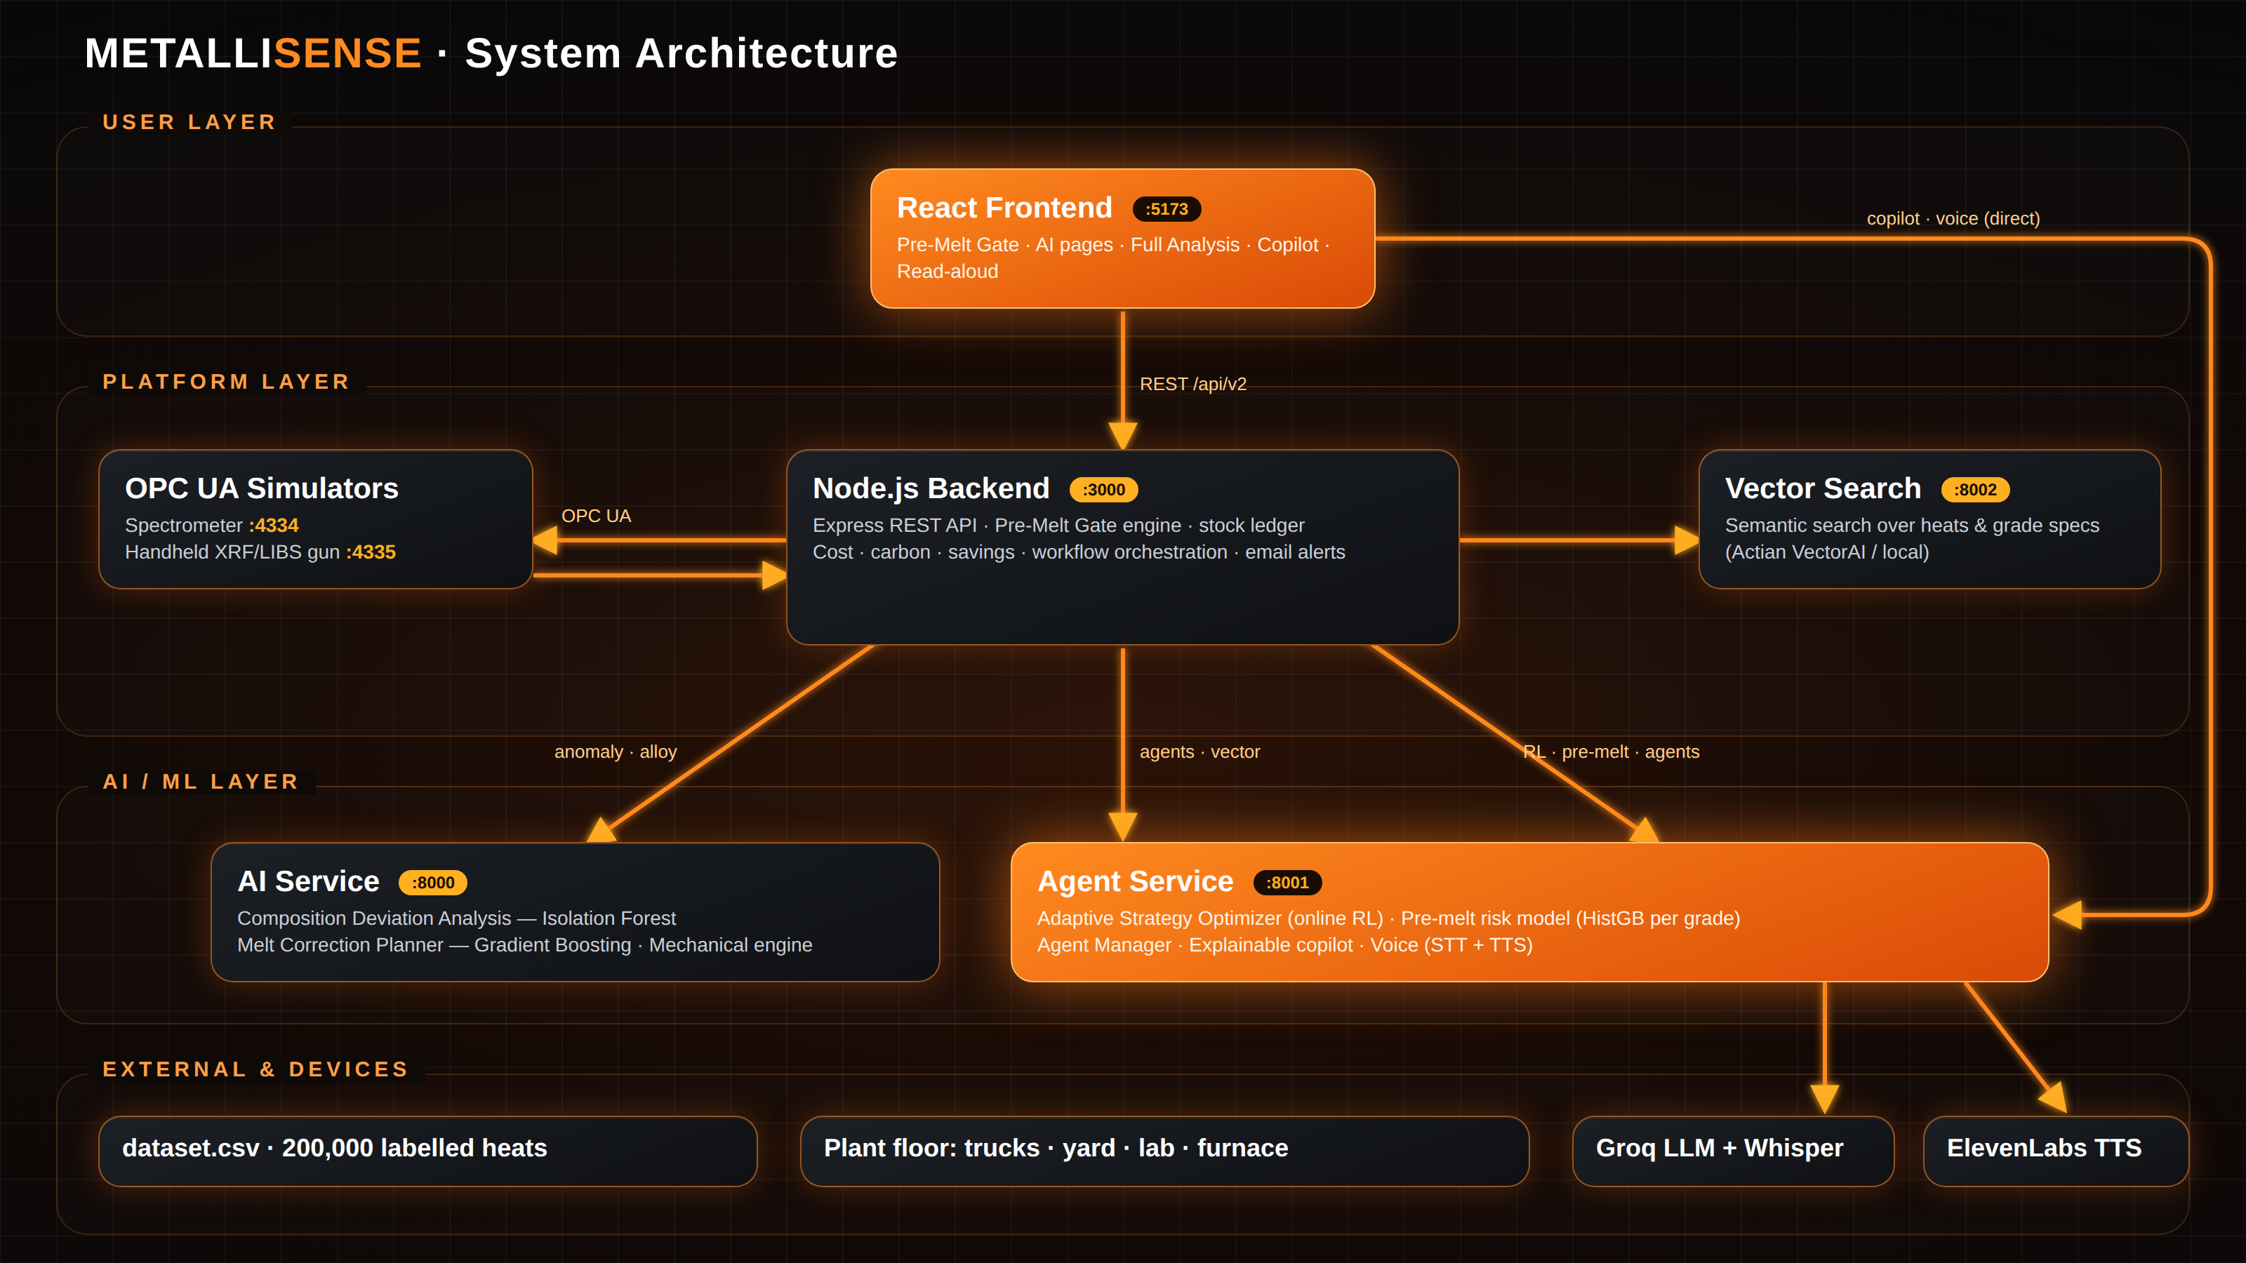
04

Slide 5



RAW MATERIAL · YARD INSPECTION
Every lot is trusted before it is charged
Chemistry trust (1σ)
Gun decision (400-piece hidden load)
Supplier declared
15%
Any stainless piece, ≥ 20% alloy or ≥ 10% copper → QUARANTINED
Mill certificate
6%
Some copper or alloy pieces → RESTRICTED (max 20–25% of charge)
QA lab (approved)
3%
Parent heat OES
3%
< 70% reliable readings (paint, oil, rust) → clean and re-test
Handheld gun
Flags only
Nothing flagged → RELEASED
05

Slide 6

DRI QA LAB
Sponge iron needs a second signature
Lab entry
Release rules
Fe total, Fe metallic, C, P, S (+ gangue, moisture, fines)
Rule | Release | Restrict | Quarantine
Metallization | ≥ 85% | 80–85% (25%) | < 80%
Phosphorus | ≤ 0.05% | ≤ 0.08% (25%) | > 0.08%
Sulphur | ≤ 0.03% | ≤ 0.05% (30%) | > 0.05%
Validation
Hard limits reject; unusual values need confirmation
Second approver
Metallization = Fe metallic ÷ Fe total. Moisture > 1% or a result older than 7 days raises a gate warning.
Same person as analyst → refused (403)
06

Slide 7
FURNACE INTERLOCK
Pre-Melt Gate: 8 checks, one decision
1
Charge weight
2
Lot release status
3
Stock available
4
Handheld XRF / LIBS
5
Sponge-iron lab
6
Predicted chemistry vs grade
7
Residuals Cu Cr Ni Mo Sn
8
AI off-spec risk
GO
WARN
HOLD
All pass — furnace may start
Operator must tick the warnings
Locked — engineer override + written reason
07

Slide 8
MELT-DOWN CHEMISTRY · AI RISK
Predicting the melt before it exists
Charge → bath chemistry
0.95–0.97
holdout AUC, per grade
Metal weight: kg × yield (scrap 95%, pig iron 97%, returns 98%; DRI from its lab result)
Bath value: metal-weighted average × melt recovery (C 96%, Si 95%, Mn 93%)
Uncertainty: each lot's trust level combined + 2% process variation
Fe is the balance; each element traced to the lot it came from
400
Monte-Carlo samples inside σ
2 passes
risk before and after additions
08
Notes:
Model: HistGradientBoostingClassifier, one per grade, features C Si Mn P S, trained on is_deviated labels in dataset.csv. If risk stays >= 50% after the Melt Correction Planner's additions, the gate holds: the charge must change.

Slide 9

AI STAGE 1
Composition Deviation Analysis
Severity
Isolation Forest
LOW
0.00 – 0.33
200 trees, contamination 0.35, trained on 200,000 heats
18 features: 6 elements + deviation from spec midpoint + out-of-range flag per element
Short isolation path = abnormal; score rescaled to 0–1
Result unlocks the Melt Correction Planner
MEDIUM
0.33 – 0.66
HIGH
0.66 – 1.00
09

Slide 10

AI STAGE 2
Melt Correction Planner
Multi-output gradient boosting
Target: gap to grade midpoint, additions only
One regressor per element (100 trees, depth 5)
Caps: 5% per element; in-spec heats get no additions
Too-high elements → dilution warning
Additions converted to kg of in-stock FeSi-75, HC FeMn, recarburiser (FIFO)
10

Slide 11

AI STAGE 3 · ONLINE REINFORCEMENT LEARNING
Adaptive Strategy Optimizer
0.3×
1.0×
2.0×
Conservative
Balanced
Aggressive
Smallest additions, lowest overshoot risk
Full model correction, best trade-off
Over-corrects, fastest pull into spec
Learned reward model
Reward = outcome bonus + measured improvement − 0.05 × weighted cost
SGD regressor scores each (deviation, grade, additions) pair and is updated after every operator decision — no retraining pipeline.
Accepted +0.4 · Modified 0 · Rejected −0.6
Safety clip: C, Si ≤ 1.5%, Mn ≤ 1.0%, total ≤ 6%
11

Slide 12
STRATEGY COMPARISON
Choosing a strategy: the composite score
How it works
Each metric normalised across the 3 strategies (best = 1)
Mechanical FAIL costs 0.5 on spec compliance
−10 points per constraint violation
Grid marks the best per metric and 'Best overall'
Accept one → the other two lock; stock is deducted
12

Slide 13



COST · CARBON · PROPERTIES
Every strategy priced, weighed and tested
Cost
Carbon
Savings
Mechanical
Base metal ₹/kg × batch + element kg × alloy price + strategy premium (₹800 / 4,300 / 11,300)
Base factor × batch + element kg × CO₂ factor (FeSi 4.0, FeMn 2.8 kg CO₂e/kg)
Downgrade loss per tonne − correction cost; shown as % of selling price
UTS, YS, elongation, HB from C Si Mn P S, checked against IS 2062, 1570, 210, 1865
13

Slide 14



COPILOT · VOICE
Explainable, hands-free AI
Explainable copilot
Groq LLM (switchable to Claude or Gemini) turns every result into plain-language reasoning and operator guidance.
Voice questions
Groq Whisper large-v3 transcribes the operator's spoken question.
Read aloud
ElevenLabs multilingual voice reads the gate decision and strategy comparison; gTTS and browser voice as fallbacks.
Semantic memory
Similar past heats found by meaning, via vector search.
14

Slide 15
TECH STACK
Built on five independent services
Service | Port | Stack | Role
Frontend | 5173 | React 18, Vite, Tailwind, Recharts | All screens
Backend | 3000 | Node.js, Express, node-opcua | API, gate engine, cost, orchestration
AI service | 8000 | FastAPI, scikit-learn | Deviation + correction models
Agent service | 8001 | FastAPI, Groq, ElevenLabs | RL, risk model, copilot, voice
Vector search | 8002 | Actian VectorAI / NumPy | Semantic search
OPC UA | 4334 · 4335 | node-opcua | Spectrometer + gun simulators
15

Slide 16
ROADMAP
Honest limits and what comes next
Limits today
Next
Models trained on synthetic data; prices and limits illustrative
Gun samples pieces and can miss one — spectrometer check stays
Real guns export CSV/Bluetooth; simulator uses OPC UA
State in memory; restart resets
Re-run the gate on every mid-melt addition
Weigh actual charged kg at the bucket
Learn from gate vs spectrometer error
Persist to a database; plant-specific limits
16

Slide 17
Caught at the gate —
not in the furnace.
MetalliSense · AI melt-shop intelligence
17

