Slide 1
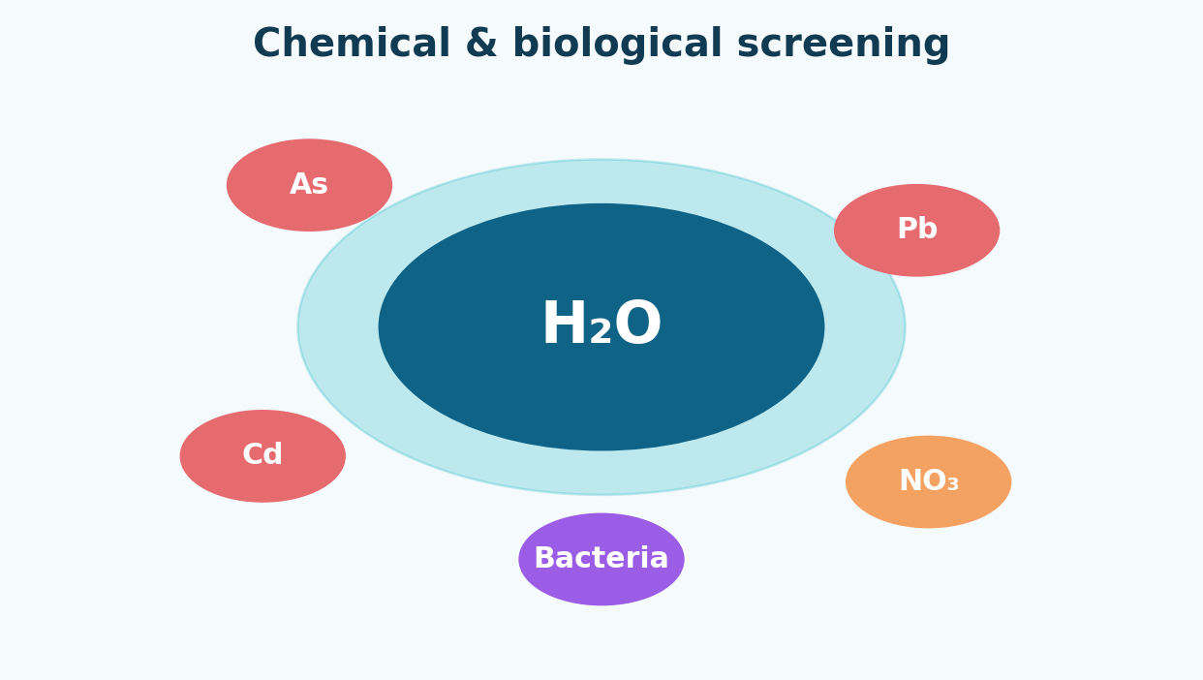
OPTIMIZED MACHINE LEARNING PREDICTION
HydroShield – Water Safety Classification Screening
Presented by: Manish Purohit Guided by: Ritik Raj Vaishya Sir

Slide 2
Presenter Introduction
Environmental machine learning project
• Data Scientist focused on environmental machine learning
• HydroShield screens water samples using contaminant values
• Goal: fast, data-driven support for water-quality monitoring
• Final safety decisions still require laboratory and expert review

Slide 3
Literature Review
Water contamination, machine learning and safety standards
Water contamination
ML in hydrology
Feature optimization
Cadmium and arsenic can create serious health risks. Continuous monitoring is important.
Ensemble models such as Random Forest and XGBoost perform well on structured water data.
Important predictors can reduce screening cost while maintaining useful performance.
Safety predictions should be checked against applicable WHO/EPA and local water-quality guidelines.

Slide 4
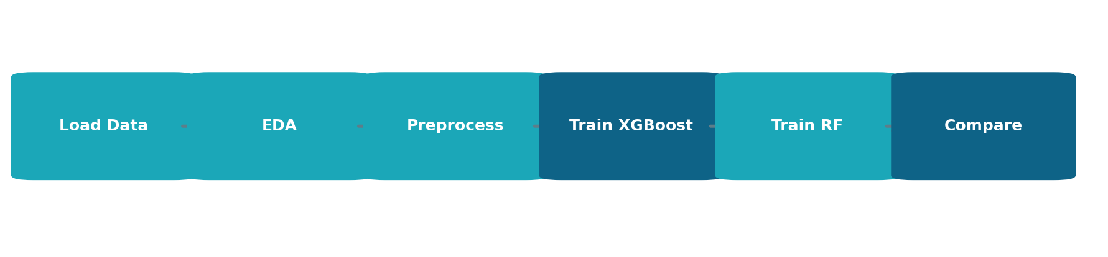
Methodology Workflow
End-to-end machine learning pipeline
• Exploration: distribution checks, outlier review and feature analysis
• Preprocessing: stratified 80:20 split and StandardScaler
• Training: baseline and tuned XGBoost, plus Random Forest
• Evaluation: accuracy, precision, recall, F1-score and ROC-AUC

Slide 5
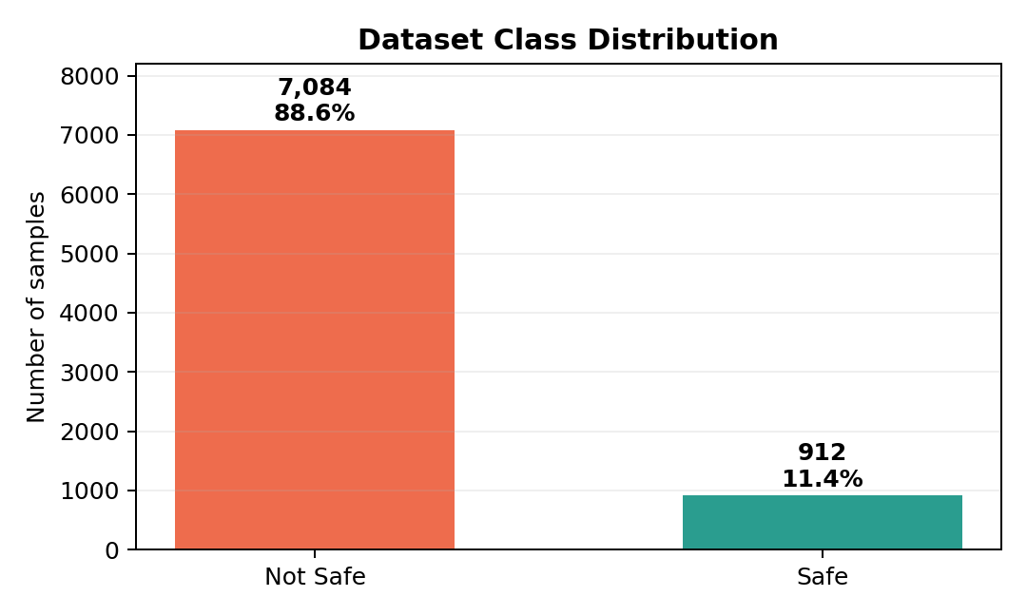
Modeling Details
Handling imbalance and optimizing the classifier
• Data split: 80% training, 20% testing with stratification
• Dataset imbalance: 88.6% not safe and 11.4% safe
• Scaling: StandardScaler normalizes feature ranges
• Optimization: GridSearchCV selects settings using ROC-AUC

Slide 6
Model Inputs: Top Chemical Indicators
Twenty chemical and biological measurements are used
Cadmium (Cd)
0.005 mg/L
Aluminium (Al)
0.20 mg/L
Silver (Ag)
0.10 mg/L
Perchlorate
15.0 μg/L
Arsenic (As)
0.01 mg/L
Note: guideline values must be verified for the local regulation and water-use purpose.

Slide 7
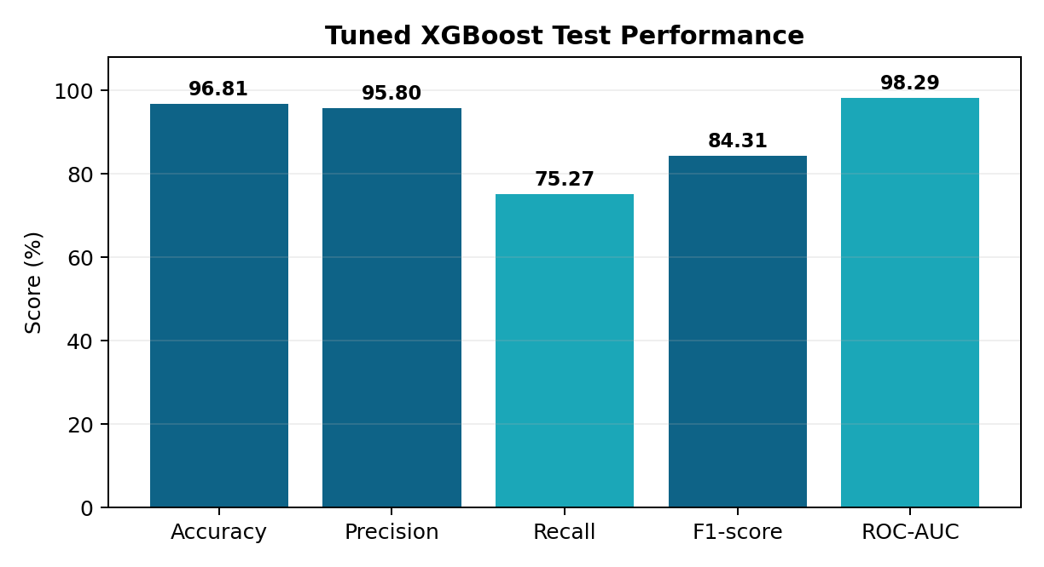
Model Output: Tuned XGBoost Metrics
Test-set performance
• ROC-AUC: 98.29%
• Accuracy: 96.81%
• Precision: 95.80%
• The model distinguishes safe and not-safe samples strongly. Recall should be monitored because safe samples are the minority class.

Slide 8
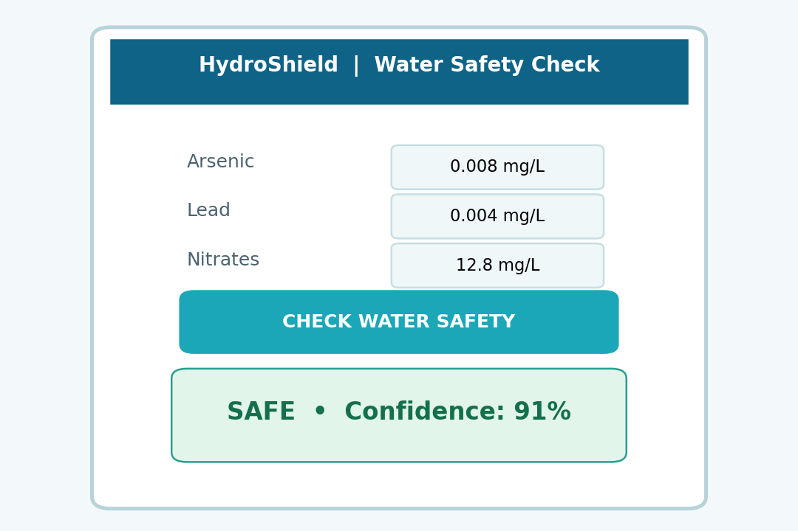
Output: Deployed App Verdicts
Simple interface for sample screening
• User enters measured water parameters
• System calculates a safety probability score
• Safe / Not Safe verdict appears instantly
• Critical values can be highlighted for review

Slide 9
Conclusion & Future Scope
HydroShield can support fast water-quality screening
• Tuned XGBoost achieved a high ROC-AUC of 98.29%
• The system combines 20 contaminant indicators for prediction
• Use the model as a screening aid, not a replacement for laboratory testing
Future Scope
• Integrate real-time IoT sensor data
• Use local, expert-validated water data
• Predict contamination sources and biological threats
• Create a monitored web application with human approval

Slide 10
THANK YOU
Questions and discussion
Manish Purohit Guided by Ritik Raj Vaishya Sir

