Slide 2
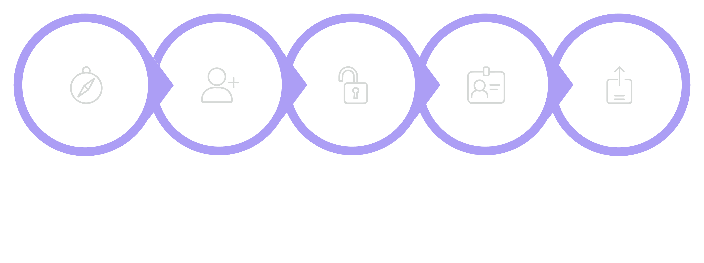
SLIDE 1
OVERVIEW
NutriGuard User Journey
Goal: Receive personalized AI nutrition guidance
The complete flow shows how a user moves from first visit to ongoing daily progress.
Landing
Sign Up
Login
Profile
Upload
Emotions progression: Curious → Excited → Comfortable → Curious → Satisfied → Motivated

Slide 3
SLIDE 2
REGISTRATION
User Registration
Goal: Create account
Emotion: Curious
User Actions
System Process
Open app
Sign Up
Enter Name, Email, Password
Create Account
Validate
Encrypt password
Save in PostgreSQL
Output
Account created successfully

Slide 4
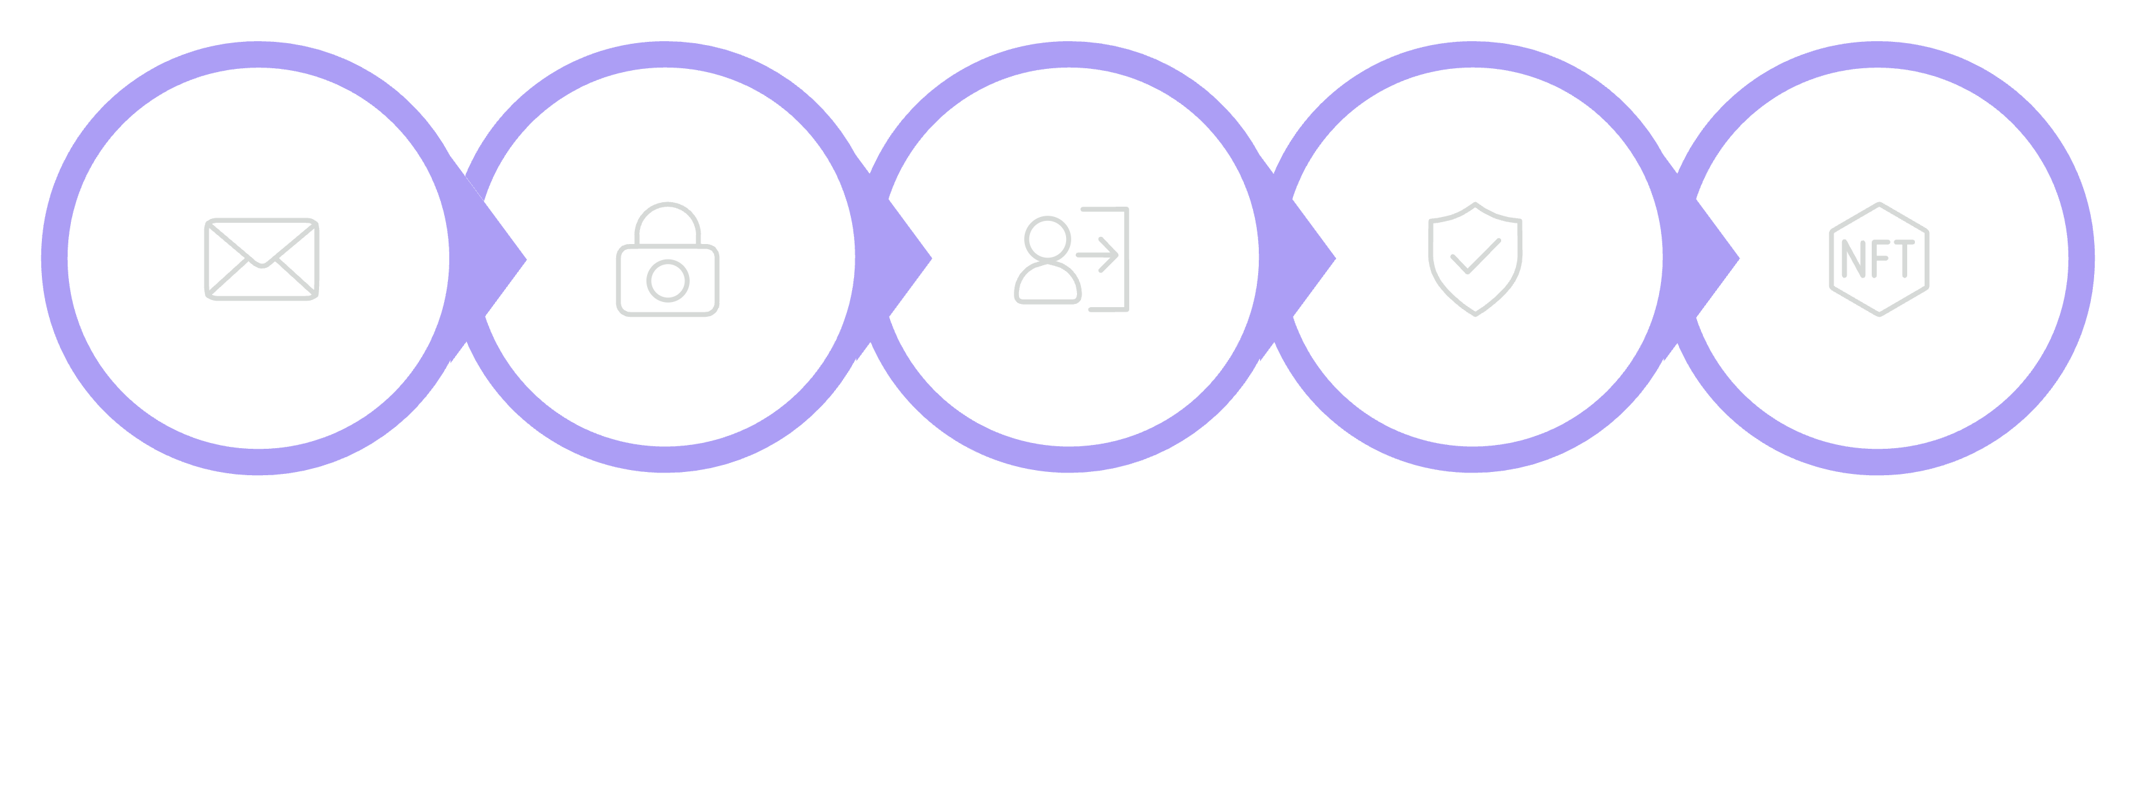
SLIDE 3
LOGIN
User Login
Goal: Access dashboard
Emotion: Comfortable
Email
Password
Login
Verify
Session

Slide 5
SLIDE 4
PROFILE
Profile Creation
Goal: Get personalized recommendations
Emotion: Hopeful
Inputs
Age, Height, Weight, Gender, Activity Level, Goals, Deficiencies, Medical Conditions
System
Save profile → Build AI personalization context

Slide 6
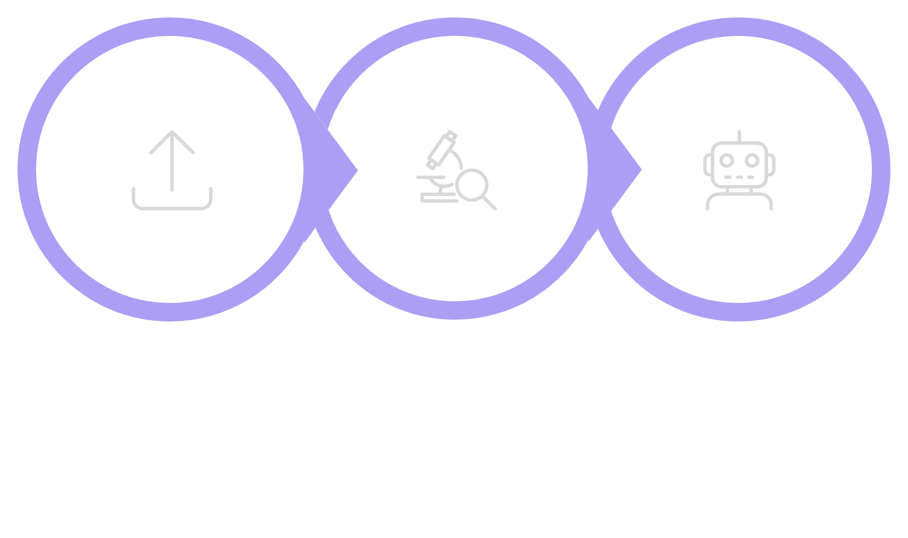
SLIDE 5
HEALTH REPORT
Health Report Upload
Goal: AI understands medical history
Emotion: Curious
Upload PDF
Analyze
Send to AI
AI Output: Deficiencies, health conditions, risk factors

Slide 7
SLIDE 6
MEAL LOGGING
Meal Logging
Goal: Track nutrition
Emotion: Responsible
User Actions
System & AI
Add Breakfast
Add Lunch
Add Dinner
Add Snacks
Add Water
Add Supplements
Save meals
Calculate calories, protein, carbs, fats and micronutrients

Slide 8

SLIDE 7
AI ANALYSIS
AI Nutrition Analysis
Goal: Receive recommendations
Emotion: Excited
Nutrition Report
Meal Logs
Score, deficiencies, suggestions
User-entered daily meals
Gemini AI
AI Nutrition Analysis Flow
Health Profile
Generates analysis & insights
Demographics & goals
AI Orchestrator
Medical Report
Aggregates and normalizes data
Clinical history & labs
Output: Nutrition score, deficiencies, meal suggestions

Slide 9
SLIDE 8
DASHBOARD
Dashboard & Daily Progress
Goal: Monitor progress
Emotion: Happy and Motivated
Calories
Protein
Calories
Protein
Daily intake tracking
Macro monitoring
Water
Score
Water Intake
Nutrition Score
Hydration progress
AI guidance summary
Dashboard displays: Calories, Protein, Water Intake, Nutrition Score, Timeline, AI Recommendations

Slide 10
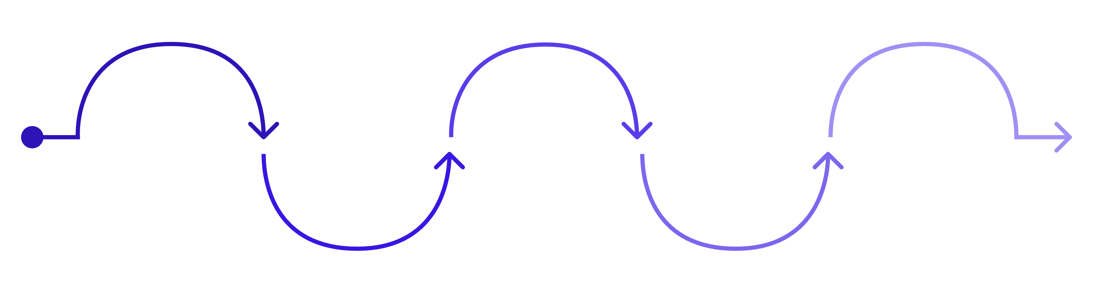
SLIDE 9
SUCCESS
User Success Journey
Registration
Profile
Report Upload
Meal Logging
Recommendations
Account created — Curious
Personalized profile — Hopeful
AI analysis begins — Curious
Nutrition tracking — Responsible
Better food choices — Excited
Progression: Registration (Curious) → Account Created | Profile (Hopeful) → Personalized Profile | Report Upload (Curious) → AI Analysis | Meal Logging (Responsible) → Nutrition Tracking | Recommendations (Excited) → Better Food Choices | Dashboard (Motivated) → Healthy Lifestyle

