Slide 1


Wipro Limited
Manish Kumar Singh
February 03, 2025
Public

Slide 2
Capstone Project
Content
1. Embedded testing capstone project-1
2. E-Commerce Automation Testing Project
3. Rest API Capstone Project – Users Project-2

Slide 3

Embedded Testing Capstone Project 2
Objective:
> The capstone project focuses on exploring reverse debugging using GDB.
> Reverse debugging allows developers to step backward through program execution to identify the root cause of bugs more effectively.
> This project involves practical implementation of reverse debugging on real-world debugging scenarios, highlighting its utility in resolving complex issues.
©
2

Slide 4
Agenda of Project Outline:
1. Project Goals
2. Tools and Setup
3. Capstone Project-2
Key Highlights
©

Slide 5
1. Project Goals > Understand the concept and setup of reverse debugging in GDB. > Implement and debug C programs with common issues where reverse debugging is beneficial. > Demonstrate reverse debugging in scenarios like logical errors, memory corruption, and race conditions. > Document how reverse debugging aids in fixing issues compared to traditional debugging.

Slide 6
Why Debugging is Important
> Identify Errors
Debugging helps locate and fix issues such as syntax errors, logical bugs, or runtime errors that cause incorrect behavior or crashes.
> Understand Program Flow
Stepping through the code reveals how the program executes, helping you understand control flow and function interactions.
> Verify Logic
It ensures your code behaves as expected, allowing you to validate assumptions and spot mistakes in the logic.
> Optimize Performance
Debugging can uncover inefficiencies or bottlenecks, enabling performance improvements.
> Catch Edge Cases
It helps identify rare scenarios or inputs that might cause unexpected behavior, improving reliability.
> Enhance Learning
Debugging deepens your understanding of programming concepts, error handling, and the tools available.
> Build Robust Software
A thorough debugging process ensures the final product is stable, maintainable, and error-free.

Slide 7
Intro GDB
gcc -g -o filename.c run
> GDB stands for GNU Project Debugger and is a powerful debugging tool for C (along with other languages like C++).
> It helps you to poke around inside your C programs while they are executing and also allows you to see what exactly happens when your program crashes.
> GDB operates on executable files which are binary files produced by the compilation process.
gdb ./compiled file name
Break
run
target record-full
next
print var
continue
x/20x &buffer
reverse-next
reverse-step
info frame
thread <thread-number>
forward or backward shared_counter
backtrace
delete record

Slide 8
2. Tools and Setup > GDB with Reverse Debugging Support: Ensure GDB is built with reverse debugging capabilities. Most distributions (e.g., Ubuntu) provide this by default. Compiler: GCC with -g flag for including debug symbols. > Test Environment: Linux environment. > Editor/IDE: Optional (VSCode or CLion with GDB integration).

Slide 9
3. Capstone Project-2
Content
Module 1:- Debugging Logical Errors in Loops with Reverse Debugging
Module 2:- Debugging Null Pointer Dereference with Reverse Debugging
Module 3:- Debugging Memory Corruption in Dynamic Arrays
Module 4:- Debugging Race Conditions in Multithreaded Code
Module 5:- Debugging Recursive Function Logic Errors

Slide 10
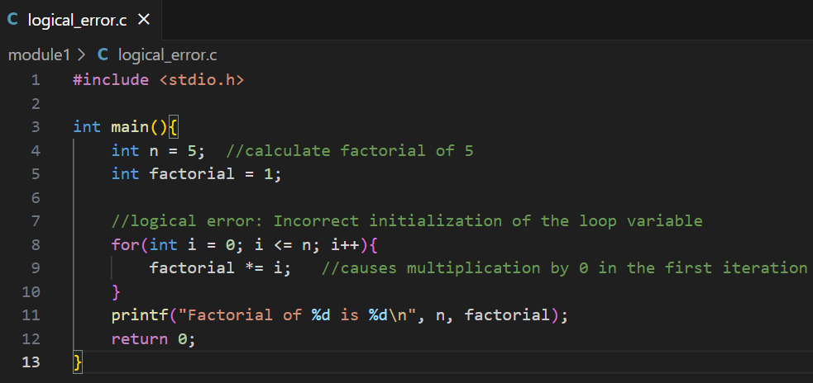
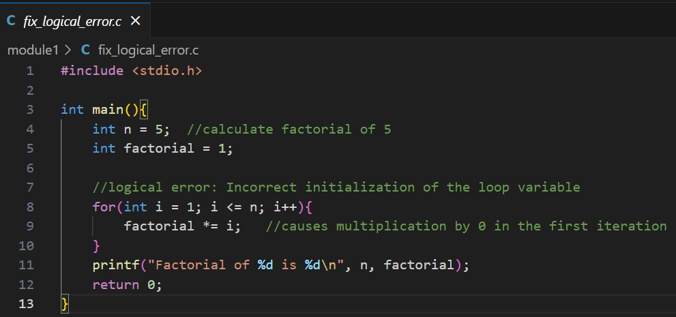
Module 1: Debugging Logical Errors in Loops and fixing
Overview
> Logical errors in loops can cause incorrect results such as exceeding bounds or incorrect calculations.
> Reverse debugging in GDB helps trace how the loop state evolved.

Slide 11
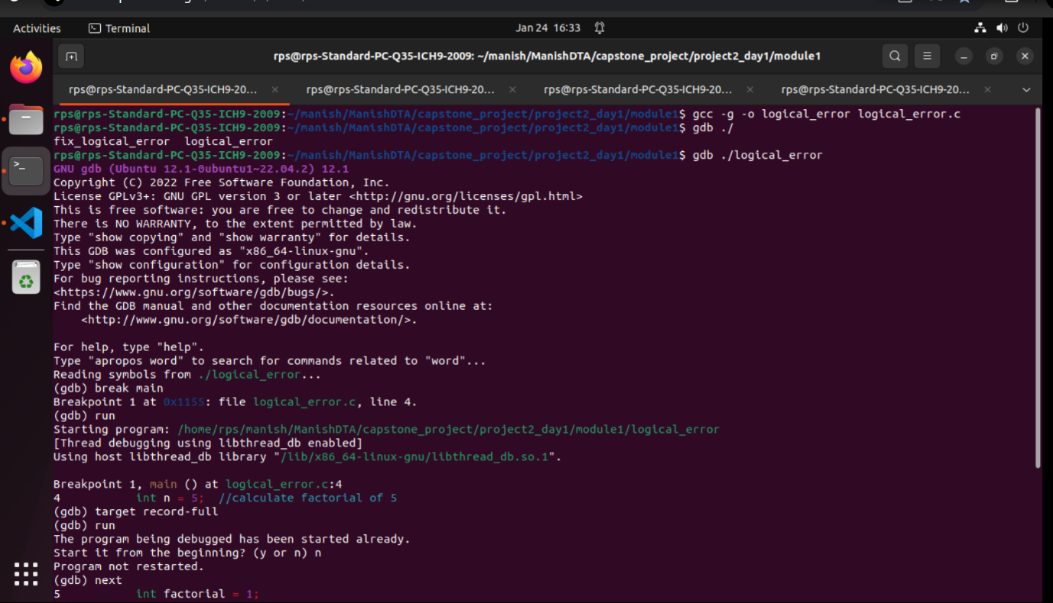
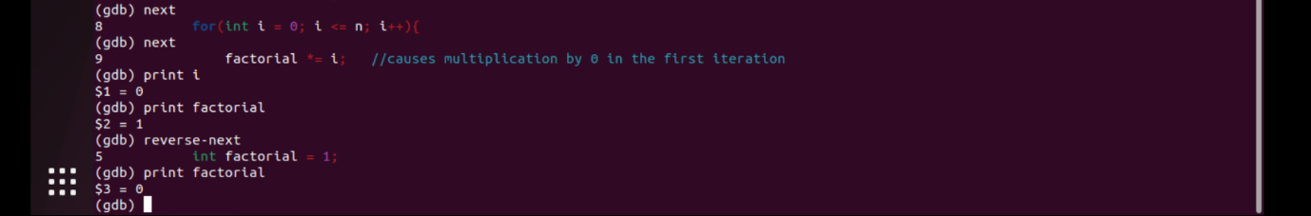
To See
The gdb o/p
Module.1
Click Me!

Slide 12
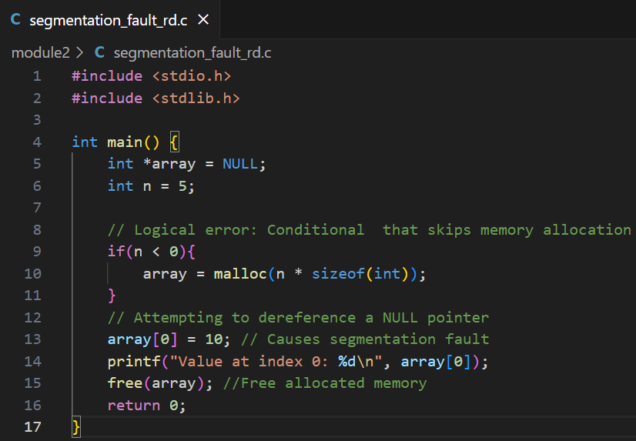
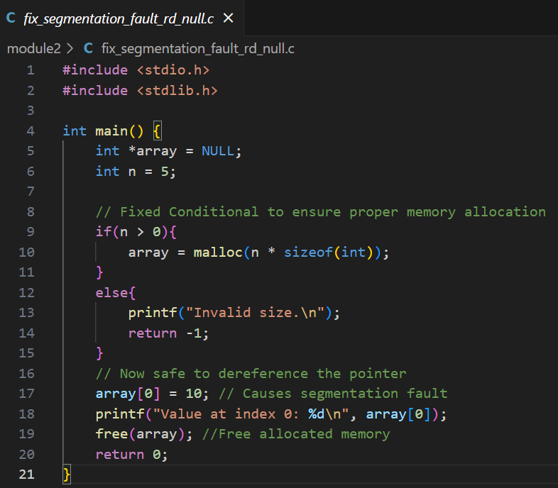
Module 2: Debugging Null Pointer Dereference
Overview
Null pointer dereferences occur when a program accesses memory using a null pointer, causing segmentation faults.
Reverse debugging helps trace where the null assignment occurred.
To see gdb o/p of Module.2 :- Click Me!

Slide 13
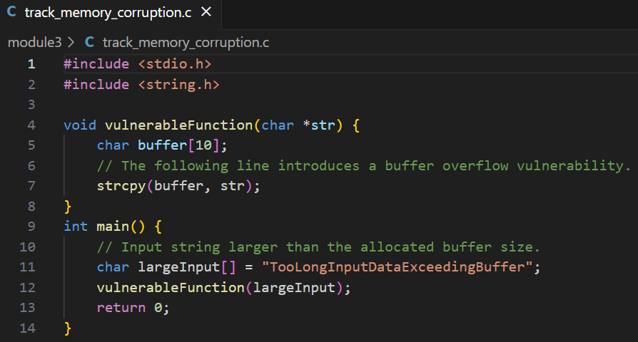
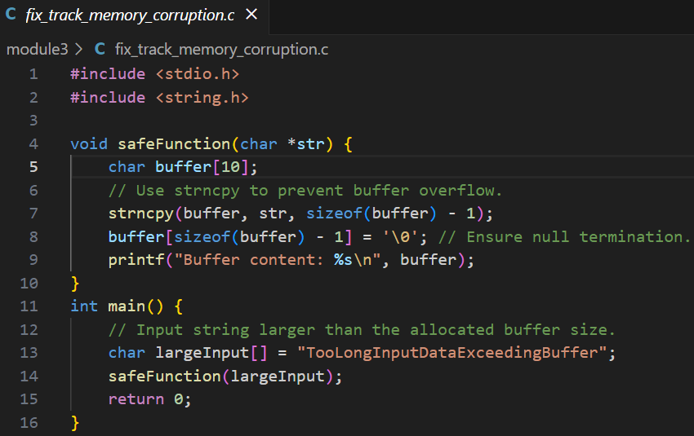
Module 3: Memory Corruption in Dynamic Arrays
Overview
Buffer overflows can corrupt memory.
Reverse debugging helps identify out-of-bounds writes.
To see gdb o/p of Module.3 :- Click Me!

Slide 14
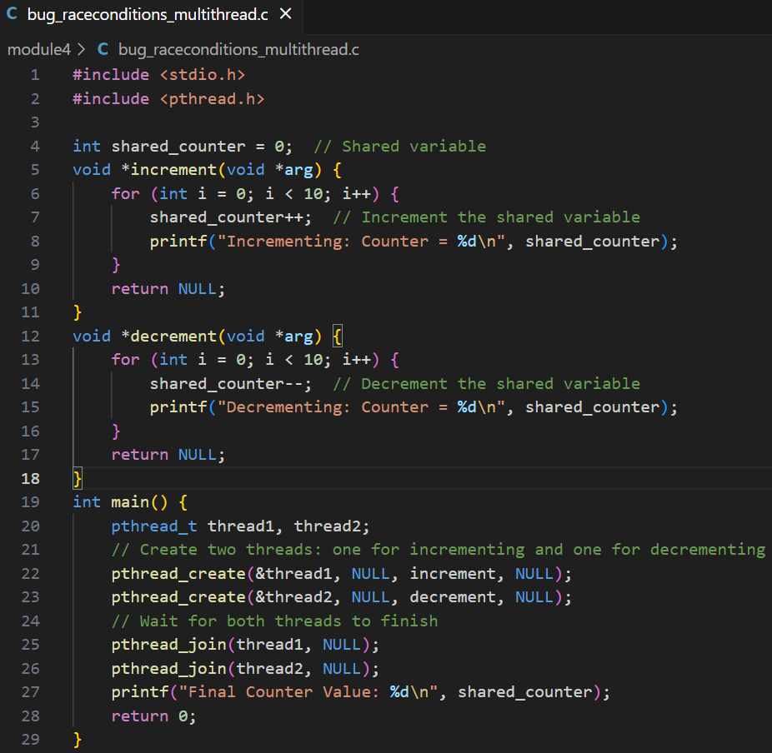
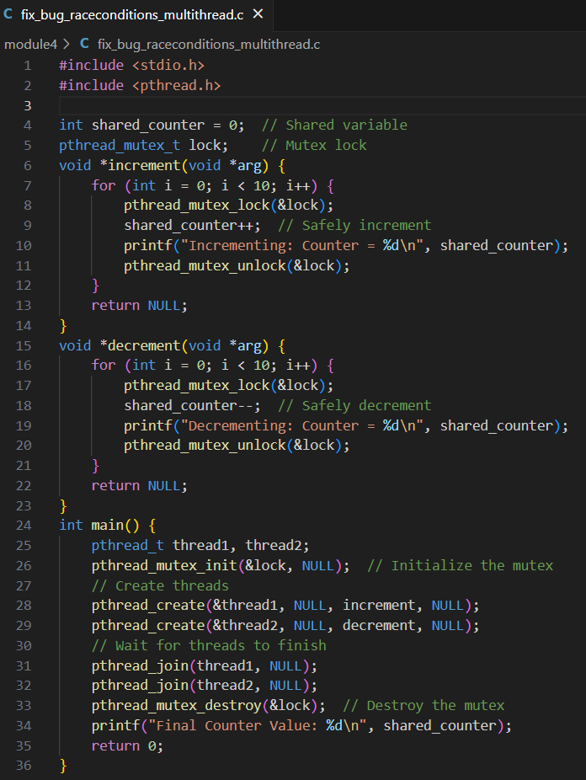
Module 4: Debugging Race Conditions in Multithreaded Code
Overview
Race conditions cause nondeterministic bugs.
Use reverse debugging to trace simultaneous thread access.
To see gdb o/p of Module.4 :- Click Me!

Slide 15
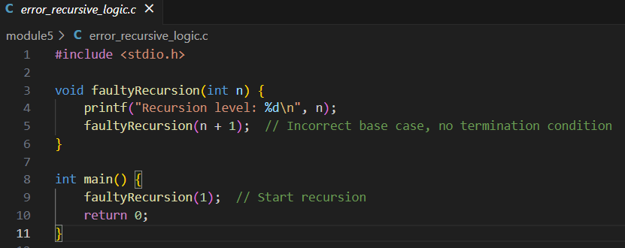
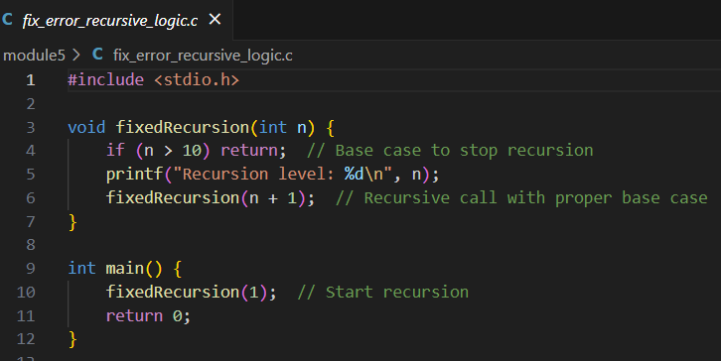
Module 5: Recursive Function Debugging
Overview
Recursive functions can cause stack overflow if improperly terminated.
Reverse debugging helps locate incorrect base cases.
To see gdb o/p of Module.5 :- Click Me!

Slide 16
Key highlights
©

Slide 17
Cross-Debugging
Debug programs running on a different architecture using cross-debugging tools like gdbserver.
Analyze code running on embedded systems from a host machine.
Real-Time Debugging
Debug time-sensitive applications without halting the entire system.
Monitor real-time data with minimal intrusion using hardware breakpoints.
Remote Debugging
Connect GDB to embedded devices using protocols like JTAG, SWD, or over serial/TCP/IP.
Debug applications directly on the target hardware.
Reverse Debugging
Step backward in time to identify the root cause of bugs in embedded systems.
Useful for debugging hard-to-reproduce errors.
Memory Inspection and Corruption Detection
Examine and manipulate memory regions in embedded devices.
Debug memory-mapped peripherals and identify corruption or misaligned accesses.
Breakpoint Flexibility
Use hardware breakpoints for debugging read-only memory (e.g., Flash).
Conditional and watchpoint support for observing variable or register changes.
Debugging Interrupts and ISR
Analyze interrupt service routines (ISRs) and trace how interrupts affect program behavior.
Manage nested interrupt debugging with stack inspection.
Low-Level Register Debugging
Access and modify CPU registers, I/O registers, and special-function registers directly.
Debug issues related to clock configuration, peripherals, and initialization.
Shared Library and Firmware Debugging
Debug shared libraries or dynamically linked firmware components.
Test bootloaders or multi-stage initialization processes.
Scripting for Automation
Use GDB scripting to automate repetitive debugging tasks.
Streamline embedded testing workflows with custom GDB commands.
Signal and Exception Handling
Debug embedded-specific exceptions like hard faults, bus faults, and memory management faults.
Monitor and trace exception handlers effectively.
Integration with CI/CD
Automate testing and debugging in continuous integration pipelines using GDB.
Generate logs and test reports directly from embedded debugging sessions.

Slide 18
E-Commerce Web Automation Testing Capstone project
Objective:
> The objective is to showcase the key automation test cases implemented using Selenium and Python for an e-commerce website which is http://automationexercise.com.
> This includes functional testing of critical user interactions such as registration, login, checkout, cart operations, product searches, and order placements.
> Additionally, the test report highlights essential Selenium methods used to ensure efficient and reliable test execution.
©
2

Slide 19
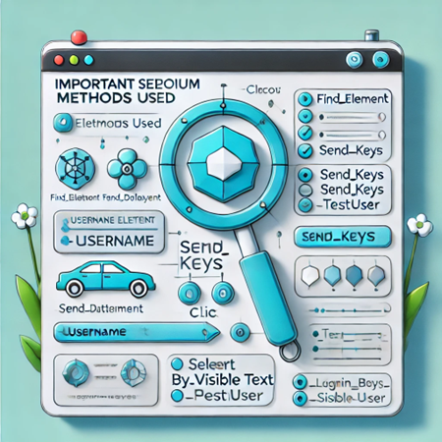
Tools & Frameworks Used:
Selenium WebDriver – Automates browser interactions.
PyTest – Framework for running test cases efficiently.
Page Object Model (POM) – Enhances test maintainability by separating test logic from UI elements.
Fluent Interface Design – Improves test readability and modularity.
pytest-html – Generates detailed HTML reports for test execution.

Slide 20
Test Scenarios Covered (26 Test Cases) for Navigation to url used- 'http://automationexercise.com'
1️⃣ User Authentication
📌 Purpose: Ensures secure login and logout operations. ✅ Login with valid credentials – Verifies successful access. ✅ Login with invalid credentials – Checks system response to incorrect credentials. ✅ Logout functionality – Confirms session termination after logout. ✅ Password reset feature – Tests the password recovery mechanism.
2️⃣ User Registration
📌 Purpose: Validates user account creation process. ✅ New user registration – Ensures users can sign up successfully. ✅ Registration with existing email – Tests duplicate account handling. ✅ Form validation (empty fields, invalid data) – Ensures proper input validation.
4️⃣ Cart Operations
📌 Purpose: Ensures users can manage shopping cart efficiently. ✅ Add items to cart – Verifies cart update after adding products. ✅ Remove items from cart – Checks item removal functionality. ✅ Update item quantity in cart – Ensures users can modify quantities. ✅ Verify cart total price calculation – Confirms price accuracy.
3️⃣ Product Search & Filtering
📌 Purpose: Ensures users can find products efficiently. ✅ Search by product name – Verifies search results for specific keywords. ✅ Search by category – Ensures category-based filtering. ✅ Apply filters (price, brand, rating) – Confirms filter functionality.

Slide 21
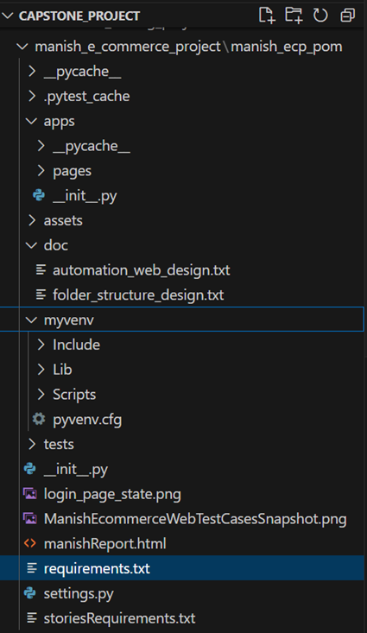
Test Scenarios Covered (26 Test Cases)
6️⃣ Payment Processing
📌 Purpose: Ensures secure and seamless transactions. ✅ Successful payment transaction – Verifies order completion upon payment success. ✅ Payment failure handling – Tests system behavior on transaction failure.
7️⃣ Order History & Tracking
📌 Purpose: Enables users to track their purchases. ✅ View past orders – Ensures users can access order history. ✅ Track order status – Confirms real-time order tracking updates.
8️⃣ Account Management
📌 Purpose: Allows users to manage personal account settings. ✅ Update user profile – Verifies profile update functionality. ✅ Change password – Ensures password change process works correctly.

Slide 22
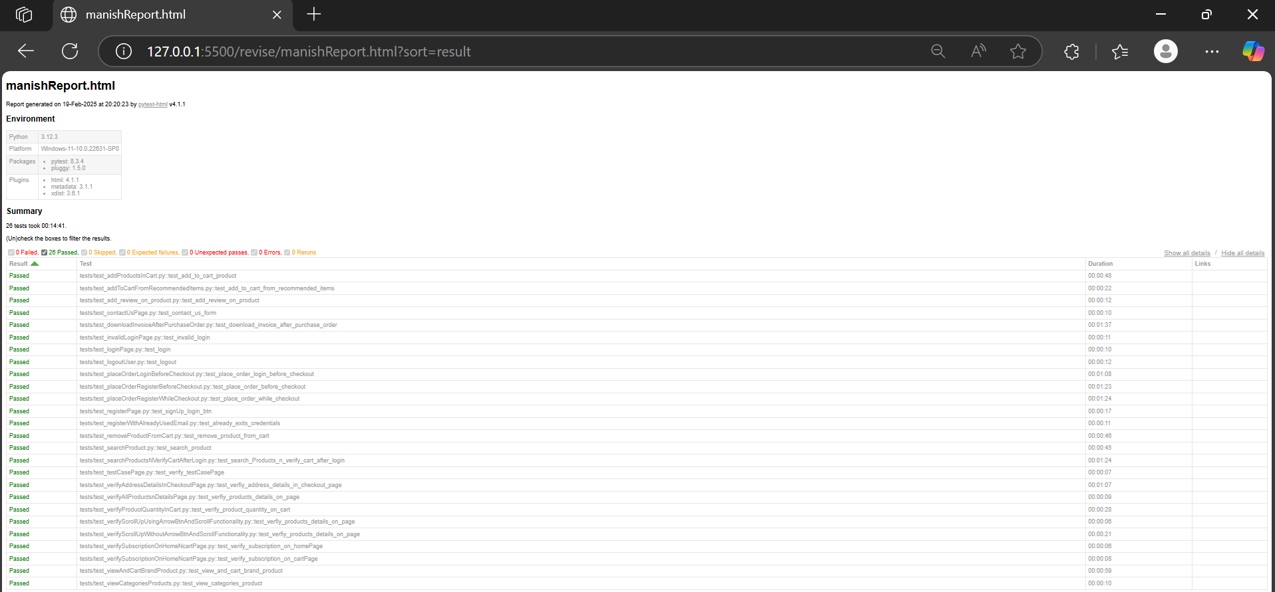
Test Execution Summary

Slide 23
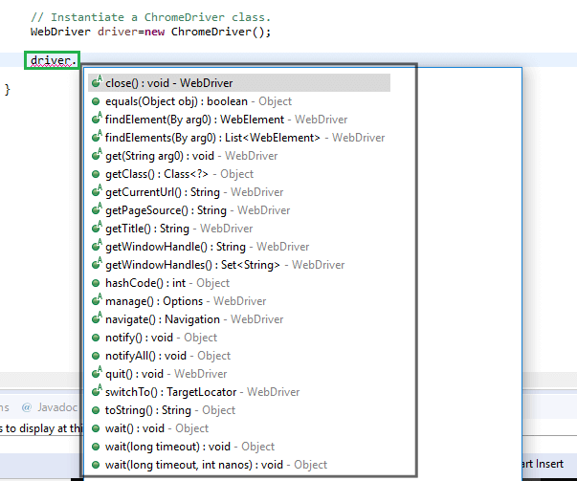
Key highlights
Key Selenium Built-in Methods Used
To See Project
Click Me!
©

Slide 24
Rest API Testing for Users Capstone Project 2
Objective:
The objective of this testing is to ensure the functionality and reliability of the ReqRes API endpoints for https://reqres.in/api. The testing involves:
Verifying the expected behavior of GET, POST, PUT, and DELETE methods.
> Ensuring correct responses from the API under different test conditions.
> Validating response status codes, content, and handling edge cases.
> Automating the testing process using python, pytest, requests and for continuous integration and reporting.
©
2

Slide 25
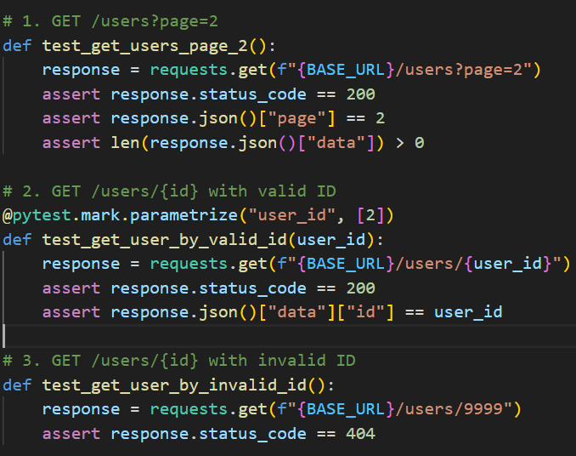
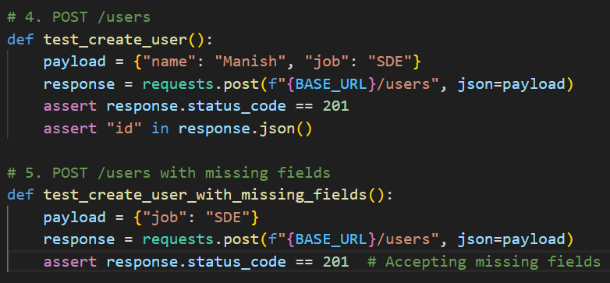
GET METHOD:-
test_get_users_page_2():
Purpose:
> Tests the retrieval of the second page of users.
> This implies the API supports pagination.
Method:
> It constructs a GET request to the /users endpoint with the page query parameter set to 2.
POST METHOD:-
test_create_user():
Purpose:
> Tests the successful creation of a new user.
Method:
> Defines a payload dictionary containing the data for the new user (name and job).
> Sends a POST request to /users with the payload as JSON data using json=payload in the requests.post() method.

Slide 26
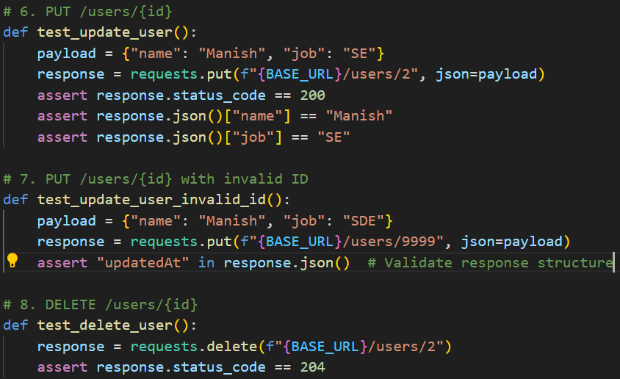
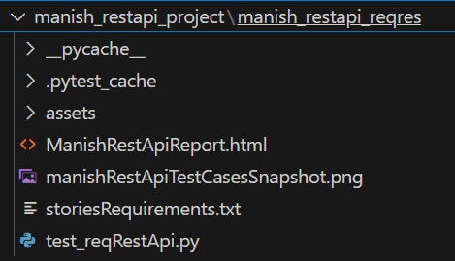
PUT-
Purpose:
> Tests the successful update of an existing user's information.
Method:
> Defines a payload dictionary with the updated user data (name and job).
> Sends a PUT request to /users/2 (assuming user ID 2 exists) with
the payload as JSON data.
DELETE-
Purpose:
> Tests the successful deletion of an existing user.
Method:
> Sends a DELETE request to /users/2 (assuming user ID 2 exists).
To see Project:- Click Me!

Slide 27
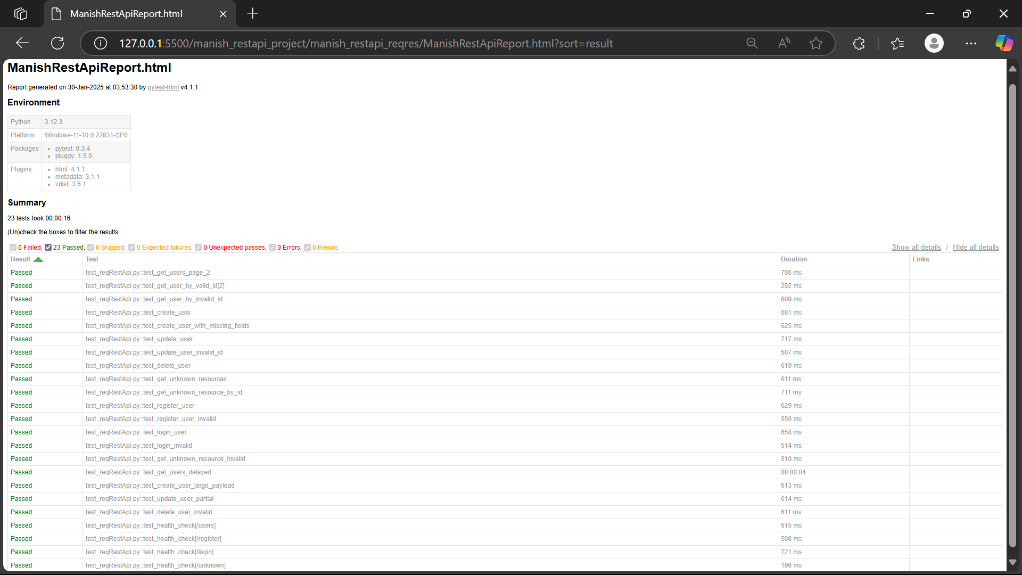
Test Execution Summary

Slide 28
Conclusion & Future Scope:-
Ensured API reliability by covering multiple test cases.
Automated testing saves time & reduces manual errors.
Can be extended with:-
Mock testing for external dependencies.
CI/CD integration for continuous testing.
Load testing to check API performance under heavy traffic.

Slide 29
Thank You
©

