Slide 1
Verification of Controllers for Advanced Driver Assistance Systems
Under the guidance of
Dr. Purandar Bhaduri
Dept. of CSE, IIT Guwahati
Presented by:
Manish Semwal (204101032)
M.Tech (CSE), IIT Guwahati
June 10, 2022

Slide 2
Motivation
According to The United States Department of Transportation (USDOT), the rise of driverless cars will lead to 90% fall of traffic deaths.
Reduced incidents caused by human errors, drugged driving, speeding and distractions
Helpful for people with disabilities.
Increased productivity.
500% increase in lane capacity.
60% drop in harmful emissions.
40% reduction in travel time.
10% improvement in fuel economy.

Slide 3
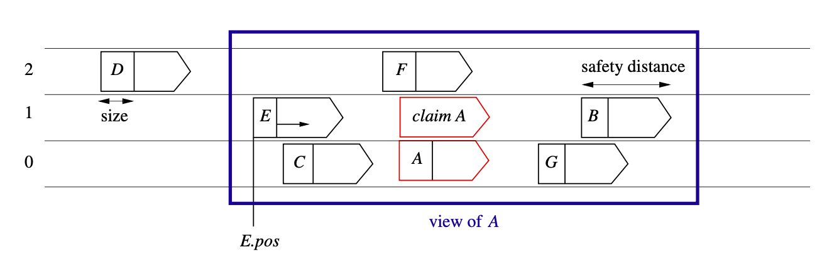
Problem Statement
A multi-lane highway with several cars. The large rectangle shows the view of car A, i.e. the part of the environment visible to A[1].

Slide 4
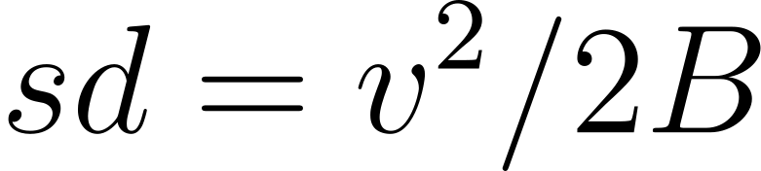
The safety condition
Safety Envelop : A region around a vehicle in which no other vehicle should ever enter to guarantee safety. It is also known as Critical Zone.
Safety Distance : The minimum distance a vehicle will travel if it applies brakes as hard as possible.
If the maximum possible deceleration of a vehicle is given by B and the current velocity of the vehicle is v. Then the safety distance sd is given by the formula :

Slide 5
The safety condition
res: The set of reserved lanes. It has at most two elements, the current lane n, and possibly an adjacent lane m to which the car wants to move.
The dangerous situation of a collision is formalized by the following condition:

Slide 6
Modelling dynamic behavior of a car
res: The set of reserved lanes. It has at most two elements, the current lane n, and possibly an adjacent lane m to which the car wants to move.
clm: The set of claimed lanes. It has at most one element. The claimed element must be a lane adjacent to the current lane n.

Slide 7
Modelling dynamic behavior of a car
To describe the dynamic behavior of a car during lane change, the following interactions are introduced:
• c(m): Introduce a claim for lane m.
• wd − c(m): Withdraw the claim for lane m.
• r(m): Change a claim for lane m into a reservation for lane m.
• wd − r(m): Withdraw the reservation for lane m.

Slide 8
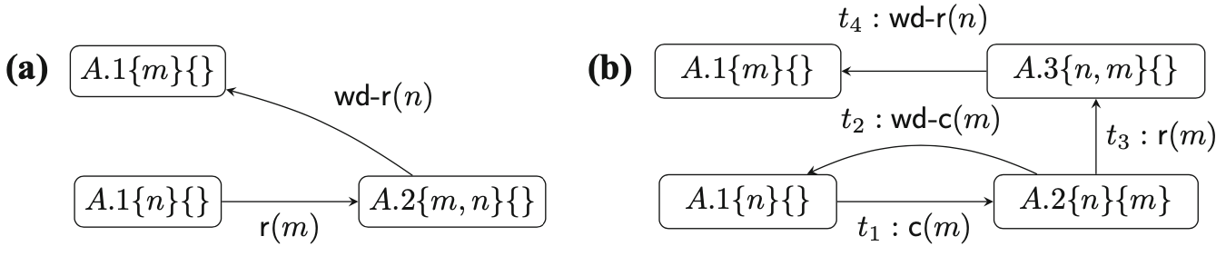
Modelling the dynamic behavior of a car
Let the notation A.qRC means that the car A is in some control state q, it has reserved the lanes in the set R, and it claims the lanes in the set C.
Behavior of a car A changing from its current lane n to a neighboring target lane m is either n − 1 or n + 1: (a) simple algorithm, (b) protocol with a claim transition c(m)[1].

Slide 9
KeYmaera X : a tool for the verification of hybrid systems
Hybrid programs: Programs that involve continuous evolution as well as conventional discrete programs. They can be defined by following grammar:
• α and β are the hybrid programs
• x is a variable
• x′ represents time derivative of variable x
• f(x) is a function of x that evolves with time
• Q is the evolution domain constraint, which is given by a First-Order Logic formula
• x′ = f(x)&Q means that the differential equation x′ = f(x) can only evolve till it satisfies the evolution domain constraint Q

Slide 10
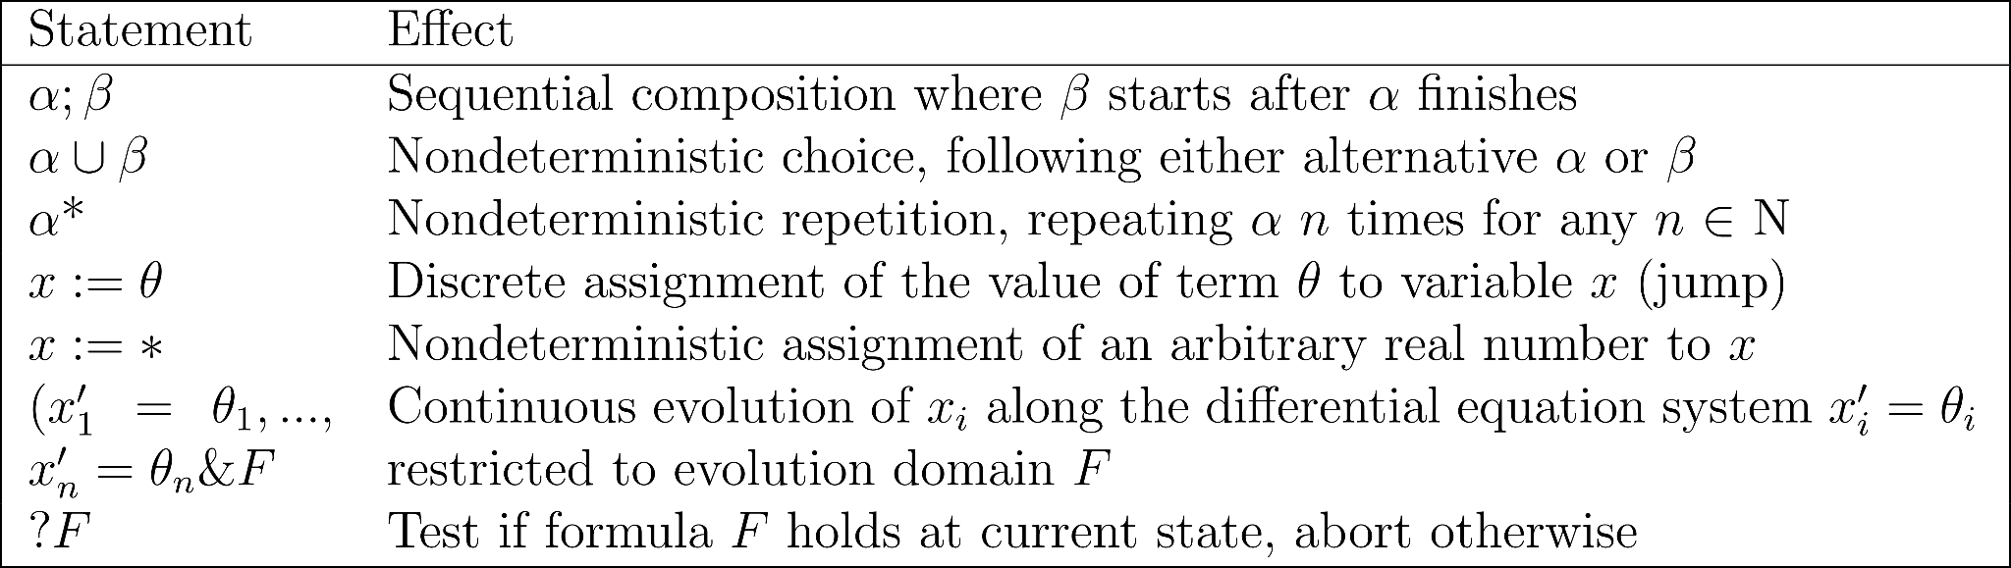
Hybrid programs
Statements of hybrid programs (F is a first-order formula, α, β are hybrid programs)

Slide 11
Differential dynamic logic (dL)
Differential dynamic logic (dL) : A logic for specifying and verifying hybrid systems.
dL can be defined by following grammar :
• P and Q are dL formulas
• e and ̃e are polynomial terms
• x is a variable
• box and diamond operator are the modal operators.

Slide 12
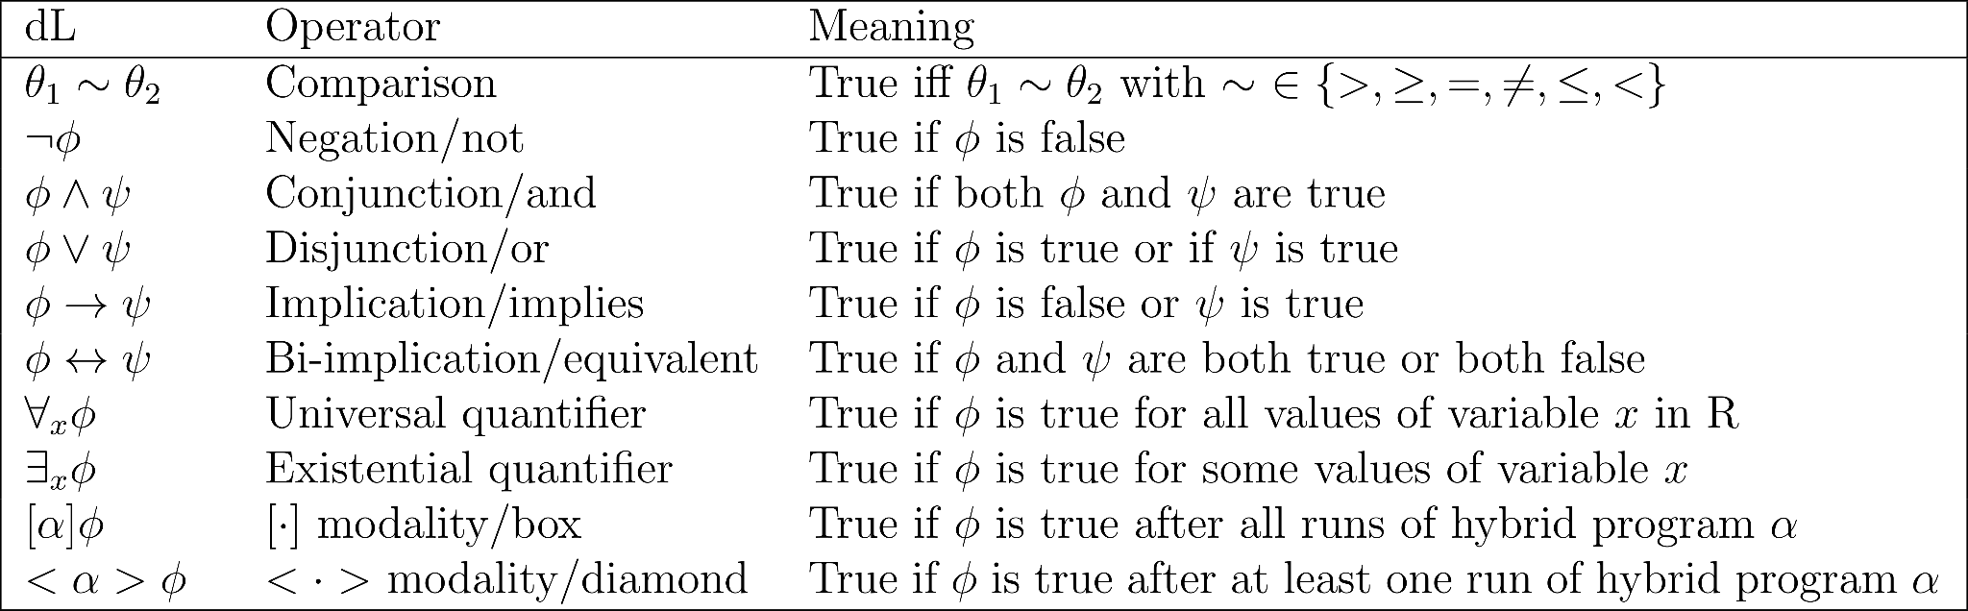
Differential dynamic logic (dL)
Operators and (informal) meaning in differential dynamic logic (dL)

Slide 13
KeYmaera X
The input to KeYmaera X is a dL formula of the form :
• init : It is the set of initial conditions for the system.
• {ctrl; plant} : It is a hybrid program where ctrl represents the discrete dynamics and the plant represents the continuous dynamics. ; is the sequential composition operator.∗ is the non-deterministic repetition operator.
• safe : It is the set of safety conditions that should be true at all times for the system to be safe, it is also called post-condition.

Slide 14
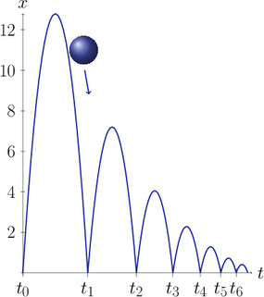
KeYmaera X
The motion of a bouncing ball can be verified by the
following model:
A bouncing ball behavior[2]

Slide 15
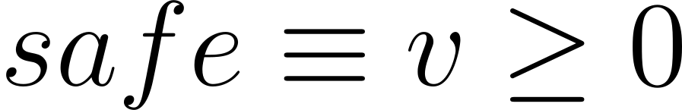
KeYmaera X
The safety of a car moving forward in a straight-line can be verified using following model:

Slide 16
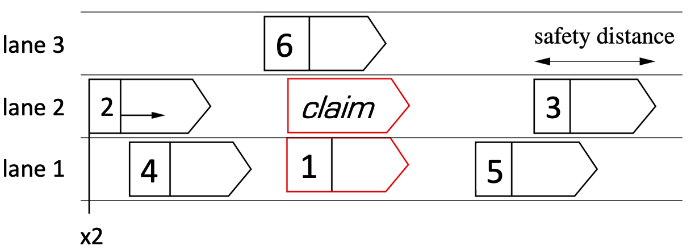
Considerations
xi, vi, ai, li are the current position, velocity, acceleration and lane number of vehicle i.
Safety distance sd is defined as :

Slide 17
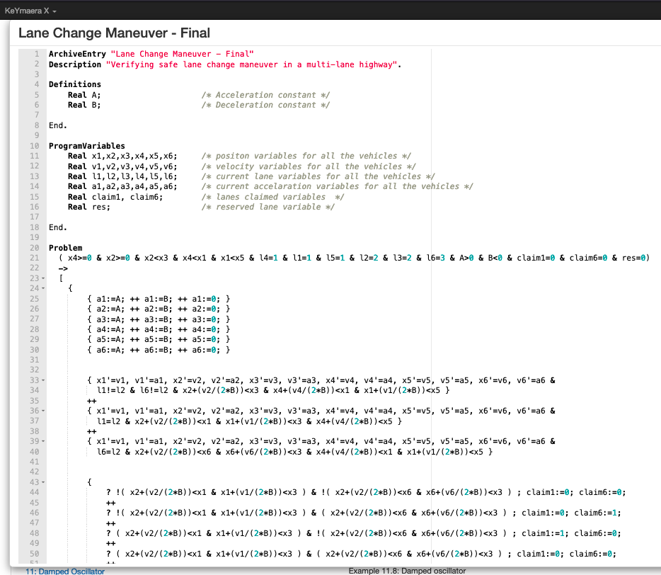

Slide 18
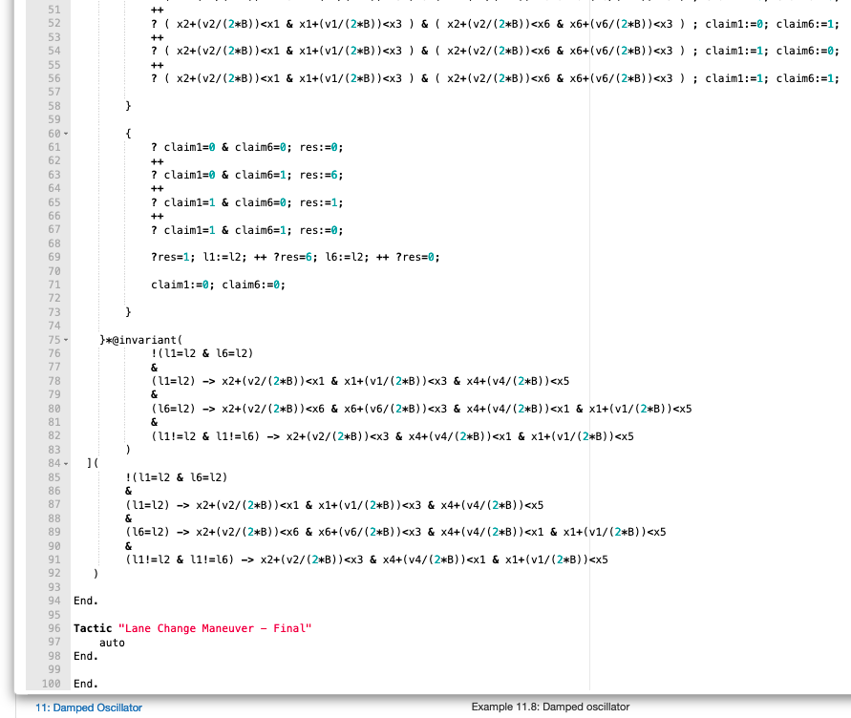

Slide 19
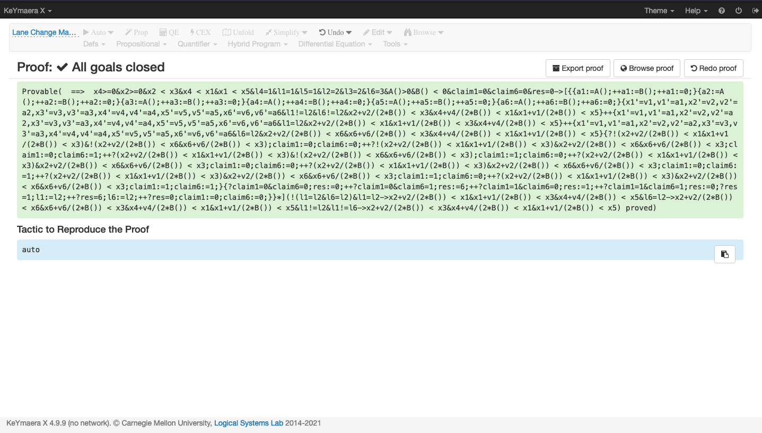

Slide 20
References:
[1] G.V. Bochmann, M. Hilscher, S. Linker, and E.R. Olderog. Synthesizing and verifying controllers for multi-lane traffic maneuvers. Form Asp Comp 29, page 583–600, 2017.
[2] lfcps.org/info/fig-bouncing-ball-dark-trace.png

Slide 21
Thank You!

Slide 22
Questions?

