Slide 1
EV ANALYTICS
using Tableau & Flask
Electric Vehicle Data Analysis — India & Global
Team ID: SWTID-2026-6056 | Team Leader: Manish Sharma Ritik Sharma • Mayank Kumar • Lucky Yadav • Radhika Agarwal
Notes:
Title slide. Introduce yourself and the team.

Slide 2
01
Problem Statement
05
Story
AGENDA
02
Dataset & Database
06
Web Integration
What we cover today
03
Data Preparation
07
Performance Testing
04
Tableau Dashboards
08
Conclusion

Slide 3
PROBLEM STATEMENT
The Challenge
If someone in India wants to buy an Electric Vehicle, they have to visit multiple websites to compare brands, prices, charging stations, and efficiency. There is no single platform where all EV data is available visually.
PS-1: EV Buyer (India)
PS-2: EV Market Analyst
Wants to compare brands, prices & charging stations — but data is scattered across multiple websites.
Wants to understand global EV efficiency trends — but raw datasets are hard to interpret without visualization.
OUR GOAL: Build ONE centralized platform with interactive dashboards & filters

Slide 4
DATASET & DATABASE
1
electric_vehicles_spec_2025.csv
478 rows
Global EV specs: brands, speed, battery, range, efficiency
2
ev-charging-stations-india.csv
1,342 rows
Charging stations across states and regions of India
3
EV_Dataset(1).csv
5,000 rows
India-specific EV sales data — brands and models
4
global_ev_market_charging_infrastructure.csv
96,845 rows
Global EV market and charging infrastructure data
SQLite Database: ev_analytics.db | 4 Tables | Total: 1,03,665 Rows

Slide 5
DATA PREPARATION
Raw CSV Datasets
data_cleaning.py
(Python / Pandas)
SQLite Database
ev_analytics.db
Tableau
Dashboards
Flask Website
E-CarStart
End User
What we cleaned:
Removed null and missing values from all 4 datasets
Standardized format of all datasets for Tableau visualization
Fixed inconsistencies in column names and data types
Created 2 calculated fields: Count and Count_powertrain
Removed duplicate records

Slide 6
TABLEAU VISUALIZATIONS
18 Total Visualizations | 2 Dashboards | 4 Filters | 2 Calculated Fields
🇮🇳 India EV Analytics Dashboard
🌍 Global EV Market Overview
EV Charging Stations Map
Charging Stations by Region & Type
Top Speed for Different Brands
Top 10 Most Efficient EV Brands
Different EV Cars in India (Treemap)
Brands According to Bodystyle
Brand Filtered by PowerTrain
Price for Different Cars
EV Models by Brand
Avg Battery Capacity by Brand
Avg Driving Range by Brand
Avg Top Speed by Brand
Avg Fast Charging Power
4 Interactive Filters:
BodyStyle
Brand
PowerTrain
Car Filter

Slide 7
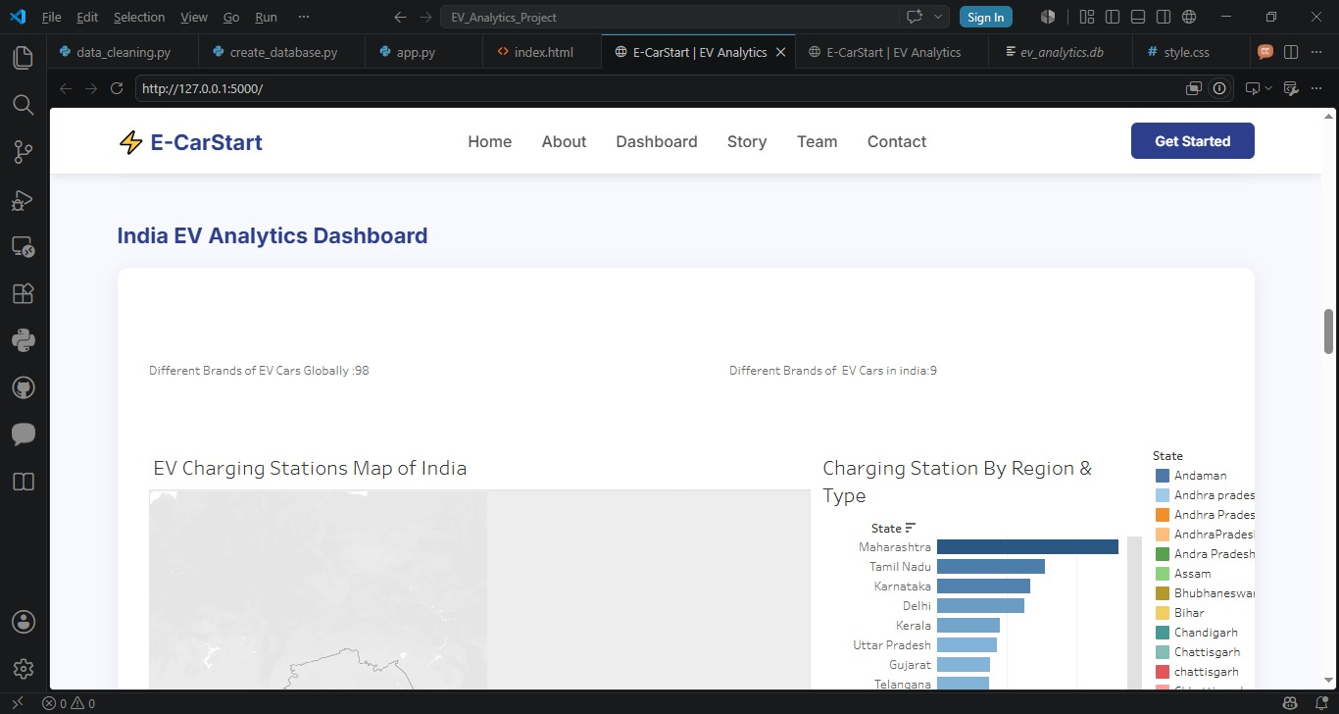
INDIA EV ANALYTICS DASHBOARD
Tableau Public Dashboard | Interactive Filters | Live Data

Slide 8
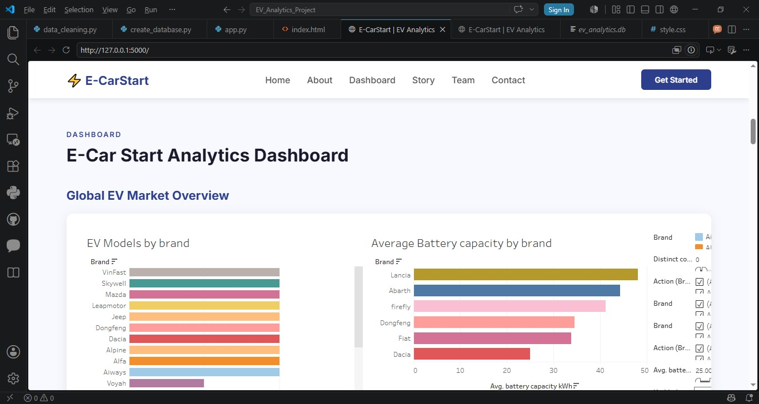
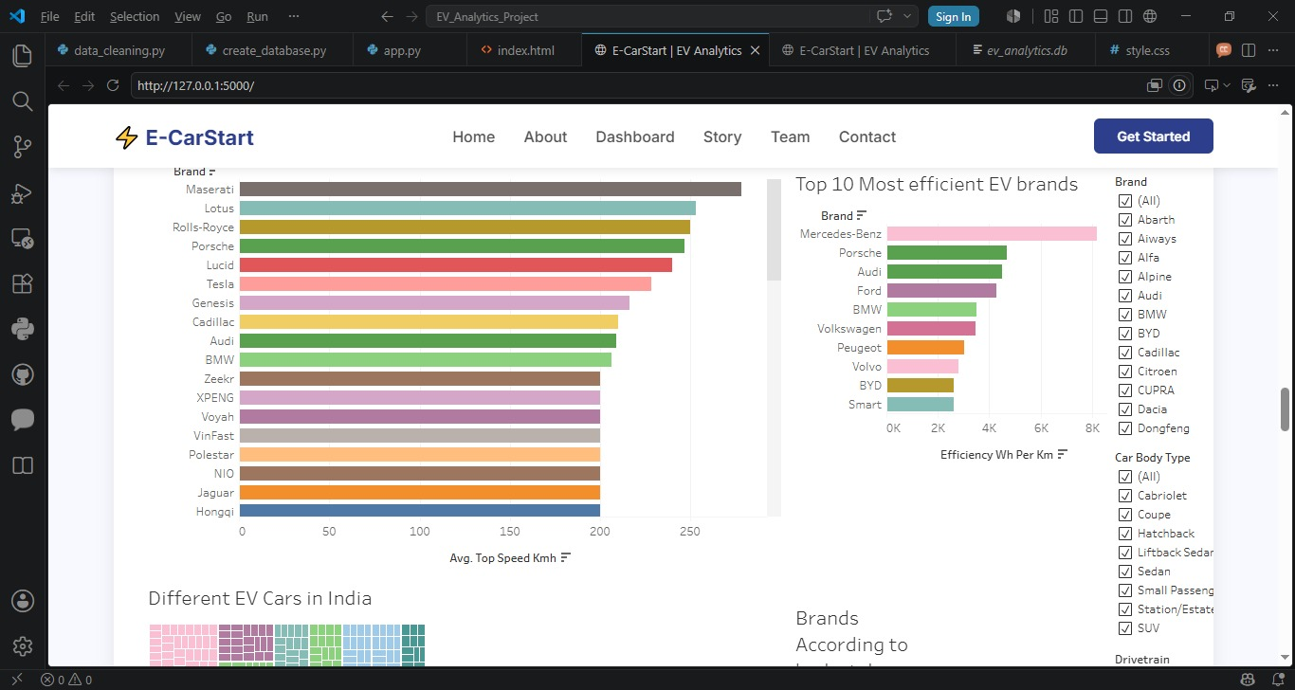
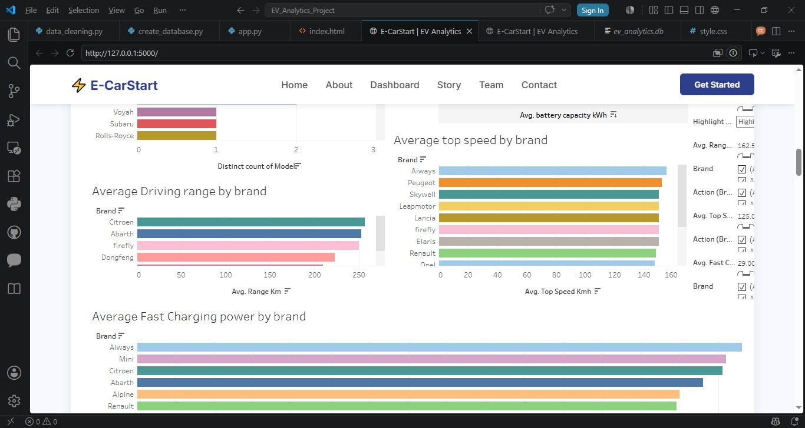
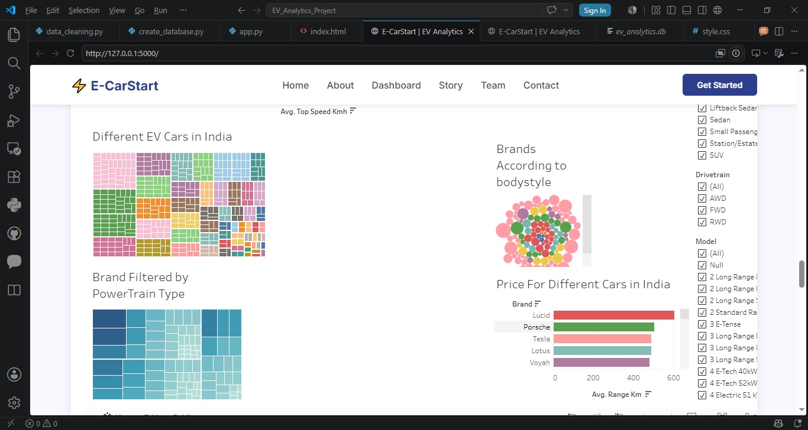
GLOBAL EV MARKET OVERVIEW DASHBOARD

Slide 9
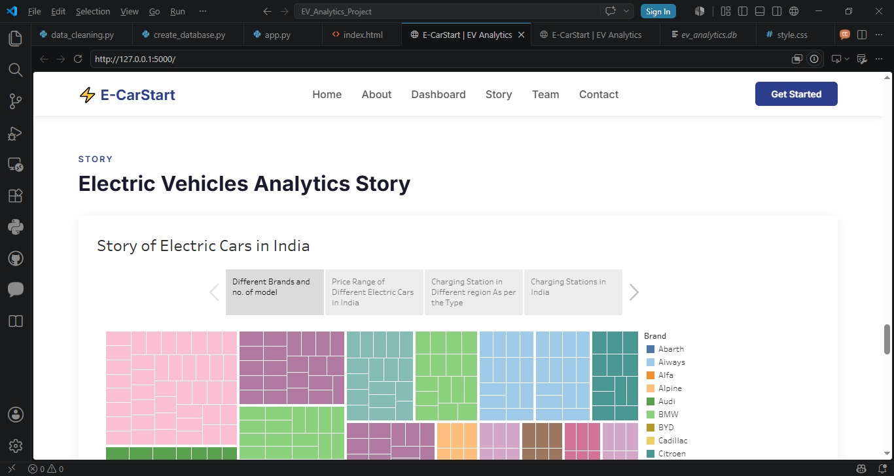
TABLEAU STORY
Story of Electric Cars in India — 4 Scenes
1
Different Brands & No. of Models
2
Price Range of Electric Cars in India
Treemap showing all EV brands and how many models each brand offers in India
Bar chart comparing price/range of different EV brands available in India
3
Charging Stations by Region & Type
4
Charging Stations Map of India
Bar chart showing state-wise charging station count by type across India
Geographic map showing locations of all EV charging stations across India

Slide 10
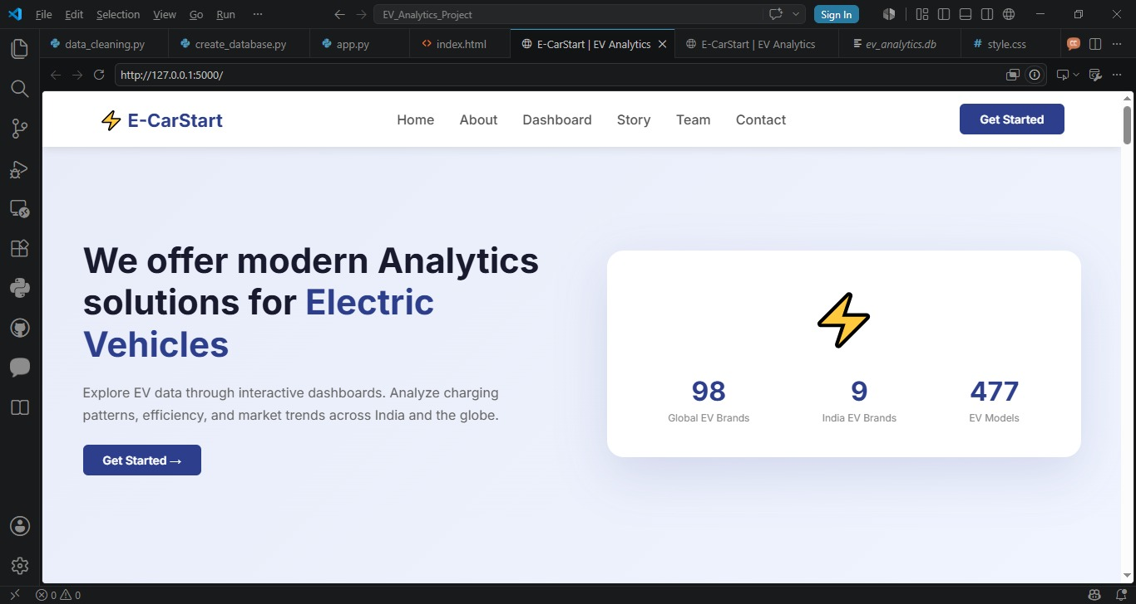
WEB INTEGRATION — E-CarStart
6 Pages:
Home
About
Dashboard
Story
Team
Contact
localhost:5000

Slide 11
PERFORMANCE TESTING
1,03,665
4
2
18
Total Rows in DB
Data Filters
Calculated Fields
Visualizations
4 Tables
BodyStyle, Brand, PowerTrain, Car
Count, Count_powertrain
Across 2 Dashboards + Story
Parameter | Result
Data Rendered to DB | 1,03,665 rows — vehicle_specs(478) + charging_stations(1,342) + ev_sales(5,000) + global_market(96,845)
Data Filters Used | 4 — BodyStyle, Brand, PowerTrain, Car Filter
Calculated Fields | 2 — Count, Count_powertrain
Total Visualizations | 18 Graphs across 2 dashboards and 1 story

Slide 12
PROJECT STRUCTURE & TECH STACK
01_Dataset
05_Documentation
📁
📁
Raw CSV Files
Final Project Report (DOCX)
02_Database
06_Web_Integration
📁
📁
create_database.py + ev_analytics.db
app.py + index.html + style.css
03_Data_Preparation
07_Video
📁
📁
data_cleaning.py + Cleaned CSV
Project Demo Video
04_Tableau
Tech Stack
📁
Tableau Workbook Files
Python • Pandas • SQLite
Tableau Public • Flask
HTML • CSS • GitHub

Slide 13
CONCLUSION
We successfully built a complete EV Analytics platform that:
✓
Collects & cleans real EV data from 4 datasets
✓
Stores 1,03,665 rows in a structured SQLite database
✓
Visualizes insights through 18 charts across 2 Tableau dashboards
✓
Tells a guided story of EV trends in India (4 scenes)
✓
Makes everything accessible through a custom Flask website (E-CarStart)
Team SWTID-2026-6056 | EV Analytics using Tableau & Flask | Thank You!

