Slide 1

A Proposal on
Satisfaction of User on Payment Gateway
By
Manish Shrestha
Britant Shrestha
Rijan Shrestha
Pokhara Engineering College
B.E. Computer
June, 2024

Slide 2
A Research Presentation on Satisfaction of User on Payment Gateway

Slide 3
Abstract
This proposal aims to investigate the satisfaction of user on payment gateway.
To identify the key factors influencing user satisfaction with payment gateways.
To evaluate the current level of user satisfaction with popular payment gateways.
To analyze the impact of security, ease of use, transaction speed, reliability, and support on user satisfaction.
To provide recommendations for improving user satisfaction with payment gateways.

Slide 4
Introduction
A Payment Gateway is a technology used by merchants to accept debit or credit card purchases from customers.
It acts as an intermediate between the merchant and the financial institutions to process the transaction.
It checks whether there are sufficient funds available, and check details of users that are correct or not.
In order to check these details, the payment gateway will communicate with the Card Schemas and Issuing Banks.
And then report back with its findings and relevant transaction response.

Slide 5
Introduction (Cont’d)
Merchants gain the ability to perform real-time Credit Card authorizations from a web site over the Internet.
Customers can pay for purchases across the Internet through Credit Cards within seconds, after the gateway obtains authorization from the Credit Card institutions.

Slide 6
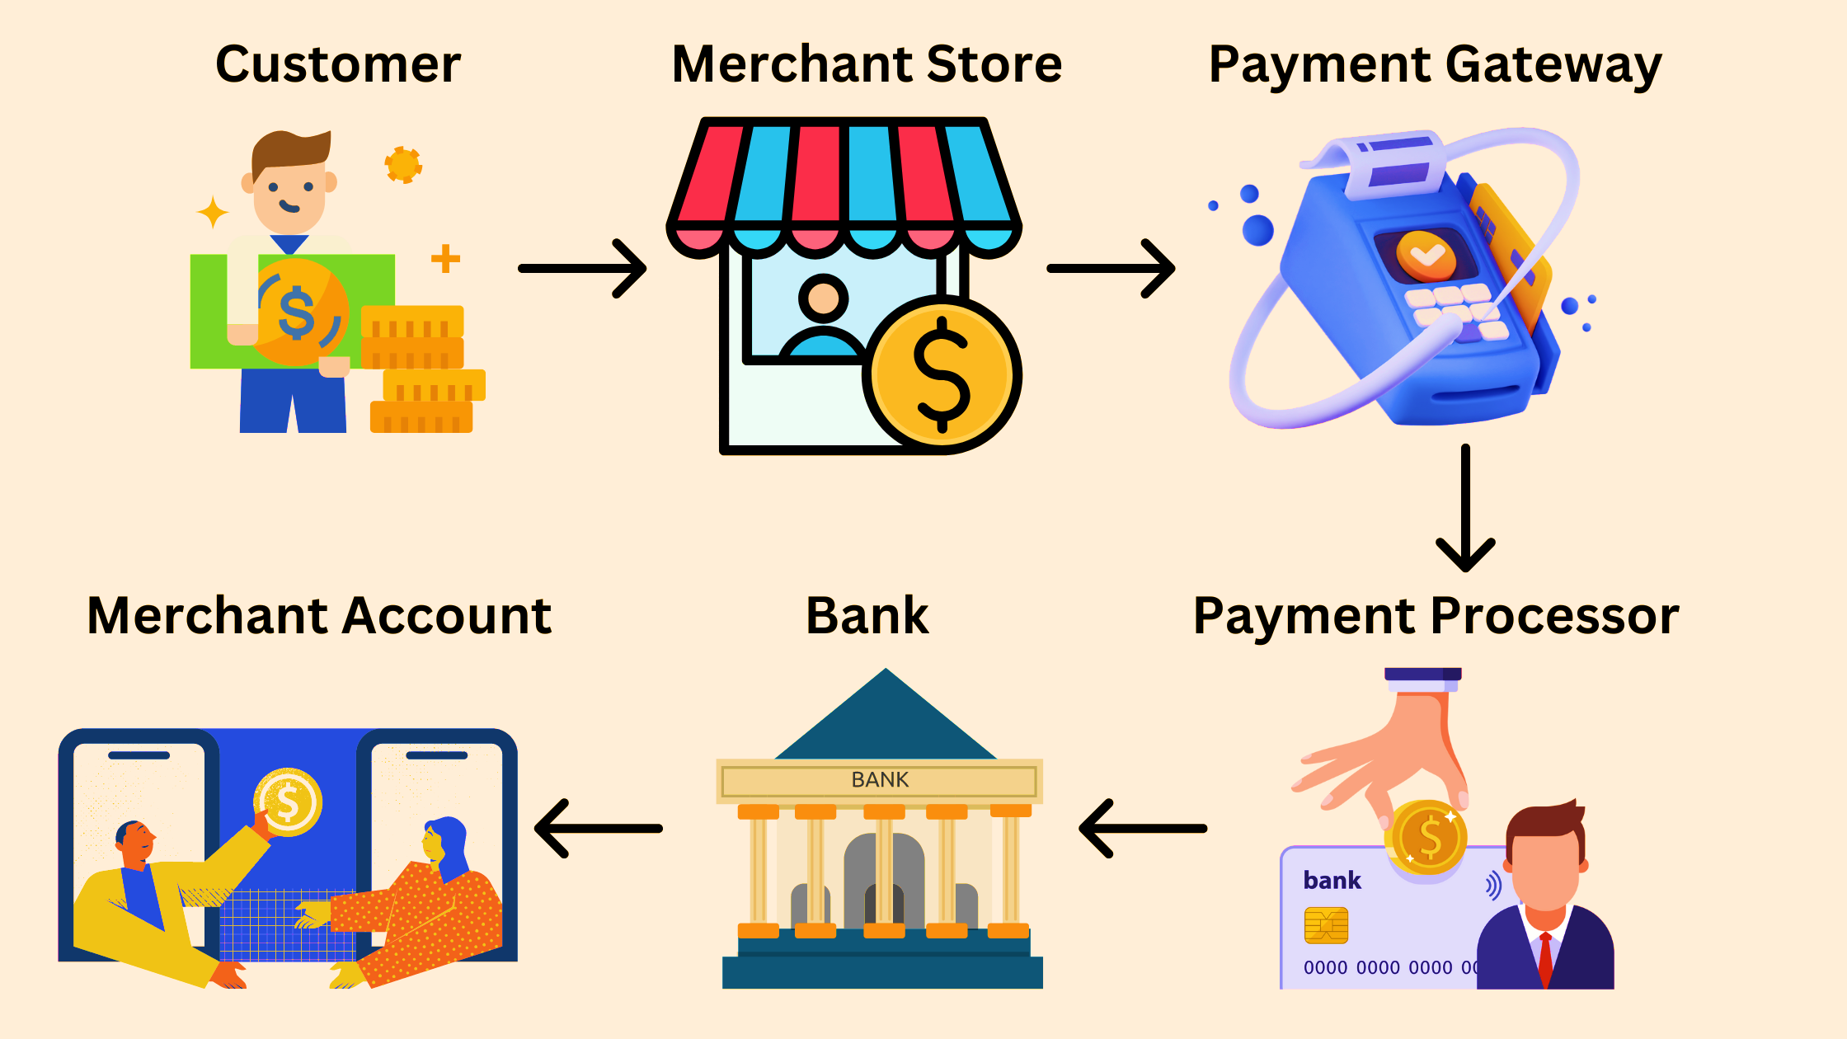
Payment Gateway

Slide 7
Research Objective
To identify the key factors influencing user satisfaction with payment gateways.
To evaluate the current level of user satisfaction with popular payment gateways.
To analyze the impact of security, ease of use, transaction speed, reliability, and support on user satisfaction.
To provide recommendations for improving user satisfaction with payment gateways.

Slide 8
Literature Review

Slide 9
This section will synthesize findings from academic research, industry analyses, and case studies to build a theoretical foundation for the current study.
Literature Review
Security and Trust
Ease of use
Transaction Speed
Reliability and Uptime
Support Service
Payment Options
Fees and Cost
Integrity and Compatibility

Slide 10
Research Questions
What are the primary factors influencing user satisfaction with payment gateways?
How do different payment gateways compare in terms of user satisfaction?
What is the relative importance of security, ease of use, transaction speed, reliability, and support in determining user satisfaction?

Slide 11
Methodology

Slide 12
Data Collection
Quantitative Data: Online surveys targeting users of various payment gateways. The survey will include Likert scale questions to measure satisfaction levels across different factors.
Qualitative Data: In-depth interviews with a subset of survey respondents to gain deeper insights into their experiences and suggestions for improvement.

Slide 13
Data Sampling
A diverse sample of online consumers who have used payment gateways for transactions in the past six months.
A target of 500 survey responses and 20 in-depth interviews.

Slide 14
Data Analysis
Quantitative Data: Statistical analysis using software such as SPSS or R to identify trends and correlations.
Qualitative Data: Thematic analysis to extract common themes and insights from interview transcripts.

Slide 15
Expected Outcome
Identification of the key factors that drive user satisfaction in payment gateways.
Comparative analysis of user satisfaction across different payment gateways.
Practical recommendations for payment gateway providers to enhance user satisfaction.
Insights into the importance of various aspects (security, ease of use, speed, reliability, support) in influencing user satisfaction.

Slide 16
Conclusion
This research aims to enhance the understanding of user satisfaction with payment gateways by identifying key influencing factors and providing actionable recommendations.
By improving user satisfaction, payment gateway providers can increase trust and loyalty.
It will contribute to the growth of e-commerce.

Slide 17
References
Chandra, S., Srivastava, S. C., & Theng, Y. L. (2010). Evaluating the Role of Trust in Consumer Adoption of Mobile Payment Systems: An Empirical Analysis. Communications of the Association for Information Systems, 27(1), 561-588.
Davis, F. D. (1989). Perceived usefulness, perceived ease of use, and user acceptance of information technology. MIS Quarterly, 13(3), 319-340.
Gefen, D., & Straub, D. W. (2000). The relative importance of perceived ease of use in IS adoption: A study of e-commerce adoption. Journal of the Association for Information Systems, 1(1), 1-30.
Wolfinbarger, M., & Gilly, M. C. (2003). eTailQ: Dimensionalizing, measuring and predicting etail quality. Journal of Retailing, 79(3), 183-198.
Creswell, J. W., & Creswell, J. D. (2017). Research Design: Qualitative, Quantitative, and Mixed Methods Approaches. Sage Publications.
Saunders, M., Lewis, P., & Thornhill, A. (2019). Research Methods for Business Students. Pearson.
https://docs.stripe.com/api/errors
https://core.ac.uk/download/pdf/162136359.pdf

Slide 18
Thank you

