Slide 1
RAID
By Manish Shrestha

Slide 2
Introduction
RAID stands for Redundant Array of Independent Disks.
Raid is a storage technology that combines multiple disk drive components into a logical components.

Slide 3
What is RAID?
Redundant Array of Inexpensive Disks.
Basic idea is to connect multiple disks together to provide
Large storage capacity
Faster access to reading data and
Redundant data

Slide 4
RAID LEVELS:
﻿﻿RAID 0 - striping
﻿﻿RAID 1 - mirroring
﻿﻿RAID 2 - redundancy through Hamming
RAID 3 - bit interleaved Parity
﻿﻿RAID 4 - block interleaved Parity
﻿﻿RAID 5 - striping with parity

Slide 5
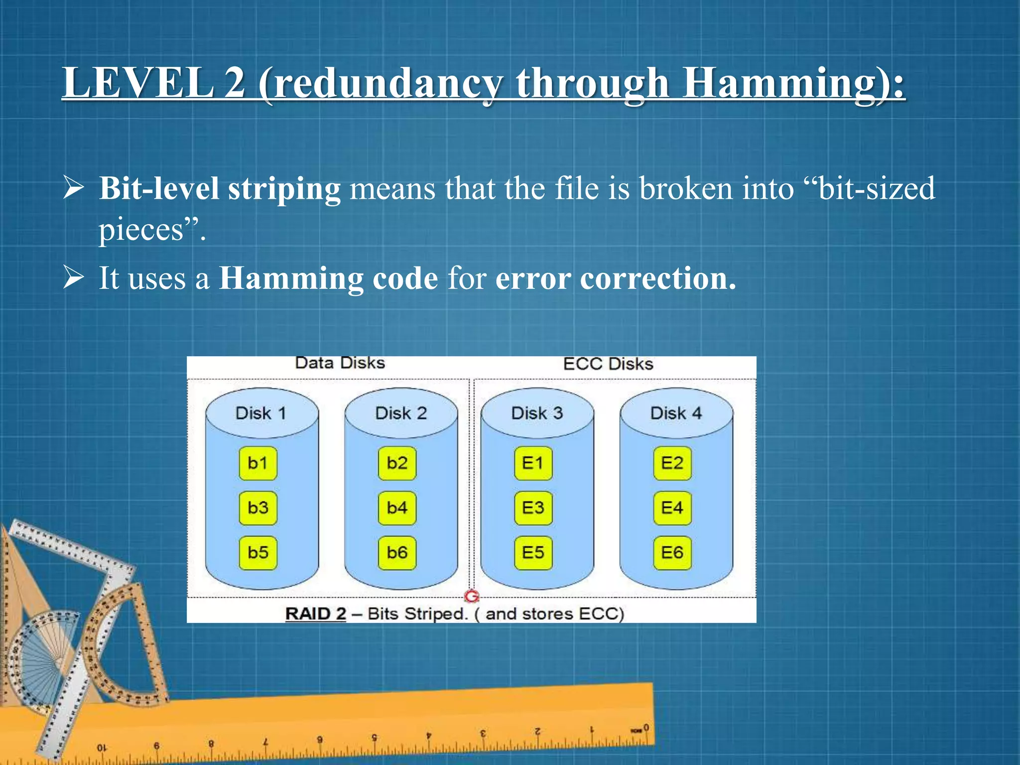
LEVEL 2 (redundancy through Hamming):
﻿﻿﻿﻿Bit-level striping means that the file is broken into "bit-sized pieces".
﻿﻿It uses a Hamming code for error correction.

Slide 6
Ideal use:
No commercial use.
Advantages:
Data transferred rate is very high.
Single bit errors can be detected and corrected.
Multiple bit errors can be detected.
Disadvantages:
Multiple bits error cannot be corrected.

Slide 7
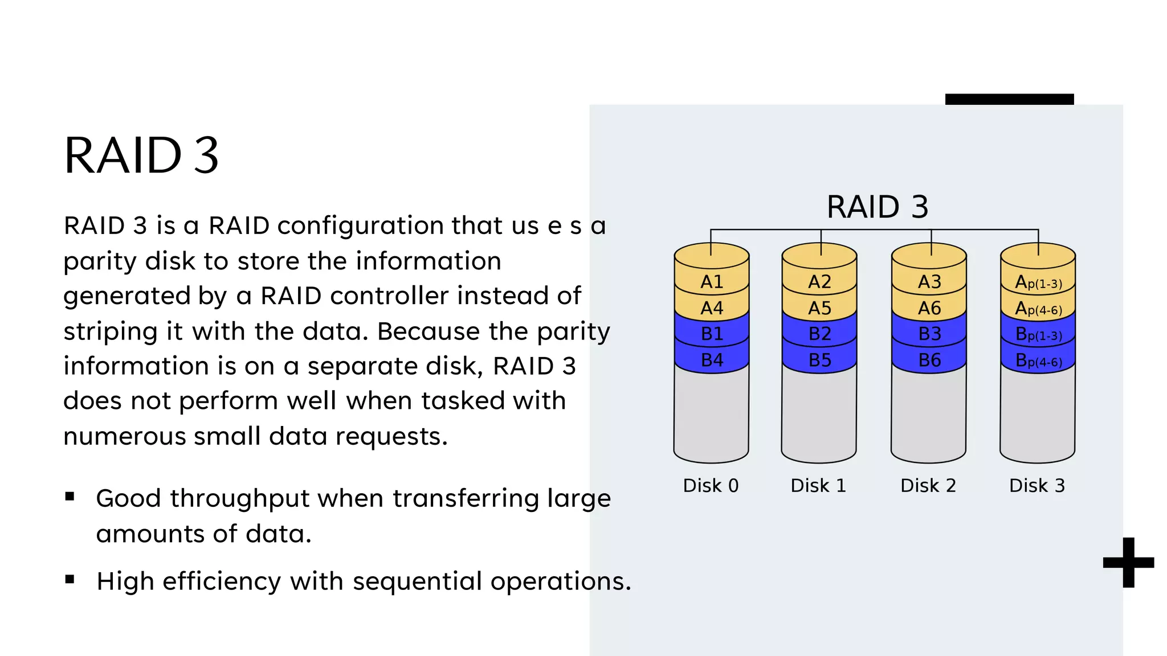
LEVEL 3 (bit interleaved Parity):
Byte-level striping means that the file is broken into "byte-sized pieces"
﻿﻿Written in parallel on two or more drives.
﻿﻿An additional drive stores parity information.

Slide 8
Ideal use:
Video streaming.
Advantages:
It provides high throughput for large data transfers.
﻿﻿Disk failures do not significantly slow down throughput.
Disadvantages:
Performance is slower for random, small I/O operations.

Slide 9
THANK YOU

