Slide 1

Swagger
Presenters: Pawan Jain, Sainik

Slide 2

Road map
impressico
Introduction
Why Swagger
Top-Down Swagger Approach
Bottom-Up Swagger Approach
Spring boot-swagger Code gen using command line
Spring boot-swagger Code gen Maven plugin
Generate Swagger Specification from API code by Maven plugin
www.impressico.com | Unsolicited Distribution is Restricted | Impressico © 2018 All rights reserved.

Slide 3
Introduction
impressico
Swagger is an open source software to build standard documentation in a human readable format for REST APIs. This provides a UI to easily understand service contract and consumer can interact with service without any detailed knowledge of underlying logic.
Swagger is developed by SmartBear software and comes with tools like Swagger Editor, Swagger CodeGen, Swagger UI & Swagger Inspector. Swagger has provided it’s specification known as OpenAPI specification to follow while documenting REST API.
www.impressico.com | Unsolicited Distribution is Restricted | Impressico © 2018 All rights reserved.

Slide 4
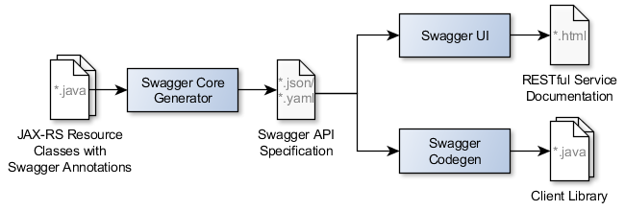
Introduction
impressico
www.impressico.com | Unsolicited Distribution is Restricted | Impressico © 2018 All rights reserved.

Slide 5
Introduction
impressico
Swagger Core
Swagger Editor
{specification}
json, yaml
Swagger Codegen
Swagger UI
www.impressico.com | Unsolicited Distribution is Restricted | Impressico © 2018 All rights reserved.

Slide 6




Introduction
impressico
Swagger UI
Webserver
/api-docs
HTML
{specification}
json, yaml
CSS
JS
www.impressico.com | Unsolicited Distribution is Restricted | Impressico © 2018 All rights reserved.

Slide 7
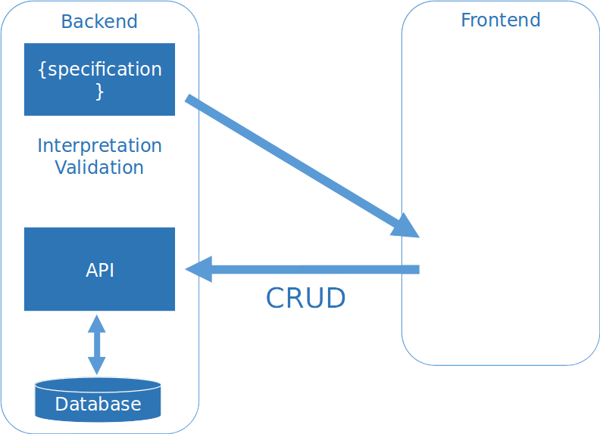



Specification webservices
impressico
www.impressico.com | Unsolicited Distribution is Restricted | Impressico © 2018 All rights reserved.

Slide 8
Integration
impressico
Swagger can be integrated with REST APIs in below ways:
1. A top-down approach – First API specification and then code generation
2. A bottom-up approach – First API code and then Swagger integration. This is quite familiar and mostly useful when there is already an existing REST APIs built in and Swagger documentation needs to be integrated.
www.impressico.com | Unsolicited Distribution is Restricted | Impressico © 2018 All rights reserved.

Slide 9
impressico
A Top-Down Approach
Following are the steps:
1. we have saved the specification in yaml format https://editor.swagger.io/
2. Swagger provides utility jar to generate client REST clients for different programming languages and framework. The latest stable version jar can be downloaded
https://github.com/swagger-api/swagger-codegen/releases
www.impressico.com | Unsolicited Distribution is Restricted | Impressico © 2018 All rights reserved.

Slide 10
Swagger Code Gen
impressico
3. To generate client execute below command.
java -jar swagger-codegen-cli.jar generate \
-i swagger.yaml \
--api-package com.example.employee.api \
--model-package com.example.employee.model \
--group-id com.example \
--artifact-id spring-swagger-codegen-demo \
--artifact-version 0.0.1-SNAPSHOT \
-l spring \
-o spring-swagger-codegen-demo
www.impressico.com | Unsolicited Distribution is Restricted | Impressico © 2018 All rights reserved.

Slide 11
Swagger Code Gen(Top-Down Approach)
impressico
To list all Java-related options, type the following command:
java -jar swagger-codegen-cli.jar config-help -l java
jersey1 – Jersey1 + Jackson
jersey2 – Jersey2 + Jackson
feign – OpenFeign + Jackson
okhttp-gson – OkHttp + Gson
retrofit (Obsolete) – Retrofit1/OkHttp + Gson
retrofit2 – Retrofit2/OkHttp + Gson
rest-template – Spring RestTemplate + Jackson
rest-easy – Resteasy + Jackson
www.impressico.com | Unsolicited Distribution is Restricted | Impressico © 2018 All rights reserved.

Slide 12
Swagger Dependency(Top-Down Approach)
impressico
<dependency>
<groupId>io.swagger</groupId>
<artifactId>swagger-annotations</artifactId>
<version>1.5.13</version>
</dependency>
<dependency>
<groupId>io.springfox</groupId>
<artifactId>springfox-swagger2</artifactId>
<version>2.7.0</version>
</dependency>
<dependency>
<groupId>io.springfox</groupId>
<artifactId>springfox-swagger-ui</artifactId>
<version>2.7.0</version>
<dependency>
www.impressico.com | Unsolicited Distribution is Restricted | Impressico © 2018 All rights reserved.

Slide 13
Swagger Configuration(Top-Down Approach)
impressico
@Configuration
public class SwaggerDocumentationConfig {
ApiInfo apiInfo() {
return new ApiInfoBuilder()
.title("Petstore")
.description("A simple Petstore API")
.license("")
.licenseUrl("http://unlicense.org")
.termsOfServiceUrl("")
.version("0.3.1")
.contact(new Contact("","", ""))
.build();
}
/**
* After the Docket bean is defined, its select() method returns an instance of ApiSelectorBuilder,
* which provides a way to control the endpoints exposed by Swagger.
*
* Predicates for selection of RequestHandlers can be configured with the help of RequestHandlerSelectors
* and PathSelectors. Using basePackage will make documentation for your entire API available through Swagger.
*
* This configuration is enough to integrate Swagger 2 into existing Spring Boot project.
* For other Spring projects, some additional tuning is required.
* @return
*/
@Bean
public Docket customImplementation(){
return new Docket(DocumentationType.SWAGGER_2)
.select()
.apis(RequestHandlerSelectors.basePackage("io.swagger.api"))
.build()
.directModelSubstitute(org.joda.time.LocalDate.class, java.sql.Date.class)
.directModelSubstitute(org.joda.time.DateTime.class, java.util.Date.class)
.apiInfo(apiInfo());
}
}
/**
* After the Docket bean is defined, its select() method returns an instance of ApiSelectorBuilder,
* which provides a way to control the endpoints exposed by Swagger.
*
* Predicates for selection of RequestHandlers can be configured with the help of RequestHandlerSelectors
* and PathSelectors. Using basePackage will make documentation for your entire API available through Swagger.
*
* This configuration is enough to integrate Swagger 2 into existing Spring Boot project.
* For other Spring projects, some additional tuning is required.
* @return
*/
@Bean
public Docket customImplementation(){
return new Docket(DocumentationType.SWAGGER_2)
.select()
.apis(RequestHandlerSelectors.basePackage("io.swagger.api"))
.build()
.directModelSubstitute(org.joda.time.LocalDate.class, java.sql.Date.class)
.directModelSubstitute(org.joda.time.DateTime.class, java.util.Date.class)
.apiInfo(apiInfo());
}
}
www.impressico.com | Unsolicited Distribution is Restricted | Impressico © 2018 All rights reserved.

Slide 14
Swagger Maven Plugin(Top-Down Approach)
impressico
<plugin>
<groupId>io.swagger</groupId>
<artifactId>swagger-codegen-maven-plugin</artifactId>
<version>2.2.3</version>
<executions>
<execution>
<goals>
<goal>generate</goal>
</goals>
<configuration>
<inputSpec>./api-contract/petstore.yml</inputSpec>
<language>spring</language>
<configOptions>
<java8>true</java8>
<interfaceOnly>true</interfaceOnly>
</configOptions>
</configuration>
</execution>
</executions>
</plugin>
www.impressico.com | Unsolicited Distribution is Restricted | Impressico © 2018 All rights reserved.

Slide 15
impressico
Bottom-Up Approach
First API code and then Swagger integration. This is quite familiar and mostly useful when there is already an existing REST APIs built in and Swagger documentation needs to be integrated
Step:
1. Annoted your API with swagger annotation
2. Download swagger UI zip and extract into target/classes/static folder
3. replace http://petstore.swagger.io/v2/swagger.json link to your dynamic swagger json link
4. feed the your swagger.json with below config file
www.impressico.com | Unsolicited Distribution is Restricted | Impressico © 2018 All rights reserved.

Slide 16
Swagger Dependency(Bottom-Top Approach)
impressico
Maven Dependency
<dependency>
<groupId>io.swagger</groupId>
<artifactId>swagger-jersey2-jaxrs</artifactId>
<version>${swagger.jersey2.version}</version>
</dependency>
www.impressico.com | Unsolicited Distribution is Restricted | Impressico © 2018 All rights reserved.

Slide 17
Swagger Maven Plugin(Bottom-Top Approach)
impressico
<plugins>
<plugin>
<artifactId>maven-compiler-plugin</artifactId>
<configuration>
<source>${java.version}</source>
<target>${java.version}</target>
</configuration>
</plugin>
<plugin>
<groupId>com.googlecode.maven-download-plugin</groupId>
<artifactId>download-maven-plugin</artifactId>
<version>1.2.1</version>
<executions>
<execution>
<id>swagger-ui</id>
<goals>
<goal>wget</goal>
</goals>
<configuration>
<url>
https://github.com/swagger-api/swagger-ui/archive/v${swagger.ui.version}.tar.gz
</url>
<unpack>true</unpack>
<outputDirectory>${project.build.directory}
</outputDirectory>
</configuration>
</execution>
</executions>
</plugin>
<plugin>
<groupId>org.apache.maven.plugins</groupId>
<artifactId>maven-antrun-plugin</artifactId>
<version>1.8</version>
<executions>
<execution>
<phase>prepare-package</phase>
<goals>
<goal>run</goal>
</goals>
<configuration>
<tasks>
<sequential>
<echo>Copy Files</echo>
<copy todir="${project.build.directory}/classes/static">
<fileset dir="${project.build.directory}/swagger-ui-${swagger.ui.version}/dist">
<include name="**"/>
</fileset>
</copy>
<echo>Renaming 'index.html' to 'swagger-ui.html'</echo>
<move file="${project.build.directory}/classes/static/index.html"
tofile="${project.build.directory}/classes/static/swagger-ui.html"/>
<echo>Replace petstore swagger.json link</echo>
<replace token="http://petstore.swagger.io/v2/swagger.json"
value="/swagger.json"
dir="${project.build.directory}/classes/static">
<include name="swagger-ui.html"/>
</replace>
</sequential>
</tasks>
</configuration>
</execution>
</executions>
</plugin>
www.impressico.com | Unsolicited Distribution is Restricted | Impressico © 2018 All rights reserved.

Slide 18
Swagger Configuration(Bottom-Top Approach)
impressico
@Configuration
public class JerseyConfiguration extends ResourceConfig {
@Autowired
public JerseyConfiguration() throws UnknownHostException {
register(BookController.class);
configureSwagger();
property(ServletProperties.FILTER_FORWARD_ON_404, true);
}
public void configureSwagger() {
this.register(ApiListingResource.class);
this.register(SwaggerSerializers.class);
BeanConfig config = new BeanConfig();
config.setConfigId("spring-jersey-swagger-example");
config.setTitle("Spring, Jersey, and Swagger Example");
config.setVersion("1.0.0");
config.setBasePath("/");
config.setResourcePackage("com.basaki");
config.setScan(true);
}
}
www.impressico.com | Unsolicited Distribution is Restricted | Impressico © 2018 All rights reserved.

Slide 19
Swagger Link
impressico
Code Base :
https://github.com/thomasJoei/swagger-codegen-springboot
https://github.com/indrabasak/spring-jersey-swagger-example
Swagger Doc:
https://swagger.io
Code Base :
https://github.com/thomasJoei/swagger-codegen-springboot
https://github.com/indrabasak/spring-jersey-swagger-example
Swagger Doc:
https://swagger.io
www.impressico.com | Unsolicited Distribution is Restricted | Impressico © 2018 All rights reserved.

Slide 20
impressico
THANKS
www.impressico.com | Unsolicited Distribution is Restricted | Impressico © 2018 All rights reserved.

