Slide 1

Web Fundamentals
JS best practices
Session-08
Thanos is on a mission to make his website standout from his rest of universe with Javascript
Notes:
Add one logo

Slide 2
Web Fundamentals
Session-08
JS best practices
Notes:
Add one logo

Slide 3
Agenda : JS best practices
01
Performance
02
Best Coding Practices
03
Security Practices
04
Mini Project
05
06
Hands-On

Slide 4
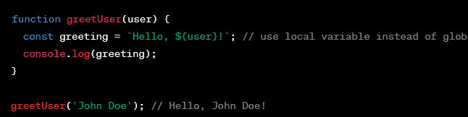
Avoid Global Variables
Reduces the risk of naming conflicts and unexpected behavior.

Slide 5
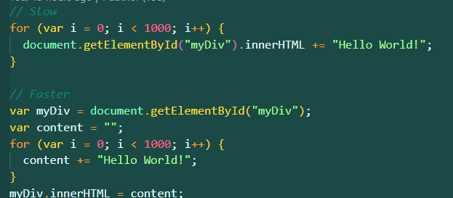
Minimize DOM Manipulation
DOM manipulation is a costly operation and can lead to performance issues. By minimizing it, we can improve the performance of our application.

Slide 6
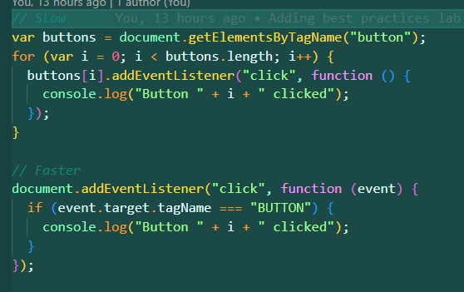
Use Event Delegation
Event delegation allows us to handle events on a parent element rather than on individual child elements. This reduces the number of event handlers and improves the performance of our application.

Slide 7
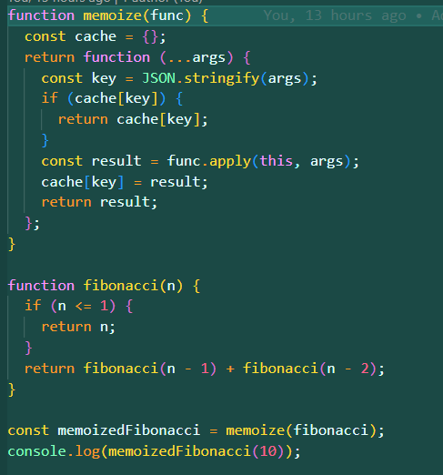
Use memoization
Memoization is a technique that allows us to cache the results of expensive function calls and reuse them when the same function is called again with the same arguments. This can greatly improve the performance of our application.

Slide 8

Use Strict Mode
Helps you catch coding mistakes that might otherwise go unnoticed, such as using a variable before it's been declared.

Slide 9
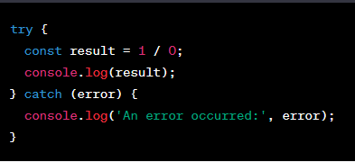
Use try/catch blocks to handle errors gracefully.
Improves code reliability and makes it easier to handle unexpected errors.

Slide 10
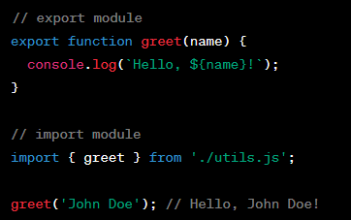
Use ES6 modules instead of CommonJS modules for importing and exporting code.
Improves code readability and makes it easier to manage dependencies.

Slide 11

Use Const, let instead of Var
const and let are block-scoped and have better scoping rules than var, which can cause bugs and unexpected behavior.

Slide 12
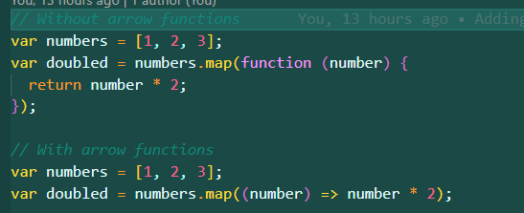
Use Arrow function
Improves code readability and reduces the amount of boilerplate code.

Slide 13
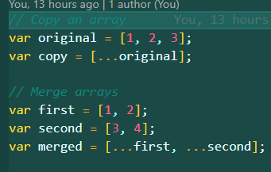
Use Spread Operator
Makes it easier to work with complex data structures and reduce code duplication.

Slide 14
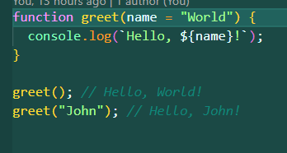
Use Default Params
Makes it easier to write functions that can handle a variety of inputs.

Slide 15
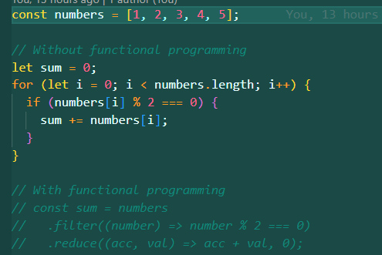
Use Functional Programming
TBF

Slide 16

Use nullish Coaelscing operator
The nullish operator is a new operator introduced in ES2020 that checks for nullish values (null and undefined) rather than falsy values. This helps avoid unexpected behavior and bugs in our code.

Slide 17
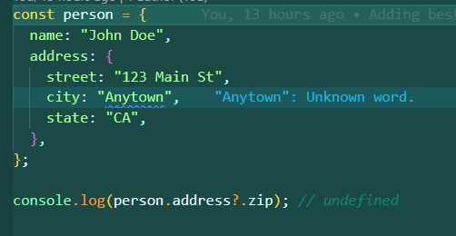
Use Optional Chaining
Optional chaining is another new feature introduced in ES2020 that allows us to safely access nested properties and methods without throwing errors if any intermediate property is null or undefined.

Slide 18

Use strict equality (=== and !==) instead of loose equality (== and !=).
Improves code reliability and reduces the risk of type coercion errors.

Slide 19
Use descriptive comments to explain complex code.
Improves code readability and makes it easier for other developers to understand the code.

Slide 20
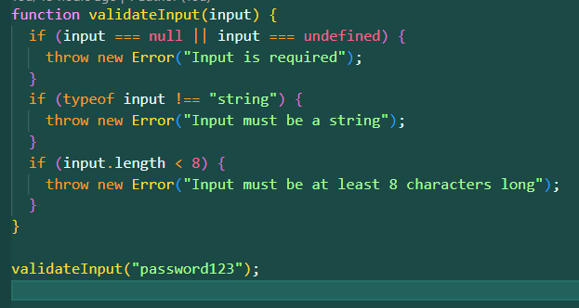
Secure validating user inputs
Security is a critical aspect of any application, and following security best practices helps protect against common security vulnerabilities

Slide 21
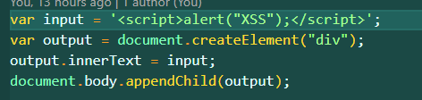
Secure against XSS
Security is a critical aspect of any application, and following security best practices helps protect against common security vulnerabilities

Slide 22
Mini Project

Slide 23

Notes:
What are some good examples of using it

Slide 24
Q & A

