Slide 1

Web Fundamentals
JS in depth- Big Picture
Session-07
Thanos is on a mission to make his website standout from his rest of universe with Javascript
Notes:
Add one logo

Slide 2
Web Fundamentals
Session-07
JS in depth- Big picture
Notes:
Add one logo

Slide 3
Agenda : JS in depth
01
JS Engine
02
Compilation & Interpretation
03
JIT Compilation in detail
04
Memory leaks & Garbage collection
05
Maps, Sets
06
Hands-On

Slide 4
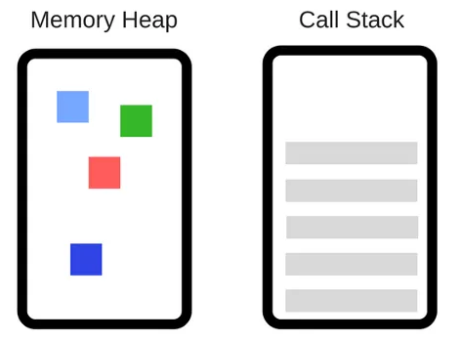
JS Engine
Only browser understands JavaScript, Not Computer.
A JavaScript engine is a computer program that executes JavaScript code and converts it into computer understandable language.
JS Engine- Components
The Engine consists of two main components:
* Memory Heap — this is where the memory allocation happens
* Call Stack — this is where your stack frames are as your code executes

Slide 5
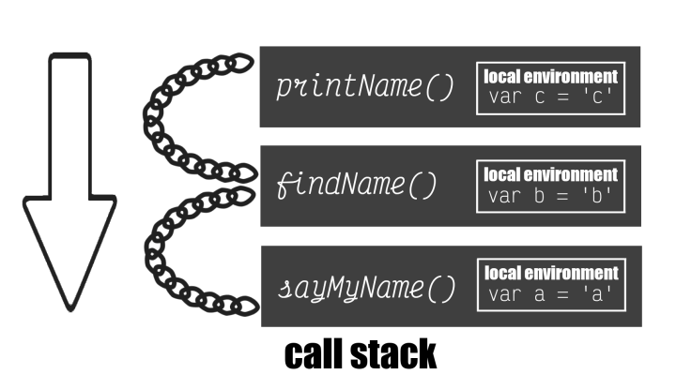
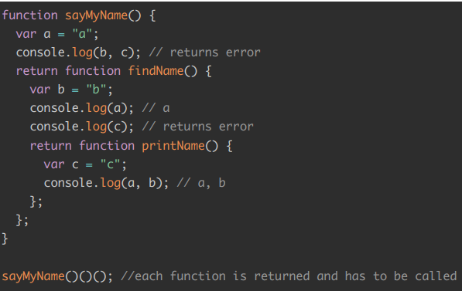
CallStack
The call stack keeps track of where we are in the code
Things are placed into the call stack on top and removed as they are finished.
It runs in a first in last out mode.

Slide 6
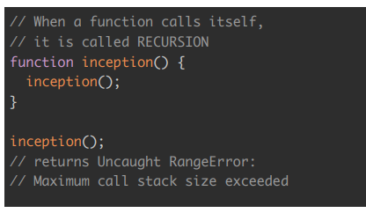
What is StackOverflow?
What happens if you keep calling functions that are nested inside each other? When this happens it’s called a stack overflow

Slide 7
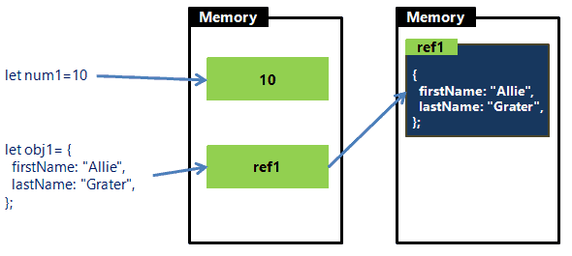
Primitive Vs Non-Primitive
Stack Vs Heap
Stack ( Call Stack)
Heap(Memory Heap)
Stores in location
Stores the ref
to location

Slide 8
List of JS Engines
Different browsers have different JS Engines
Different JS Engines can have different components
Browser | Name of Javascript Engine
Google Chrome | V8
Edge (Internet Explorer) | Chakra
Mozilla Firefox | Spider Monkey
Safari | Javascript Core Webkit
Commonly used JS engines

Slide 9
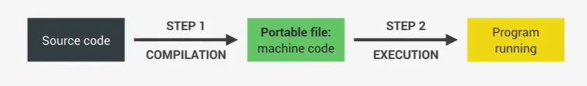
Compilation & Interpretation
Compilation
Compilation converts the source code into machine code in one go, which is then saved as a portable file for execution on any computer.
Process: Code is converted ahead of time and then creates a portable file.
Creating a portable file and then executing degrades performance

Slide 10
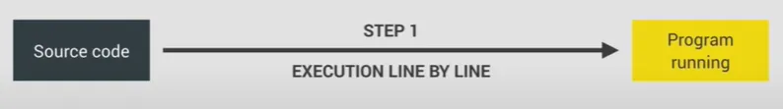
Compilation & Interpretation
Interpretation
Interpretation involves an interpreter reading and executing the source code line by line, without the need for separate compilation and execution steps.
Since line by line execution needs to be convered to machine code everytime, degrades performance
Compilation is not ahead of time.
JavaScript was first born as interpretated language, which was degrading performance
Hence… JIT( Just in time ) Compilation

Slide 11
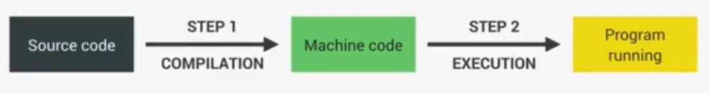
JIT compilation
Modern JavaScript engine now uses a mix between compilation and interpretation which is called Just-in-time(JIT) compilation.
JIT process compiles the entire code into machine code at once and then executes it right away.
So we will have two steps of regular ahead of time compilation, but there is no portable file to execute.
This is perfect for JavaScript as it’s really a lot faster than just execution code line by line.

Slide 12
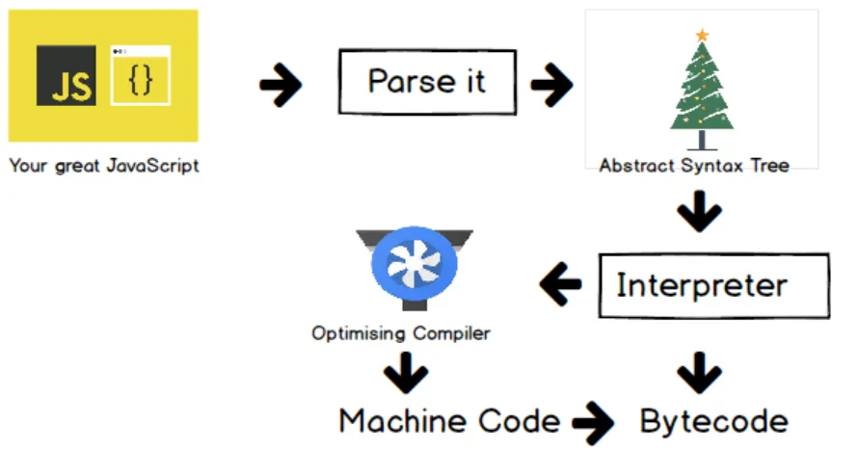
Just in time compilation flow inside JS Engine

Slide 13
AOT vs Interpretation vs JIT Compilation Summary
AOT compilation
Interpretation
JIT compilation

Slide 14
JS Engine – Components Deep dive
Parser: Parsing is the process of analyzing the source code, checking it for errors, and breaking it up into parts.
AST: The parser produces a data structure called the Abstract Syntax Tree or AST. AST is a tree graph of the source code that does not show every detail of the original syntax

Slide 15
JS Engine – Deep dive
Interpreter: An interpreter directly executes each line of code line by line, without requiring them to be compiled into a machine language program.
Compiler: The compiler works ahead of time to convert instructions into a machine-code or lower level form so that they can be read and executed by a computer. It runs all of the code and tries to figure out what the code does and then compiles it down into another language that is easier for the computer to read.

Slide 16
JS Engine – Optimized vs Unoptimized execution
Modern JavaScript engines use optimization strategies to improve code performance.
Initially, an unoptimized version of machine code is created for fast execution.
In the background, this code is optimized and recompiled without stopping the execution.
Parsing, compilation, and optimization happen in separate threads from the main thread that executes our code.
JIT improves performance here with optimized and unoptimized code in this block

Slide 17
Knowledge check
You are working on a web application that involves a lot of complex computations and data processing in JavaScript.
Which approach to running JavaScript code would likely provide better performance for this application, and why: Compilation, Interpretation, or JIT (Just-in-Time) Compilation?

Slide 18
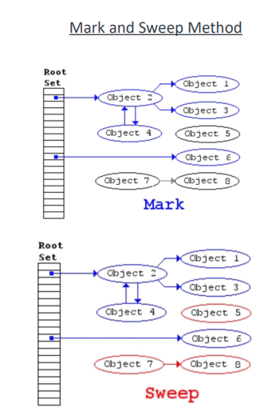
Garbage Collection
JavaScript is a garbage collected language. If you allocate memory inside of a function,
JavaScript will automatically remove it from the memory heap when the function is done
being called.
JavaScript completes garbage collection with a mark and sweep method.
If there is no reference, then they will be collected

Slide 19
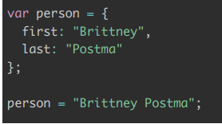
Memory Leaks
By changing the variable person from an object to a string, it leaves the values of first and last in the memory heap and does
not remove it.
Hence the memory leak is created.
Tips to avoid memory leaks:
Avoid global variables, create variables inside functions when possible
Deallocate the objects to null when they no longer required.

Slide 20
Transpiler
A transpiler is used to convert code written in a newer version of JavaScript into code that can run in older environments.
Babel is popular example of a JavaScript transpiler. It is widely used to convert code written in newer versions of JavaScript (such as ES6 or ES7) into code that can run in older browsers
Other examples of JavaScript transpilers include:
TypeScript: A superset of JavaScript that adds optional static typing and other features.
CoffeeScript: A language that compiles to JavaScript and aims to improve code readability and conciseness.
Dart: A language that can be transpiled to JavaScript and is designed for building large-scale web applications.

Slide 21
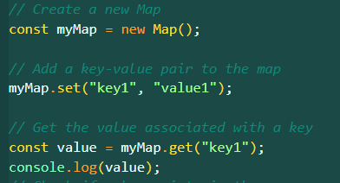
Maps
A Map holds key-value pairs where the keys can be any datatype.
A Map remembers the original insertion order of the keys.
A Map has a property that represents the size of the map.

Slide 22
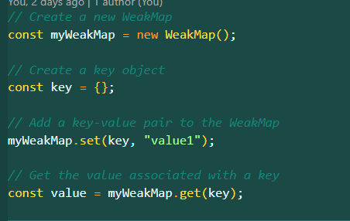
Weak Maps
In a WeakMap, the keys must be objects, and the values can be any type.
The key object references are weakly held, which means that if the key object is no longer referenced anywhere else, it can be garbage collected, along with its associated value in the WeakMap.

Slide 23
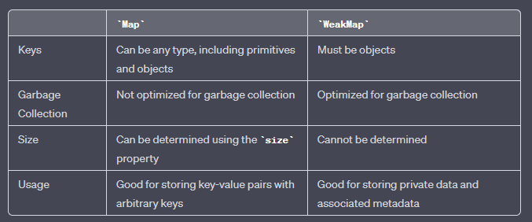
Map Vs Weak Maps

Slide 24
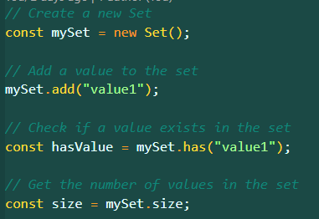
Sets
A JavaScript Set is a collection of unique values.
Each value can only occur once in a Set.
A Set can hold any value of any data type.

Slide 25
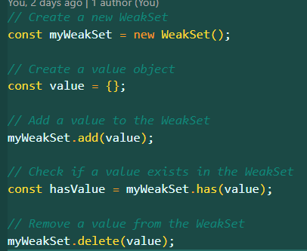
Weak Sets
In a WeakSet, the values must be objects, and like with WeakMap, the object references are weakly held.
This means that if an object in a WeakSet is no longer referenced anywhere else, it can be garbage collected.

Slide 26
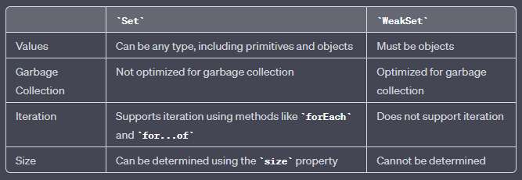
Set Vs Weak Sets

Slide 27
Knowledge check
You are working on a JavaScript application that manages a large collection of objects, and you want to ensure that these objects are not retained in memory unnecessarily.
Which data structure would be more appropriate for this scenario: Map or WeakMap, and why?

Slide 28
JS Modules
JavaScript modules are a way of organizing and structuring code in separate files, which can then be imported and used in other parts of your application.
Modules help to improve code organization, reduce duplication, and increase reusability.
Modules are implemented in modern JavaScript using the import and export statements.
Three ways of writing modules
ES6 Modules
CommonJS ( Prior to ES6)
AMD Modules( Legacy)

Slide 29
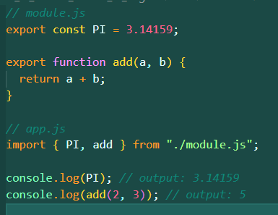
ES6 Modules- Mostly used
To use a module in another file, you need to import it using the import statement.
You can import named exports by enclosing them in curly braces {} and specifying the name of the export.

Slide 30
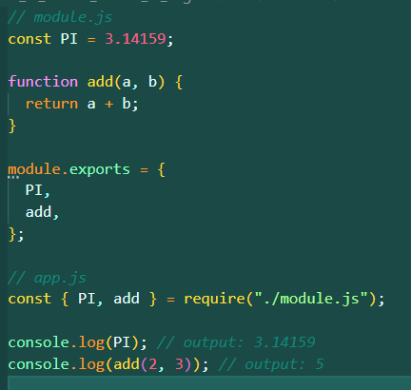
CommonJS Modules
Prior to ES6, the most common way of implementing modules in JavaScript was through the CommonJS standard.
CommonJS modules use the require() function to import modules and module.exports to export them.

Slide 31
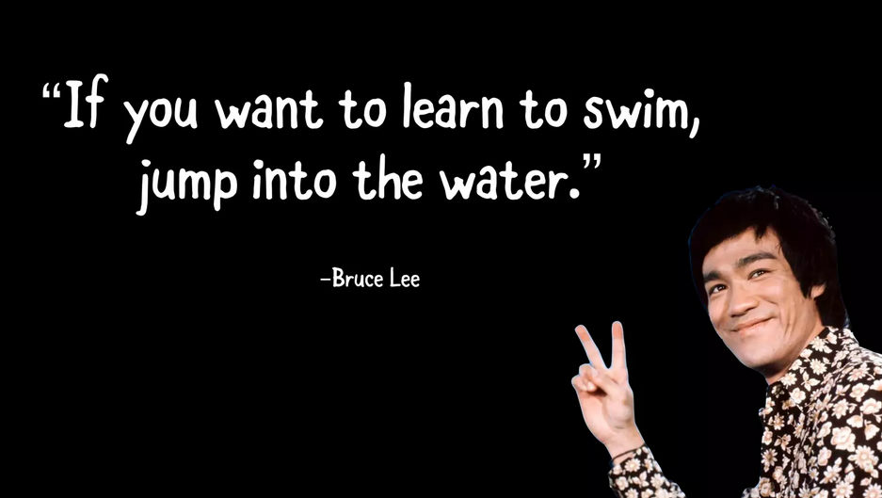
Notes:
What are some good examples of using it

Slide 32
Q & A

