Slide 1

Next JS

Slide 2
Types of Rendering
Static Page Rendering (SSG) – Static Site Generation
Static Server Rendering (SSR) – Server Side Rendering
Client Side Rendering (CSR)

Slide 3
BROWSER
SERVER
HTTP + URL
NAVIGATION
HTML PAGES
CSS
HTML + CSS
HTTP + URL
HTML + CSS
Page
Reload!

Slide 4
BROWSER
SERVER
HTTP + URL
NAVIGATION
HTML + CSS
Server PAGES
CSS
HTTP + URL
ASP
ASP .NET
JSP
PHP
Ruby
Express JS
HTML + CSS
Page
Reload!
DB

Slide 5
BROWSER
SERVER
HTTP + URL
NAVIGATION
Server PAGES
CSS
HTML + CSS + JS
AJAX - HTTP + URL
JS
Partial
Page
Reload!
PARTIAL HTML
ID
1
<table>
<thead>
<tr>
<th>ID</th>
</tr>
</thead>
<tbody>
<tr>
<td>1</td>
</tr>
</tbody>
</table>
ASP
ASP .NET
JSP
PHP
Ruby
Express JS
ASP .NET MVC
Spring MVC
Ruby On Rails
Laravel
Sails JS
DB

Slide 6
SERVER
Single Page Application (SPA)
SERVER PAGES
CSS
BROWSER
HTTP + URL
NAVIGATION
JS
HTML + CSS + JS
(Client Side JS App)
ASP
ASP .NET
JSP
PHP
Ruby
ASP .NET MVC
Spring MVC
Ruby On Rails
Laravel
<table>
<thead>
<tr>
<th>ID</th>
</tr>
</thead>
<tbody>
<tr>
<td>1</td>
</tr>
</tbody>
</table>
SERVER
AJAX - HTTP + URL
RESTful API
ASP .NET Web API
JWS
Express JS
Python
DB
JSON to HTML on Client Side
JSON
{
“id”:1
}
Vanilla JS, jQuery, KO, BB, NG 1,
NG 2 & Above, Vue JS, React JS

Slide 7
BROWSER (Client Side)
REACTDOM
REACT COMPONENT
View* (UI) – JSX
Style (CSS) – JSX / CSS
Data (Inside) – State
Data (Outside) – Props
Behaviour – Methods
Node JS App (Server Side)
REACTDOMSERVER

Slide 8
Client Side Rendering
Client Browser send request to the server using URL
Server responds back based on the URL requested with an HTML
Browser download the JS files referred on the page.
Once the JS files are downloaded, Browser executes React App.
Page now is Viewable and is enabled with interactions.

Slide 9
Pros and Cons of Client-Side
Pros of Client-Side Rendering:
Rich site interactions
Fast website rendering after the initial load.
Great for web applications.
Robust selection of JavaScript libraries.
Cons of Client-Side Rendering:
Low SEO if not implemented correctly.
Initial load might require more time.
In most cases, requires an external library.

Slide 10
Server Side Rendering
Client Browser send request to the server using URL
Server responds back based on the URL requested, with an rendered HTML.
Browser renders the page which viewable and download the JS files referred on the page.
Once the JS files are downloaded, Browser executes React Code.
Page now is enabled with interactions.

Slide 11
Pros and Cons of Server-Side
Pros of Server-Side Rendering :
Search engines can crawl the site for better SEO.
The initial page load is faster.
Great for static sites.
Cons of Server-Side Rendering:
Frequent server requests.
An overall slow page rendering.
Full page reloads.
Non-rich site interactions

Slide 12
Next JS
Next.js is used for server-side rendering of react application.
Some core features of Next.js are:
Server rendering React Apps.
Automatic code splitting and lazy loading.
Built in CSS support.
Hot Reloading support.

Slide 13
React
Components
ES 2015 +
(Multiple Files)
Manual Configuration
Installed next
Installed react
installed react-dom
Configure the “npm run dev” command to run next in dev mode
Next JS Compiler
Babel
Preset (Env)
Preset (React)
Polyfill (core-js
Next JS
Build & Deploy your
Project on Local Server
npm start
Browser Compatible Files
(Multiple Files)
WEBPACK
CLI
WEBPACK-DEV-
SERVER
Bundling
BROWSER
WEBPACK
Single File / Set of Files
Local
HTTP Server
HTML PAGE
Deploy
Inject Bundles

Slide 14
React
Components
ES 2015 +
(Multiple Files)
Auto Configuration
CLI (create-next-app)
Next JS Compiler
Babel
Preset (Env)
Preset (React)
Polyfill (core-js
Next JS
Build & Deploy your
Project on Local Server
npm start
Browser Compatible Files
(Multiple Files)
WEBPACK
CLI
WEBPACK-DEV-
SERVER
Bundling
BROWSER
WEBPACK
Single File / Set of Files
Local
HTTP Server
HTML PAGE
Deploy
Inject Bundles

Slide 15
Using Next CLI
To Create a new application
npx create-next-app
cd <app-name>
Commands available in the application
npm run dev
Starts the development server.
npm run build
Bundles the app into static files for production.
npm run start
Build and run in production.

Slide 16
Web Performance & Core Web Vitals
Web Vitals is an initiative created by Google to provide unified guidance and metrics to measure end-user page experience on the web.
Core Web Vitals is a subset of Web Vitals, and currently consists of three metrics that measure loading, interactivity, and visual stability.
These metrics are
Largest Contentful Paint (LCP)
First Input Delay (FID)
Cumulative Layout Shift (CLS).
Achieving a great score in these three metrics will create a smoother website experience for your users.
Websites scoring poorly in each of the Core Web Vitals metrics will impact its search engine ranking.

Slide 17
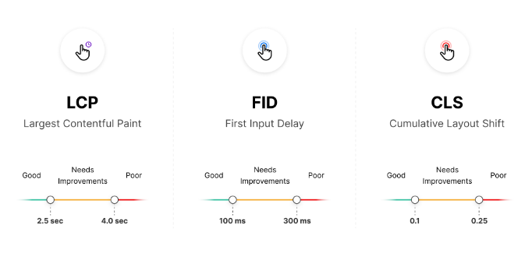
Core Web Vitals
There are three different values when measuring Core Web Vitals: "Good", "Needs Improvement", and "Poor".

Slide 18
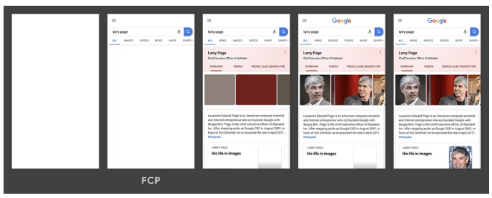
First Contentful Paint
The First Contentful Paint (FCP) metric measures the time from when the page starts loading to when any part of the page's content is rendered on the screen.
For this metric, "content" refers to text, images (including background images), <svg> elements, or non-white <canvas> elements.

Slide 19
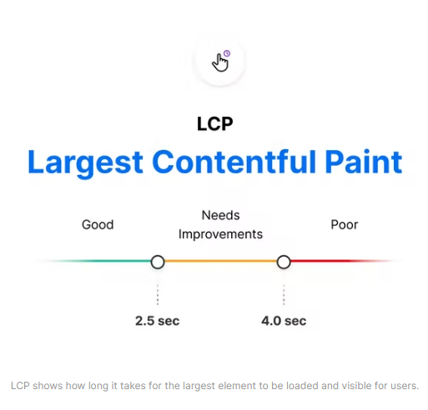
Largest Contentful Paint (LCP)
The Largest Contentful Paint (LCP) metric looks at the loading performance of your page.
LCP measures the time it takes to get the largest element on the page visible within the viewport.
This could be a large text block, video, or image that takes up the primary real estate on the page.

Slide 20
FCP vs LCP
The First Contentful Paint (FCP) metric measures the time from when the page starts loading to when any part of the page's content is rendered on the screen.
The Largest Contentful Paint (LCP) metric reports the render time of the largest image or text block visible within the viewport, relative to when the page first started loading.

Slide 21
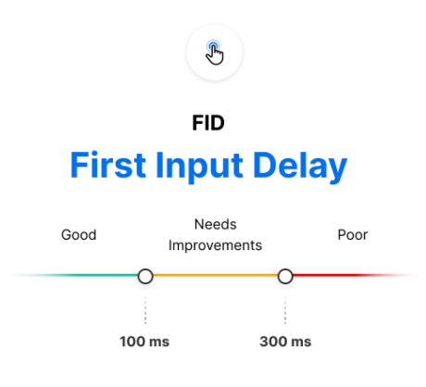
First Input Delay (FID)
The First Input Delay (FID) metric is the perception of an end user’s experience while interacting with a web page.
Imagine clicking inside an input box only for nothing to happen – this frustration with the interactivity and responsiveness of a site is caused by large input delays.
FID requires real user data and cannot be measured in the lab

Slide 22
Total Blocking Time (TBT)
The Total Blocking Time (TBT) metric measures the total amount of time between First Contentful Paint (FCP) and Time to Interactive (TTI) where the main thread was blocked for long enough to prevent input responsiveness.
Total Blocking Time (TBT) is an important lab metric for measuring load responsiveness because it helps quantify the severity of how non-interactive a page is prior to it becoming reliably interactive.

Slide 23
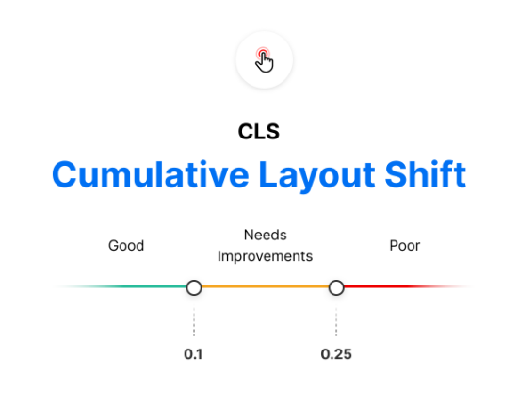
Cumulative Layout Shift (CLS)
The Cumulative Layout Shift (CLS) metric is a measure of your site’s overall layout stability.
A site that unexpectedly shifts layout as the page loads can lead to accidental user error and distraction.
Cumulative Layout Shift (CLS) occurs when elements have been shifted after initially being rendered by the DOM.

Slide 24
next/image
Next.js 10 introduced a built-in image component with automatic optimization capabilities, and this has been one of the most important features ever added to Next.js.
This was developed with the Core Web Vitals scores in mind, which are an important measurement of user experience and are factored into the Google search rankings.
Optimizations the <Image /> component include:
Faster page load: Next.js images will only be loaded when entering the viewport, being lazy-loaded by default.
Responsiveness: images will be resized according to the device used.
Visual stability: the cumulative layout shift problem is automatically avoided.
Improved performance: Next.js images can be resized and encoded on-demand, even when they are stored on remote servers or an external data source, such as CMS. This prevents you from having to create images with different sizes at build time, making it faster.

Slide 25
Next/image Layouts
intrinsic:
This is the behavior adopted by default.
The image will be adjusted visually on smaller viewports and maintain the original dimensions for larger viewports.
The height and width provided as props will act as the maximum dimensions for the image.
fixed:
The image dimensions will not change as the viewport changes.
There is no resizing or responsiveness, just as happens with the HTML <img> tag.
responsive:
The image will be scaled down for smaller viewports and scaled up for larger viewports.
fill:
The image will scale both width and height to the dimensions of the parent element, provided that the latter has position: relative in its stylesheet.
When using this layout width and height do not have to match image dimensions.

Slide 26
Data Fetching
Data fetching in Next.js allows you to render your content in different ways, depending on your application's use case.
SSR: Server-side rendering - On each Request
getServiceSideProps()
SSG: Static-site generation - On Build
getStaticProps()
CSR: Client-side rendering
useEffect()
useSWR()
ISR: Incremental Static Regeneration
getStaticProps() with revalidate

Slide 27
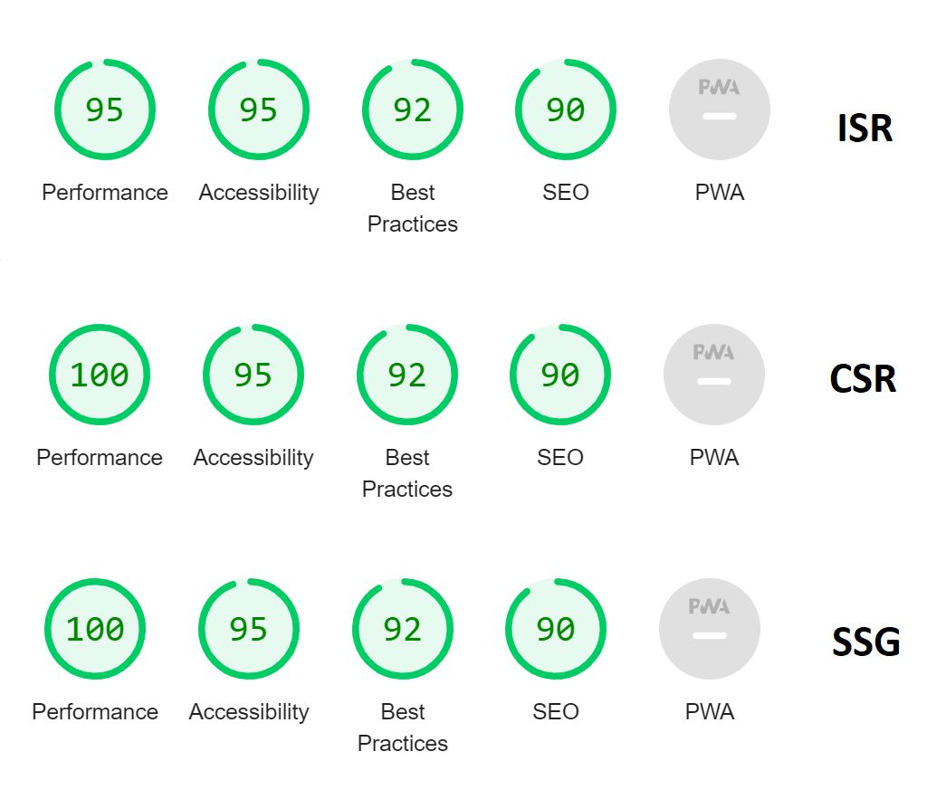

Slide 28
Routing
Next.js uses the file system to enable routing in the app.
Next automatically treats every file with the extensions .js, .jsx, .ts, or .tsx under the pages directory as a route.
A page in Next.js is a React component that has a route based on its file name.
To enable transitions between routes, we use the Link component provided by next/link.

Slide 29
API Routes
As part of our Next.js application folder structure, API routes allow us to establish RESTful endpoints.
We need to establish a folder named ‘api’ within the page folder, and within that folder, we can define all APIs for our application and add business logic without having to write any additional custom server code or set up any API routes.

Slide 30
Authentication
Authentication verifies who a user is, while authorization controls what a user can access.
Next.js supports multiple authentication patterns, each designed for different use cases.
Authentication Patterns
Server-Side Authentication
Client-Side Authentication

Slide 31
Server-Side Authentication
The request is sent from the browser to a server-side page on our Next.js App.
The SSR page calls a backend API to authenticate the user session
If the session is valid the server pre-renders the requested page on the backend and sends it to the browser
If the session is invalid, the server redirects to the Sign In page.

Slide 32
Iron-session
Node.js stateless session utility using signed and encrypted cookies to store data. Works with Next.js, Express, NestJs, Fastify, and any Node.js HTTP framework.
The session data is stored in encrypted cookies ("seals"). And only your server can decode the session data. There are no session ids, making iron sessions "stateless" from the server point of view.
npm i iron-session

Slide 33
Client Side Authentication
Use static generation to server-render a loading state, followed by fetching user data client-side.
In this pattern, the request is sent from the browser to a static page on our Next.js App, our Next app immediately renders a static-loader/loading-skeleton.
After that, on the client-side (i.e., the browser), we fetch the user data by calling our Backend API.
Depending on the response from the API, we either populate the data or redirect the user to the Sign In page.

Slide 34
BROWSER
SERVER
http://localhost:3000
Login Page
http://localhost:3000/api/authenticate
Username & Password
Token in JSON Format
JSON with Token
Data

Slide 35
Contact Me
Manish Sharma | Gmail
Manish Sharma | WhatsApp
Manish Sharma | Facebook
Manish Sharma | LinkedIn

