Slide 1

TypeScript

Slide 2
“
TypeScript lets you write JavaScript the way you really want to.
TypeScript is a typed superset of JavaScript that compiles to plain JavaScript.

Slide 3

Overview
Syntax based on ECMAScript proposals
TypeScript is first and foremost a superset of JavaScript
Any regular JavaScript is valid TypeScript Code

Slide 4
Installation
Install Node LTS version - https://nodejs.org/en/
Install / Update Visual Studio Code to Latest Release - https://code.visualstudio.com/
Extensions of VS Code
AutoFileName
vscode-icons
JavaScript (ES6) code snippets
After all Extensions are installed
File Menu -> Preferences -> File Icon Theme -> Select VScode Icons

Slide 5
JAVA / CS
TS
JAVAC / CSC
TSC
Byte Code / MSIL
JavaScript
JavaScript
JIT Compiler (JVM / CLR)
JavaScript Runtime
JavaScript Runtime
Native
Native
Native
O.S.
O.S.
O.S.

Slide 6
How to install?
Global Installation
npm install -g typescript
OR
npm i -g typescript
tsc -v
Local Installation
npm install --save-dev typescript
OR
npm i -D typescript

Slide 7
Local Installation – New Project
Create a new Folder
Open the folder path in terminal window
npm init -y
Change the package.json file as required (Copy from Codepen)
npm i -D typescript@4.4.3
npm run version / npx tsc -v

Slide 8
.ts files
.ts files
Will be compiled by
Will be compiled by
Automate .ts
to .js file
Creation
Run tsc in
Watch mode
tsc
tsc
Convert to
Convert to
.js files
.js files
Refer in
Refer in
.html page
.html page
Open in
Open in
BROWSER
BROWSER

Slide 9
Local Installation – New Project
Create a new Folder
Open the folder path in terminal window
npm init -y
Change the package.json file as required
npm i -D typescript@4.4.3
Create and Configure tsconfig.json
Create a 1_FirstDemo.ts file in root folder
To run the compiler in watch mode, use the following command
npm run compile

Slide 10
Using the Shared Application
Download & extract TSDemos.zip file
Open the folder in VS Code
Open Terminal window on the folder path and run the following command
npm install
4. To run the compiler in watch mode, use the following command
npm run compile

Slide 11
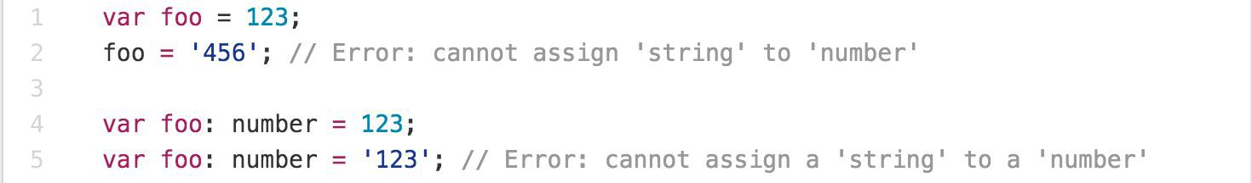
Main Goals of TypeScript
Provide an optional type system for JavaScript.
Provide planned features from future JavaScript editions to current JavaScript engines
Modular Development

Slide 12
TypeScript Features
Data Types Supported
Optional Static Type Annotation
Classes
Interface
Modules
Arrow Expressions
Type Assertions
Ambient Declarations
Source File Dependencies

Slide 13
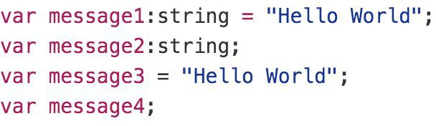
Type Inference
TypeScript tries to infer types
Four ways to variable declaration -
Type and Value in one statement
Type but no Value then Value will be undefined
Value but on Type then the it will be of Any type but maybe be inferred based on its value.
Neither Value nor Type then Type will be Any and Value will be undefined.

Slide 14
Data Types
Any
Never
Unknown
Primitive
Number
Boolean
String
Void
Null
Undefined
Array
Tuple
Enum

Slide 15
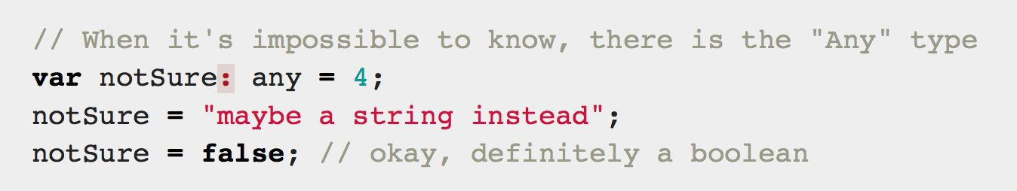
Any
Any is used when it’s impossible to determine the type

Slide 16
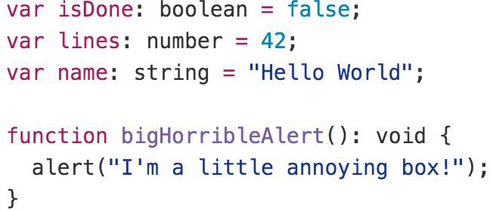
Primitive
Doesn’t have separate integers and float/double type. These all are floating point values and get the type ‘number’
boolean - true/false value
string - both single/double quote can be used
No separate char type
void - is used in function type returning nothing
null and undefined - functions as usual

Slide 17
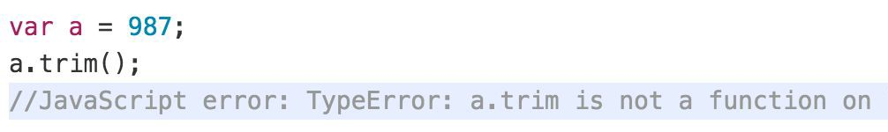
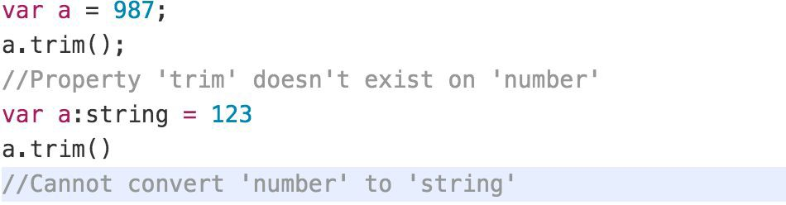
Type Annotations/Checking
JavaScript
TypeScript

Slide 18
Type Assertion
TypeScript's type assertion are purely, you telling the compiler that you know about the types better than it does, and that it should not second guess you.
Type assertion is a mechanism which tells the compiler about the type of a variable.
Type assertion is explicitly telling the compiler that we want to treat the entity as a different type.

Slide 19
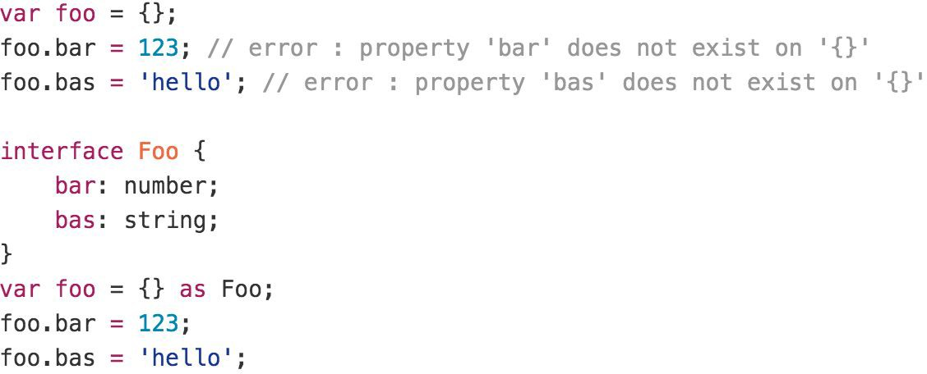
Type Assertion Example

Slide 20
Type Guards / Union Types
Type Guards allow you to narrow down the type of a variable within a conditional block.
Union types are a powerful way to express a value that can be one of the several types.
Two or more data types are combined using the pipe symbol (|) to denote a Union Type. In other words, a union type is written as a sequence of types separated by vertical bars.

Slide 21
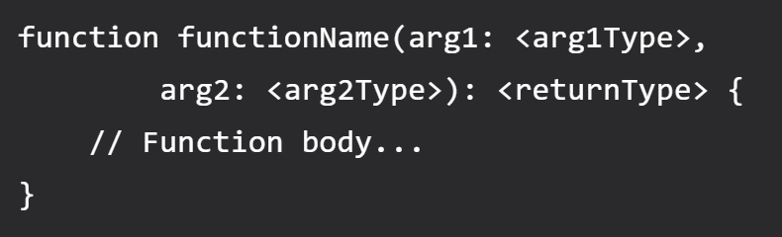
Functions
Writing a function in TypeScript is like writing them in JavaScript but with added parameters and return type. Note that any JavaScript function is a perfectly valid TypeScript function. However, we can do better by adding type.
TypeScript function syntax (with two arguments)

Slide 22
Contact Me
Manish Sharma | Gmail
Manish Sharma | WhatsApp
Manish Sharma | Facebook
Manish Sharma | LinkedIn

