Slide 1

TypeScript

Slide 2
“
TypeScript lets you write JavaScript the way you really want to.
TypeScript is a typed superset of JavaScript that compiles to plain JavaScript.

Slide 3

Overview
Syntax based on ECMAScript proposals
TypeScript is first and foremost a superset of JavaScript
Any regular JavaScript is valid TypeScript Code

Slide 4

“Microsoft's TypeScript may be the best of the many JavaScript front ends. It seems to generate the most attractive code.” - Douglas Crockford
“CoffeeScript is to Ruby as TypeScript is to Java/C#/C++.” - Luke Hoban

Slide 5
Installation
Install Node LTS version - https://nodejs.org/en/
Install / Update Visual Studio Code to Latest Release - https://code.visualstudio.com/
Extensions of VS Code
AutoFileName
vscode-icons
JavaScript (ES6) code snippets
After all Extensions are installed
File Menu -> Preferences -> File Icon Theme -> Select VScode Icons

Slide 6
JAVA / CS
TS
JAVAC / CSC
TSC
Byte Code / MSIL
JavaScript
JavaScript
JIT Compiler (JVM / CLR)
JavaScript Runtime
JavaScript Runtime
Native
Native
Native
O.S.
O.S.
O.S.

Slide 7
.ts files
.ts files
Will be compiled by
Will be compiled by
Automate .ts
to .js file
Creation
Run tsc in
Watch mode
tsc
tsc
Convert to
Convert to
.js files
.js files
Refer in
Refer in
.html page
.html page
Open in
Open in
BROWSER
BROWSER

Slide 8
How to install?
Global Installation
npm install -g typescript
OR
npm i -g typescript
tsc -v
Local Installation
npm install --save-dev typescript
OR
npm i -D typescript

Slide 9
Local Installation – New Project
Create a new Folder
Open the folder path in terminal window
npm init -y
Change the package.json file as required
npm i -D typescript@4.4.3
Create and Configure tsconfig.json
Create a 1_FirstDemo.ts file in root folder
To run the compiler in watch mode, use the following command
npm run compile

Slide 10
Using the Shared Application
Download & extract TSDemos.zip file
Open the folder in VS Code
Open Terminal window on the folder path and run the following command
npm install
4. To run the compiler in watch mode, use the following command
npm run compile

Slide 11
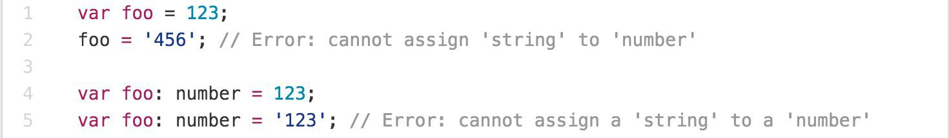
Main Goals of TypeScript
Provide an optional type system for JavaScript.
Provide planned features from future JavaScript editions to current JavaScript engines
Modular Development

Slide 12
TypeScript Features
Data Types Supported
Optional Static Type Annotation
Classes
Interface
Modules
Arrow Expressions
Type Assertions
Ambient Declarations
Source File Dependencies

Slide 13
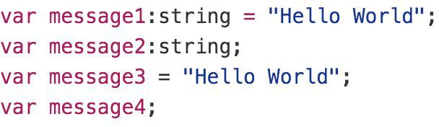
Type Inference
TypeScript tries to infer types
Four ways to variable declaration -
Type and Value in one statement
Type but no Value then Value will be undefined
Value but on Type then the it will be of Any type but maybe be inferred based on its value.
Neither Value nor Type then Type will be Any and Value will be undefined.

Slide 14
Data Types
Any
Never
Unknown
Primitive
Number
Boolean
String
Void
Null
Undefined
Array
Tuple
Enum

Slide 15
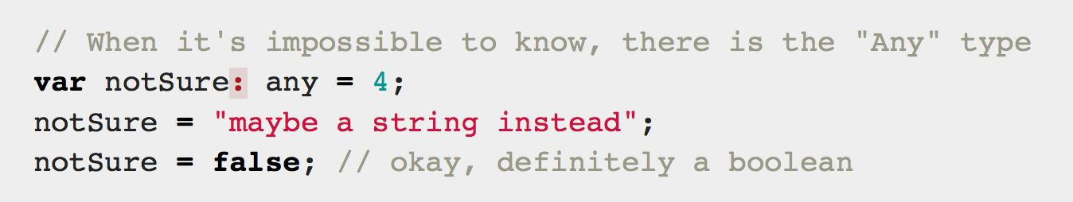
Any
Any is used when it’s impossible to determine the type

Slide 16
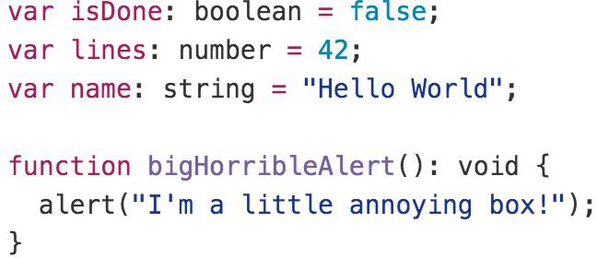
Primitive
Doesn’t have separate integers and float/double type. These all are floating point values and get the type ‘number’
boolean - true/false value
string - both single/double quote can be used
No separate char type
void - is used in function type returning nothing
null and undefined - functions as usual

Slide 17
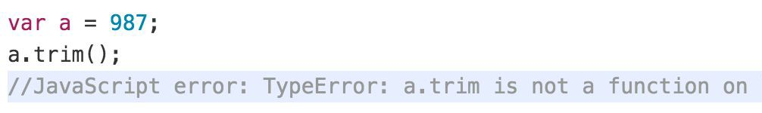
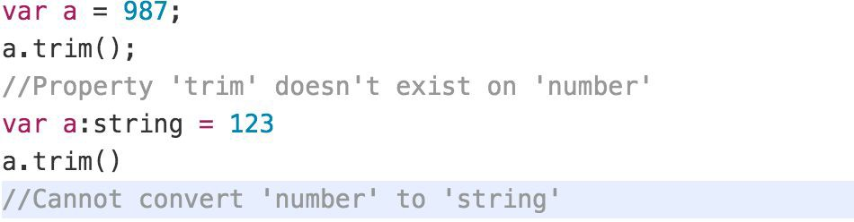
Type Annotations/Checking
JavaScript
TypeScript

Slide 18
Type Assertion
TypeScript's type assertion are purely, you telling the compiler that you know about the types better than it does, and that it should not second guess you.
Type assertion is a mechanism which tells the compiler about the type of a variable.
Type assertion is explicitly telling the compiler that we want to treat the entity as a different type.

Slide 19
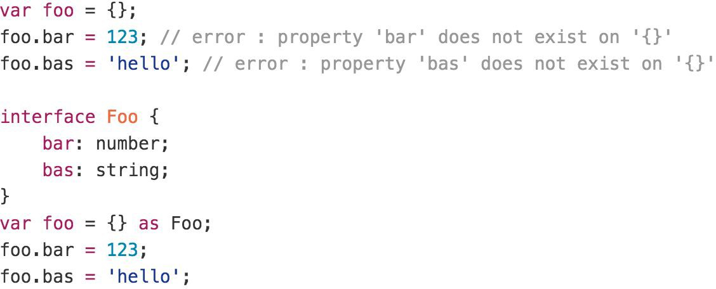
Type Assertion Example

Slide 20
Type Guards & Union Types
Type Guards allow you to narrow down the type of a variable within a conditional block.
Union types are a powerful way to express a value that can be one of the several types.
Two or more data types are combined using the pipe symbol (|) to denote a Union Type. In other words, a union type is written as a sequence of types separated by vertical bars.

Slide 21
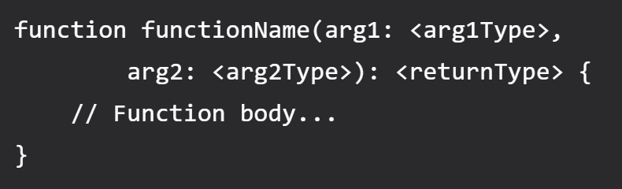
Functions
Writing a function in TypeScript is like writing them in JavaScript but with added parameters and return type. Note that any JavaScript function is a perfectly valid TypeScript function. However, we can do better by adding type.
TypeScript function syntax (with two arguments)

Slide 22
Function Parameters
Function Parameters are required, and you cannot pass extra arguments to a function
Function Parameters are also type safe, if you don't use any type explicitly
Adding an optional parameter is super simple, just add ? to the end of the argument name.
For default argument suffix it with an equal sign and default value (TS compiler will automatically deduce the type for default argument based on provided value).

Slide 23
Rest Parameter (…args)
A rest parameter allows you a function to accept zero or more arguments of the specified type.
In TypeScript, rest parameters follow these rules:
A function has only one rest parameter.
The rest parameter appears last in the parameter list.
The type of the rest parameter is an array type.
To declare a rest parameter, you prefix the parameter name with three dots and use the array type as the type annotation:

Slide 24
Lambda Expression
Implicit return
No braces for single expression
Part of ES6 termed as Arrow Functions
Lexically scoped this
You don't need to keep typing function
It lexically captures the meaning of arguments

Slide 25
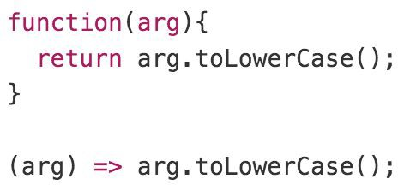
Lambda Example

Slide 26
Shallow Copy
emp2
emp1
id: 1
ename: “Manish”
address:
id: 1
ename: “Manish”
address:
city: “Mumbai”

Slide 27
Deep Copy
emp2
emp1
id: 1
ename: “Manish”
address:
id: 1
ename: “Manish”
address:
city: “Mumbai”
city: “Pune”

Slide 28
Arrays
The use of variables to store values poses the following limitations −
Variables are scalar in nature. In other words, a variable declaration can only contain a single at a time. This means that to store n values in a program n variable declarations will be needed. Hence, the use of variables is not feasible when one needs to store a larger collection of values.
Variables in a program are allocated memory in random order, thereby making it difficult to retrieve/read the values in the order of their declaration.
TypeScript introduces the concept of arrays to tackle the same.
An array is a homogenous collection of values.
An array is a collection of values of the same data type.
It is a user defined type.

Slide 29
Features of an Array
An array declaration allocates sequential memory blocks.
Arrays are static. This means that an array once initialized cannot be resized.
Each memory block represents an array element.
Array elements are identified by a unique integer called as the subscript / index of the element.
Like variables, arrays too, should be declared before they are used. Use the var keyword to declare an array.
Array initialization refers to populating the array elements.
Array element values can be updated or modified but cannot be deleted.

Slide 30
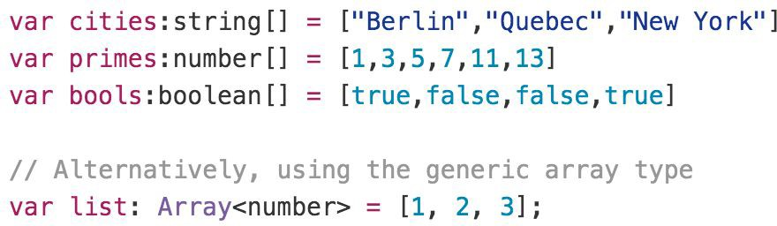
Array

Slide 31
Learn for Day 2
What are Modules in JavaScript
CommonJS
Require
System
AMD
UMD
ESModule
Learn about the other compiler options in tsconfig.json file
https://www.typescriptlang.org/tsconfig

Slide 32
Contact Me
Manish Sharma | Gmail
Manish Sharma | WhatsApp
Manish Sharma | Facebook
Manish Sharma | LinkedIn

