Slide 1
WEB DEVELOPMENT
Submitted To: Submitted By:
Atul Gaur sir Sheetija Saini

Slide 2
Table Contents
Definition
Introduction
Classification
Frontend Roadmap
Backend Roadmap
Full-Stack Developer
What does Developer do?
Tools Used
Conclusion
2
Notes:
SAY: Before we wrap up the course, let’s review what we have learned today.
During this course, we have
<READ the bullets from the slide.>
GO to next slide.

Slide 3
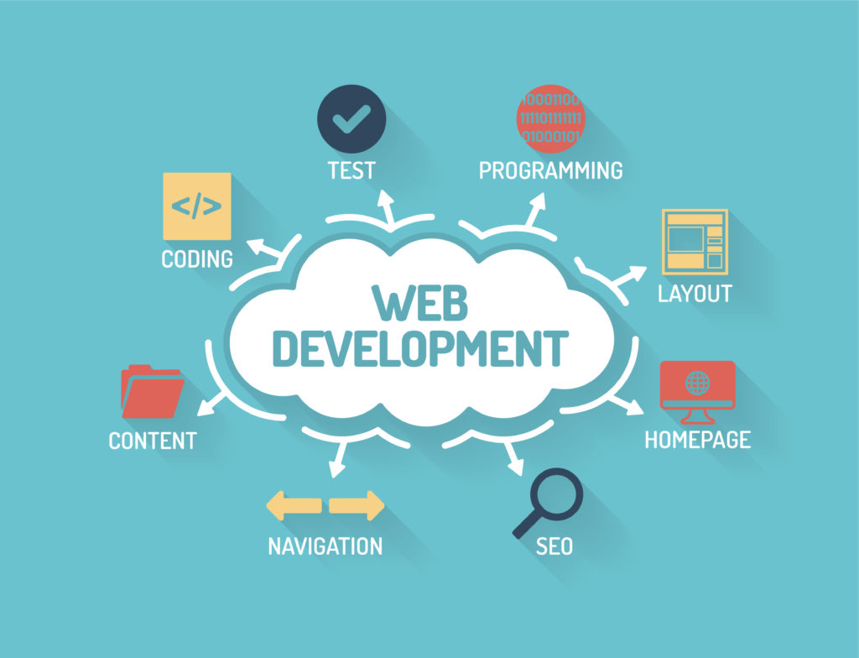
Definition
The word Web Development is made up of two words:
Web: It refers to websites, web pages or anything that works over the internet.
Development: Building the application from scratch.
3
Notes:
SAY: Before we wrap up the course, let’s review what we have learned today.
During this course, we have
<READ the bullets from the slide.>
GO to next slide.

Slide 4
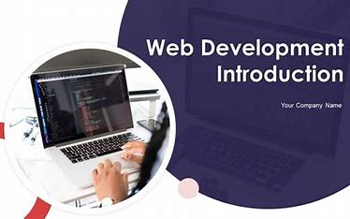
Introduction
What is Web Development?
Web development refers to the process of building and maintaining websites. It includes aspects such as web design, web content creation, client-side and server-side scripting, and network security configuration.
4
Notes:
SAY: Before we wrap up the course, let’s review what we have learned today.
During this course, we have
<READ the bullets from the slide.>
GO to next slide.

Slide 5
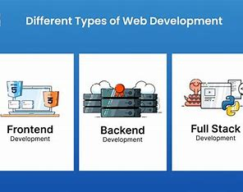
Classification
Web Development can be classified into two ways:
Frontend Development: The part of a website that the user interacts directly is termed as front end.
Backend Development: Backend is the server side of a website. It is the part of the website that users cannot see and interact.
5
Notes:
SAY: Before we wrap up the course, let’s review what we have learned today.
During this course, we have
<READ the bullets from the slide.>
GO to next slide.

Slide 6
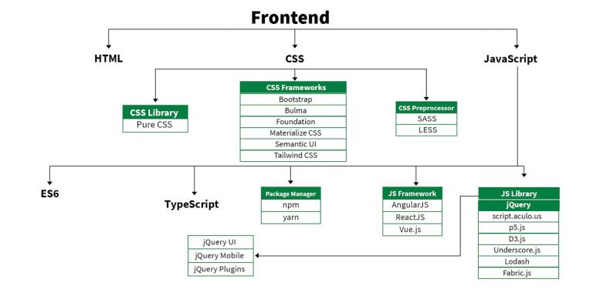
Frontend Roadmap
●●●
6
Notes:
SAY: Before we wrap up the course, let’s review what we have learned today.
During this course, we have
<READ the bullets from the slide.>
GO to next slide.

Slide 7
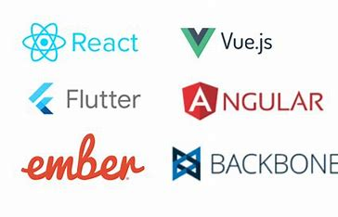
Libraries
Frontend Frameworks and Libraries:
AngularJS
React.js
VueJS
jQuery
Bootstrap
Material UI
Tailwind CSS
jQuery UI
7
Notes:
SAY: Before we wrap up the course, let’s review what we have learned today.
During this course, we have
<READ the bullets from the slide.>
GO to next slide.

Slide 8
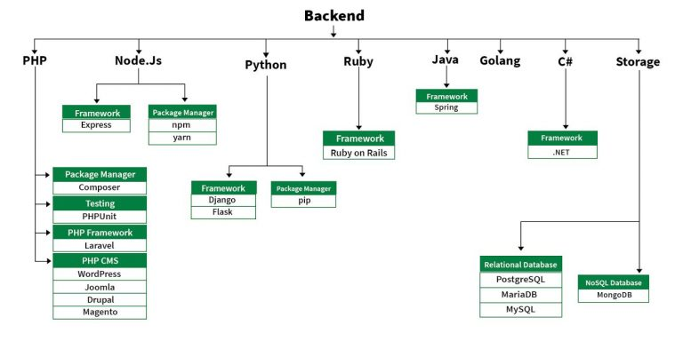
Backend Roadmap
●●●
8
Notes:
SAY:
The purpose of epidemiology in public health practice is to
discover the agent, host, and environmental factors that affect health;
determine the relative importance of causes of illness, disability, and death;
identify those segments of the population that have the greatest risk from specific causes of ill health; and
evaluate the effectiveness of health programs and services in improving population health.
GO to next slide.

Slide 9
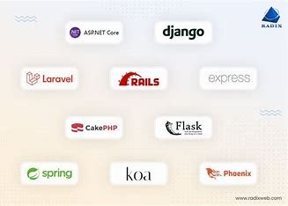
Backend frameworks
Back End Frameworks
Express,
Django,
Rails,
Laravel,
Spring, etc.
9
Notes:
SAY:
The purpose of epidemiology in public health practice is to
discover the agent, host, and environmental factors that affect health;
determine the relative importance of causes of illness, disability, and death;
identify those segments of the population that have the greatest risk from specific causes of ill health; and
evaluate the effectiveness of health programs and services in improving population health.
GO to next slide.

Slide 10
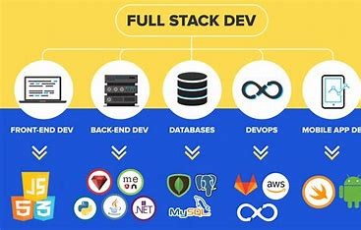
Full-Stack Developer
A full-stack developer helps build and maintain both the front-end and the back-end of a website.
Full-stack developers design and create websites and applications for various platforms
10
Notes:
SAY:
The purpose of epidemiology in public health practice is to
discover the agent, host, and environmental factors that affect health;
determine the relative importance of causes of illness, disability, and death;
identify those segments of the population that have the greatest risk from specific causes of ill health; and
evaluate the effectiveness of health programs and services in improving population health.
GO to next slide.

Slide 11
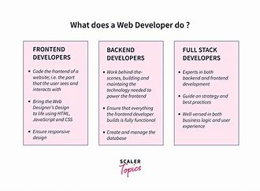
What Does Web-Developer Do?
Develop and maintain web services and interfaces
Contribute to front-end and back-end development
Build new product features or APIs
Perform tests, troubleshoot software, and fix bugs
Collaborate with other departments on projects and sprints
11
Notes:
SAY:
The purpose of epidemiology in public health practice is to
discover the agent, host, and environmental factors that affect health;
determine the relative importance of causes of illness, disability, and death;
identify those segments of the population that have the greatest risk from specific causes of ill health; and
evaluate the effectiveness of health programs and services in improving population health.
GO to next slide.

Slide 12
Tools Used
Angular JS
Apache HTTP Server
AWS
CSS
Ember.js
JavaScript
jQuery
Laravel
Microsoft SQL Server
MySQL
Nginx
Node.js
PHP
Polymer
React
Ruby on Rails
Vue.js
12
Notes:
SAY:
The purpose of epidemiology in public health practice is to
discover the agent, host, and environmental factors that affect health;
determine the relative importance of causes of illness, disability, and death;
identify those segments of the population that have the greatest risk from specific causes of ill health; and
evaluate the effectiveness of health programs and services in improving population health.
GO to next slide.

Slide 13
Conclusion
The conclusion of web development is that it is a process used to create a website or web application. This process includes developing both front-end and back-end components.
The front-end component is what makes up the look and feel of the site, while the back-end component focuses on functionality. Web development is typically a collaborative effort between designers, developers, and clients in order to create an effective end product that meets everyone’s needs and expectations.
13
Notes:
SAY:
The purpose of epidemiology in public health practice is to
discover the agent, host, and environmental factors that affect health;
determine the relative importance of causes of illness, disability, and death;
identify those segments of the population that have the greatest risk from specific causes of ill health; and
evaluate the effectiveness of health programs and services in improving population health.
GO to next slide.

Slide 14


