Slide 1

Hostler Squad
React-News
Teamsize : 7 members
(Atleast 1 female member)

Slide 2
Agenda
Introduction
Problem statement
Website concept
Key features
Benefits & impact

Slide 3
Problem Statement
Current Issues:
News fragmentation: Users must visit multiple websites for comprehensive news.
Difficulty in identifying the most impactful stories amidst the noise.
Opportunity:
Develop a centralized platform that aggregates, ranks, and curates top news from various sources.

Slide 4


Website Concept
Overview: A platform that aggregates
news stories from multiple leading channels
Mission Statement: To simplify news consumption by providing a one-stop-shop for top-ranked news stories.
Target Audience: General public, news learner, professionals.

Slide 5
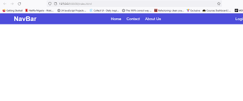
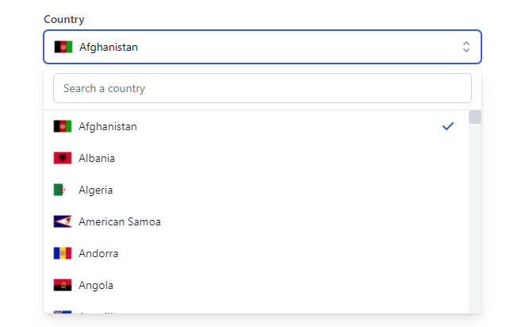
Existing Phase:
Existing phase includes :
It’s have website logo with name in a navbar.
It’s contain news according to their platform which they want to show.
Existing website is developed by outdated software environment that load the page and consume time.
These websites does not contain any type of option to chose news according to the countries.

Slide 6



Updated Phase:
Updated phase includes :
In our website logo , advanced-navbar ,choosing dropdown
,search bar etc. are integrated.
Our website is developed in a React JS that provide the facility of no loading page.
Also embedded Map to watch news according to the viewer location.

Slide 7
Advantages of news websites:
1. Instant updates : News is constantly updated in real-time.
2. Multimedia content : Includes videos, interactive graphics, etc.
3. Global reach : Accessible from anywhere with an internet connection.

Slide 8
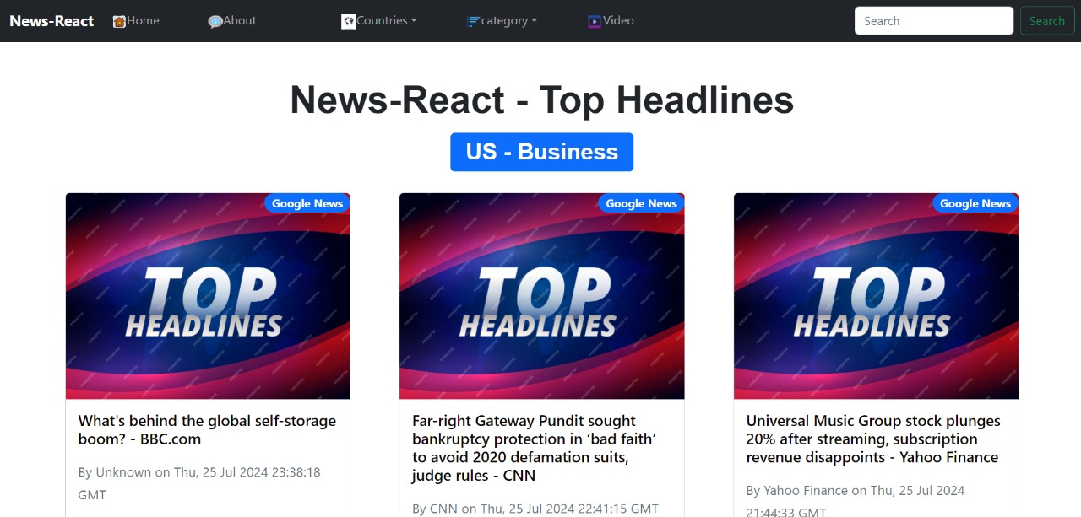
User Interface Design
Home Page :
Overview of the layout with top-ranked stories and trending topics.
About Page :
To show the more different type of content.
Category Page :
Design of pages for different news categories.
Country Page:
In this we select the more country and
see the news.
Videos Page :
Include visual videos or Different key pages.
Search Page :
In this we search any type of categories .

Slide 9

Team Representators - Hostler Squad
Team Leader : Shashi Pratap Singh
Team Members :
Rashika Bhardwaj
Rajat Singh
Rahul Kumar Yadav
Manish Yadav
Virendra Kumar
Aarti Kumari

Slide 10


