Slide 1
Introduction to Database Management System

Slide 2
Database
A database is a collection of information that is organized so that it can be easily accessed, managed and updated.
Data is organized into rows, columns and tables, and it is indexed to make it easier to find relevant information.

Slide 3
Database Management System (DBMS)
Collection of interrelated data
Set of programs to access the data
DBMS contains information about a particular enterprise
DBMS provides an environment that is both convenient and
efficient to use.

Slide 4
Database Applications
Banking: all transactions
Airlines: reservations, schedules
Universities: registration, grades
Sales: customers, products, purchases
Manufacturing: production, inventory, orders, supply chain
Human resources: employee records, salaries, tax deductions

Slide 5
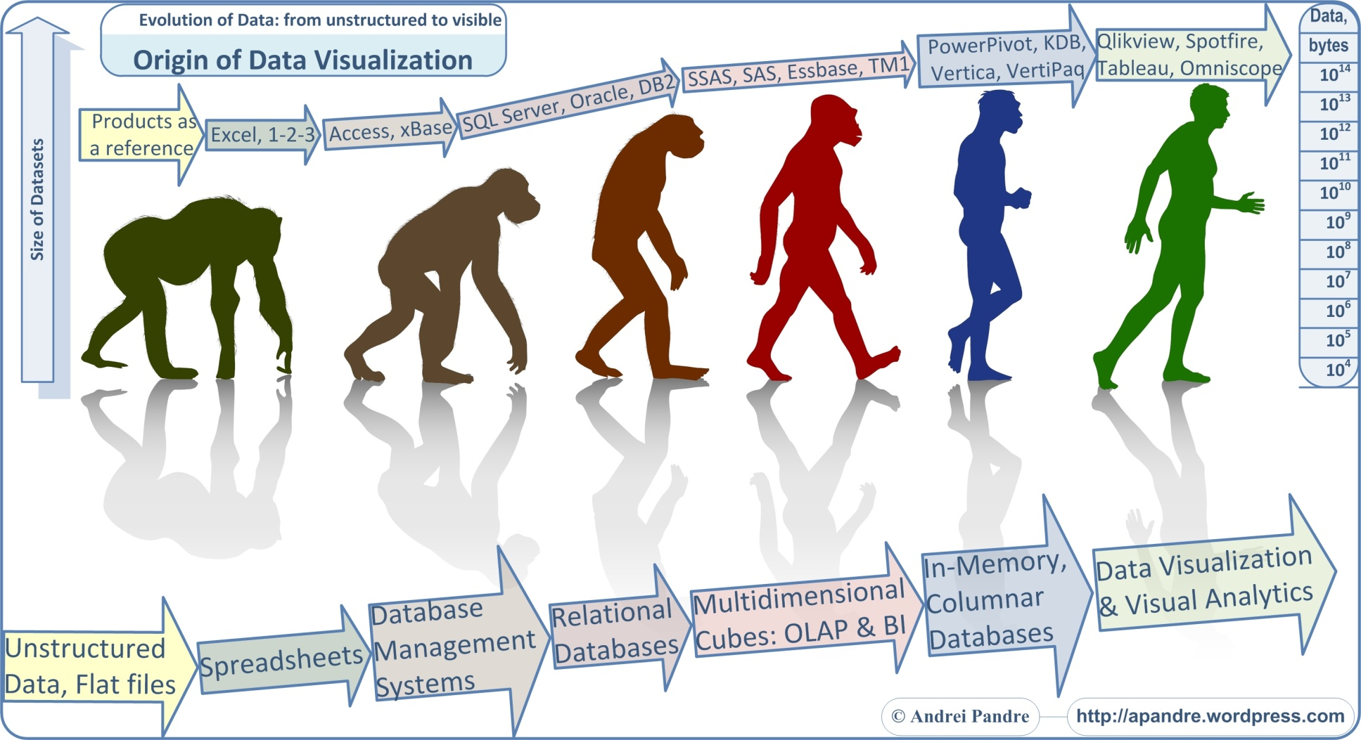
Evolution of Database

Slide 6
Purpose of Database System
In the early days, database applications were built on top of file systems
Drawbacks of using file systems to store data:
Data redundancy and inconsistency
Multiple file formats, duplication of information in different files
Difficulty in accessing data
Need to write a new program to carry out each new task
Integrity problems
Integrity constraints (e.g. account balance > 0) become part of program code.
Hard to add new constraints or change existing ones.

Slide 7
Purpose of Database System…
Drawbacks of using file systems…
Atomicity of updates.
Failures may leave database in an inconsistent state with partial updates carried out.
E.g. transfer of funds from one account to another should either complete or not happen at all
Concurrent access by multiple users.
Concurrent accessed needed for performance
Uncontrolled concurrent accesses can lead to inconsistencies
E.g. two people reading a balance and updating it at the same time
Security problems
Notes:
Atomicity is a feature of databases systems dictating where a transaction must be all-or-nothing. That is, the transaction must either fully happen, or not happen at all. It must not complete partially.

Slide 8
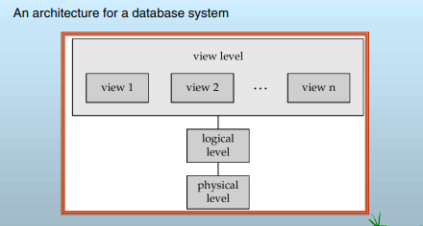
Levels of Abstraction

Slide 9
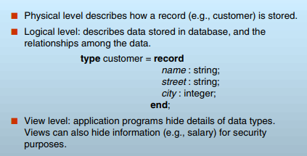
Levels of Abstraction…

Slide 10
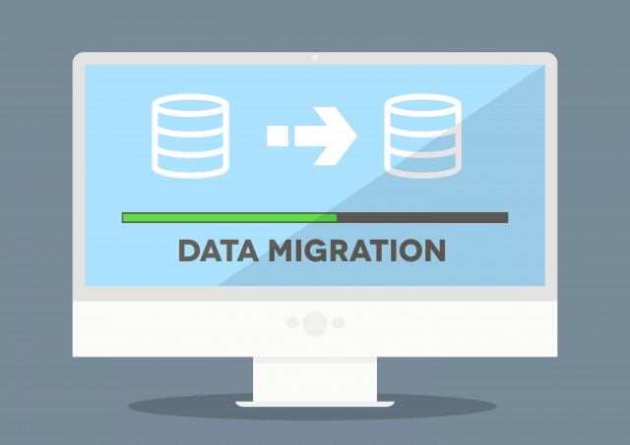
Data Migration

Slide 11
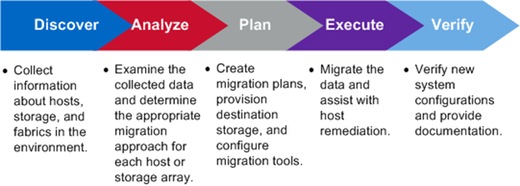
Data Migration Process

Slide 12
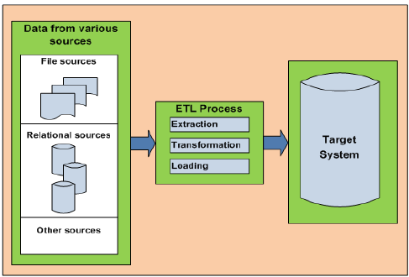
Data Migration process..

