Slide 1
DBMS | ER Model: Generalization, Specialization and Aggregation

Slide 2
Introduction
Generalization, Specialization and Aggregation in ER model are used for data abstraction in which abstraction mechanism is used to hide details of a set of objects.

Slide 3
Generalization
Generalization is the process of extracting common properties from a set of entities and create a generalized entity from it.
It is a bottom-up approach in which two or more entities can be generalized to a higher level entity if they have some attributes in common.

Slide 4
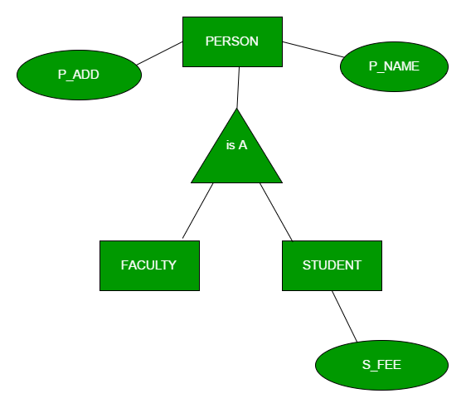
Generalization
Notes:
For Example, STUDENT and FACULTY can be generalized to a higher level entity called PERSON as shown in Figure 1. In this case, common attributes like P_NAME, P_ADD become part of higher entity (PERSON) and specialized attributes like S_FEE become part of specialized entity (STUDENT).

Slide 5
Specialization
In specialization, an entity is divided into sub-entities based on their characteristics.
It is a top-down approach where higher level entity is specialized into two or more lower level entities.

Slide 6
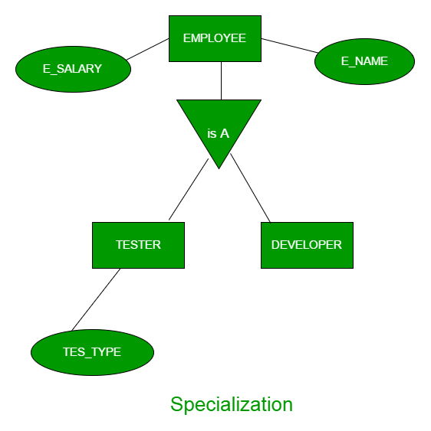
Specialization
Notes:
For Example, EMPLOYEE entity in an Employee management system can be specialized into DEVELOPER, TESTER etc. as shown in Figure 2. In this case, common attributes like E_NAME, E_SAL etc. become part of higher entity (EMPLOYEE) and specialized attributes like TES_TYPE become part of specialized entity (TESTER).

Slide 7
Aggregation
An ER diagram is not capable of representing relationship between an entity and a relationship which may be required in some scenarios.
In those cases, a relationship with its corresponding entities is aggregated into a higher level entity.

Slide 8
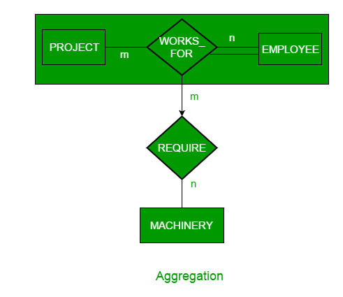
Aggregation
Notes:
For Example, Employee working for a project may require some machinery. So, REQUIRE relationship is needed between relationship WORKS_FOR and entity MACHINERY. Using aggregation, WORKS_FOR relationship with its entities EMPLOYEE and PROJECT is aggregated into single entity and relationship REQUIRE is created between aggregated entity and MACHINERY.

