Slide 1
CHAPTER 6:
INTRODUCTION TO SQL
Essentials of Database Management
Jeffrey A. Hoffer, Heikki Topi, V. Ramesh
Copyright © 2014 Pearson Education, Inc.

Slide 2
SQL OVERVIEW
Structured Query Language
The standard for relational database management systems (RDBMS)
RDBMS: A database management system that manages data as a collection of tables in which all relationships are represented by common values in related tables

Slide 3
BENEFITS OF A STANDARDIZED RELATIONAL LANGUAGE
Reduced training costs
Productivity
Application portability
Application longevity
Reduced dependence on a single vendor
Cross-system communication

Slide 4
SQL ENVIRONMENT
Catalog
  A set of schemas that constitute the description of a database
Schema
  The structure that contains descriptions of objects created by a user (base tables, views, constraints)
Data Definition Language (DDL)
  Commands that define a database, including creating, altering, and dropping tables and establishing constraints
Data Manipulation Language (DML)
  Commands that maintain and query a database
Data Control Language (DCL)
  Commands that control a database, including administering privileges and committing data

Slide 5
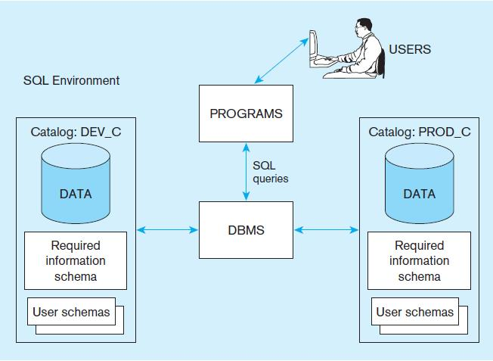
Figure 6-1
A simplified schematic of a typical SQL environment, as described by the SQL: 2008 standard
Chapter 6
Copyright © 2014 Pearson Education, Inc.

Slide 6
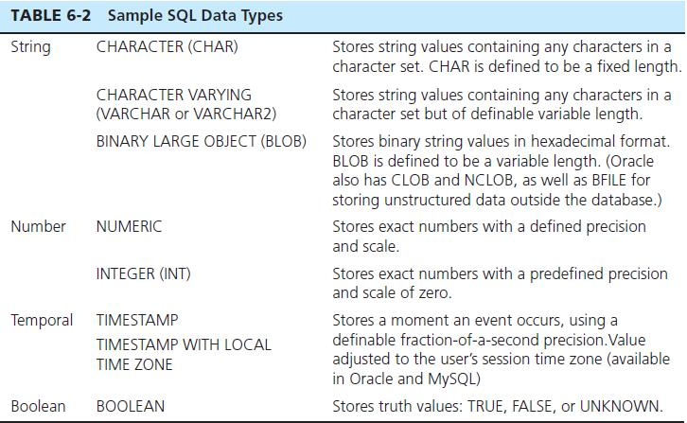
SQL DATA TYPES

Slide 7
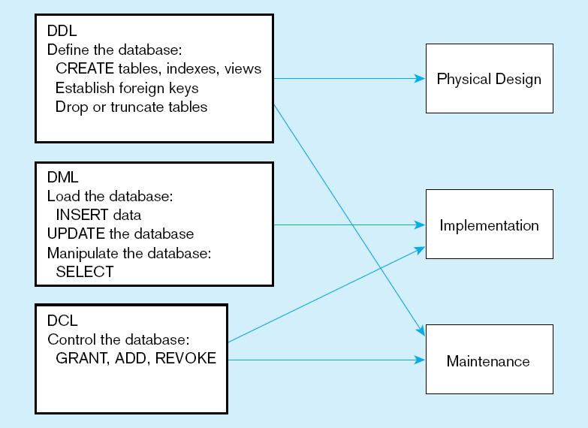
Figure 6-4
DDL, DML, DCL, and the database development process
Chapter 6
Copyright © 2014 Pearson Education, Inc.

Slide 8
SQL DATABASE DEFINITION
Data Definition Language (DDL)
Major CREATE statements:
  CREATE SCHEMA–defines a portion of the database owned by a particular user
  CREATE TABLE–defines a new table and its columns
  CREATE VIEW–defines a logical table from one or more tables or views

Slide 9
STEPS IN TABLE CREATION
Identify data types for attributes
Identify columns that can and cannot be null
Identify columns that must be unique (candidate keys)
Identify primary key–foreign key mates
Determine default values
Identify constraints on columns (domain specifications)
Create the table and associated indexes

Slide 10
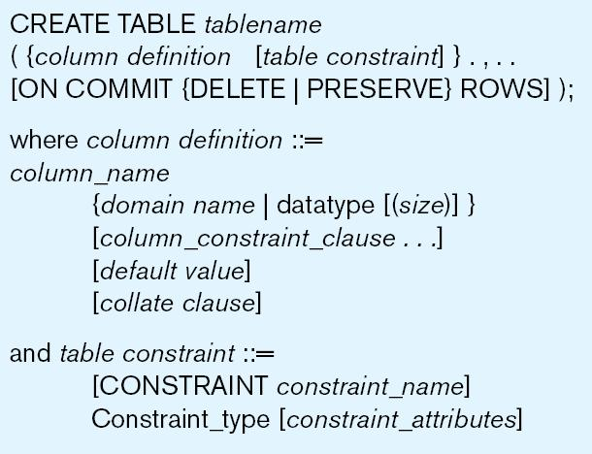
Figure 6-5 General syntax for CREATE TABLE statement used in data definition language

Slide 11
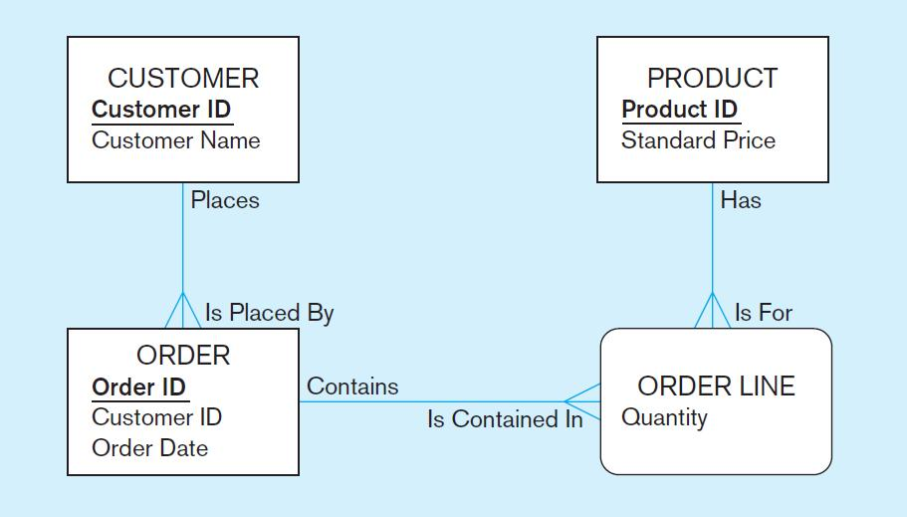
THE FOLLOWING SLIDES CREATE TABLES FOR THIS ENTERPRISE DATA MODEL
(from Chapter 1, Figure 1-3)

Slide 12
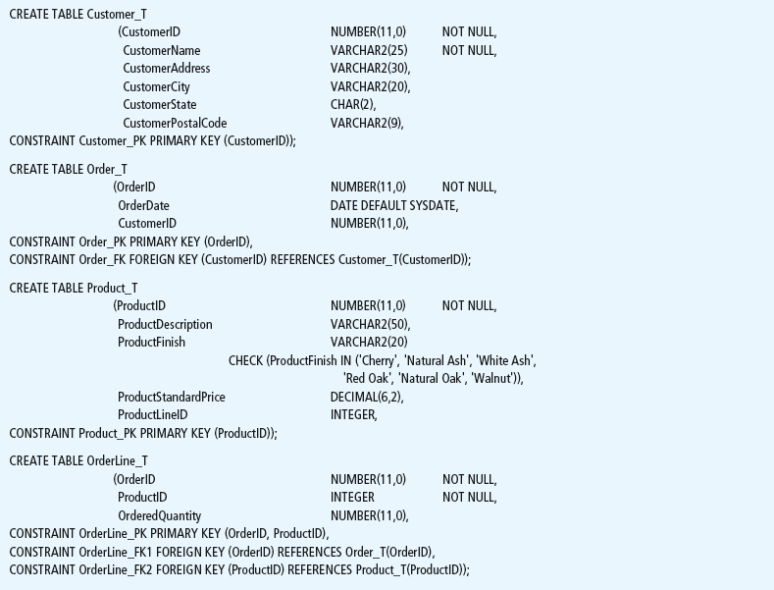
Figure 6-6 SQL database definition commands for Pine Valley Furniture Company (Oracle 11g)
Overall table definitions

Slide 13
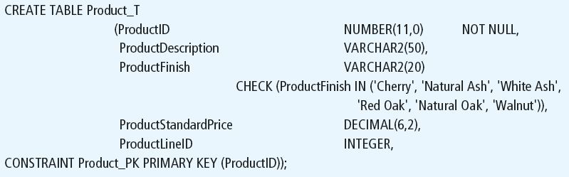
Defining attributes and their data types
Chapter 6
Copyright © 2014 Pearson Education, Inc.

Slide 14
Non-nullable specification
Primary keys can never have NULL values
Identifying primary key
Chapter 6
Copyright © 2014 Pearson Education, Inc.

Slide 15
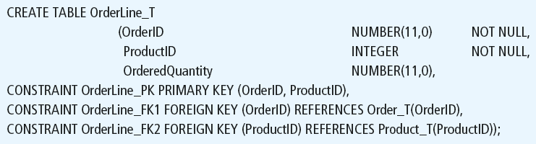
Non-nullable specifications
Primary key
Some primary keys are composite– composed of multiple attributes
Chapter 6
Copyright © 2014 Pearson Education, Inc.

Slide 16
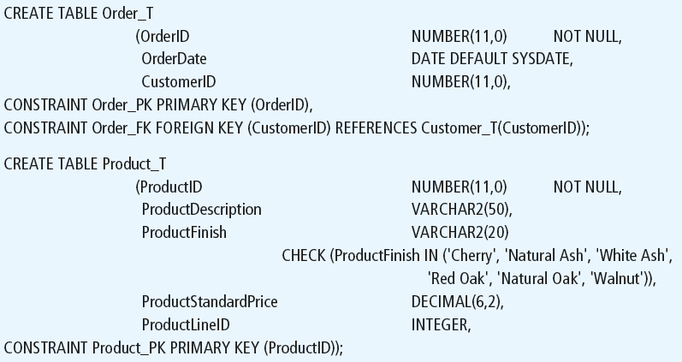
Controlling the values in attributes
Default value
Domain constraint
Chapter 6
Copyright © 2014 Pearson Education, Inc.

Slide 17
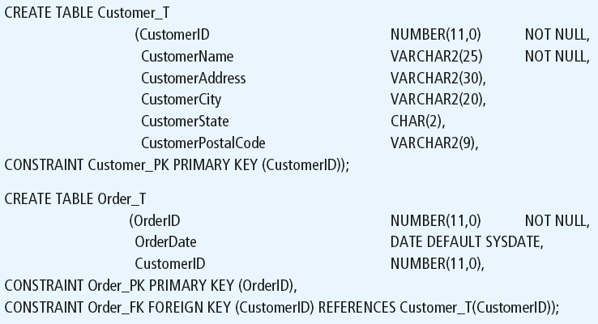
Identifying foreign keys and establishing relationships
Primary key of parent table
Foreign key of dependent table
Chapter 6
Copyright © 2014 Pearson Education, Inc.

Slide 18
DATA INTEGRITY CONTROLS
Referential integrity–constraint that ensures that foreign key values of a table must match primary key values of a related table in 1:M relationships
Restricting:
  Deletes of primary records
  Updates of primary records
  Inserts of dependent records

Slide 19

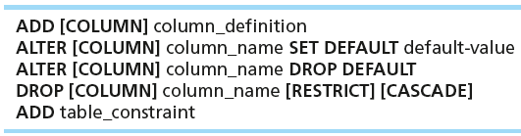

CHANGING TABLES
ALTER TABLE statement allows you to change column specifications:
Table Actions:
Example (adding a new column with a default value):

Slide 20
REMOVING TABLES
DROP TABLE statement allows you to remove tables from your schema:
  DROP TABLE CUSTOMER_T

Slide 21



INSERT STATEMENT
Adds one or more rows to a table
Inserting into a table
Inserting a record that has some null attributes requires identifying the fields that actually get data
Inserting from another table

Slide 22
DELETE STATEMENT
Removes rows from a table
Delete certain rows
  DELETE FROM CUSTOMER_T WHERE CUSTOMERSTATE = ‘HI’;
Delete all rows
  DELETE FROM CUSTOMER_T;

Slide 23

UPDATE STATEMENT
Modifies data in existing rows

Slide 24
SELECT STATEMENT
Used for queries on single or multiple tables
Clauses of the SELECT statement:
  SELECT
    List the columns (and expressions) to be returned from the query
  FROM
    Indicate the table(s) or view(s) from which data will be obtained
  WHERE
    Indicate the conditions under which a row will be included in the result
  GROUP BY
    Indicate categorization of results
  HAVING
    Indicate the conditions under which a category (group) will be included
  ORDER BY
    Sorts the result according to specified criteria

Slide 25
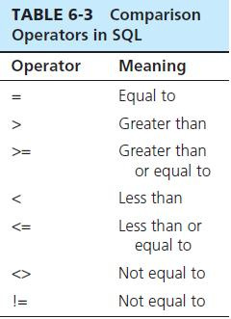

SELECT EXAMPLE
Find products with standard price less than $275
Table 6-3: Comparison Operators in SQL

Slide 26
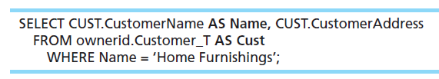
SELECT EXAMPLE USING ALIAS
Alias is an alternative column or table name
Here, CUST is a table alias and Name is a column alias

