Slide 1
Chapter 3: Relational Model
Structure of Relational Databases
Relational Algebra
Tuple Relational Calculus
Domain Relational Calculus
Extended Relational-Algebra-Operations
Modification of the Database
Views

Slide 2

Example of a Relation

Slide 3
Basic Structure
Formally, given sets D₁, D₂, …. D_{n} a relation r is a subset of
D₁ x D₂ x … x D_{n}
Thus a relation is a set of n-tuples (a₁, a₂, …, a_{n}) where
each a_{i} ∈ D_{i}
Example: if
customer-name = {Jones, Smith, Curry, Lindsay}
customer-street = {Main, North, Park}
customer-city = {Harrison, Rye, Pittsfield}
Then r = { (Jones, Main, Harrison),
(Smith, North, Rye),
(Curry, North, Rye),
(Lindsay, Park, Pittsfield)}
is a relation over customer-name x customer-street x customer-city

Slide 4
Attribute Types
Each attribute of a relation has a name
The set of allowed values for each attribute is called the domain of the attribute
Attribute values are (normally) required to be atomic, that is, indivisible
  E.g. multivalued attribute values are not atomic
  E.g. composite attribute values are not atomic
The special value null is a member of every domain
The null value causes complications in the definition of many operations
  we shall ignore the effect of null values in our main presentation and consider their effect later

Slide 5
Relation Schema
A₁, A₂, …, A_{n} are attributes
R = (A₁, A₂, …, A_{n} ) is a relation schema
E.g. Customer-schema =
(customer-name, customer-street, customer-city)
r(R) is a relation on the relation schema R
E.g. customer (Customer-schema)

Slide 6
Relation Instance
The current values (relation instance) of a relation are specified by a table
An element t of r is a tuple, represented by a row in a table
attributes
(or columns)
customer-name
customer-street
customer-city
Jones
Smith
Curry
Lindsay
Main
North
North
Park
Harrison
Rye
Rye
Pittsfield
tuples
(or rows)
customer

Slide 7
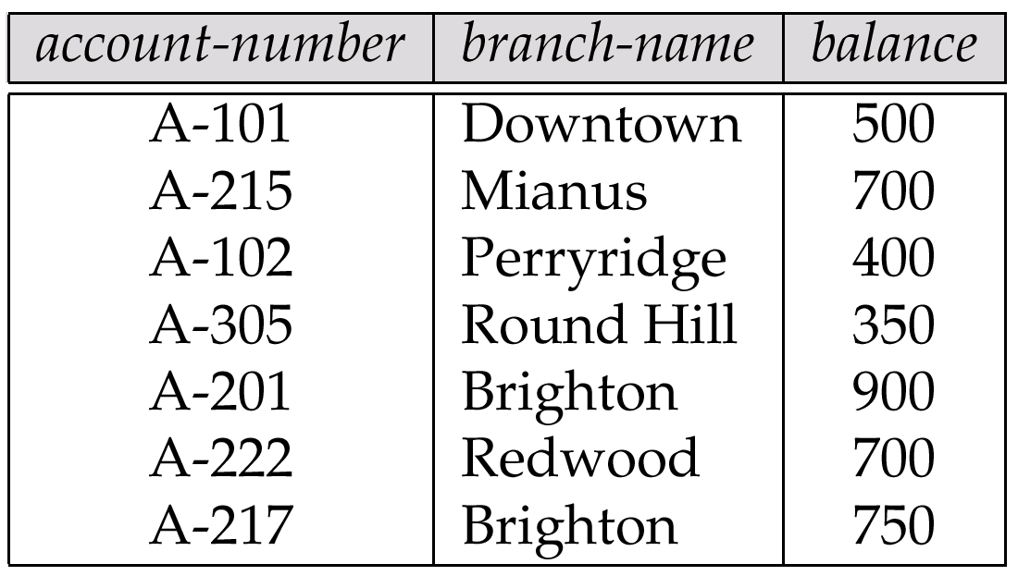
Relations are Unordered
Order of tuples is irrelevant (tuples may be stored in an arbitrary order)
E.g. account relation with unordered tuples

Slide 8
Database
A database consists of multiple relations
Information about an enterprise is broken up into parts, with each relation storing one part of the information
E.g.: account : stores information about accounts
depositor : stores information about which customer
owns which account
customer : stores information about customers
Storing all information as a single relation such as
bank(account-number, balance, customer-name, ..)
results in
  repetition of information (e.g. two customers own an account)
  the need for null values (e.g. represent a customer without an account)
Normalization theory (Chapter 7) deals with how to design relational schemas

Slide 9

The customer Relation

Slide 10

The depositor Relation

Slide 11
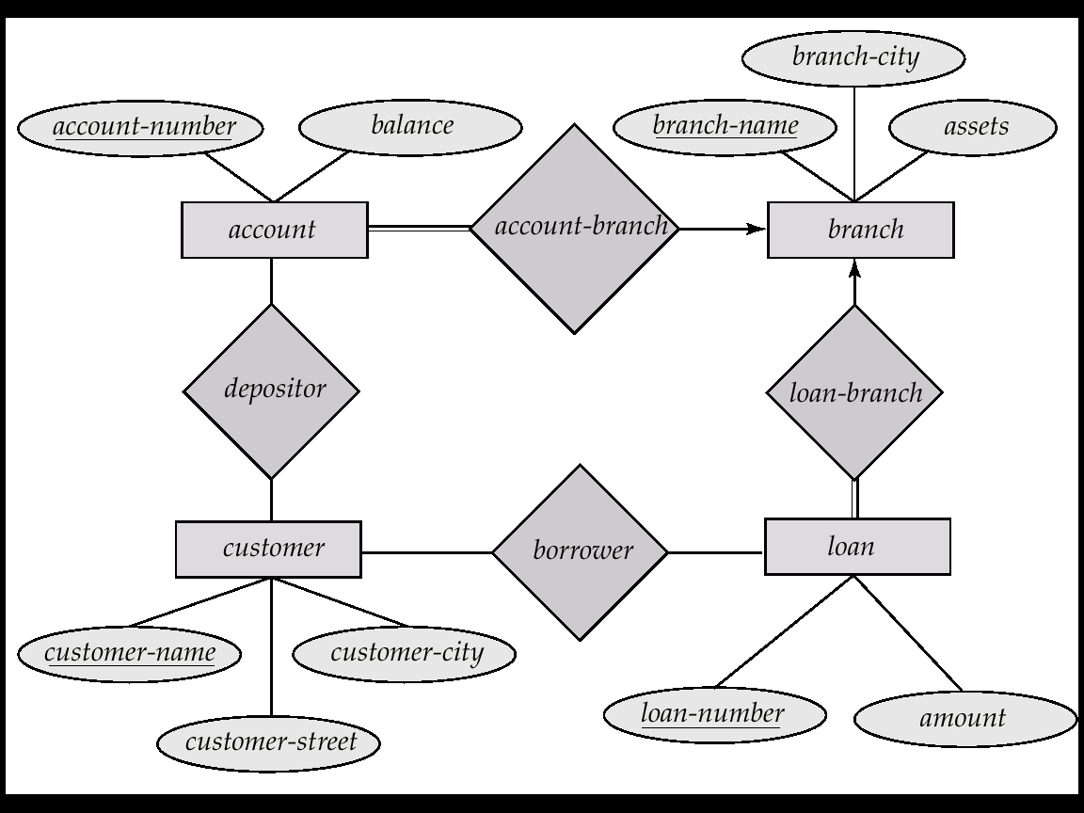
E-R Diagram for the Banking Enterprise

Slide 12
Keys
Let K ⊆ R
K is a superkey of R if values for K are sufficient to identify a unique tuple of each possible relation r(R)
  by “possible r” we mean a relation r that could exist in the enterprise we are modeling.
  Example: {customer-name, customer-street} and
  {customer-name}
  are both superkeys of Customer, if no two customers can possibly have the same name.
K is a candidate key if K is minimal
Example: {customer-name} is a candidate key for Customer, since it is a superkey (assuming no two customers can possibly have the same name), and no subset of it is a superkey.

Slide 13
Determining Keys from E-R Sets
Strong entity set. The primary key of the entity set becomes the primary key of the relation.
Weak entity set. The primary key of the relation consists of the union of the primary key of the strong entity set and the discriminator of the weak entity set.
Relationship set. The union of the primary keys of the related entity sets becomes a super key of the relation.
  For binary many-to-one relationship sets, the primary key of the “many” entity set becomes the relation’s primary key.
  For one-to-one relationship sets, the relation’s primary key can be that of either entity set.
  For many-to-many relationship sets, the union of the primary keys becomes the relation’s primary key

Slide 14

Schema Diagram for the Banking Enterprise

Slide 15
Query Languages
Language in which user requests information from the database.
Categories of languages
  procedural
  non-procedural
“Pure” languages:
  Relational Algebra
  Tuple Relational Calculus
  Domain Relational Calculus
Pure languages form underlying basis of query languages that people use.

Slide 16
Relational Algebra
Procedural language
Six basic operators
  select
  project
  union
  set difference
  Cartesian product
  rename
The operators take one or more relations as inputs and give a new relation as a result.

Slide 17
Select Operation – Example
Relation r
A
B
C
D
α
α
β
β
α
β
β
β
1
5
12
23
7
7
3
10
σ_{A=B ^ D > 5} (r)
A
B
C
D
α
β
α
β
1
23
7
10

Slide 18
Select Operation
Notation: σ _{p}(r)
p is called the selection predicate
Defined as:
σ_{p}(r) = {t | t ∈ r and p(t)}
Where p is a formula in propositional calculus consisting of terms connected by : ∧ (and), ∨ (or), ¬ (not)
Each term is one of:
<attribute> op <attribute> or <constant>
where op is one of: =, ≠, >, ≥. <. ≤
Example of selection:
σ _{branch-name=“Perryridge”}(account)

Slide 19
Project Operation – Example
A
B
C
Relation r:
α
α
β
β
10
20
30
40
1
1
1
2
A
C
A
C
∏_{A,C} (r)
α
α
β
β
1
1
1
2
α
β
β
1
1
2
=

Slide 20
Project Operation
Notation:
∏_{A1, A2, …, Ak} (r)
where A₁, A₂ are attribute names and r is a relation name.
The result is defined as the relation of k columns obtained by erasing the columns that are not listed
Duplicate rows removed from result, since relations are sets
E.g. To eliminate the branch-name attribute of account
∏_{account-number, balance} (account)

Slide 21
Union Operation – Example
Relations r, s:
A
B
A
B
α
α
β
1
2
1
α
β
2
3
s
r
r ∪ s:
A
B
α
α
β
β
1
2
1
3

Slide 22
Union Operation
Notation: r ∪ s
Defined as:
r ∪ s = {t | t ∈ r or t ∈ s}
For r ∪ s to be valid.
1. r, s must have the same arity (same number of attributes)
2. The attribute domains must be compatible (e.g., 2nd column
of r deals with the same type of values as does the 2nd
column of s)
E.g. to find all customers with either an account or a loan
∏_{customer-name} (depositor) ∪ ∏_{customer-name} (borrower)

Slide 23
Set Difference Operation – Example
Relations r, s:
A
B
A
B
α
α
β
1
2
1
α
β
2
3
s
r
r – s:
A
B
α
β
1
1

Slide 24
Set Difference Operation
Notation r – s
Defined as:
r – s = {t | t ∈ r and t ∉ s}
Set differences must be taken between compatible relations.
  r and s must have the same arity
  attribute domains of r and s must be compatible

Slide 25
Cartesian-Product Operation-Example
A
B
C
D
E
Relations r, s:
α
β
1
2
α
β
β
γ
10
10
20
10
a
a
b
b
r
s
r x s:
A
B
C
D
E
α
α
α
α
β
β
β
β
1
1
1
1
2
2
2
2
α
β
β
γ
α
β
β
γ
10
10
20
10
10
10
20
10
a
a
b
b
a
a
b
b

Slide 26
Cartesian-Product Operation
Notation r x s
Defined as:
r x s = {t q | t ∈ r and q ∈ s}
Assume that attributes of r(R) and s(S) are disjoint. (That is,
R ∩ S = ∅).
If attributes of r(R) and s(S) are not disjoint, then renaming must be used.

Slide 27
Composition of Operations
Can build expressions using multiple operations
Example: σ_{A=C}(r x s)
r x s
σ_{A=C}(r x s)
A
B
C
D
E
α
α
α
α
β
β
β
β
1
1
1
1
2
2
2
2
α
β
β
γ
α
β
β
γ
10
10
20
10
10
10
20
10
a
a
b
b
a
a
b
b
A
B
C
D
E
α
β
β
1
2
2
α
β
β
10
20
20
a
a
b

Slide 28
Rename Operation
Allows us to name, and therefore to refer to, the results of relational-algebra expressions.
Allows us to refer to a relation by more than one name.
Example:
ρ _{x} (E)
returns the expression E under the name X
If a relational-algebra expression E has arity n, then
ρ_{x} _{(A1, A2, …, An)} (E)
returns the result of expression E under the name X, and with the
attributes renamed to A1, A2, …., An.

Slide 29
Banking Example
branch (branch-name, branch-city, assets)
customer (customer-name, customer-street, customer-only)
account (account-number, branch-name, balance)
loan (loan-number, branch-name, amount)
depositor (customer-name, account-number)
borrower (customer-name, loan-number)

Slide 30
Example Queries
Find all loans of over $1200
σ_{amount > 1200} (loan)
Find the loan number for each loan of an amount greater than
$1200
∏_{loan-number} (σ_{amount} _{> 1200} (loan))

Slide 31
Example Queries
Find the names of all customers who have a loan, an account, or both, from the bank
  ∏_{customer-name} (borrower) ∪ ∏_{customer-name} (depositor)
Find the names of all customers who have a loan and an
account at bank.
  ∏_{customer-name} (borrower) ∩ ∏_{customer-name} (depositor)

Slide 32
Example Queries
Find the names of all customers who have a loan at the Perryridge branch.
∏_{customer-name} (σ_{branch-name=“Perryridge”}
(σborrower.loan-number = loan.loan-number(borrower x loan)))
Find the names of all customers who have a loan at the
Perryridge branch but do not have an account at any branch of
the bank.
∏_{customer-name} (σ_{branch-name = “Perryridge”}
(σborrower.loan-number = loan.loan-number(borrower x loan))) –
∏_{customer-name}(depositor)

Slide 33
Example Queries
Find the names of all customers who have a loan at the Perryridge branch.
  Query 1
  ∏_{customer-name}(σ_{branch-name = “Perryridge”} (
  σborrower.loan-number = loan.loan-number(borrower x loan)))
  − Query 2
  ∏_{customer-name}(σloan.loan-number = borrower.loan-number(
  (σ_{branch-name = “Perryridge”}(loan)) x borrower))

Slide 34
Example Queries
Find the largest account balance
Rename account relation as d
The query is:
∏_{balance}(account) - ∏_{account.balance}
(σ_{account.balance < d.balance} (account x ρ_{d} (account)))

Slide 35
Formal Definition
A basic expression in the relational algebra consists of either one of the following:
  A relation in the database
  A constant relation
Let E₁ and E₂ be relational-algebra expressions; the following are all relational-algebra expressions:
  E₁ ∪ E₂
  E₁ - E₂
  E₁ x E₂
  σ_{p} (E₁), P is a predicate on attributes in E₁
  ∏_{s}(E₁), S is a list consisting of some of the attributes in E₁
  ρ _{x} (E₁), x is the new name for the result of E₁

Slide 36
Additional Operations
We define additional operations that do not add any power to the
relational algebra, but that simplify common queries.
Set intersection
Natural join
Division
Assignment

Slide 37
Set-Intersection Operation
Notation: r ∩ s
Defined as:
r ∩ s ={ t | t ∈ r and t ∈ s }
Assume:
  r, s have the same arity
  attributes of r and s are compatible
Note: r ∩ s = r - (r - s)

Slide 38
Set-Intersection Operation - Example
Relation r, s:
r ∩ s
A B
A B
α
α
β
1
2
1
α
β
2
3
r
s
A B
α 2

Slide 39
Natural-Join Operation
Notation: r s
Let r and s be relations on schemas R and S respectively.
Then, r s is a relation on schema R ∪ S obtained as follows:
  Consider each pair of tuples t_{r} from r and t_{s} from s.
  If t_{r} and t_{s} have the same value on each of the attributes in R ∩ S, add a tuple t to the result, where
    t has the same value as t_{r} on r
    t has the same value as t_{s} on s
Example:
  R = (A, B, C, D)
  S = (E, B, D)
  Result schema = (A, B, C, D, E)
  r s is defined as:
  ∏_{r.A, r.B, r.C, r.D, s.E} (σ_{r.B = s.B} ∧ _{r.D = s.D} (r x s))

Slide 40
Natural Join Operation – Example
Relations r, s:
A
B
C
D
B
D
E
α
β
γ
α
δ
1
2
4
1
2
α
γ
β
γ
β
a
a
b
a
b
1
3
1
2
3
a
a
a
b
b
α
β
γ
δ
∈
r
s
r s
A
B
C
D
E
α
α
α
α
δ
1
1
1
1
2
α
α
γ
γ
β
a
a
a
a
b
α
γ
α
γ
δ

Slide 41
Division Operation
r ÷ s
Suited to queries that include the phrase “for all”.
Let r and s be relations on schemas R and S respectively where
  R = (A₁, …, A_{m}, B₁, …, B_{n})
  S = (B₁, …, B_{n})
  The result of r ÷ s is a relation on schema
  R – S = (A₁, …, A_{m})
  r ÷ s = { t | t ∈ ∏ _{R-S}(r) ∧ ∀ u ∈ s ( tu ∈ r ) }

Slide 42
Division Operation – Example
A
B
Relations r, s:
B
α
α
α
β
γ
δ
δ
δ
∈
∈
β
1
2
3
1
1
1
3
4
6
1
2
1
2
s
r ÷ s:
A
r
α
β

Slide 43
Another Division Example
Relations r, s:
A
B
C
D
E
D
E
α
α
α
β
β
γ
γ
γ
a
a
a
a
a
a
a
a
α
γ
γ
γ
γ
γ
γ
β
a
a
b
a
b
a
b
b
1
1
1
1
3
1
1
1
a
b
1
1
s
r
r ÷ s:
A
B
C
α
γ
a
a
γ
γ

Slide 44
Division Operation (Cont.)
Property
  Let q – r ÷ s
  Then q is the largest relation satisfying q x s ⊆ r
Definition in terms of the basic algebra operation
Let r(R) and s(S) be relations, and let S ⊆ R
r ÷ s = ∏_{R-S} (r) –∏_{R-S} ( (∏_{R-S} (r) x s) – ∏_{R-S,S}(r))
To see why
  ∏_{R-S,S}(r) simply reorders attributes of r
  ∏_{R-S}(∏_{R-S} (r) x s) – ∏_{R-S,S}(r)) gives those tuples t in
  ∏_{R-S} (r) such that for some tuple u ∈ s, tu ∉ r.

Slide 45
Assignment Operation
The assignment operation (←) provides a convenient way to express complex queries.
  Write query as a sequential program consisting of
    a series of assignments
    followed by an expression whose value is displayed as a result of the query.
  Assignment must always be made to a temporary relation variable.
Example: Write r ÷ s as
temp1 ← ∏_{R-S} (r)
temp2 ← ∏_{R-S} ((temp1 x s) – ∏_{R-S,S} (r))
result = temp1 – temp2
  The result to the right of the ← is assigned to the relation variable on the left of the ←.
  May use variable in subsequent expressions.

Slide 46
Example Queries
Find all customers who have an account from at least the “Downtown” and the Uptown” branches.
  Query 1
    ∏_{CN}(σ_{BN=“Downtown”}(depositor account)) ∩
    ∏_{CN}(σ_{BN=“Uptown”}(depositor account))
  where CN denotes customer-name and BN denotes
  branch-name.
  Query 2
  ∏_{customer-name, branch-name} (depositor account)
  ÷ ρ_{temp(branch-name)} ({(“Downtown”), (“Uptown”)})

Slide 47
Example Queries
Find all customers who have an account at all branches located in Brooklyn city.
∏_{customer-name, branch-name} (depositor account)
÷ ∏_{branch-name} (σ_{branch-city = “Brooklyn”} (branch))

Slide 48
Extended Relational-Algebra-Operations
Generalized Projection
Outer Join
Aggregate Functions

Slide 49
Generalized Projection
Extends the projection operation by allowing arithmetic functions to be used in the projection list.
∏ _{F1, F2, …, Fn}(E)
E is any relational-algebra expression
Each of F₁, F₂, …, F_{n} are are arithmetic expressions involving constants and attributes in the schema of E.
Given relation credit-info(customer-name, limit, credit-balance), find how much more each person can spend:
∏customer-name, limit – credit-balance (credit-info)

Slide 50
Aggregate Functions and Operations
Aggregation function takes a collection of values and returns a single value as a result.
avg: average value
min: minimum value
max: maximum value
sum: sum of values
count: number of values
Aggregate operation in relational algebra
_{G1, G2, …, Gn} g _{F1( A1), F2( A2),…, Fn( An)} (E)
  E is any relational-algebra expression
  G₁, G₂ …, G_{n} is a list of attributes on which to group (can be empty)
  Each F_{i} is an aggregate function
  Each A_{i} is an attribute name

Slide 51
Aggregate Operation – Example
Relation r:
A
B
C
α
α
β
β
α
β
β
β
7
7
3
10
sum-C
g _{sum(c)} (r)
27

Slide 52
Aggregate Operation – Example
Relation account grouped by branch-name:
branch-name
account-number
balance
Perryridge
Perryridge
Brighton
Brighton
Redwood
A-102
A-201
A-217
A-215
A-222
400
900
750
750
700
_{branch-name} g _{sum(balance)} (account)
branch-name
balance
Perryridge
Brighton
Redwood
1300
1500
700

Slide 53
Aggregate Functions (Cont.)
Result of aggregation does not have a name
  Can use rename operation to give it a name
  For convenience, we permit renaming as part of aggregate operation
_{branch-name} g _{sum(balance) as sum-balance} (account)

Slide 54
Outer Join
An extension of the join operation that avoids loss of information.
Computes the join and then adds tuples form one relation that do not match tuples in the other relation to the result of the join.
Uses null values:
  null signifies that the value is unknown or does not exist
  All comparisons involving null are (roughly speaking) false by definition.
    Will study precise meaning of comparisons with nulls later

Slide 55
Outer Join – Example
Relation loan
loan-number
branch-name
amount
L-170
L-230
L-260
Downtown
Redwood
Perryridge
3000
4000
1700
Relation borrower
customer-name
loan-number
Jones
Smith
Hayes
L-170
L-230
L-155

Slide 56
Outer Join – Example
Inner Join
loan Borrower
loan-number
branch-name
amount
customer-name
L-170
L-230
Downtown
Redwood
3000
4000
Jones
Smith
Left Outer Join
loan Borrower
loan-number
branch-name
amount
customer-name
L-170
L-230
L-260
Downtown
Redwood
Perryridge
3000
4000
1700
Jones
Smith
null

Slide 57
Outer Join – Example
Right Outer Join
loan borrower
loan-number
branch-name
amount
customer-name
L-170
L-230
L-155
Downtown
Redwood
null
3000
4000
null
Jones
Smith
Hayes
Full Outer Join
loan borrower
loan-number
branch-name
amount
customer-name
L-170
L-230
L-260
L-155
Downtown
Redwood
Perryridge
null
3000
4000
1700
null
Jones
Smith
null
Hayes

Slide 58
Null Values
It is possible for tuples to have a null value, denoted by null, for some of their attributes
null signifies an unknown value or that a value does not exist.
The result of any arithmetic expression involving null is null.
Aggregate functions simply ignore null values
  Is an arbitrary decision. Could have returned null as result instead.
  We follow the semantics of SQL in its handling of null values
For duplicate elimination and grouping, null is treated like any other value, and two nulls are assumed to be the same
  Alternative: assume each null is different from each other
  Both are arbitrary decisions, so we simply follow SQL

Slide 59
Null Values
Comparisons with null values return the special truth value unknown
  If false was used instead of unknown, then not (A < 5)
  would not be equivalent to A >= 5
Three-valued logic using the truth value unknown:
  OR: (unknown or true) = true,
  (unknown or false) = unknown
  (unknown or unknown) = unknown
  AND: (true and unknown) = unknown,
  (false and unknown) = false,
  (unknown and unknown) = unknown
  NOT: (not unknown) = unknown
  In SQL “P is unknown” evaluates to true if predicate P evaluates to unknown
Result of select predicate is treated as false if it evaluates to unknown

Slide 60
Modification of the Database
The content of the database may be modified using the following operations:
  Deletion
  Insertion
  Updating
All these operations are expressed using the assignment operator.

Slide 61
Deletion
A delete request is expressed similarly to a query, except instead of displaying tuples to the user, the selected tuples are removed from the database.
Can delete only whole tuples; cannot delete values on only particular attributes
A deletion is expressed in relational algebra by:
r ← r – E
where r is a relation and E is a relational algebra query.

Slide 62
Deletion Examples
Delete all account records in the Perryridge branch.
account ← account – σ _{branch-name = “Perryridge”} (account)
Delete all loan records with amount in the range of 0 to 50
loan ← loan – σ _{amount ≥ 0 and amount ≤ 50} (loan)
Delete all accounts at branches located in Needham.
r₁ ← σ _{branch-city = “Needham”} (account branch)
r₂ ← ∏branch-name, account-number, balance (r₁)
r₃ ← ∏ _{customer-name, account-number} (r₂ depositor)
account ← account – r₂
depositor ← depositor – r₃

Slide 63
Insertion
To insert data into a relation, we either:
  specify a tuple to be inserted
  write a query whose result is a set of tuples to be inserted
in relational algebra, an insertion is expressed by:
r ← r ∪ E
where r is a relation and E is a relational algebra expression.
The insertion of a single tuple is expressed by letting E be a constant relation containing one tuple.

Slide 64
Insertion Examples
Insert information in the database specifying that Smith has $1200 in account A-973 at the Perryridge branch.
account ← account ∪ {(“Perryridge”, A-973, 1200)}
depositor ← depositor ∪ {(“Smith”, A-973)}
Provide as a gift for all loan customers in the Perryridge
branch, a $200 savings account. Let the loan number serve
as the account number for the new savings account.
r₁ ← (σ_{branch-name = “Perryridge”} (borrower loan))
account ← account ∪ ∏branch-name, account-number,200 (r₁)
depositor ← depositor ∪ ∏_{customer-name, loan-number}(r₁)

Slide 65
Updating
A mechanism to change a value in a tuple without charging all values in the tuple
Use the generalized projection operator to do this task
r ← ∏ _{F1, F2, …, FI,} (r)
Each F_{i} is either
  the ith attribute of r, if the ith attribute is not updated, or,
  if the attribute is to be updated F_{i} is an expression, involving only constants and the attributes of r, which gives the new value for the attribute

Slide 66
Update Examples
Make interest payments by increasing all balances by 5 percent.
account ← ∏ _{AN, BN, BAL * 1.05} (account)
where AN, BN and BAL stand for account-number, branch-name and balance, respectively.
Pay all accounts with balances over $10,000 6 percent interest
and pay all others 5 percent
account ← ∏ _{AN, BN, BAL * 1.06} (σ _{BAL > 10000} (account))
∪ ∏_{AN, BN, BAL * 1.05} (σ_{BAL ≤ 10000} (account))

Slide 67
Views
In some cases, it is not desirable for all users to see the entire logical model (i.e., all the actual relations stored in the database.)
Consider a person who needs to know a customer’s loan number but has no need to see the loan amount. This person should see a relation described, in the relational algebra, by
∏_{customer-name, loan-number} (borrower loan)
Any relation that is not of the conceptual model but is made visible to a user as a “virtual relation” is called a view.

Slide 68
View Definition
A view is defined using the create view statement which has the form
create view v as <query expression
where <query expression> is any legal relational algebra query expression. The view name is represented by v.
Once a view is defined, the view name can be used to refer to the virtual relation that the view generates.
View definition is not the same as creating a new relation by evaluating the query expression
  Rather, a view definition causes the saving of an expression; the expression is substituted into queries using the view.

Slide 69
View Examples
Consider the view (named all-customer) consisting of branches and their customers.
create view all-customer as
∏_{branch-name, customer-name} (depositor account)
∪ ∏_{branch-name, customer-name} (borrower loan)
We can find all customers of the Perryridge branch by writing:
∏_{customer-name}
(σ_{branch-name = “Perryridge”} (all-customer))

Slide 70
Updates Through View
Database modifications expressed as views must be translated to modifications of the actual relations in the database.
Consider the person who needs to see all loan data in the loan relation except amount. The view given to the person, branch-loan, is defined as:
create view branch-loan as
∏_{branch-name, loan-number} (loan)
Since we allow a view name to appear wherever a relation name is allowed, the person may write:
branch-loan ← branch-loan ∪ {(“Perryridge”, L-37)}

Slide 71
Updates Through Views (Cont.)
The previous insertion must be represented by an insertion into the actual relation loan from which the view branch-loan is constructed.
An insertion into loan requires a value for amount. The insertion can be dealt with by either.
  rejecting the insertion and returning an error message to the user.
  inserting a tuple (“L-37”, “Perryridge”, null) into the loan relation
Some updates through views are impossible to translate into database relation updates
  create view v as σ_{branch-name = “Perryridge”} (account))
  v ← v ∪ (L-99, Downtown, 23)
Others cannot be translated uniquely
  all-customer ← all-customer ∪ {(“Perryridge”, “John”)}
    Have to choose loan or account, and
    create a new loan/account number!

Slide 72
Views Defined Using Other Views
One view may be used in the expression defining another view
A view relation v₁ is said to depend directly on a view relation v₂ if v₂ is used in the expression defining v₁
A view relation v₁ is said to depend on view relation v₂ if either v₁ depends directly to v₂ or there is a path of dependencies from v₁ to v₂
A view relation v is said to be recursive if it depends on itself.

Slide 73
View Expansion
A way to define the meaning of views defined in terms of other views.
Let view v₁ be defined by an expression e₁ that may itself contain uses of view relations.
View expansion of an expression repeats the following replacement step:
repeat
Find any view relation v_{i} in e₁
Replace the view relation v_{i} by the expression defining v_{i}
until no more view relations are present in e₁
As long as the view definitions are not recursive, this loop will terminate

Slide 74
Tuple Relational Calculus
A nonprocedural query language, where each query is of the form
{t | P (t) }
It is the set of all tuples t such that predicate P is true for t
t is a tuple variable, t[A] denotes the value of tuple t on attribute A
t ∈ r denotes that tuple t is in relation r
P is a formula similar to that of the predicate calculus

Slide 75
Predicate Calculus Formula
1. Set of attributes and constants
2. Set of comparison operators: (e.g., <, ≤, =, ≠, >, ≥)
3. Set of connectives: and (∧), or (v)‚ not (¬)
4. Implication (⇒): x ⇒ y, if x if true, then y is true
x ⇒ y ≡ ¬x v y
5. Set of quantifiers:
  ∃ t ∈ r (Q(t)) ≡ ”there exists” a tuple in t in relation r
  such that predicate Q(t) is true
  ∀t ∈ r (Q(t)) ≡ Q is true “for all” tuples t in relation r

Slide 76
Banking Example
branch (branch-name, branch-city, assets)
customer (customer-name, customer-street, customer-city)
account (account-number, branch-name, balance)
loan (loan-number, branch-name, amount)
depositor (customer-name, account-number)
borrower (customer-name, loan-number)

Slide 77
Example Queries
Find the loan-number, branch-name, and amount for loans of over $1200
{t | t ∈ loan ∧ t [amount] > 1200}
Find the loan number for each loan of an amount greater than $1200
{t | ∃ s ∈ loan (t[loan-number] = s[loan-number] ∧ s [amount] > 1200)}
Notice that a relation on schema [loan-number] is implicitly defined by the query

Slide 78
Example Queries
Find the names of all customers having a loan, an account, or both at the bank
{t | ∃s ∈ borrower( t[customer-name] = s[customer-name])
∨ ∃u ∈ depositor( t[customer-name] = u[customer-name])
Find the names of all customers who have a loan and an account
at the bank
{t | ∃s ∈ borrower( t[customer-name] = s[customer-name])
∧ ∃u ∈ depositor( t[customer-name] = u[customer-name])

Slide 79
Example Queries
Find the names of all customers having a loan at the Perryridge branch
{t | ∃s ∈ borrower(t[customer-name] = s[customer-name]
∧ ∃u ∈ loan(u[branch-name] = “Perryridge”
∧ u[loan-number] = s[loan-number]))}
Find the names of all customers who have a loan at the
Perryridge branch, but no account at any branch of the bank
{t | ∃s ∈ borrower( t[customer-name] = s[customer-name]
∧ ∃u ∈ loan(u[branch-name] = “Perryridge”
∧ u[loan-number] = s[loan-number]))
∧ not ∃v ∈ depositor (v[customer-name] =
t[customer-name]) }

Slide 80
Example Queries
Find the names of all customers having a loan from the Perryridge branch, and the cities they live in
{t | ∃s ∈ loan(s[branch-name] = “Perryridge”
∧ ∃u ∈ borrower (u[loan-number] = s[loan-number]
∧ t [customer-name] = u[customer-name])
∧ ∃ v ∈ customer (u[customer-name] = v[customer-name]
∧ t[customer-city] = v[customer-city])))}

Slide 81
Example Queries
Find the names of all customers who have an account at all branches located in Brooklyn:
{t | ∃ c ∈ customer (t[customer.name] = c[customer-name]) ∧
∀ s ∈ branch(s[branch-city] = “Brooklyn” ⇒
∃ u ∈ account ( s[branch-name] = u[branch-name]
∧ ∃ s ∈ depositor ( t[customer-name] = s[customer-name]
∧ s[account-number] = u[account-number] )) )}

Slide 82
Safety of Expressions
It is possible to write tuple calculus expressions that generate infinite relations.
For example, {t | ¬ t ∈ r} results in an infinite relation if the domain of any attribute of relation r is infinite
To guard against the problem, we restrict the set of allowable expressions to safe expressions.
An expression {t | P(t)} in the tuple relational calculus is safe if every component of t appears in one of the relations, tuples, or constants that appear in P
  NOTE: this is more than just a syntax condition.
    E.g. { t | t[A]=5 ∨ true } is not safe --- it defines an infinite set with attribute values that do not appear in any relation or tuples or constants in P.

Slide 83
Domain Relational Calculus
A nonprocedural query language equivalent in power to the tuple relational calculus
Each query is an expression of the form:
{ < x₁, x₂, …, x_{n} > | P(x₁, x₂, …, x_{n})}
  x₁, x₂, …, x_{n} represent domain variables
  P represents a formula similar to that of the predicate calculus

Slide 84
Example Queries
Find the loan-number, branch-name, and amount for loans of over $1200
{< l, b, a > | < l, b, a > ∈ loan ∧ a > 1200}
Find the names of all customers who have a loan of over $1200
{< c > | ∃ l, b, a (< c, l > ∈ borrower ∧ < l, b, a > ∈ loan ∧ a > 1200)}
Find the names of all customers who have a loan from the
Perryridge branch and the loan amount:
{< c, a > | ∃ l (< c, l > ∈ borrower ∧ ∃b(< l, b, a > ∈ loan ∧
b = “Perryridge”))}
or {< c, a > | ∃ l (< c, l > ∈ borrower ∧ < l, “Perryridge”, a > ∈ loan)}

Slide 85
Example Queries
Find the names of all customers having a loan, an account, or both at the Perryridge branch:
{< c > | ∃ l ({< c, l > ∈ borrower
∧ ∃ b,a(< l, b, a > ∈ loan ∧ b = “Perryridge”))
∨ ∃ a(< c, a > ∈ depositor
∧ ∃ b,n(< a, b, n > ∈ account ∧ b = “Perryridge”))}
Find the names of all customers who have an account at all
branches located in Brooklyn:
{< c > | ∃ s, n (< c, s, n > ∈ customer) ∧
∀ x,y,z(< x, y, z > ∈ branch ∧ y = “Brooklyn”) ⇒
∃ a,b(< x, y, z > ∈ account ∧ < c,a > ∈ depositor)}

Slide 86
Safety of Expressions
{ < x₁, x₂, …, x_{n} > | P(x₁, x₂, …, x_{n})}
is safe if all of the following hold:
1. All values that appear in tuples of the expression are values from dom(P) (that is, the values appear either in P or in a tuple of a relation mentioned in P).
2. For every “there exists” subformula of the form ∃ x (P₁(x)), the subformula is true if and only if there is a value of x in dom(P₁) such that P₁(x) is true.
3. For every “for all” subformula of the form ∀_{x} (P₁ (x)), the subformula is true if and only if P₁(x) is true for all values x from dom (P₁).

Slide 87
End of Chapter 3

Slide 88
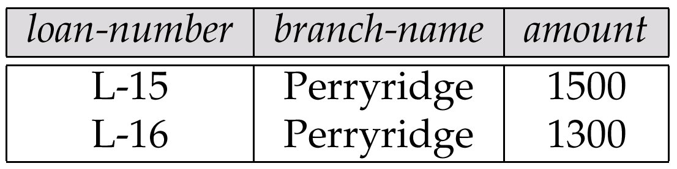
Result of σ _{branch-name = “Perryridge”} (loan)

Slide 89
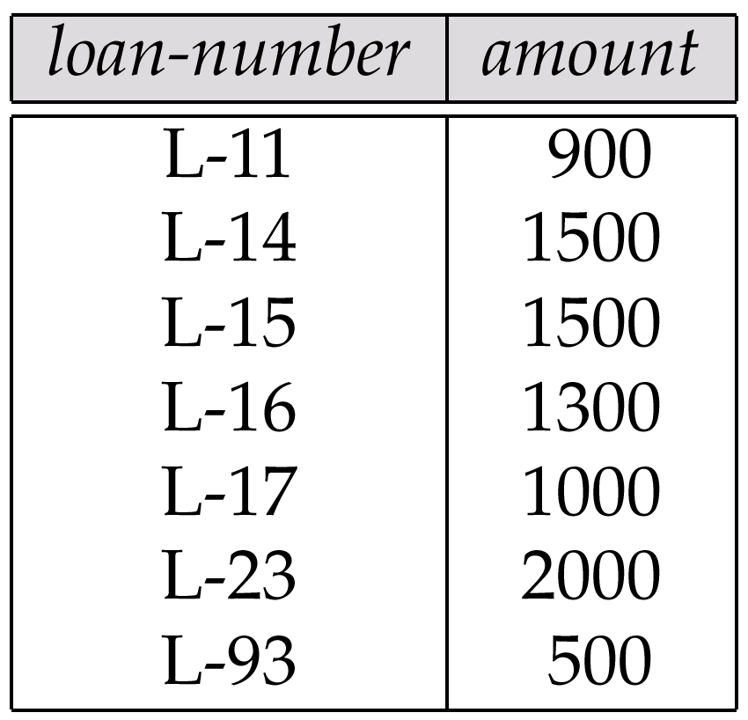
Loan Number and the Amount of the Loan

Slide 90
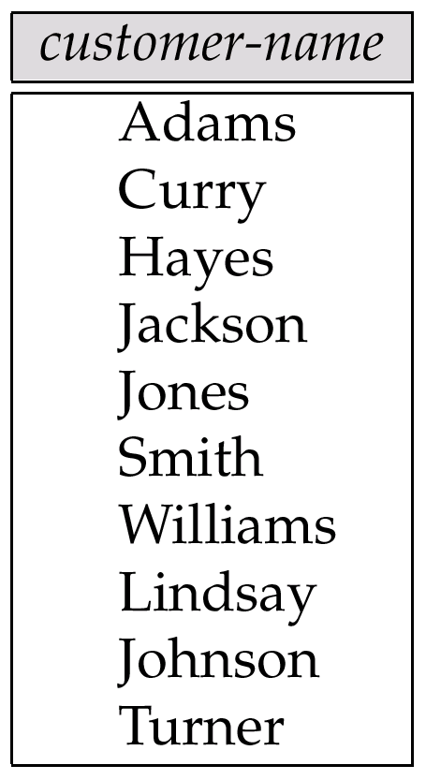
Names of All Customers Who Have Either a Loan or an Account

Slide 91
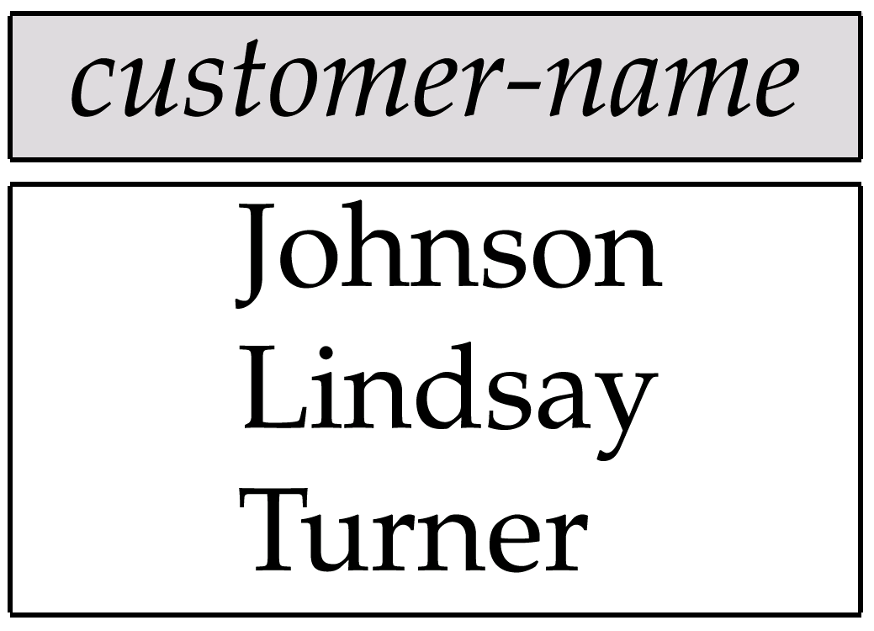
Customers With An Account But No Loan

Slide 92
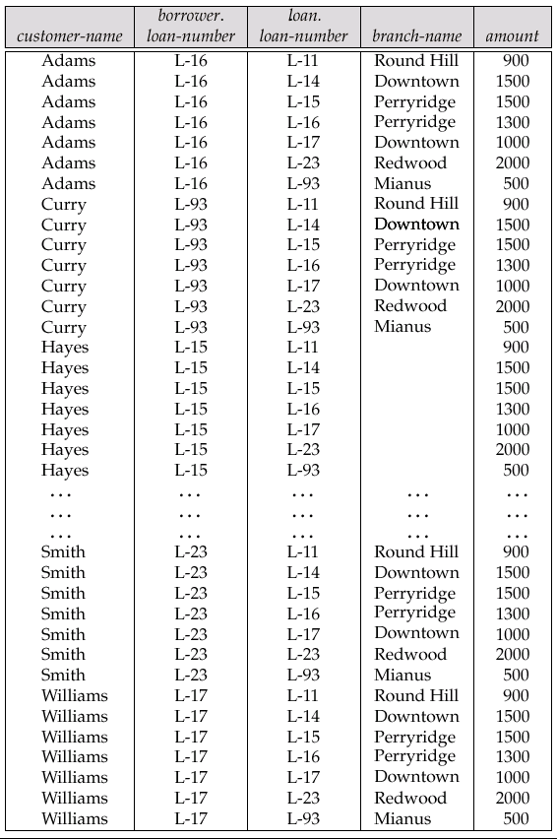
Result of borrower × loan

Slide 93
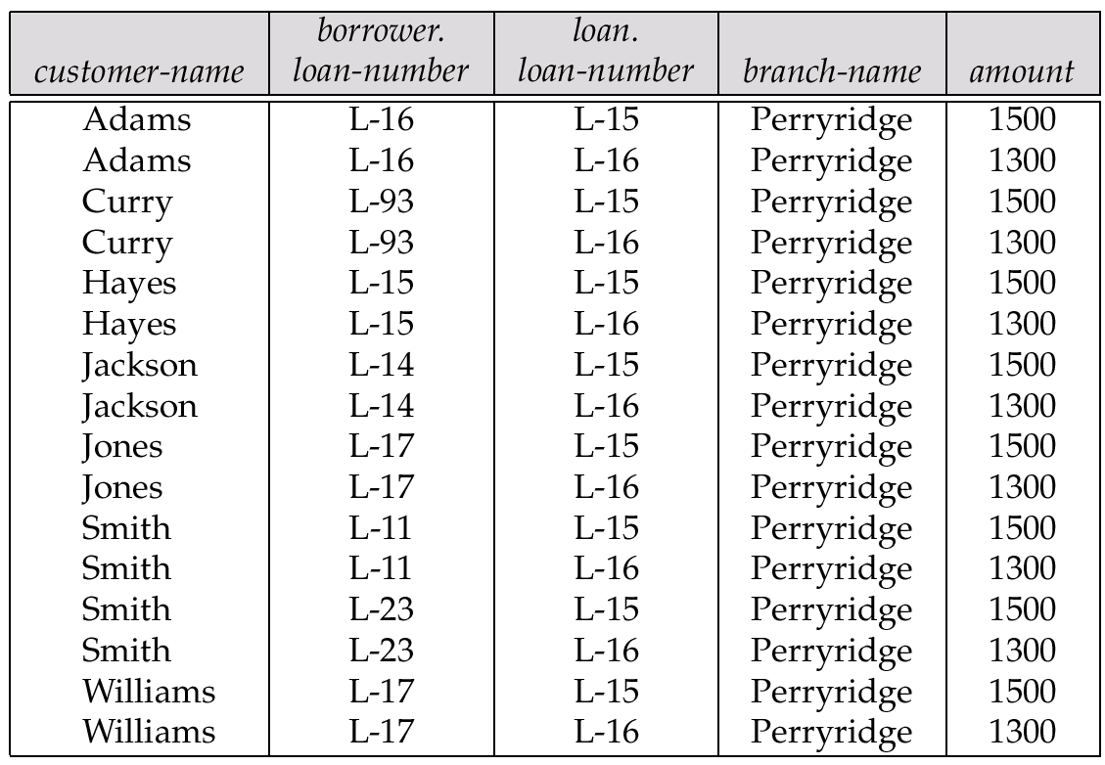
Result of σ _{branch-name = “Perryridge”} (borrower × loan)

Slide 94
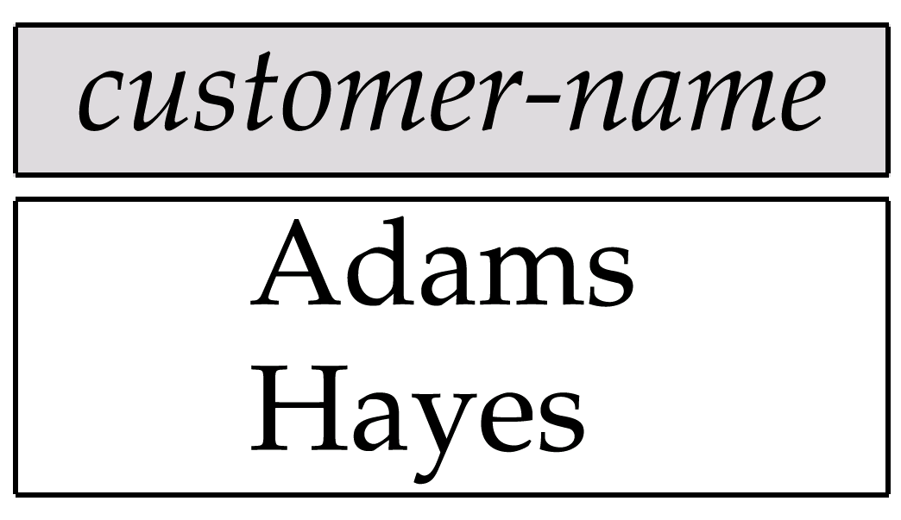
Result of Π_{customer-name}

Slide 95
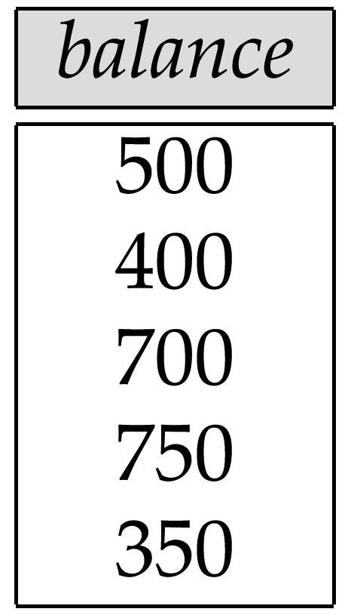
Result of the Subexpression

Slide 96
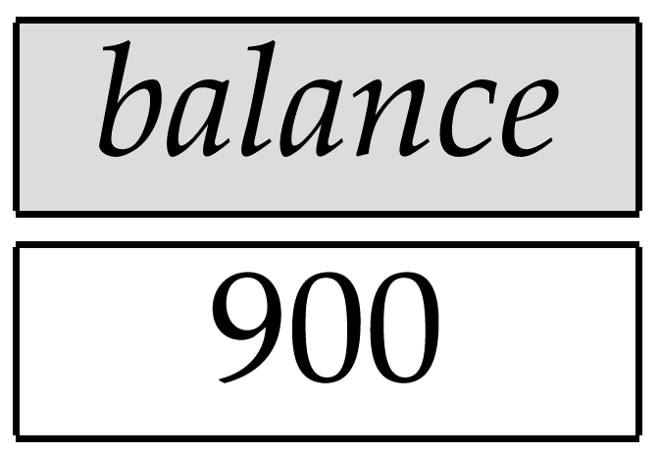
Largest Account Balance in the Bank

Slide 97
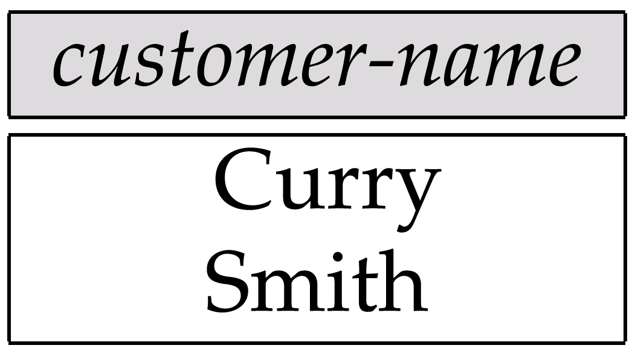
Customers Who Live on the Same Street and In the Same City as Smith

Slide 98
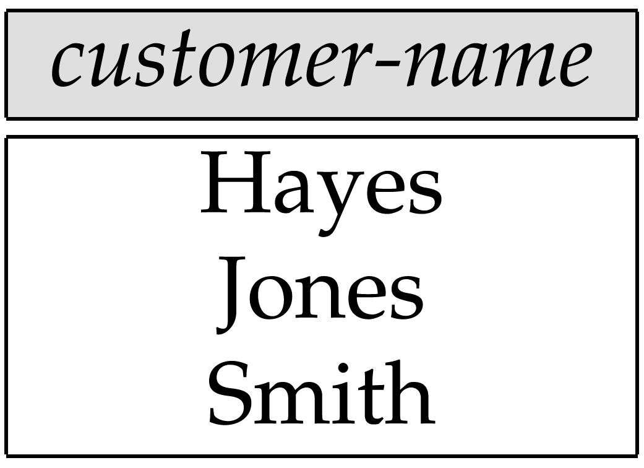
Customers With Both an Account and a Loan at the Bank

Slide 99
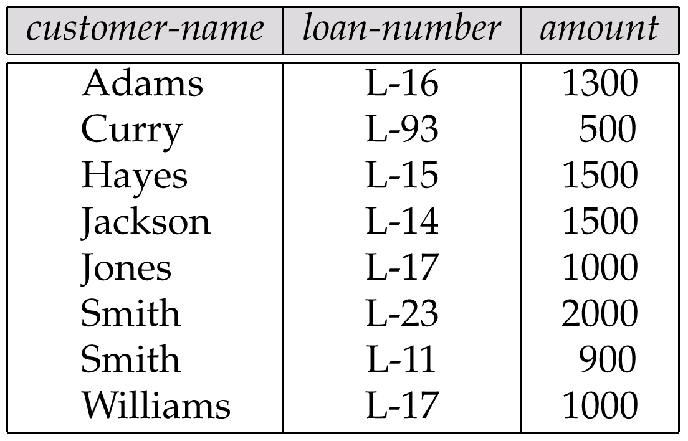
Result of Πcustomer-name, loan-number, amount (borrower loan)

Slide 100
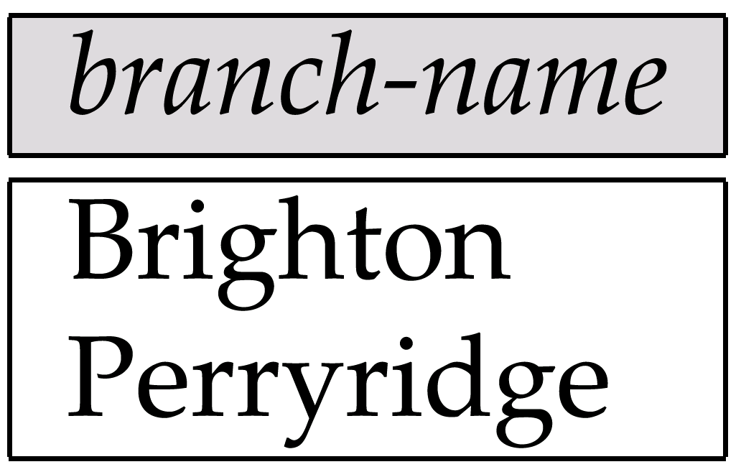
Result of Π_{branch-name}(σ_{customer-city = “Harrison”}(customer account depositor))

Slide 101
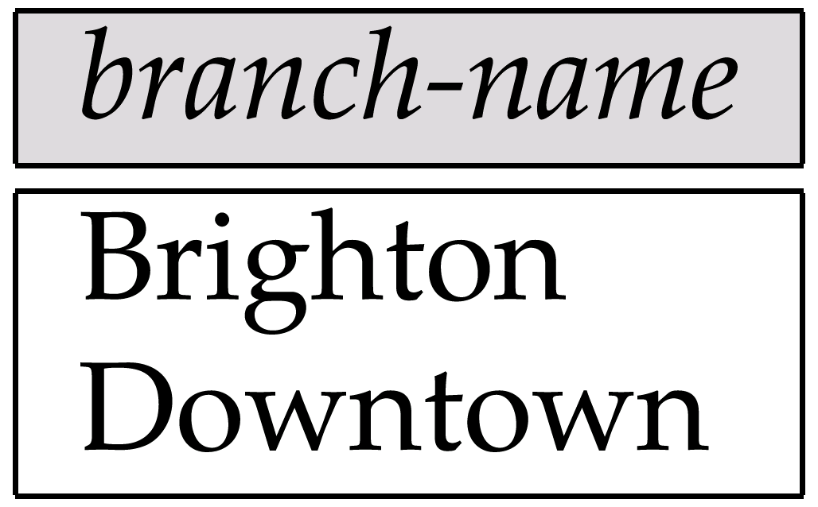
Result of Π_{branch-name}(σ_{branch-city =} “Brooklyn”^{(branch))}

Slide 102
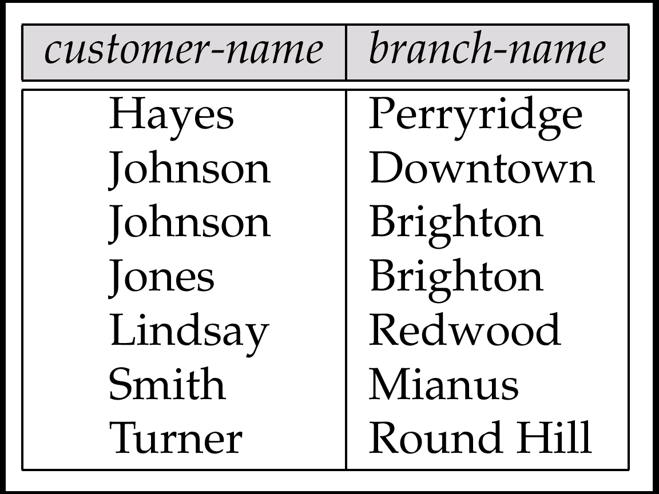
Result of Π_{customer-name, branch-name}(depositor account)

Slide 103
The credit-info Relation

Slide 104
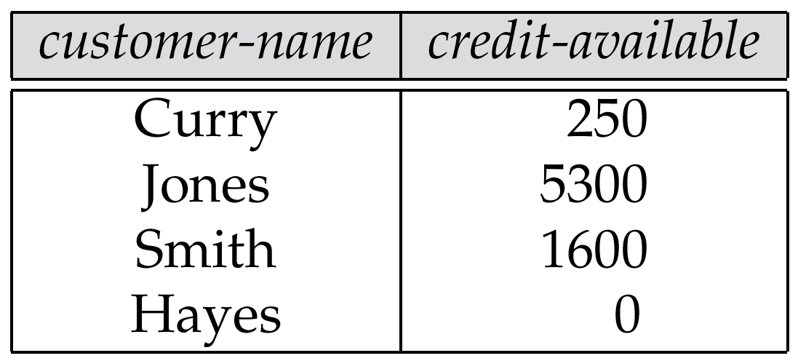
Result of Πcustomer-name, (limit – credit-balance) as credit-available(credit-info).

Slide 105
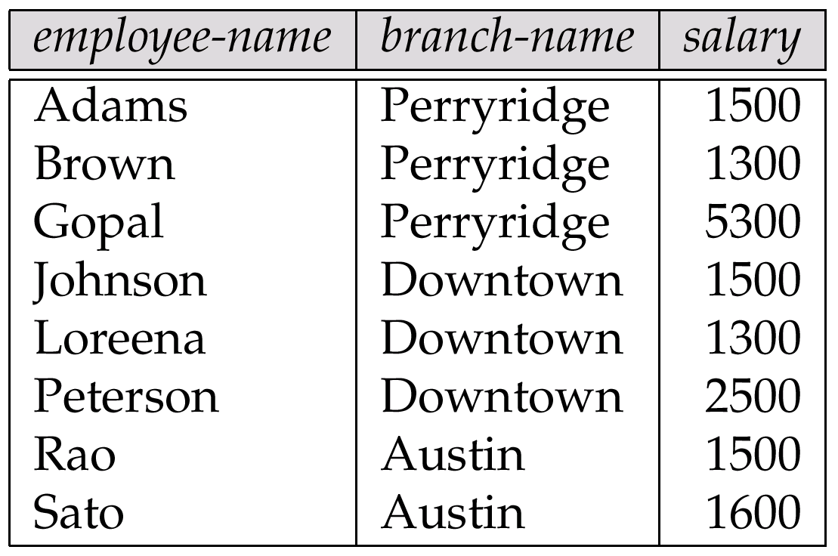
The pt-works Relation

Slide 106
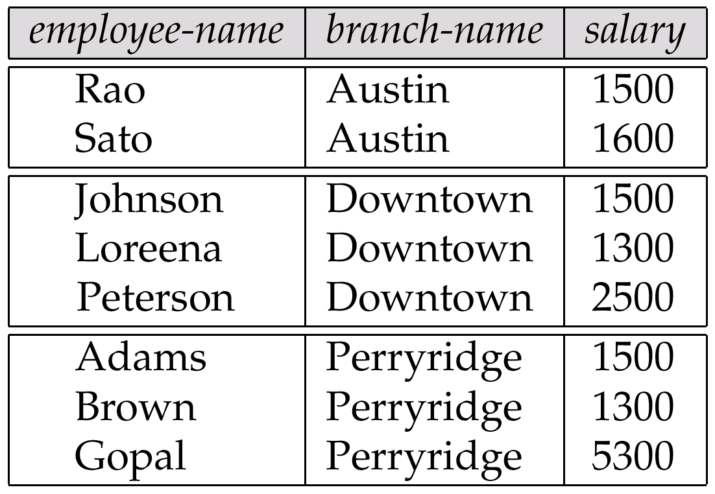
The pt-works Relation After Grouping

Slide 107
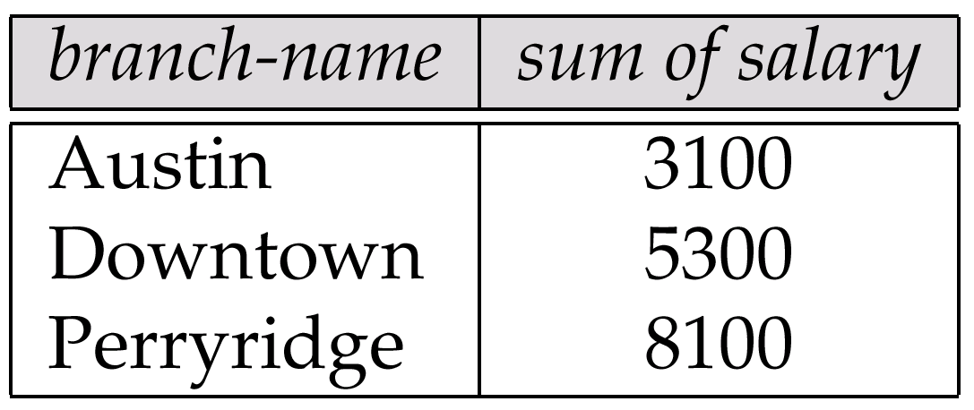
Result of _{branch-name} ς _{sum(salary)} (pt-works)

Slide 108
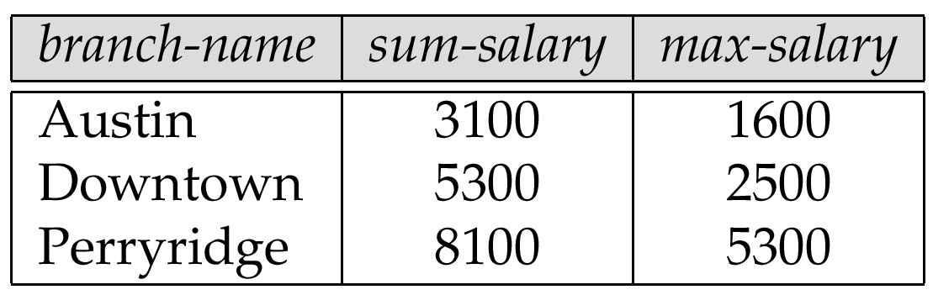
Result of _{branch-name} ς sum salary, max(salary) as max-salary (pt-works)

Slide 109
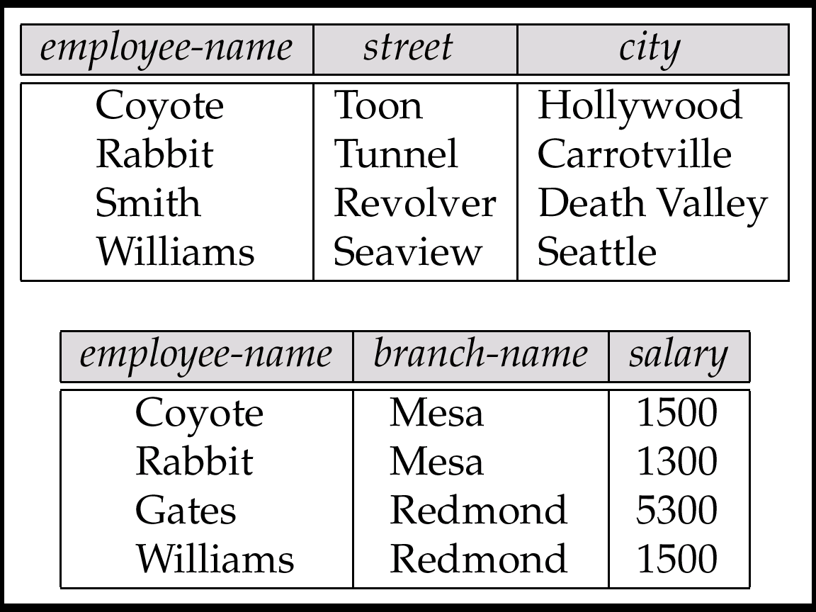
The employee and ft-works Relations

Slide 110
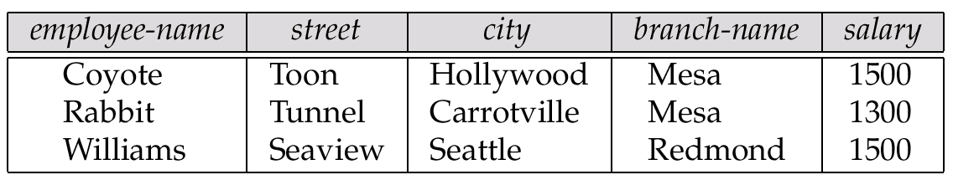
The Result of employee ft-works

Slide 111
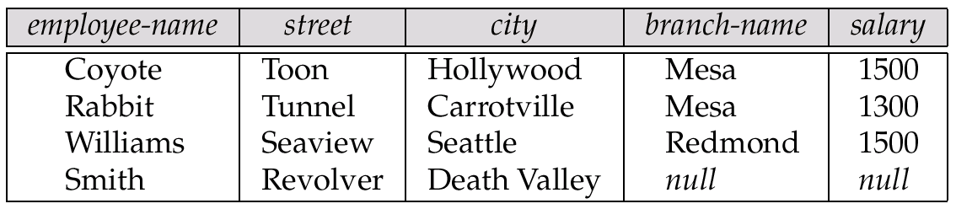
The Result of employee ft-works

Slide 112
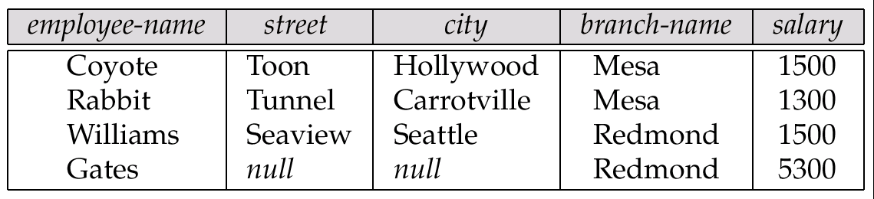
Result of employee ft-works

Slide 113
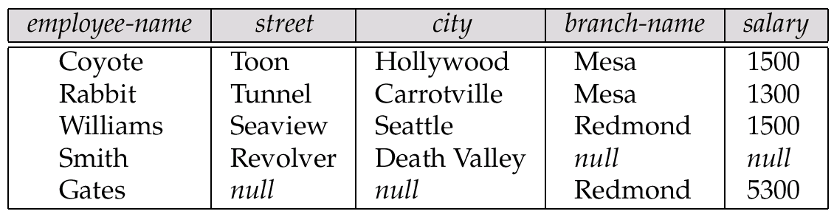
Result of employee ft-works

Slide 114
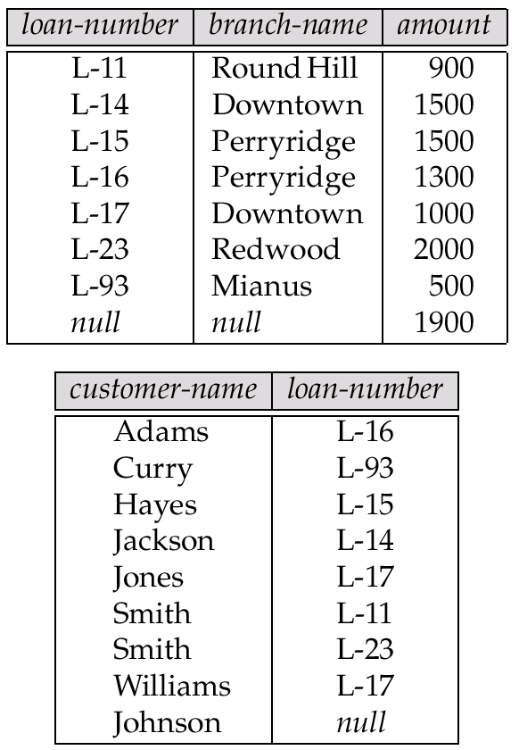
Tuples Inserted Into loan and borrower

Slide 115

Names of All Customers Who Have a Loan at the Perryridge Branch

Slide 116
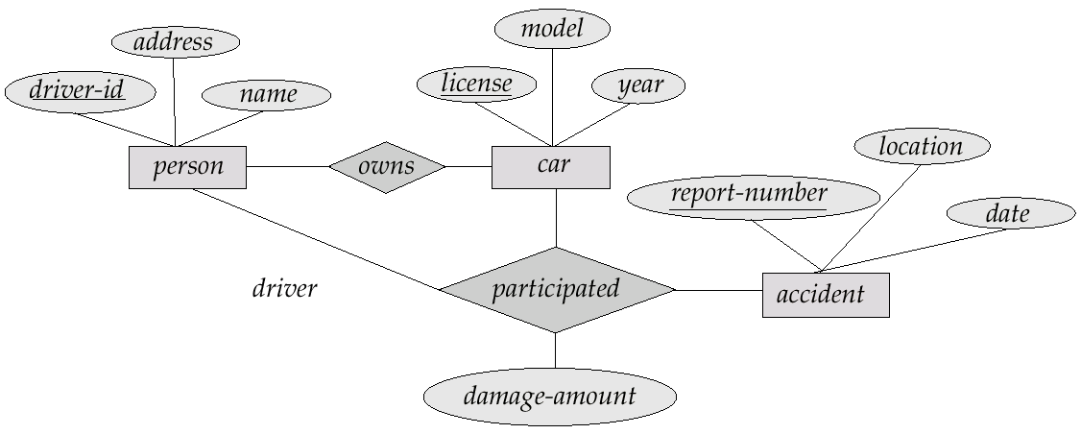
E-R Diagram

Slide 117

The branch Relation

Slide 118

The loan Relation

Slide 119

The borrower Relation

