Slide 1
DBMS | JOINS in SQL: Mysql

Slide 2
MySQL JOINS
MySQL supports the following types of joins:
Cross join
Inner join
Left join
Right join

Slide 3
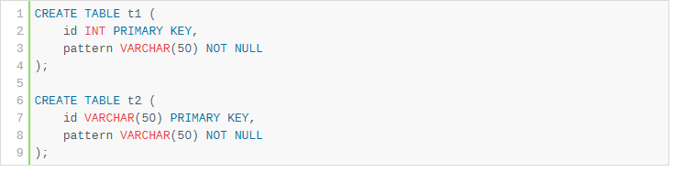
Creating Tables

Slide 4
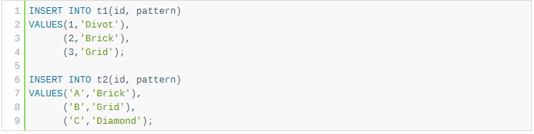
Inserting Data to Tables

Slide 5
Mysql Cross JOIN
The CROSS JOIN makes a Cartesian product of rows from multiple tables. Suppose, you join t1 and t2 tables using the CROSS JOIN, the result set will include the combinations of rows from the t1 table with the rows in the t2 table.

Slide 6
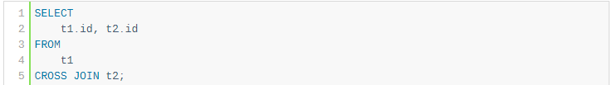
Cross JOIN
Notes:
For Example, STUDENT and FACULTY can be generalized to a higher level entity called PERSON as shown in Figure 1. In this case, common attributes like P_NAME, P_ADD become part of higher entity (PERSON) and specialized attributes like S_FEE become part of specialized entity (STUDENT).

Slide 7
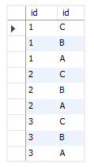
Cross JOIN result

Slide 8
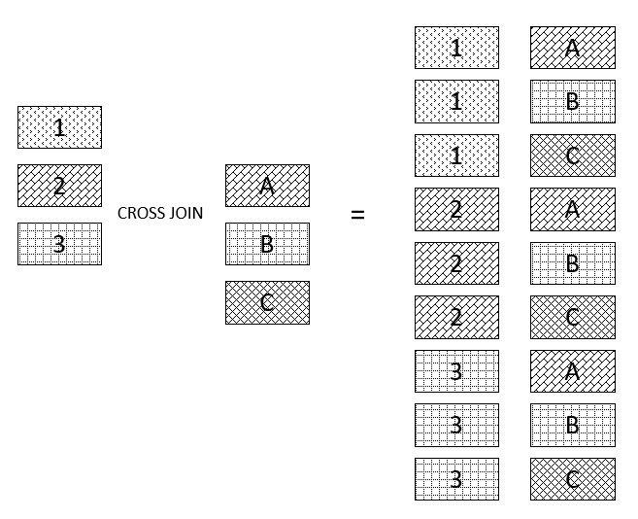

Slide 9
INNER JOIN
To form an INNER JOIN, you need a condition which is known as a join-predicate. An INNER JOIN requires rows in the two joined tables to have matching column values. The INNER JOIN creates the result set by combining column values of two joined tables based on the join-predicate.

Slide 10
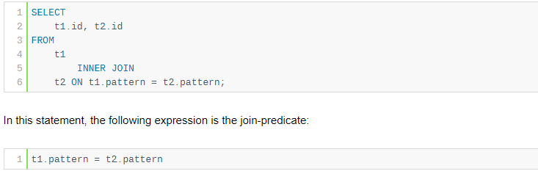
INNER JOIN

Slide 11

INNER JOIN
Notes:
For Example, EMPLOYEE entity in an Employee management system can be specialized into DEVELOPER, TESTER etc. as shown in Figure 2. In this case, common attributes like E_NAME, E_SAL etc. become part of higher entity (EMPLOYEE) and specialized attributes like TES_TYPE become part of specialized entity (TESTER).

Slide 12
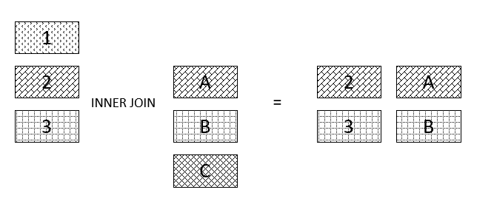
INNER JOIN

Slide 13
LEFT JOIN
Similar to an INNER JOIN, a LEFT JOIN also requires a join-predicate. When joining two tables using a LEFT JOIN, the concepts of left table and right table are introduced.
Unlike an INNER JOIN, a LEFT JOIN returns all rows in the left table including rows that satisfy join-predicate and rows that do not. For the rows that do not match the join-predicate, NULLs appear in the columns of the right table in the result set.
Notes:
For Example, Employee working for a project may require some machinery. So, REQUIRE relationship is needed between relationship WORKS_FOR and entity MACHINERY. Using aggregation, WORKS_FOR relationship with its entities EMPLOYEE and PROJECT is aggregated into single entity and relationship REQUIRE is created between aggregated entity and MACHINERY.

Slide 14
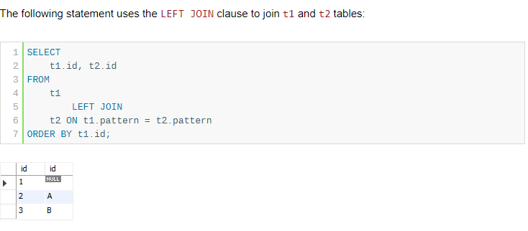
LEFT JOIN

Slide 15
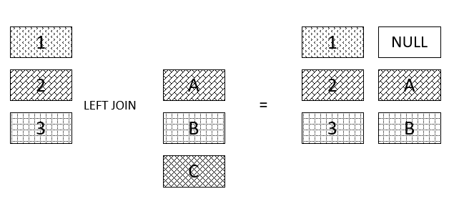
LEFT JOIN

Slide 16
RIGHT JOIN
A RIGHT JOIN is similar to the LEFT JOIN except that the treatment of tables is reversed. With a RIGHT JOIN, every row from the right table ( t2) will appear in the result set. For the rows in the right table that do not have the matching rows in the left table ( t1), NULLs appear for columns in the left table ( t1).

Slide 17
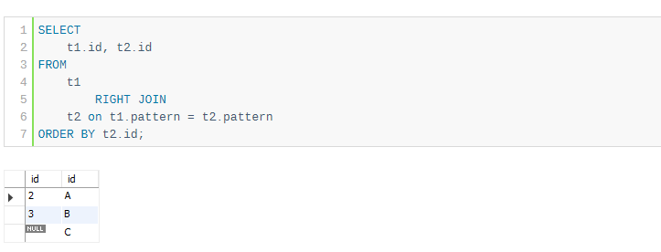
RIGHT JOIN

Slide 18
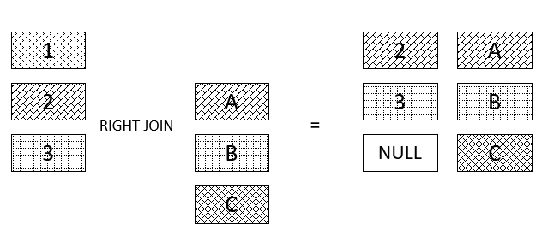
RIGHT JOIN

Slide 19
Practice 1
Write a query to find the employee id, name (last_name) along with their manager_id and name (last_name).

Slide 20
Solution 1
SELECT e.employee_id 'Emp_Id', e.last_name 'Employee', m.employee_id 'Mgr_Id', m.last_name 'Manager' FROM employees e join employees m ON (e.manager_id = m.employee_id);

Slide 21
Practice 2
Write a query to get the department name and number of employees in the department.

Slide 22
Solution 2
SELECT department_name AS 'Department Name', COUNT(*) AS 'No of Employees' FROM departments INNER JOIN employees ON employees.department_id = departments.department_id GROUP BY departments.department_id, department_name ORDER BY department_name;

Slide 23
Aggerate Functions
A function where the values of multiple rows are grouped together as input on certain criteria to form a single value of more significant meaning.
COUNT()
SUM()
AVG()
MIN()
MAX()

Slide 24
Count
Count(*) -> Returns total number of records.
Count(Salary) -> Returns number of Non Null values over the column salary.
Count(Distinct Salary) -> Returns number of distinct Non Null values over the column Salary.
SELECT COUNT(DISTINCT job_id) FROM employees;

Slide 25
SUM
Sum(Salary) -> Sum all Non Null values of column Salary.
Sum(Distinct Salary) -> Sum of all non null values.
SELECT SUM(salary) FROM employees;

Slide 26
Avg()
Avg(Salary) -> Sum(Salary)/Count(Salary)
Avg(Distinct Salary) =
Sum(Distinct Salary)/Count(Distinct Salary)
SELECT AVG(salary),count(*) FROM employees WHERE department_id = 90;

Slide 27
Min() and Max()
Min(Salary) -> Minimum value in the salary column except NULL.
Max(Salary) -> Maximum Value in the salary.
SELECT MAX(salary) FROM employees WHERE job_id = 'IT_PROG'

Slide 28
Group By
SELECT job_id, COUNT(*) FROM employees GROUP BY job_id;

