Slide 1
Query Languages
Language in which user requests information from the database.
Categories of languages
  procedural
  non-procedural

Slide 2
Procedural Language
A Procedural language, as the name implies relies on predefined and well-organized procedures functions or sub-routines in programs architecture by specifying all the steps that the computer must take to reach a desired state or output.
Procedural Query Language is a formal way of accessing the database. The information regarding what has to be accessed and how it has to be accessed are provided along with the queries so that the data can be accessed from the database.
example:
Relational Algebra

Slide 3
Non Procedural Query Language
This is an informal way of accessing the data from database.
In the case of Non-Procedural Query Language, information is required only about what data has to be accessed from database.
SQL and Tuple relational calculus are types of Non Procedural Query language.

Slide 4
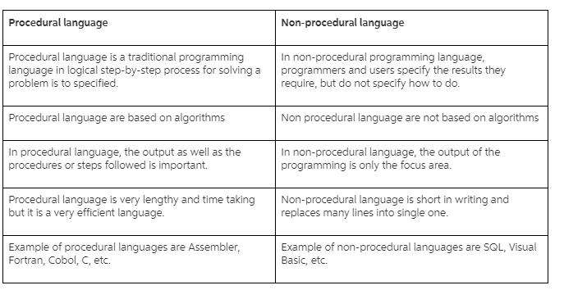
Procedural Vs Non-Procedural Language

Slide 5
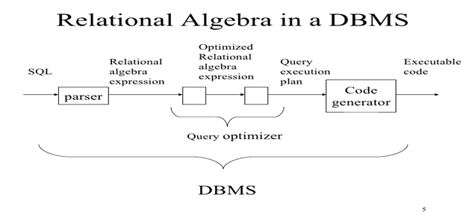
Relational Algebra
It is used in the design of transactions and forms the conceptual basis of SQL (Structured Query Language).
It consists of operators and manipulators which apply to relations and give relation as a result but do not change the actual relation in database.
It is a procedural intermediate language used within the DBMS.

Slide 6
Relational Algebra
Procedural language
Six basic operators
  select
  project
  union
  set difference
  Cartesian product
  rename
The operators take one or more relations as inputs and give a new relation as a result.

Slide 7
Select Operation (σ)
It selects tuples that satisfy the given predicate from a relation.
Notation − σ_{p}(r)
Where σ stands for selection predicate and r stands for relation. p is prepositional logic formula which may use connectors like and, or, and not. These terms may use relational operators like − =, ≠, ≥, < , >, ≤.
Example:
Output: Selects tuples from books where subject is 'database'.
σ_{subject = "database"}(Books)

Slide 8
Select Operation – Example
Relation r
A
B
C
D








1
5
12
23
7
7
3
10
_{A=B ^ D > 5} (r)
A
B
C
D




1
23
7
10

Slide 9
Select Operation
Notation: σ _{p}(r)
p is called the selection predicate
Defined as:
σ_{p}(r) = {t | t ∈ r and p(t)}
Where p is a formula in propositional calculus consisting of terms connected by : ∧ (and), ∨ (or), ¬ (not)
Each term is one of:
<attribute> op <attribute> or <constant>
where op is one of: =, ≠, >, ≥. <. ≤
Example of selection:
σ _{branch-name=“Perryridge”}(account)

Slide 10
Project Operation (∏)
It projects column(s) that satisfy a given predicate.
Notation −
∏_{A1, A2, …, Ak} (r)
where A₁, A₂ are attribute names and r is a relation name.
Example:
Selects and projects columns named as subject and author from the relation Books.
∏_{subject, author} (Books)

Slide 11
Project Operation – Example
A
B
C
Relation r:




10
20
30
40
1
1
1
2
A
C
A
C
∏_{A,C} (r)




1
1
1
2



1
1
2
=

Slide 12
Project Operation
Notation:
∏_{A1, A2, …, Ak} (r)
where A₁, A₂ are attribute names and r is a relation name.
The result is defined as the relation of k columns obtained by erasing the columns that are not listed
Duplicate rows removed from result, since relations are sets
E.g. To eliminate the branch-name attribute of account
∏_{account-number, balance} (account)

Slide 13
Union Operation – Example
Relations r, s:
A
B
A
B



1
2
1


2
3
s
r
r  s:
A
B




1
2
1
3

Slide 14
Union Operation
Notation: r ∪ s
Defined as:
r ∪ s = {t | t ∈ r or t ∈ s}
For r ∪ s to be valid.
1. r, s must have the same arity (same number of attributes)
2. The attribute domains must be compatible (e.g., 2nd column
of r deals with the same type of values as does the 2nd
column of s)
E.g. to find all customers with either an account or a loan
∏_{customer-name} (depositor) ∪ ∏_{customer-name} (borrower)

Slide 15
Set Difference Operation – Example
Relations r, s:
A
B
A
B



1
2
1


2
3
s
r
r – s:
A
B


1
1

Slide 16
Set Difference Operation
Notation r – s
Defined as:
r – s = {t | t ∈ r and t ∉ s}
Set differences must be taken between compatible relations.
  r and s must have the same arity
  attribute domains of r and s must be compatible

Slide 17
Cartesian-Product Operation-Example
A
B
C
D
E
Relations r, s:


1
2




10
10
20
10
a
a
b
b
r
s
r x s:
A
B
C
D
E








1
1
1
1
2
2
2
2








10
10
20
10
10
10
20
10
a
a
b
b
a
a
b
b

Slide 18
Cartesian-Product Operation
Notation r x s
Defined as:
r x s = {t q | t ∈ r and q ∈ s}
Assume that attributes of r(R) and s(S) are disjoint. (That is,
R ∩ S = ∅).
If attributes of r(R) and s(S) are not disjoint, then renaming must be used.

Slide 19
Composition of Operations
Can build expressions using multiple operations
Example: σ_{A=C}(r x s)
r x s
σ_{A=C}(r x s)
A
B
C
D
E








1
1
1
1
2
2
2
2








10
10
20
10
10
10
20
10
a
a
b
b
a
a
b
b
A
B
C
D
E



1
2
2



10
20
20
a
a
b

Slide 20
Rename Operation
Allows us to name, and therefore to refer to, the results of relational-algebra expressions.
Allows us to refer to a relation by more than one name.
Example:
ρ _{x} (E)
returns the expression E under the name X
If a relational-algebra expression E has arity n, then
ρ_{x} _{(A1, A2, …, An)} (E)
returns the result of expression E under the name X, and with the
attributes renamed to A1, A2, …., An.

Slide 21
Banking Example
branch (branch-name, branch-city, assets)
customer (customer-name, customer-street, customer-only)
account (account-number, branch-name, balance)
loan (loan-number, branch-name, amount)
depositor (customer-name, account-number)
borrower (customer-name, loan-number)

Slide 22
Find all loans of over $1200
Find the loan number for each loan of an amount greater than
$1200
Find the names of all customers who have a loan at the Perryridge branch.
Find the names of all customers who have a loan at the
Perryridge branch but do not have an account at any branch of
the bank.
Find the names of all customers who have a loan at the Perryridge branch.

Slide 23
Example Queries
Find all loans of over $1200
_{amount > 1200} (loan)
Find the loan number for each loan of an amount greater than
$1200
_{loan-number} (_{amount} _{> 1200} (loan))

Slide 24
Example Queries
Find the names of all customers who have a loan, an account, or both, from the bank
  _{customer-name} (borrower)  _{customer-name} (depositor)
Find the names of all customers who have a loan and an
account at bank.
  _{customer-name} (borrower)  _{customer-name} (depositor)

Slide 25
Example Queries
Find the names of all customers who have a loan at the Perryridge branch.
_{customer-name} (_{branch-name=“Perryridge”}
(borrower.loan-number = loan.loan-number(borrower x loan)))
Find the names of all customers who have a loan at the
Perryridge branch but do not have an account at any branch of
the bank.
_{customer-name} (_{branch-name = “Perryridge”}
(borrower.loan-number = loan.loan-number(borrower x loan))) –
_{customer-name}(depositor)

Slide 26
Example Queries
Find the names of all customers who have a loan at the Perryridge branch.
  Query 1
  _{customer-name}(_{branch-name = “Perryridge”} (
  borrower.loan-number = loan.loan-number(borrower x loan)))
  − Query 2
  _{customer-name}(loan.loan-number = borrower.loan-number(
  (_{branch-name = “Perryridge”}(loan)) x borrower))

Slide 27
Example Queries
Find the largest account balance
Rename account relation as d
The query is:
_{balance}(account) - _{account.balance}
(_{account.balance < d.balance} (account x ρ_{d} (account)))

Slide 28
Formal Definition
A basic expression in the relational algebra consists of either one of the following:
  A relation in the database
  A constant relation
Let E₁ and E₂ be relational-algebra expressions; the following are all relational-algebra expressions:
  E₁ ∪ E₂
  E₁ - E₂
  E₁ x E₂
  σ_{p} (E₁), P is a predicate on attributes in E₁
  ∏_{s}(E₁), S is a list consisting of some of the attributes in E₁
  ρ _{x} (E₁), x is the new name for the result of E₁

Slide 29
Additional Operations
We define additional operations that do not add any power to the
relational algebra, but that simplify common queries.
Set intersection
Natural join
Division
Assignment

Slide 30
Set-Intersection Operation
Notation: r ∩ s
Defined as:
r ∩ s ={ t | t ∈ r and t ∈ s }
Assume:
  r, s have the same arity
  attributes of r and s are compatible
Note: r ∩ s = r - (r - s)

Slide 31
Set-Intersection Operation - Example
Relation r, s:
r ∩ s
A B
A B



1
2
1


2
3
r
s
A B
 2

Slide 32
Natural-Join Operation
Notation: r s
Let r and s be relations on schemas R and S respectively.
Then, r s is a relation on schema R ∪ S obtained as follows:
  Consider each pair of tuples t_{r} from r and t_{s} from s.
  If t_{r} and t_{s} have the same value on each of the attributes in R ∩ S, add a tuple t to the result, where
    t has the same value as t_{r} on r
    t has the same value as t_{s} on s
Example:
  R = (A, B, C, D)
  S = (E, B, D)
  Result schema = (A, B, C, D, E)
  r s is defined as:
  ∏_{r.A, r.B, r.C, r.D, s.E} (σ_{r.B = s.B} ∧ _{r.D = s.D} (r x s))

Slide 33
Natural Join Operation – Example
Relations r, s:
A
B
C
D
B
D
E





1
2
4
1
2





a
a
b
a
b
1
3
1
2
3
a
a
a
b
b





r
s
r s
A
B
C
D
E





1
1
1
1
2





a
a
a
a
b






Slide 34
Division Operation
r  s
Suited to queries that include the phrase “for all”.
Let r and s be relations on schemas R and S respectively where
  R = (A₁, …, A_{m}, B₁, …, B_{n})
  S = (B₁, …, B_{n})
  The result of r ÷ s is a relation on schema
  R – S = (A₁, …, A_{m})
  r ÷ s = { t | t ∈ ∏ _{R-S}(r) ∧ ∀ u ∈ s ( tu ∈ r ) }

Slide 35
Division Operation – Example
A
B
Relations r, s:
B











1
2
3
1
1
1
3
4
6
1
2
1
2
s
r  s:
A
r



Slide 36
Another Division Example
Relations r, s:
A
B
C
D
E
D
E








a
a
a
a
a
a
a
a








a
a
b
a
b
a
b
b
1
1
1
1
3
1
1
1
a
b
1
1
s
r
r  s:
A
B
C


a
a



Slide 37
Division Operation (Cont.)
Property
  Let q – r ÷ s
  Then q is the largest relation satisfying q x s ⊆ r
Definition in terms of the basic algebra operation
Let r(R) and s(S) be relations, and let S ⊆ R
r ÷ s = ∏_{R-S} (r) –∏_{R-S} ( (∏_{R-S} (r) x s) – ∏_{R-S,S}(r))
To see why
  ∏_{R-S,S}(r) simply reorders attributes of r
  ∏_{R-S}(∏_{R-S} (r) x s) – ∏_{R-S,S}(r)) gives those tuples t in
  ∏_{R-S} (r) such that for some tuple u ∈ s, tu ∉ r.

Slide 38
Assignment Operation
The assignment operation (←) provides a convenient way to express complex queries.
  Write query as a sequential program consisting of
    a series of assignments
    followed by an expression whose value is displayed as a result of the query.
  Assignment must always be made to a temporary relation variable.
Example: Write r ÷ s as
temp1 ← ∏_{R-S} (r)
temp2 ← ∏_{R-S} ((temp1 x s) – ∏_{R-S,S} (r))
result = temp1 – temp2
  The result to the right of the ← is assigned to the relation variable on the left of the ←.
  May use variable in subsequent expressions.

Slide 39
Example Queries
Find all customers who have an account from at least the “Downtown” and the Uptown” branches.
  Query 1
    _{CN}(_{BN=“Downtown”}(depositor account)) 
    _{CN}(_{BN=“Uptown”}(depositor account))
  where CN denotes customer-name and BN denotes
  branch-name.
  Query 2
  _{customer-name, branch-name} (depositor account)
   _{temp(branch-name)} ({(“Downtown”), (“Uptown”)})

Slide 40
Example Queries
Find all customers who have an account at all branches located in Brooklyn city.
_{customer-name, branch-name} (depositor account)
 _{branch-name} (_{branch-city = “Brooklyn”} (branch))

Slide 41
Extended Relational-Algebra-Operations
Generalized Projection
Outer Join
Aggregate Functions

Slide 42
Generalized Projection
Extends the projection operation by allowing arithmetic functions to be used in the projection list.
∏ _{F1, F2, …, Fn}(E)
E is any relational-algebra expression
Each of F₁, F₂, …, F_{n} are are arithmetic expressions involving constants and attributes in the schema of E.
Given relation credit-info(customer-name, limit, credit-balance), find how much more each person can spend:
∏customer-name, limit – credit-balance (credit-info)

Slide 43
Aggregate Functions and Operations
Aggregation function takes a collection of values and returns a single value as a result.
avg: average value
min: minimum value
max: maximum value
sum: sum of values
count: number of values
Aggregate operation in relational algebra
_{G1, G2, …, Gn} g _{F1( A1), F2( A2),…, Fn( An)} (E)
  E is any relational-algebra expression
  G₁, G₂ …, G_{n} is a list of attributes on which to group (can be empty)
  Each F_{i} is an aggregate function
  Each A_{i} is an attribute name

Slide 44
Aggregate Operation – Example
Relation r:
A
B
C








7
7
3
10
sum-C
g _{sum(c)} (r)
27

Slide 45
Aggregate Operation – Example
Relation account grouped by branch-name:
branch-name
account-number
balance
Perryridge
Perryridge
Brighton
Brighton
Redwood
A-102
A-201
A-217
A-215
A-222
400
900
750
750
700
_{branch-name} g _{sum(balance)} (account)
branch-name
balance
Perryridge
Brighton
Redwood
1300
1500
700

Slide 46
Aggregate Functions (Cont.)
Result of aggregation does not have a name
  Can use rename operation to give it a name
  For convenience, we permit renaming as part of aggregate operation
_{branch-name} g _{sum(balance) as sum-balance} (account)

Slide 47
Outer Join
An extension of the join operation that avoids loss of information.
Computes the join and then adds tuples form one relation that do not match tuples in the other relation to the result of the join.
Uses null values:
  null signifies that the value is unknown or does not exist
  All comparisons involving null are (roughly speaking) false by definition.
    Will study precise meaning of comparisons with nulls later

Slide 48
Outer Join – Example
Relation loan
loan-number
branch-name
amount
L-170
L-230
L-260
Downtown
Redwood
Perryridge
3000
4000
1700
Relation borrower
customer-name
loan-number
Jones
Smith
Hayes
L-170
L-230
L-155

Slide 49
Outer Join – Example
Inner Join
loan Borrower
loan-number
branch-name
amount
customer-name
L-170
L-230
Downtown
Redwood
3000
4000
Jones
Smith
Left Outer Join
loan Borrower
loan-number
branch-name
amount
customer-name
L-170
L-230
L-260
Downtown
Redwood
Perryridge
3000
4000
1700
Jones
Smith
null

Slide 50
Outer Join – Example
Right Outer Join
loan borrower
loan-number
branch-name
amount
customer-name
L-170
L-230
L-155
Downtown
Redwood
null
3000
4000
null
Jones
Smith
Hayes
Full Outer Join
loan borrower
loan-number
branch-name
amount
customer-name
L-170
L-230
L-260
L-155
Downtown
Redwood
Perryridge
null
3000
4000
1700
null
Jones
Smith
null
Hayes

Slide 51
Null Values
It is possible for tuples to have a null value, denoted by null, for some of their attributes
null signifies an unknown value or that a value does not exist.
The result of any arithmetic expression involving null is null.
Aggregate functions simply ignore null values
  Is an arbitrary decision. Could have returned null as result instead.
  We follow the semantics of SQL in its handling of null values
For duplicate elimination and grouping, null is treated like any other value, and two nulls are assumed to be the same
  Alternative: assume each null is different from each other
  Both are arbitrary decisions, so we simply follow SQL

Slide 52
Null Values
Comparisons with null values return the special truth value unknown
  If false was used instead of unknown, then not (A < 5)
  would not be equivalent to A >= 5
Three-valued logic using the truth value unknown:
  OR: (unknown or true) = true,
  (unknown or false) = unknown
  (unknown or unknown) = unknown
  AND: (true and unknown) = unknown,
  (false and unknown) = false,
  (unknown and unknown) = unknown
  NOT: (not unknown) = unknown
  In SQL “P is unknown” evaluates to true if predicate P evaluates to unknown
Result of select predicate is treated as false if it evaluates to unknown

Slide 53
Modification of the Database
The content of the database may be modified using the following operations:
  Deletion
  Insertion
  Updating
All these operations are expressed using the assignment operator.

Slide 54
Deletion
A delete request is expressed similarly to a query, except instead of displaying tuples to the user, the selected tuples are removed from the database.
Can delete only whole tuples; cannot delete values on only particular attributes
A deletion is expressed in relational algebra by:
r ← r – E
where r is a relation and E is a relational algebra query.

Slide 55
Deletion Examples
Delete all account records in the Perryridge branch.
account  account –  _{branch-name = “Perryridge”} (account)
Delete all loan records with amount in the range of 0 to 50
loan  loan –  _{amount  0 and amount  50} (loan)
Delete all accounts at branches located in Needham.
r₁  _{ branch-city = “Needham”} (account branch)
r₂  branch-name, account-number, balance (r₁)
r₃   _{customer-name, account-number} (r₂ depositor)
account  account – r₂
depositor  depositor – r₃

Slide 56
Insertion
To insert data into a relation, we either:
  specify a tuple to be inserted
  write a query whose result is a set of tuples to be inserted
in relational algebra, an insertion is expressed by:
r ← r ∪ E
where r is a relation and E is a relational algebra expression.
The insertion of a single tuple is expressed by letting E be a constant relation containing one tuple.

Slide 57
Insertion Examples
Insert information in the database specifying that Smith has $1200 in account A-973 at the Perryridge branch.
account  account  {(“Perryridge”, A-973, 1200)}
depositor  depositor  {(“Smith”, A-973)}
Provide as a gift for all loan customers in the Perryridge
branch, a $200 savings account. Let the loan number serve
as the account number for the new savings account.
r₁  (_{branch-name = “Perryridge”} (borrower loan))
account  account  branch-name, account-number,200 (r₁)
depositor  depositor  _{customer-name, loan-number}(r₁)

Slide 58
Updating
A mechanism to change a value in a tuple without charging all values in the tuple
Use the generalized projection operator to do this task
r ← ∏ _{F1, F2, …, FI,} (r)
Each F_{i} is either
  the ith attribute of r, if the ith attribute is not updated, or,
  if the attribute is to be updated F_{i} is an expression, involving only constants and the attributes of r, which gives the new value for the attribute

Slide 59
Update Examples
Make interest payments by increasing all balances by 5 percent.
account   _{AN, BN, BAL * 1.05} (account)
where AN, BN and BAL stand for account-number, branch-name and balance, respectively.
Pay all accounts with balances over $10,000 6 percent interest
and pay all others 5 percent
account   _{AN, BN, BAL * 1.06} ( _{BAL  10000} (account))
 _{AN, BN, BAL * 1.05} (_{BAL  10000} (account))

Slide 60
Views
In some cases, it is not desirable for all users to see the entire logical model (i.e., all the actual relations stored in the database.)
Consider a person who needs to know a customer’s loan number but has no need to see the loan amount. This person should see a relation described, in the relational algebra, by
∏_{customer-name, loan-number} (borrower loan)
Any relation that is not of the conceptual model but is made visible to a user as a “virtual relation” is called a view.

Slide 61
View Definition
A view is defined using the create view statement which has the form
create view v as <query expression
where <query expression> is any legal relational algebra query expression. The view name is represented by v.
Once a view is defined, the view name can be used to refer to the virtual relation that the view generates.
View definition is not the same as creating a new relation by evaluating the query expression
  Rather, a view definition causes the saving of an expression; the expression is substituted into queries using the view.

Slide 62
View Examples
Consider the view (named all-customer) consisting of branches and their customers.
create view all-customer as
_{branch-name, customer-name} (depositor account)
 _{branch-name, customer-name} (borrower loan)
We can find all customers of the Perryridge branch by writing:
_{customer-name}
(_{branch-name = “Perryridge”} (all-customer))

Slide 63
Updates Through View
Database modifications expressed as views must be translated to modifications of the actual relations in the database.
Consider the person who needs to see all loan data in the loan relation except amount. The view given to the person, branch-loan, is defined as:
create view branch-loan as
∏_{branch-name, loan-number} (loan)
Since we allow a view name to appear wherever a relation name is allowed, the person may write:
branch-loan ← branch-loan ∪ {(“Perryridge”, L-37)}

Slide 64
Updates Through Views (Cont.)
The previous insertion must be represented by an insertion into the actual relation loan from which the view branch-loan is constructed.
An insertion into loan requires a value for amount. The insertion can be dealt with by either.
  rejecting the insertion and returning an error message to the user.
  inserting a tuple (“L-37”, “Perryridge”, null) into the loan relation
Some updates through views are impossible to translate into database relation updates
  create view v as σ_{branch-name = “Perryridge”} (account))
  v ← v ∪ (L-99, Downtown, 23)
Others cannot be translated uniquely
  all-customer ← all-customer ∪ {(“Perryridge”, “John”)}
    Have to choose loan or account, and
    create a new loan/account number!

Slide 65
Views Defined Using Other Views
One view may be used in the expression defining another view
A view relation v₁ is said to depend directly on a view relation v₂ if v₂ is used in the expression defining v₁
A view relation v₁ is said to depend on view relation v₂ if either v₁ depends directly to v₂ or there is a path of dependencies from v₁ to v₂
A view relation v is said to be recursive if it depends on itself.

Slide 66
View Expansion
A way to define the meaning of views defined in terms of other views.
Let view v₁ be defined by an expression e₁ that may itself contain uses of view relations.
View expansion of an expression repeats the following replacement step:
repeat
Find any view relation v_{i} in e₁
Replace the view relation v_{i} by the expression defining v_{i}
until no more view relations are present in e₁
As long as the view definitions are not recursive, this loop will terminate

Slide 67
Tuple Relational Calculus
A nonprocedural query language, where each query is of the form
{t | P (t) }
It is the set of all tuples t such that predicate P is true for t
t is a tuple variable, t[A] denotes the value of tuple t on attribute A
t ∈ r denotes that tuple t is in relation r
P is a formula similar to that of the predicate calculus

Slide 68
Predicate Calculus Formula
1. Set of attributes and constants
2. Set of comparison operators: (e.g., <, ≤, =, ≠, >, ≥)
3. Set of connectives: and (∧), or (v)‚ not (¬)
4. Implication (⇒): x ⇒ y, if x if true, then y is true
x ⇒ y ≡ ¬x v y
5. Set of quantifiers:
  ∃ t ∈ r (Q(t)) ≡ ”there exists” a tuple in t in relation r
  such that predicate Q(t) is true
  ∀t ∈ r (Q(t)) ≡ Q is true “for all” tuples t in relation r

Slide 69
Banking Example
branch (branch-name, branch-city, assets)
customer (customer-name, customer-street, customer-city)
account (account-number, branch-name, balance)
loan (loan-number, branch-name, amount)
depositor (customer-name, account-number)
borrower (customer-name, loan-number)

Slide 70
Example Queries
Find the loan-number, branch-name, and amount for loans of over $1200
{t | t  loan  t [amount]  1200}
Find the loan number for each loan of an amount greater than $1200
{t |  s  loan (t[loan-number] = s[loan-number]  s [amount]  1200)}
Notice that a relation on schema [loan-number] is implicitly defined by the query

Slide 71
Example Queries
Find the names of all customers having a loan, an account, or both at the bank
{t | s  borrower( t[customer-name] = s[customer-name])
 u  depositor( t[customer-name] = u[customer-name])
Find the names of all customers who have a loan and an account
at the bank
{t | s  borrower( t[customer-name] = s[customer-name])
 u  depositor( t[customer-name] = u[customer-name])

Slide 72
Example Queries
Find the names of all customers having a loan at the Perryridge branch
{t | s  borrower(t[customer-name] = s[customer-name]
 u  loan(u[branch-name] = “Perryridge”
 u[loan-number] = s[loan-number]))}
Find the names of all customers who have a loan at the
Perryridge branch, but no account at any branch of the bank
{t | s  borrower( t[customer-name] = s[customer-name]
 u  loan(u[branch-name] = “Perryridge”
 u[loan-number] = s[loan-number]))
 not v  depositor (v[customer-name] =
t[customer-name]) }

Slide 73
Example Queries
Find the names of all customers having a loan from the Perryridge branch, and the cities they live in
{t | s  loan(s[branch-name] = “Perryridge”
 u  borrower (u[loan-number] = s[loan-number]
 t [customer-name] = u[customer-name])
  v  customer (u[customer-name] = v[customer-name]
 t[customer-city] = v[customer-city])))}

Slide 74
Example Queries
Find the names of all customers who have an account at all branches located in Brooklyn:
{t |  c  customer (t[customer.name] = c[customer-name]) 
 s  branch(s[branch-city] = “Brooklyn” 
 u  account ( s[branch-name] = u[branch-name]
  s  depositor ( t[customer-name] = s[customer-name]
 s[account-number] = u[account-number] )) )}

Slide 75
Safety of Expressions
It is possible to write tuple calculus expressions that generate infinite relations.
For example, {t | ¬ t ∈ r} results in an infinite relation if the domain of any attribute of relation r is infinite
To guard against the problem, we restrict the set of allowable expressions to safe expressions.
An expression {t | P(t)} in the tuple relational calculus is safe if every component of t appears in one of the relations, tuples, or constants that appear in P
  NOTE: this is more than just a syntax condition.
    E.g. { t | t[A]=5 ∨ true } is not safe --- it defines an infinite set with attribute values that do not appear in any relation or tuples or constants in P.

Slide 76
Domain Relational Calculus
A nonprocedural query language equivalent in power to the tuple relational calculus
Each query is an expression of the form:
{ < x₁, x₂, …, x_{n} > | P(x₁, x₂, …, x_{n})}
  x₁, x₂, …, x_{n} represent domain variables
  P represents a formula similar to that of the predicate calculus

Slide 77
Example Queries
Find the loan-number, branch-name, and amount for loans of over $1200
{ l, b, a  |  l, b, a   loan  a > 1200}
Find the names of all customers who have a loan of over $1200
{ c  |  l, b, a ( c, l   borrower   l, b, a   loan  a > 1200)}
Find the names of all customers who have a loan from the
Perryridge branch and the loan amount:
{ c, a  |  l ( c, l   borrower  b( l, b, a   loan 
b = “Perryridge”))}
or { c, a  |  l ( c, l   borrower   l, “Perryridge”, a   loan)}

Slide 78
Example Queries
Find the names of all customers having a loan, an account, or both at the Perryridge branch:
{ c  |  l ({ c, l   borrower
  b,a( l, b, a   loan  b = “Perryridge”))
  a( c, a   depositor
  b,n( a, b, n   account  b = “Perryridge”))}
Find the names of all customers who have an account at all
branches located in Brooklyn:
{ c  |  s, n ( c, s, n   customer) 
 x,y,z( x, y, z   branch  y = “Brooklyn”) 
 a,b( x, y, z   account   c,a   depositor)}

Slide 79
Safety of Expressions
{ < x₁, x₂, …, x_{n} > | P(x₁, x₂, …, x_{n})}
is safe if all of the following hold:
1. All values that appear in tuples of the expression are values from dom(P) (that is, the values appear either in P or in a tuple of a relation mentioned in P).
2. For every “there exists” subformula of the form ∃ x (P₁(x)), the subformula is true if and only if there is a value of x in dom(P₁) such that P₁(x) is true.
3. For every “for all” subformula of the form ∀_{x} (P₁ (x)), the subformula is true if and only if P₁(x) is true for all values x from dom (P₁).

Slide 80
End of Chapter 3

Slide 81
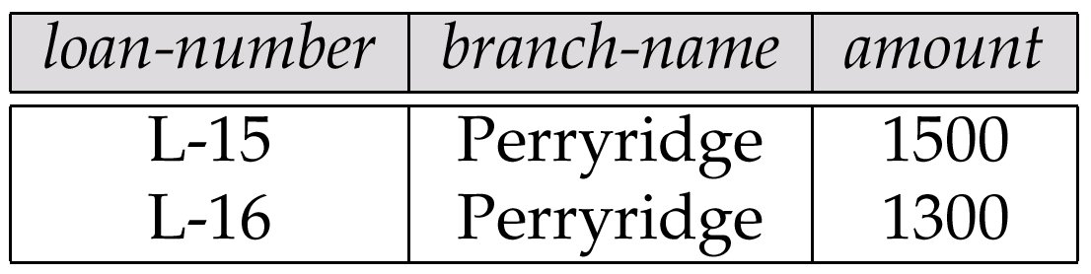
Result of σ _{branch-name = “Perryridge”} (loan)

Slide 82
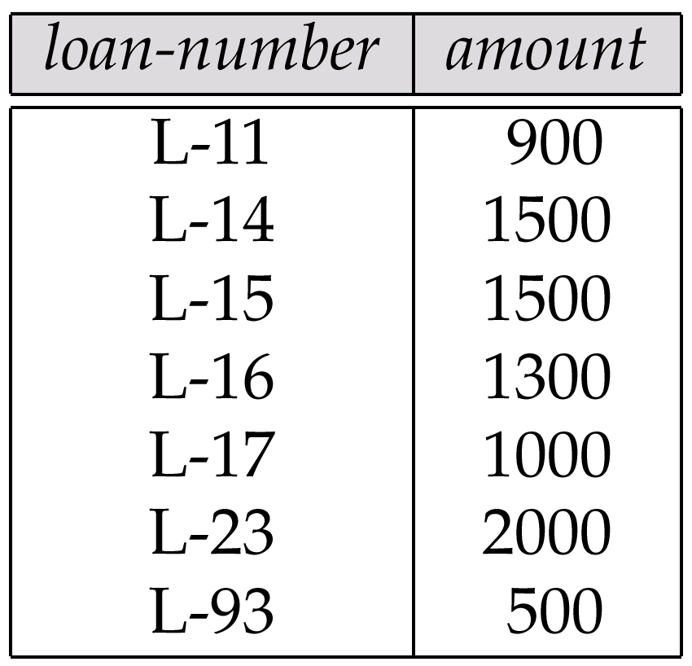
Loan Number and the Amount of the Loan

Slide 83
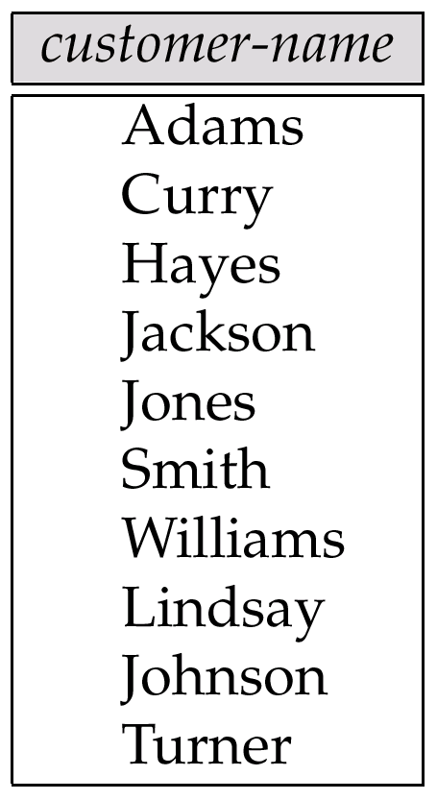
Names of All Customers Who Have Either a Loan or an Account

Slide 84
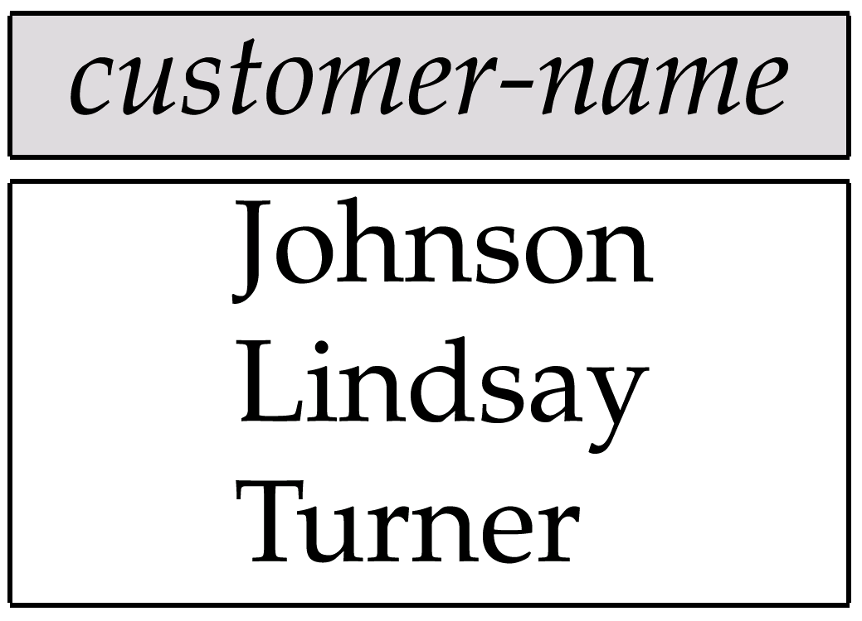
Customers With An Account But No Loan

Slide 85
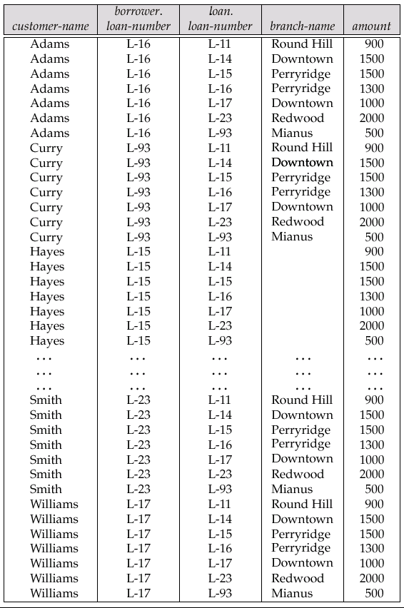
Result of borrower × loan

Slide 86
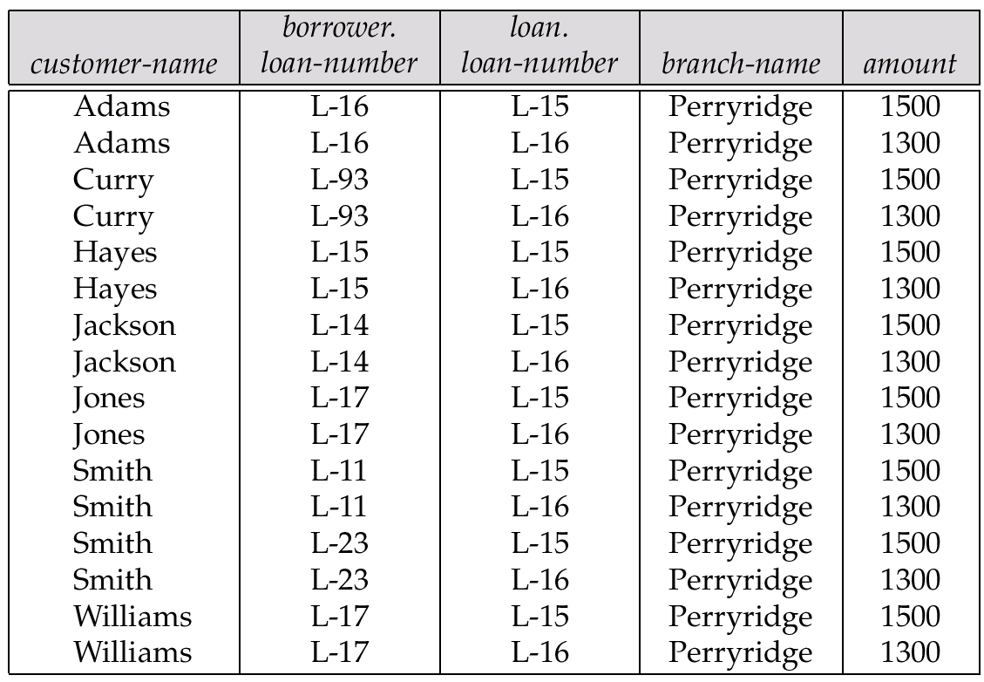
Result of σ _{branch-name = “Perryridge”} (borrower × loan)

Slide 87
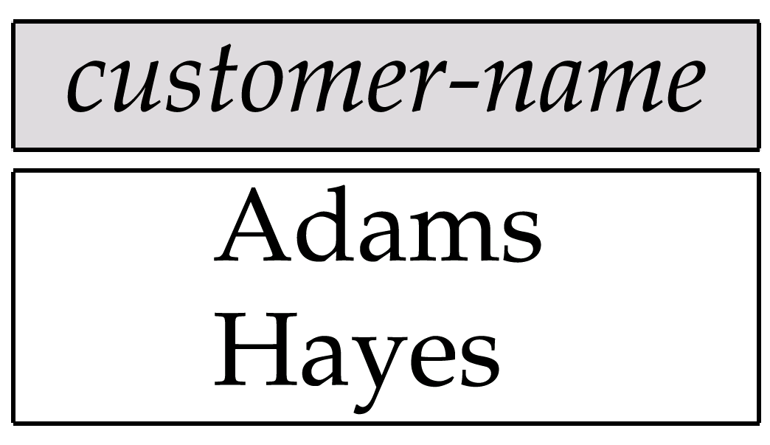
Result of Π_{customer-name}

Slide 88
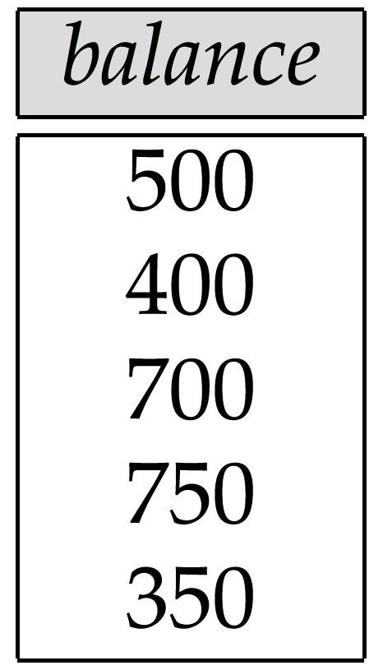
Result of the Subexpression

Slide 89
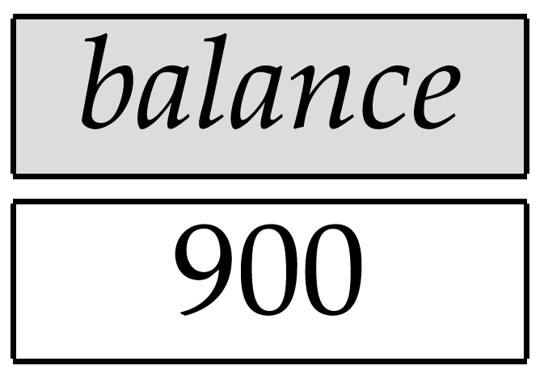
Largest Account Balance in the Bank

Slide 90
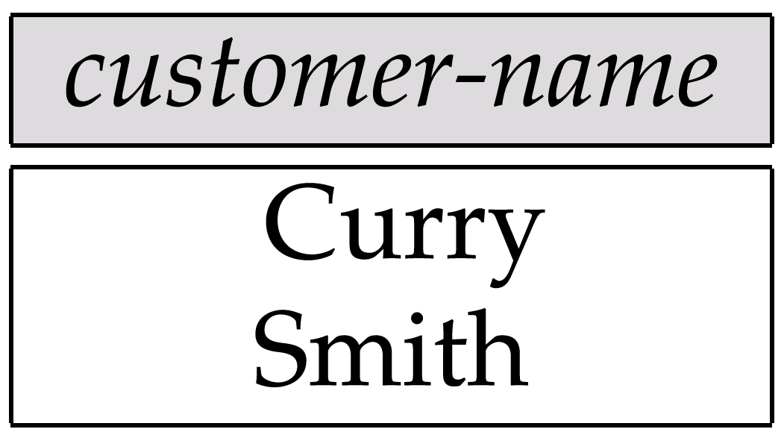
Customers Who Live on the Same Street and In the Same City as Smith

Slide 91
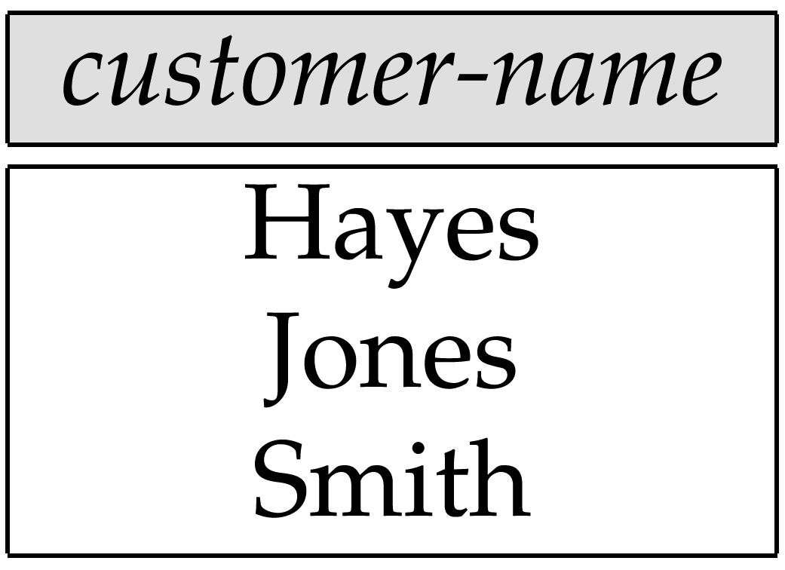
Customers With Both an Account and a Loan at the Bank

Slide 92
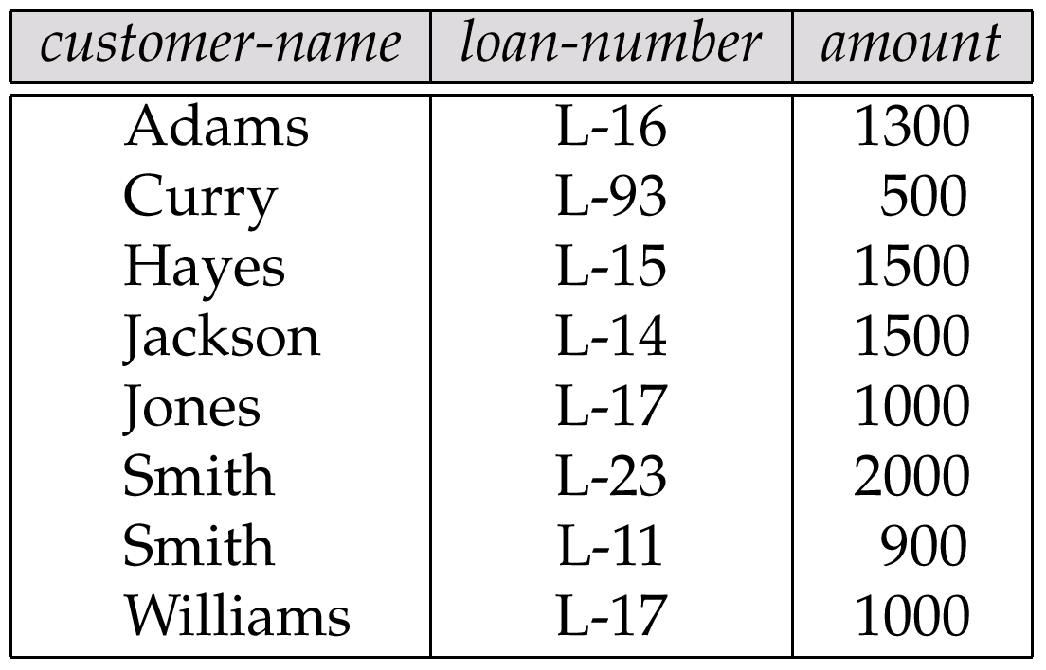
Result of Πcustomer-name, loan-number, amount (borrower loan)

Slide 93
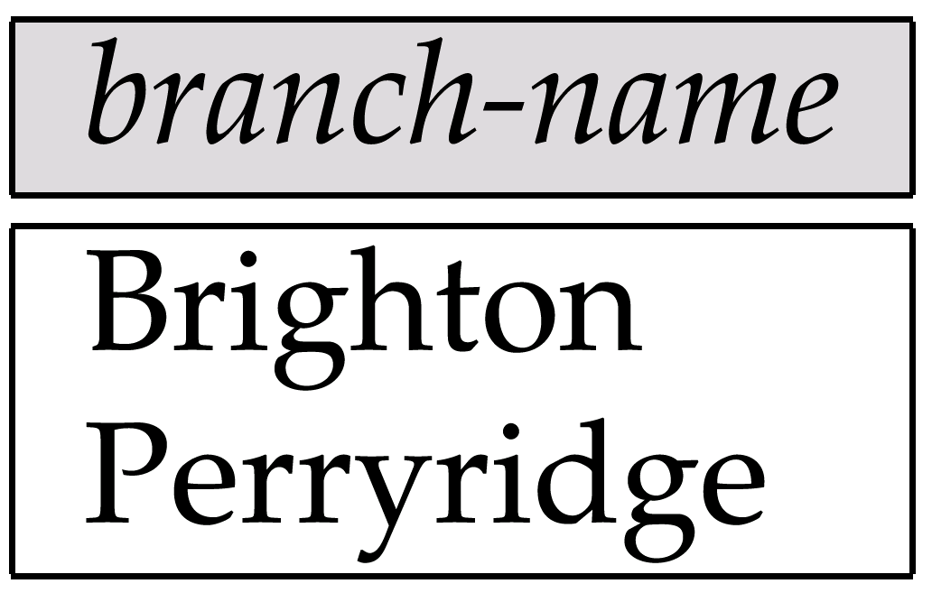
Result of Π_{branch-name}(σ_{customer-city = “Harrison”}(customer account depositor))

Slide 94
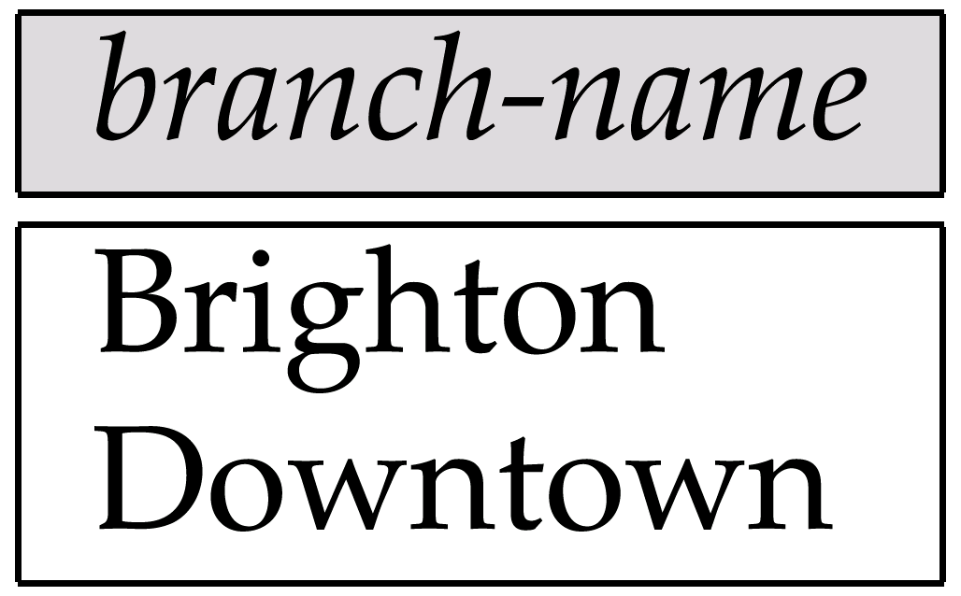
Result of Π_{branch-name}(σ_{branch-city =} “Brooklyn”^{(branch))}

Slide 95
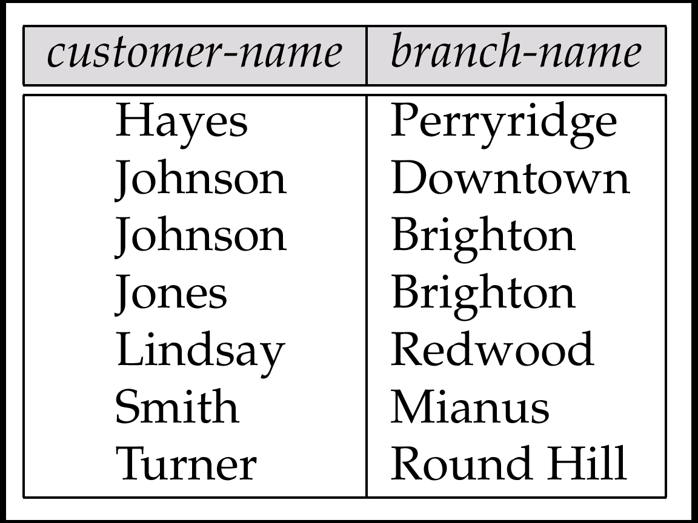
Result of Π_{customer-name, branch-name}(depositor account)

Slide 96
The credit-info Relation

Slide 97
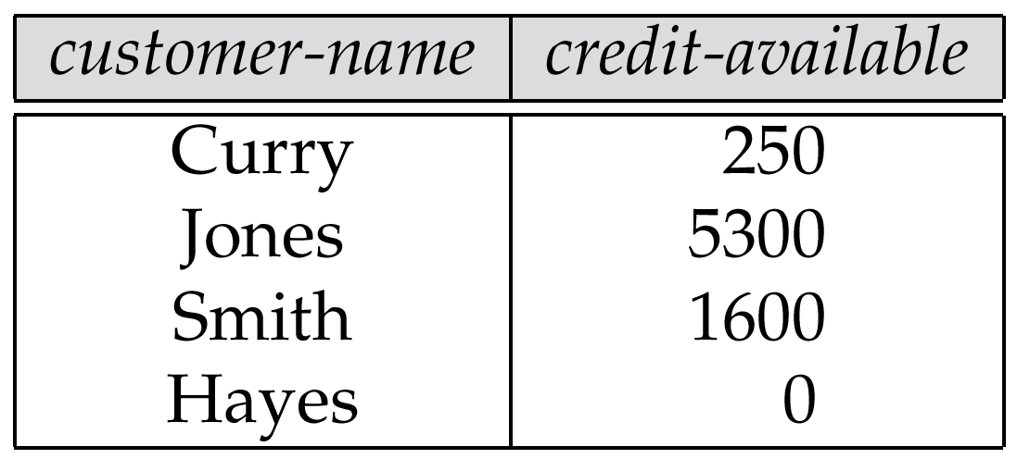
Result of Πcustomer-name, (limit – credit-balance) as credit-available(credit-info).

Slide 98
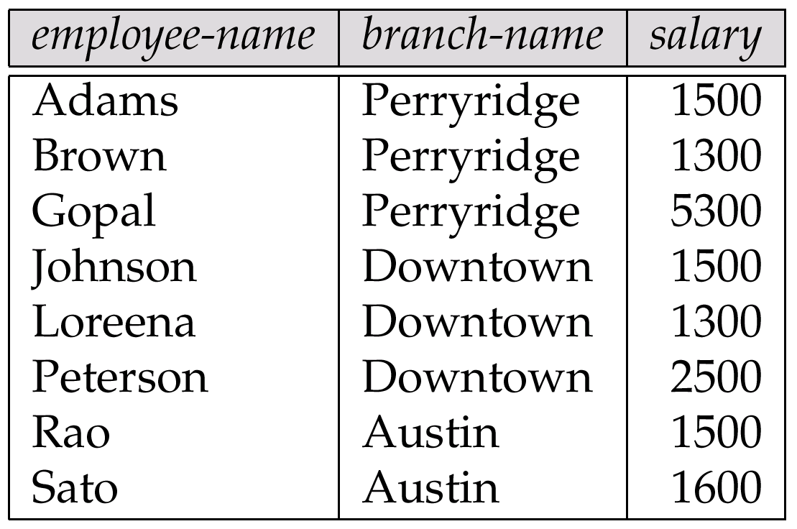
The pt-works Relation

Slide 99
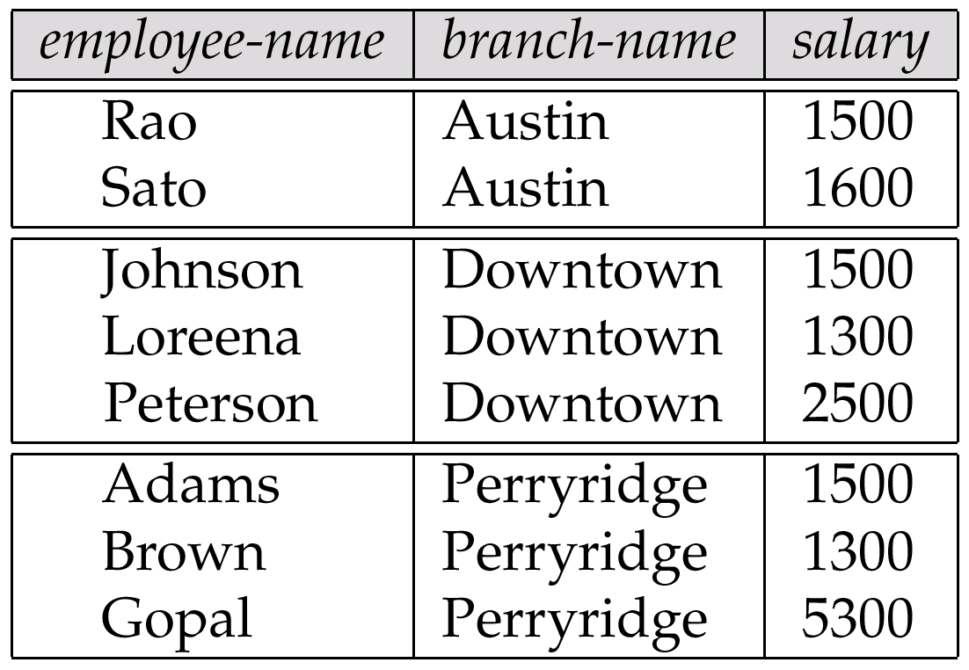
The pt-works Relation After Grouping

Slide 100
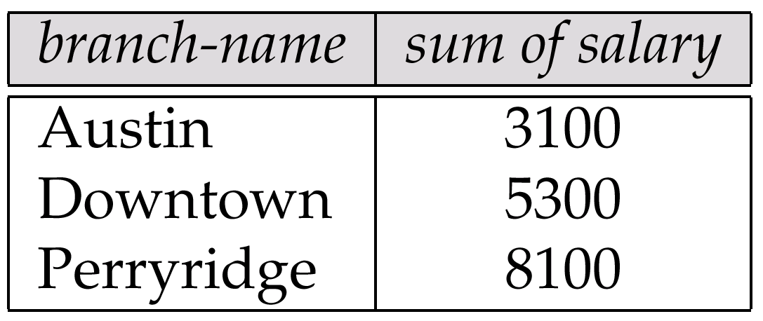
Result of _{branch-name} ς _{sum(salary)} (pt-works)

Slide 101
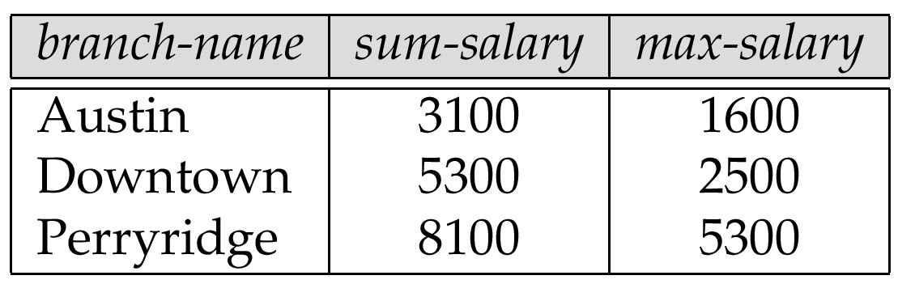
Result of _{branch-name} ς sum salary, max(salary) as max-salary (pt-works)

Slide 102
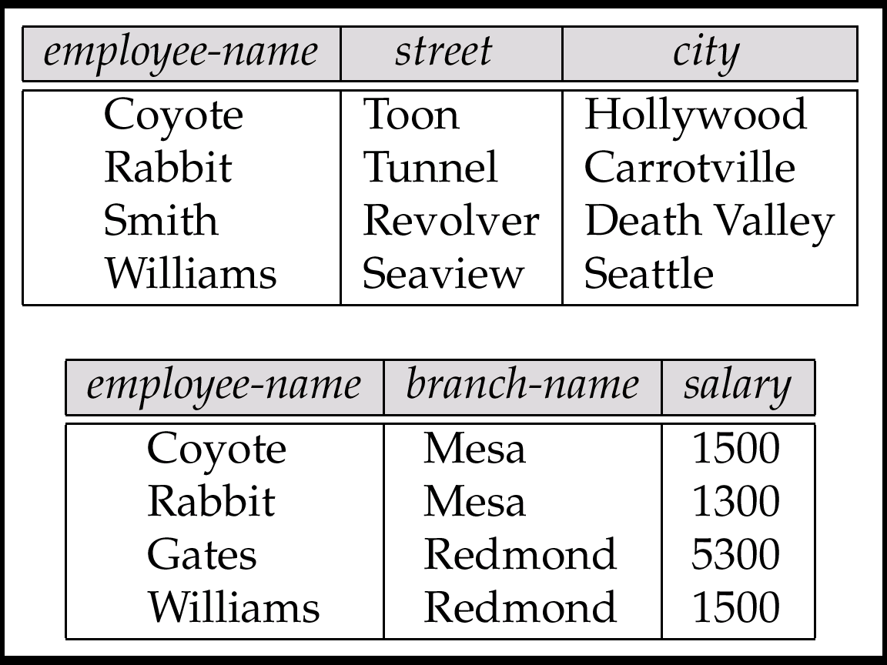
The employee and ft-works Relations

Slide 103
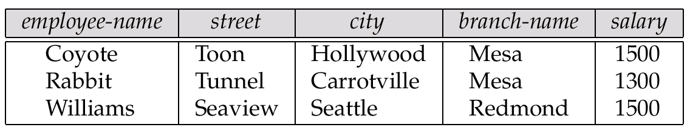
The Result of employee ft-works

Slide 104
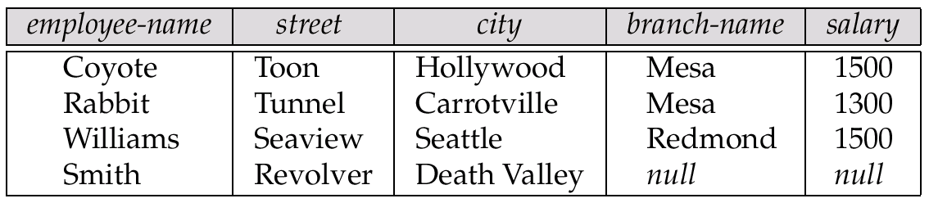
The Result of employee ft-works

Slide 105
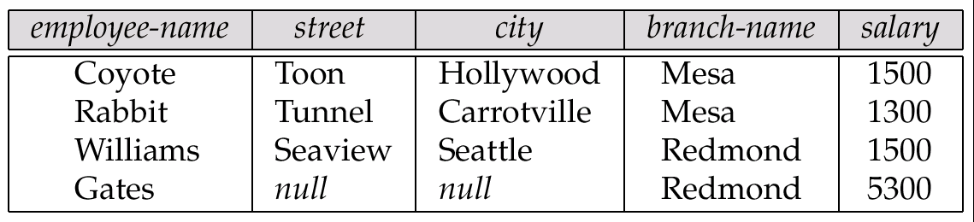
Result of employee ft-works

Slide 106
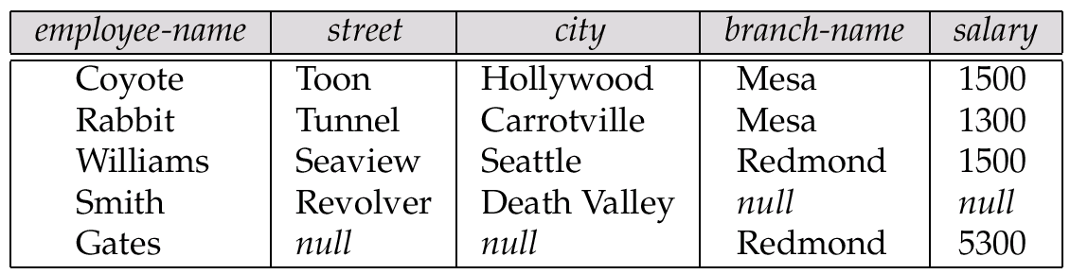
Result of employee ft-works

Slide 107
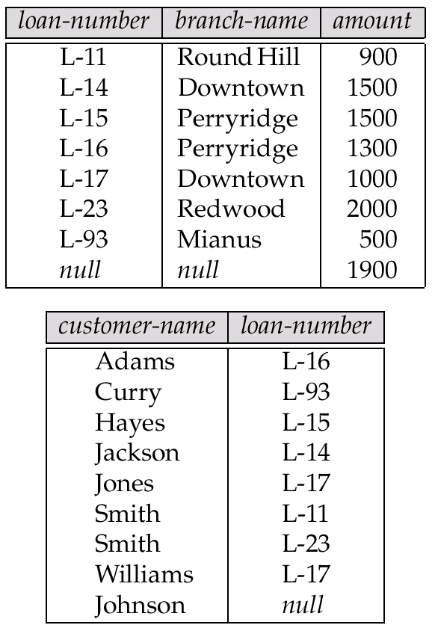
Tuples Inserted Into loan and borrower

Slide 108

Names of All Customers Who Have a Loan at the Perryridge Branch

Slide 109
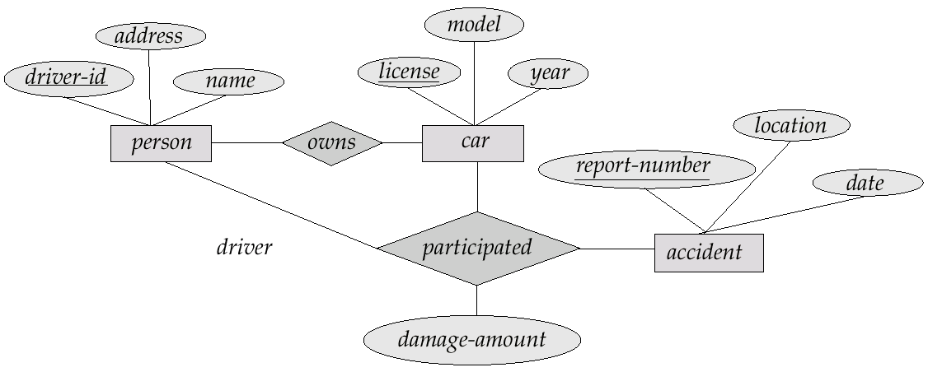
E-R Diagram

Slide 110

The branch Relation

Slide 111

The loan Relation

Slide 112

The borrower Relation

