Slide 1
securing smartphones
ANDROID & IPHONE HARDENING
(GUIDE & PRECAUTIONS)
PART-II
29-07-2022

Slide 2
TOPICS
Device Settings
Browser Security
Wi-Fi Security
Additional Security Settings

Slide 3
ANDROID HARDENING

Slide 4
DEVICE SETTINGS

Slide 5
FACTORY RESET NEW DEVICE
Before using the mobile for first time, make it a habit to factory reset the device before using it further.
Gifted device might be infected with malware to spy on our phone.
It is possible to infect a device with malware and repack it like a new device.

Slide 6
DO NOT CLICK ON UNKNOWN LINK
Do not click on any unknown link because it might prove to be malicious extracting user data secretly like:-
Location (Public & Private IP Address): The IP address can be used to track approximate user location.
When user clicks link, his IP address is stored at server
Through IP Address, his approximate location can be determined using freely available online websites like
iplocation.net
Geoiplookup.net

Slide 7
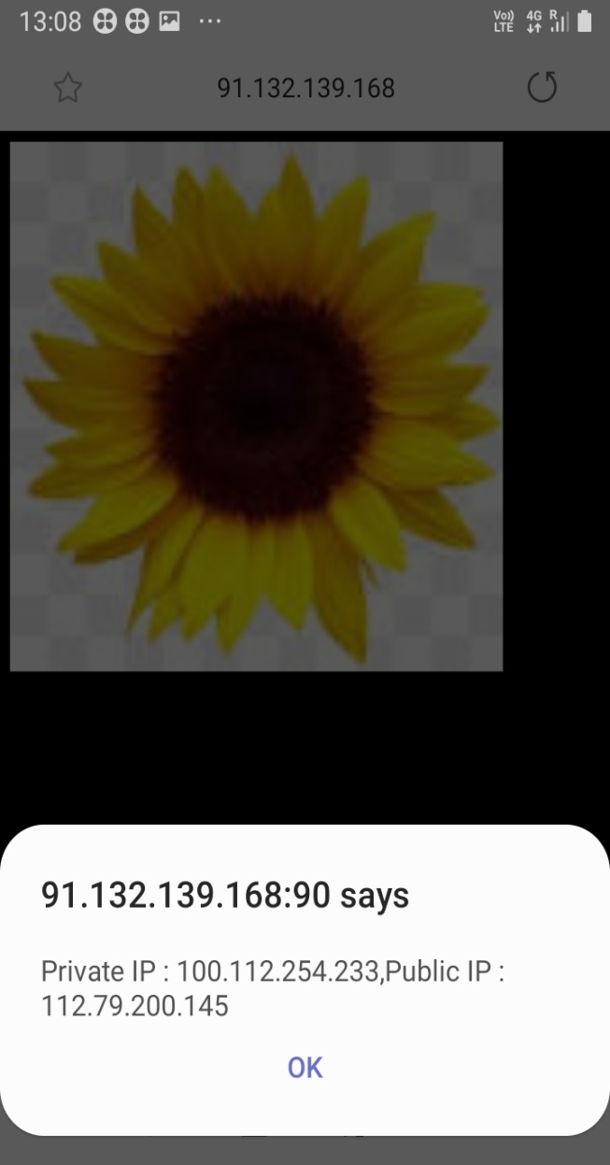

Slide 8
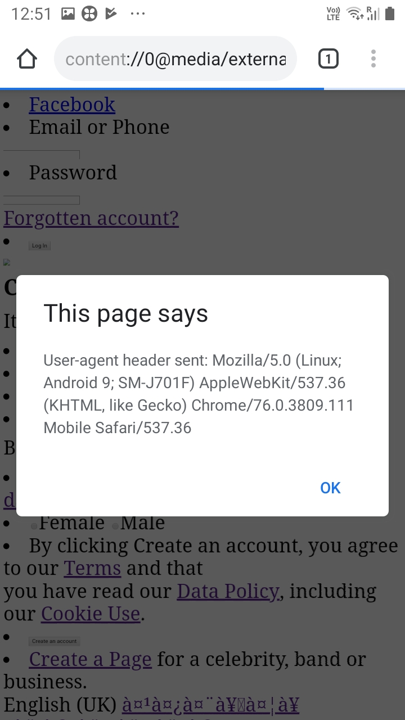
Device Model:

Slide 10
DO NOT INSTALL THIRD PARTY APPS
Do not install any apps from third party app stores since it can distribute malware disguised as genuine app.
For example : A well known Android Malware known as “Agent Smith” (that replaced genuine apps in ours phone with malicious one and sent user data to remote server) was distributed from third party app store named “9Apps”

Slide 11
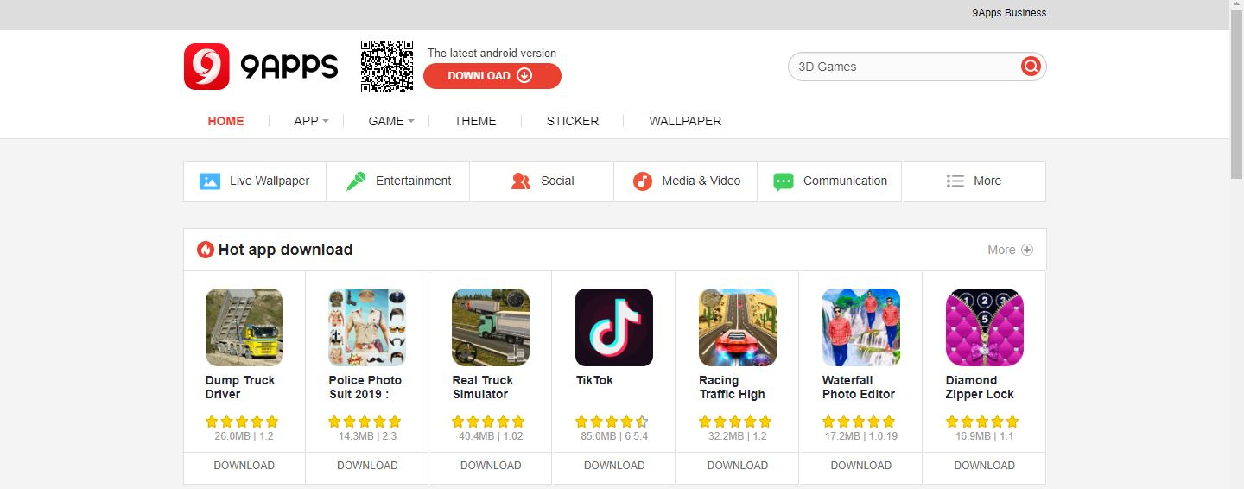

Slide 12
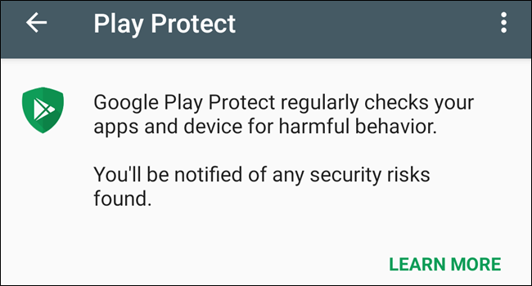
TURN ON GOOGLE PLAY PROTECT
Make sure that Google Play Protect is turned on since it checks the app for any harmful behaviour.
Settings→Biometrics and security→Google Play Protect

Slide 13

USE KASPERSKY(LICENSED VERSION AVAILABLE)
Android device should be checked regularly from malware by using popular Antivirus Apps like Kaspersky.

Slide 14
Malware Apps on Google Play Store
There are some of the apps on Google Play Store which were published as genuine apps.
These apps managed to infect device with malware infecting millions of devices extracting data like call logs,sms,etc.
Example:
CamScanner
Truecaller

Slide 15
Case study : Camscanner
Camscanner is a popular pdf convertor app with over 100million downloads
Recent versions of App installed malware module to compromise the device.
Thus the app extracted data like sms , contacts , device info , etc. to their specific server.

Slide 16
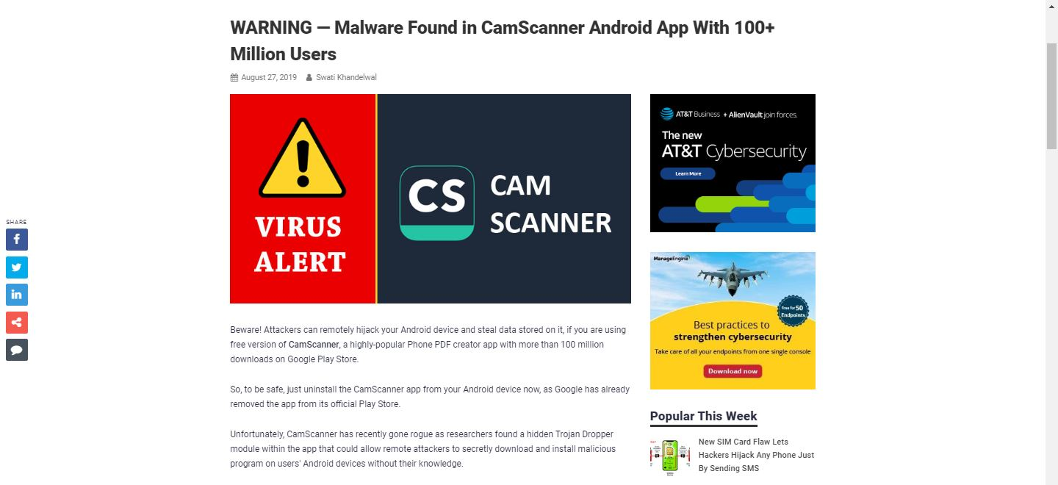

Slide 17
Do not Install Truecaller
Truecaller app initially became very popular application for blocking spam calls, any other number , etc.
This App is malicious as it gets access to all our important contacts ,sms permission, etc. in the name of security.

Slide 18
HOME MINISTRY ADVISORY
Home Ministry in 2017 has already asked all the armed forces to remove malicious Chinese Apps.
These apps classified as malware ,adware ,etc. steal users data seceretly.
BLACKLISTED APPS
Weibo
We Chat
Truecaller
UC News
UC Browser
Etc.

Slide 19
Joker Malware (June 2019)
The malware steals money from a users account by signing them up for premium subscriptions.
It starts by silently simulating interaction with an offer advertisement without the user knowledge.
While subscribing it gains access to user SMS inbox and uses OTP to sign up for subscription.

Slide 20
It also steals contact list and device info from the mobile device.
This malware has been detected in 24 Apps on Google Play Store with over 4,72,000+ installs in total
Countries affected with this malware include India, Australia, Belgium,China,UAE,US,UK,etc.

Slide 21
Google Play Store Apps Infected by Joker Malware
Advocate Wallpaper
Age Face
Altar Message
Antivirus Security-Security Scan
Beach Camera
Board Picture Editing
Mini Camera
Print Scan
Display Camera
Great VPN
Humour Camera
Ignite Clean
Leaf Face Scanner
Certain Wallpaper
Climate SMS
Cute Camera
Collate Face Scanner
Dazzle Wallpaper
Declare Wallpaper
Spark Wallpaper
Ruddy SMS
Sby Camera
Rapid Face Scanner
Display Camera

Slide 22
DISABLE UNKNOWN SOURCES OPTION
This setting allows installing apps that are not from Google Playstore.
Malware Apps can infect the phone if this feature is turned on.
Always keep this setting turned off.

Slide 23
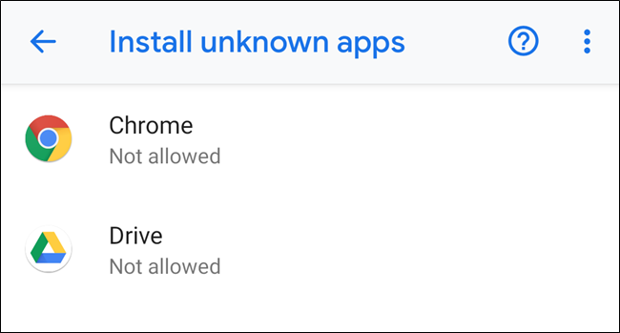
Biometrics and security →Other Security settings →Install unknown apps

Slide 24
Keep Bluetooth turned off
Bluetooth is used to
Share Data
Stream Music using Bluetooth
Stream media on bluetooth enable tv
If Bluetooth is left turned on , suspicious users may try to connect to your device and extract data using system vulnerability.

Slide 25
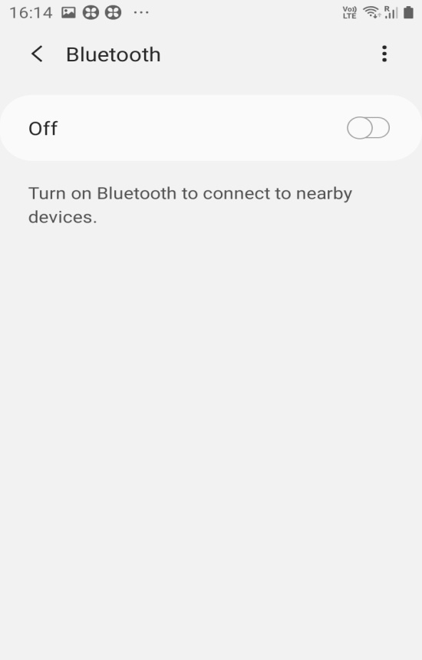

Slide 26
Configure Lock Screen Option
Always set up Screen Lock Password or pattern preferably to prevent any intruder from spying on your phone.
Settings --->Lock Screen---Screen Lock Type
Basic Screen Lock Types:-
SWIPE
PATTERN
PIN

Slide 27
PASSWORD
FINGERPRINT
FACE RECOGNITION
FINGERPRINT ,PASSWORD ARE TWO OF THE BEST OPTIONS TO SECURE OUR ANDROID PHONE
MANY OF THE ANDROID PHONES HAVE STARTED INCLUDING FACE RECOGNITION METHOD TO ADD ADDITIONAL SECURITY

Slide 28
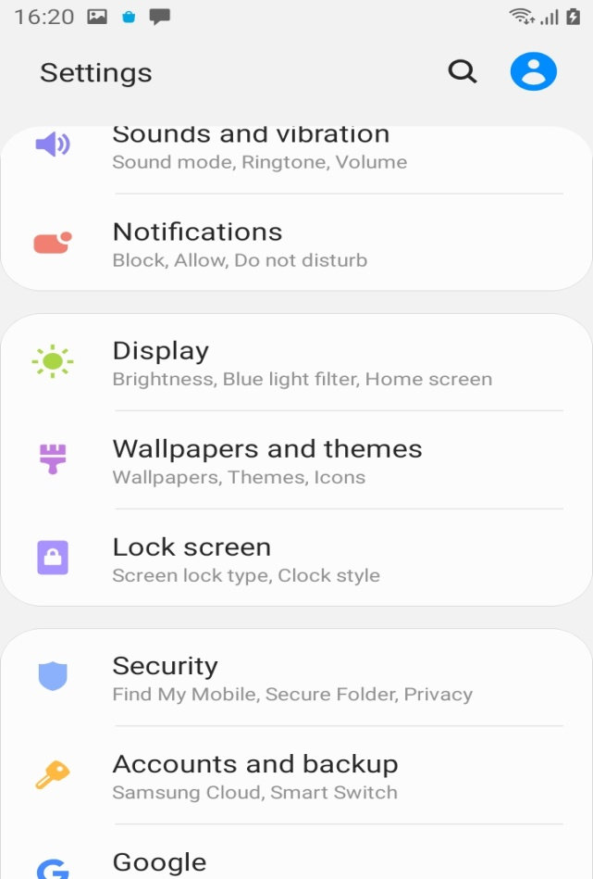
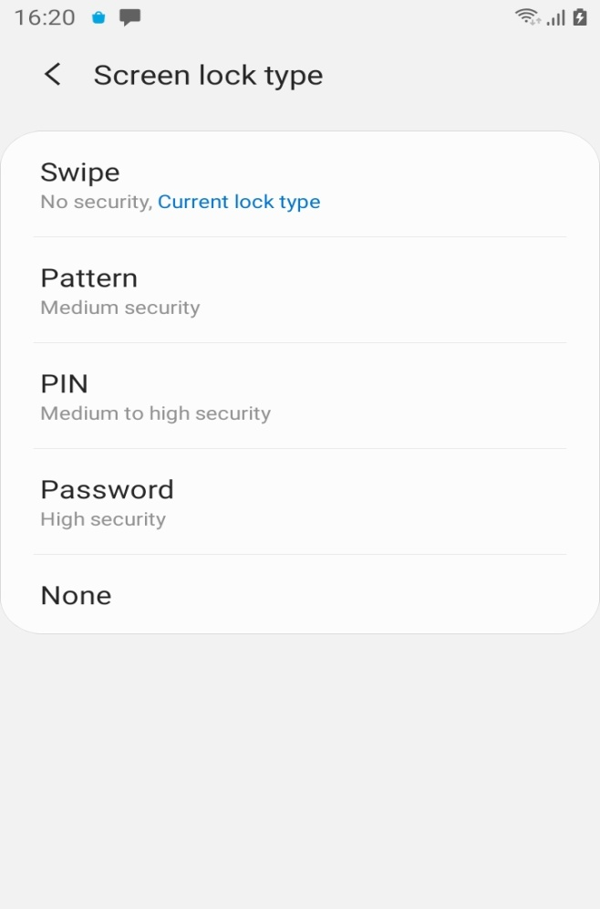

Slide 29
Turn off Make Passwords Visible
Biometrics and security-→Other Security settings Make passwords visible
Keep this option turned off since any keylogger or screen recording capable malware can view record your typed password for all your important personal accounts.

Slide 30
TURN OFF UNNECESSARY PERMISSIONS
Biometrics and security→App permissions
Turn off permissions taken by apps which are not necessarily needed like
Camera
Location
Microphone
Such permissions can be used by malware apps to extract user data, etc.

Slide 31
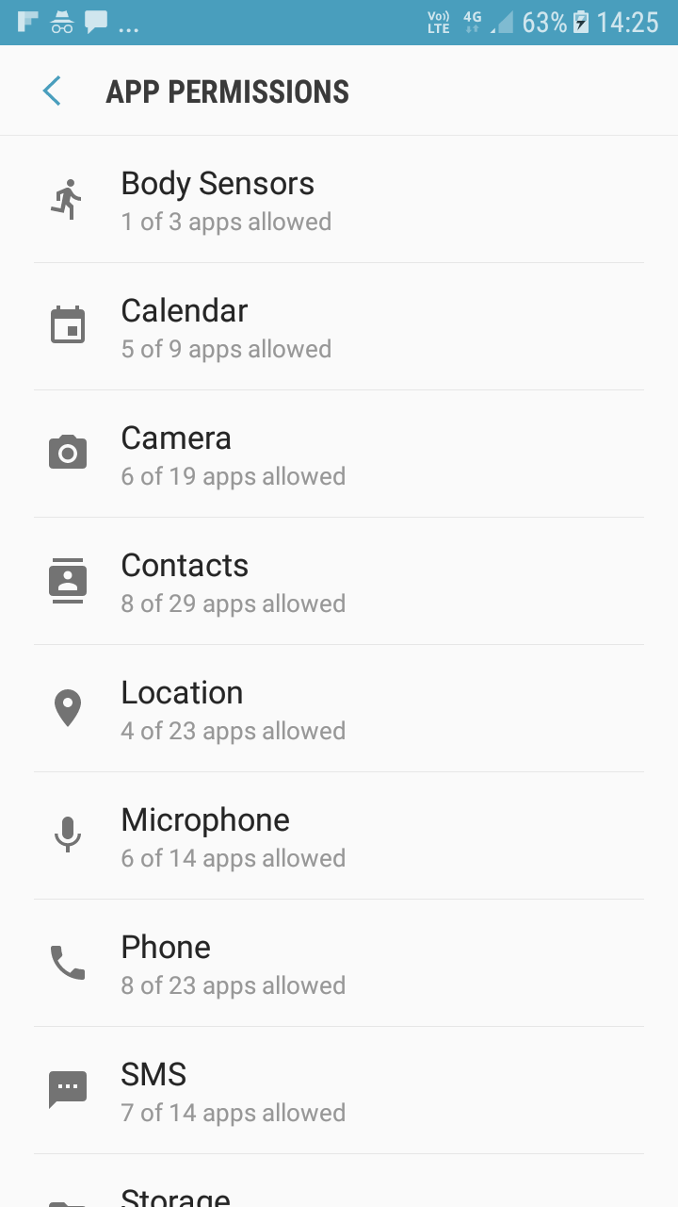

Slide 32
Turn On Anti Malware Protection in Samsung
McAfee Protection is integrated in Samsung devices to protect the android device from malware apps
Device Care → Security→ Anti Malware Protection
Activate Antimalware protection and regulary scan the android device using this option to check for he presence of infected apps in phone.

Slide 33
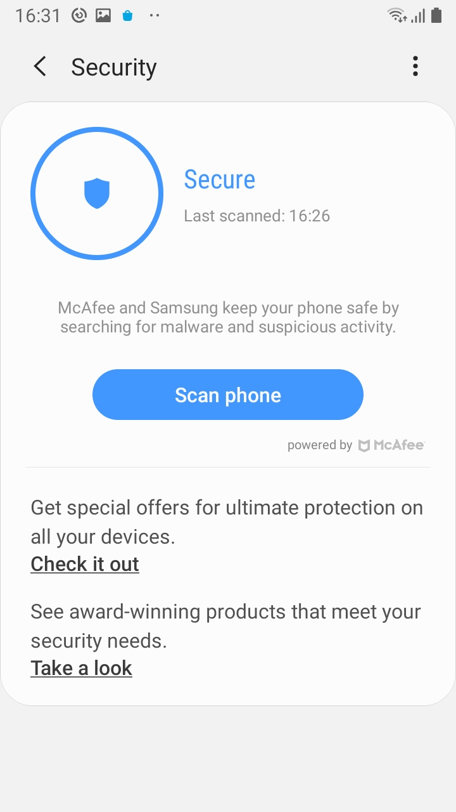

Slide 34
Regularly Install Software Updates
Settings → Software Update
Regularly install software updates to get latest security patch version and other important updates
Updates also include patch for critical system,browser level, etc. vulnerabilities

Slide 35
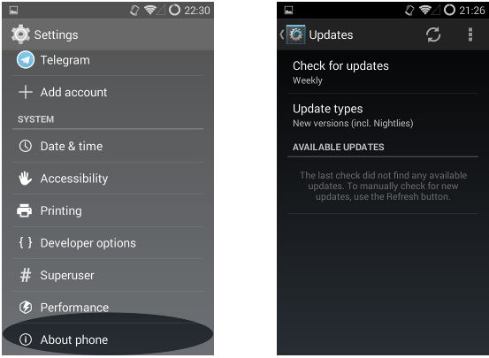

Slide 36
BROWSER SECURITY

Slide 37
Use Incognito Mode In Chrome
Chrome wont save the following information in icognito mode
Your browsing history
Cookies and site data
Information entered in forms
It is useful while performing bank transactions,submitting online application forms ,visiting other sites, etc.

Slide 38
Don’t save passwords in Chrome Browser
Google Chrome→Settings→Basics→Passwords→Save passwords
While visiting websites , do not allow the browser to store credentials
Storing credentials of websites saves rentering credentials while visiting the website again but it poses a great privacy risk.

Slide 39
Download Tor browser App from Google Play Store
When we use App, our Internet trafic is relayed (using relay servers) and encrypted three times as it passes over the TOR network.
Tor browser isolates each website we visit so that third party trackers and ads cant follow us his browser makes it difficult for us to be fingerprinted based on our browser and device information.

Slide 40
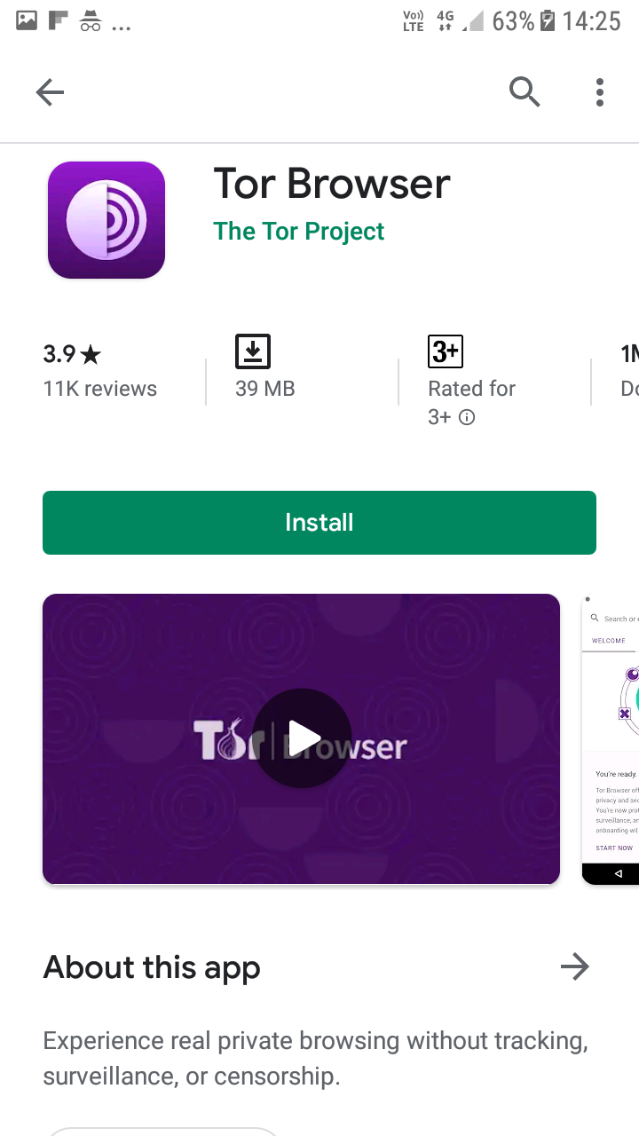

Slide 41
Watering Hole Attack
Attacker collects information about the websites or applications being used by victim.
Those websites or applications which are mostly viewed by the victim are infected with malware using security flaws in applications, web browser, operating system, flash player etc.
When user visits the infected website again, malware is installed secretly on device without using explicit download permission (Drive By download).
Always keep web browser and all types of software up-to-date as preventive measure and do not touch any unknown ad, widget etc.

Slide 42
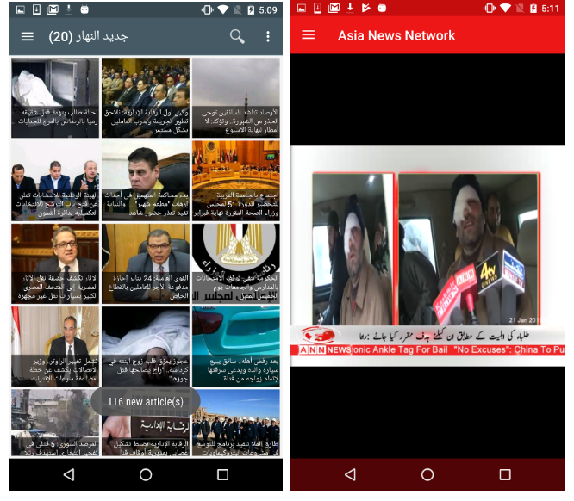

Slide 43

Al-Hayat Newspaper

Slide 44

Telegram, DroFirewall and VPN easy launcher icons

Slide 45
WIFI SECURITY

Slide 46
Be careful while using Open-Wifi
Don’t access personal bank accounts,shop fonline,fill forms, etc. at public places etc. on unsecured Open-Wifi network.
Most open networks do not encrypt the data they send over intenet.
Such unsecured networks might record and seal user information colleced from above mentioned methods which is huge risk for privacy.

Slide 47
Use Stronger Passwords while using Wifi hotspots
If weak password is kept while using hotspot, it may be easily cracked by hackers using various tools.
The hackers might push malware, Trojan to capture android data, track your device once they compromise our phone.
Always keep Strong Wifi passwords(use special characters) to prevent brute forcing an use better encryption.

Slide 48
ADDITIONAL SECURITY SETTINGS

Slide 49
Don’t click/download on any file attachment
from unknown email sender
Precaution must be taken while downloading any mail attachment.
The attachment can be in the form of link, pdf,etc. or any document which can be crafted in a way to arouse maximum interest of the target.
Such attachment may include malicious apk or links that can extract android data like user location, etc.

Slide 50
NOTIFICATION DISPLAY ON LOCK SCREEN
Settings → Lock Screen→ Notifications
Even if you have set lock screen password , someone can see sms , app notifications on lock screen in your absence.
Keep this option turned off.

Slide 51
Don’t Keep Simple passwords
Lock Screen password or App Lock password must no be kept like 0000 or 12434.
Always use special characters while setting passwords.

Slide 52
Update installed Apps Regularly
All the installed apps must be updated regularly because hackers regularly keep on testing and exploiting ay regular app to extract personal data.
E.g.: WhatsApp Video Call Vulnerability (Israel)
(CVE-2019-3168)

Slide 53
IPHONE HARDENING

Slide 54
TOPICS
Device Settings
Browser Security
Wi-Fi Security
Additional Security Settings

Slide 55
iPHONE
iPhone is a chain of smartphones developed and marketed by Apple Inc.
Ios is the operating system of iPhone
Apple has released 12 generations of iPhone models.
The first generation iPhone was GSM phone.
Latest iPhone device is iPhone 11/iPhone Pro
iPhone does follow its own security model but certain steps are to be followed while using it.

Slide 56
pics

Slide 57
Update iOS to the latest version
Settings →General →Software Update
Update always comes with the new features as well as major bugs fix, we need to update our devices and operating systems to avoid major bugs and vulnerabilities.
Automatic updates feature should be turned on to update the iPhone automatically if we forget to update it .

Slide 58
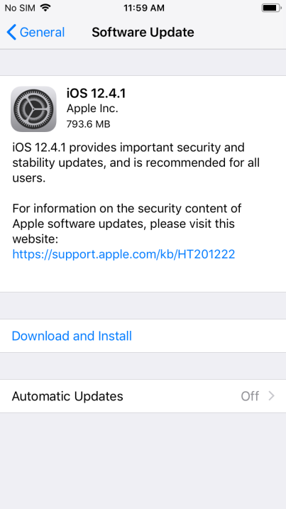

Slide 59
Enable remote wipe functionality
Our device data is more important than the device itself.
In unknown circumstances where the device is lost or stolen, one has to enable remote wipe functionality to remotely wipe all the iPhone data.

Slide 60
Enable Find My iPhone
Using Find My iPhone we can track and remotely lock or erase a Device.
If using iOS 8, also enable Send Last Location:
1. Tap Settings.
2. Tap iCloud.
3. Tap Find My iPhone.
4. Turn on Send Last Location.

Slide 61
Enable Automatic Downloads of App Updates
Always We should keep update our device ,softwares and apps aupdate as new updates are available to avoid old bugs and vulnarabilities,
Since we cant manually check for every apps update avaliblity, hence ios provide a feature in settings to auto update.

Slide 62
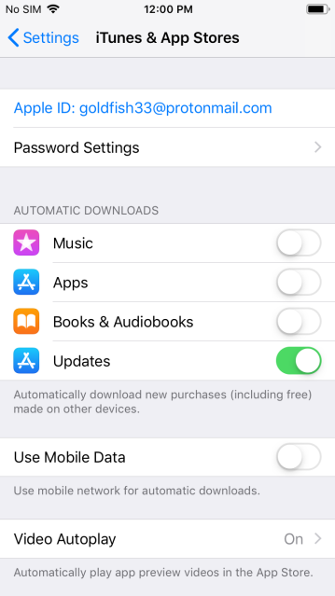
To enable auto update:
1. Tap Settings.
2. Tap iTunes & App Store.
3. Turn on Updates in the Automatic Downloads configuration list.

Slide 63
Encrypt device backups through iTunes
Device data which is backed up using iPhone should be encrypted so that no can read the data even if they are able to access it somehow.
To enable encrypted backups, connect the iOS device to the computer, open iTunes, and check "Encrypt iPhone backup" under Options. Select a strong, complex password when prompted.

Slide 64
Erase all data before return, repair, or recycle
If we give our iPhone to shops for repairing ,our personal data and all communication done through it will be at huge risk.
Before you handover your any device to any person for repair or return, you should erase all your device data.
This ensures that our device data cannot be used
by any notorious party for malicious purpose.

Slide 65
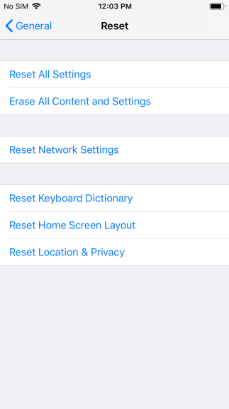
To securely erase a device:
1. Tap Settings.
2. Tap General.
3. Tap Reset.
4. Tap Erase All Contents and Settings.
5. If a passcode is configured, enter the passcode when prompted.

Slide 66
Set Passcode & Touch ID for iPhone
Always set a passcode and Touch ID for your device so that any other person can not access your device in your absence.
Touch ID can be used for
iPhone Unlock
iTunes & App Store
Password Auto fill
Always while using touch id , never use a simple password, always configure with a complex password instead.

Slide 67
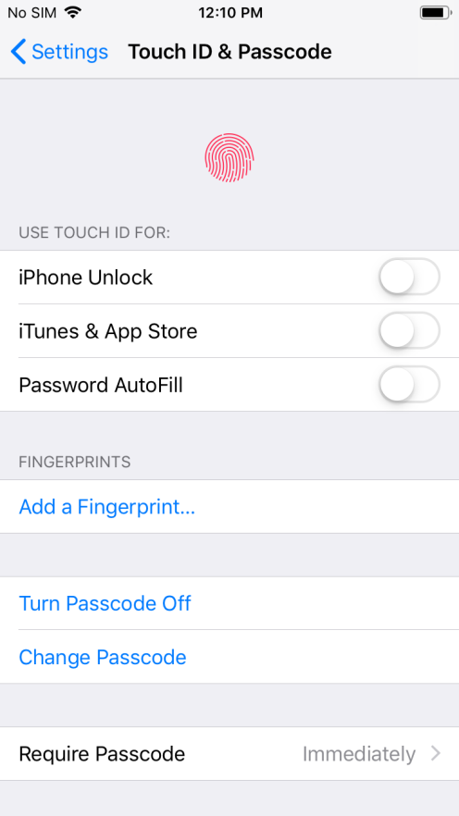
To configure a passcode:
1. Tap Settings.
2. Tap Touch ID & passcode.
3. Tap Turn Passcode On
4. Enter a passcode and then tap Next
5. Enter the same passcode and tap Next again.

Slide 68
Set auto-lock timeout
This option automatically locks the device after it has been inactive for the specified amount of time.
If the auto lock timeout feature is not enabled and the phone is left idle at any place,unwanted users may spy on to our phones data.

Slide 69
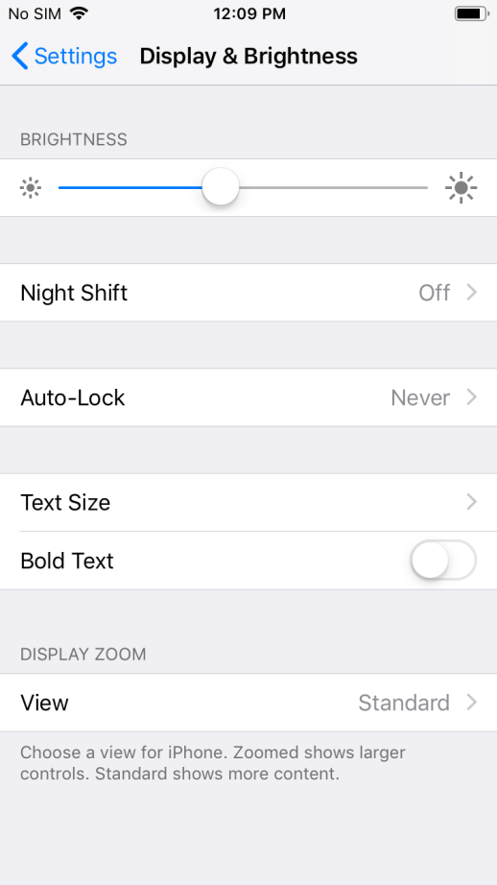
To enable the auto-lock timeout:
1. Tap Settings.
2. Tap Display & brightness.
3. Tap Auto-Lock.
4. Tap “2 Minutes” or one of the other values. Lower values are more secure.

Slide 70
Erase data upon excessive passcode failures
If notorious person has stolen our mobile ,our personal and official data is at huge risk.
Adding passcode to unlock iPhone is a good security measure
Additional security can be implemented by erasing the iPhone in case of multiple passcode failures.

Slide 71

To enable this option:
1. Tap Settings.
2. Tap TouchID & passcode.
3. Tap Passcode Lock.
4. Enter the current passcode when prompted and tap Done
.
5. Turn on Erase Data.
6. Tap Enable.

Slide 72
Enable Fraud Warning in Safari
We might visit a lot of websites based on our specific interest.
If a particular website is malicious, we may not be able to determine its malicious behaviour through manual observation.
Such malicious websites can steal the user data or install malicious applications.
There is option in Safari browser which indicates if a particular website is fraudulent.

Slide 73
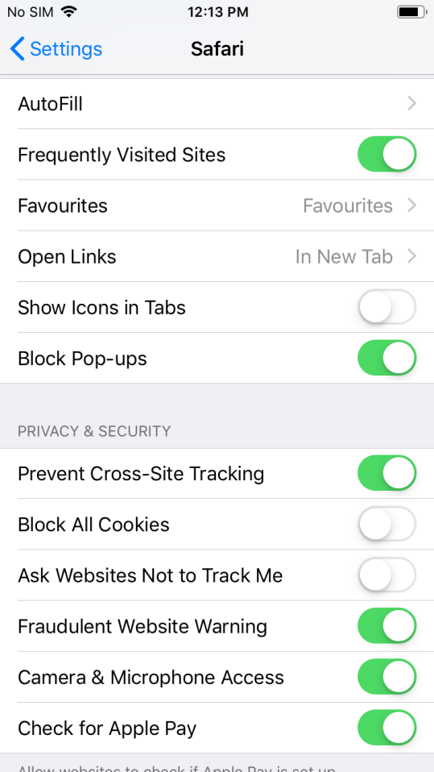
To enable:
1. Tap Settings.
2. Tap Safari.
3. Turn on Fraudulent Website Warning.

Slide 74
Disable AutoFill for sensitive information
AutoFill will remember usernames and passwords etc, and entered into forms automatically.
This Autofill poses a great threat to our data security if we have sensitive information in our iphone.

Slide 75

To enable this option:
1. Tap Settings.
2. Tap Safari.
3. Tap Passwords & AutoFill.
4. Deselect the categories of information you do not want to be saved and automatically filled in.

Slide 76
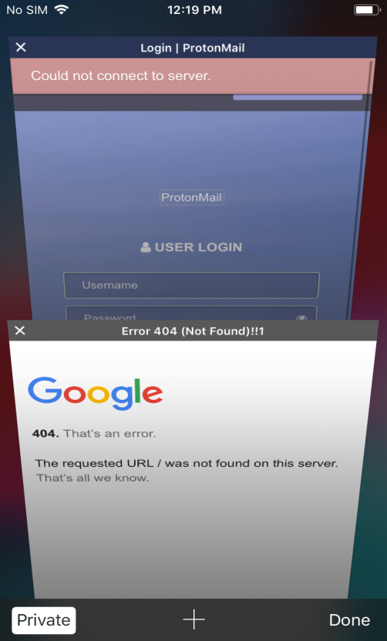
Enable Private Browsing in Mobile Safari
To enable this option:
1. Tap Safari.
2. Tap the Safari button at the lower right of the screen.
3. Tap Private.
4. Select "Close All" or "Keep All" on the "Close All Pages?" dialog box.

Slide 77
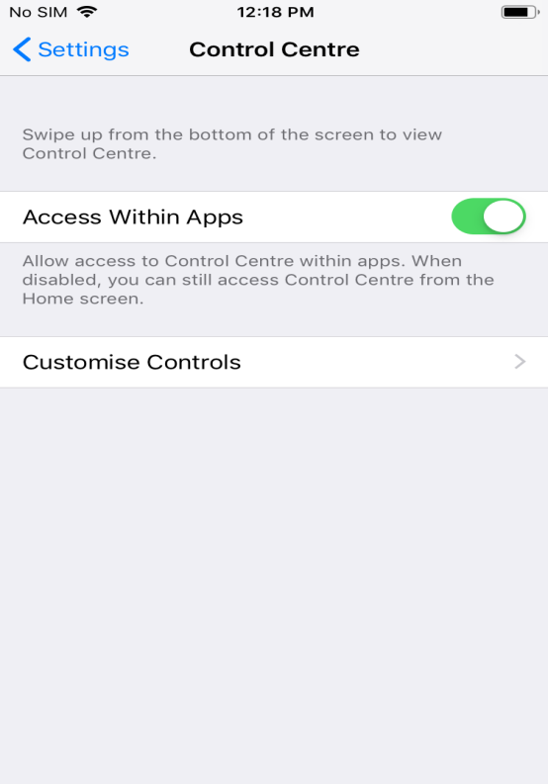
To disable the Control Center from the Lock Screen:
1. Tap Settings.
2. Tap Control Center.
3. Turn off Access on Lock Screen.

Slide 78
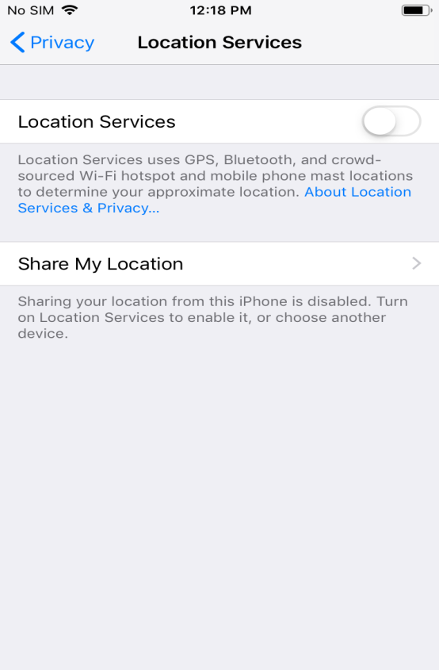
Restrict access to Location Services, etc.
Settings -> Privacy -> Location Services
Specifically choose the applications you wish to allow to access your current location.

Slide 79
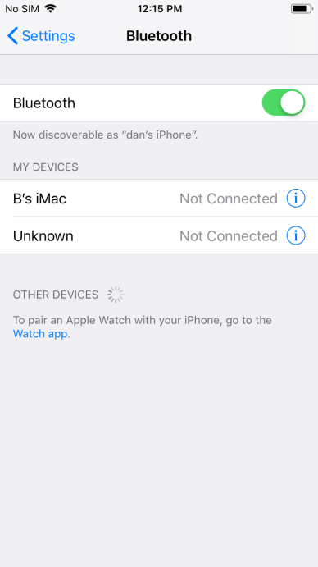
Turn off Bluetooth when not in use
To turn off Bluetooth:
1. Tap Settings.
2. Tap Bluetooth.
3. Turn off Bluetooth.

Slide 80
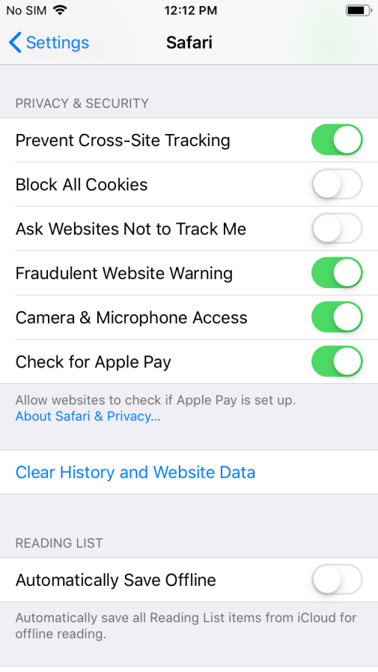
Block cookies from third parties
To configure blocking of third party cookies:
1. Tap Settings.
2. Tap Safari.
3. Tap Block Cookies and select "From third parties and advertisers"

Slide 81
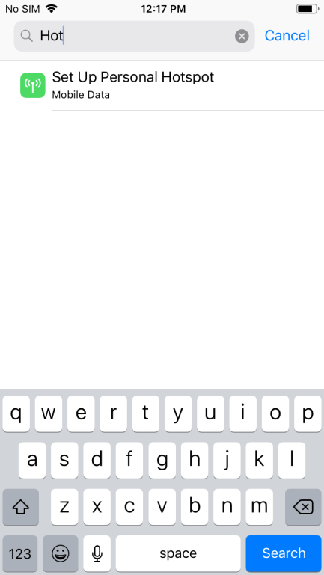
Turn off Personal Hotspot when not in use
To turn off Personal Hotspot:
1. Tap Settings.
2. Tap Cellular.
3. Tap Personal Hotspot.
4. Turn off Personal Hotspot.

Slide 82

Turn off Location Services
To turn off Location Services:
1. Tap Settings -> Privacy.
2. Tap Location Services.
3. Turn off Location Services.
4. Tap Turn off on the confirmation dialog.

Slide 83
AirDrop is easy way to transfer files and information between iOS devices.
To turn AirDrop off:
1. Tap Setting -> general.
2. Tap AirDrop.
3. Tap Off.
Turn off AirDrop when not in use

Slide 84
1. Tap Settings.
2. Tap Safari.
3. Turn on Do Not Track.
Turn on Do Not Track

