Slide 1

iPhone Jailbreaking 101
What is Jailbreaking?
How to Jailbreak an iPhone, iPad or iPod Touch.
Getting Familiar with Cydia
Adding Sources to Cydia

Slide 2
What is Jailbreaking an iPhone?
Jailbreaking an iPhone, iPad or iPod Touch
allows you install additional tweaks and apps on your iDevice by giving you access to the file system which Apple locks.
Simply put, Jailbreaking installs Cydia (similar to the App Store) on your iDevice.

Slide 3
Facts About Jailbreaking
Jailbreaking is 100% Legal
In July, 2010, the U.S Copyright Office ruled that
jailbreaking an iPhone or other mobile device will
not violate federal copyright law.
Jailbreaking is Risk Free
It is not possible to hurt your iOS device by jailbreaking.
You can always restore as new and make it exactly the
way it was the day your purcahsed it.

Slide 4
Why Should you Jailbreak?
Reasons vary but for most people it is one of the following.
Customization - Add themes and change the way your icons, phone or calendar look. There are thousands of cool looking themes to fit your style and mood.
Apps Apple Doesn’t Offer - There are tons. My favorites include iFile which is like Windows Explorer for your iDevice or some the game emulators for Sega, Nintendo and Playstation. 3G Unrestrictor lets you make Facetime calls over 3G.
Cracked Apps - Once jailbroken almost every paid app in the Apple App Store can easily be downloaded for free. While jailbreaking is legal, cracked apps are copyright infringement.

Slide 5
How Hard is it to Jailbreak?
Depends on the Jailbreak. Some are as simple as going to a website on your iDevice in Safari and tapping a button. Others require you to download jailbreaking software, an iOS firmware file and follow simple instructions. That said, the first time can be confusing as there are numerous jailbreaking tools. Redsn0w, blackra1n, greenpois0n, PwnageTool and more. You need to be sure you have the right files for your device and firmware for it work. If it doesn’t work, no big deal, remember it’s risk free. You can try again.
There are numerous websites to help with jailbreaking.
I like http://www.iPhone4idiots.com

Slide 6
_x005F_x001a__x005F_x001a__x005F_x001a__x005F_x001a_Tethered vs. Untethered
Terms used to describe the Jailbreak
Tethered Jailbreak – Tethered Jailbreak refers to the process of removing the restrictions set by Apple in an iPhone by connecting it to thbe computer and then booting the mobile phone with the help of jailbreaking software.
Untethered Jailbreak – It is one where your iDevice runs normally
even after a reboot. This is what you want. Tethered Jailbreaks
are always released first with untethered following about a month
later.

Slide 7
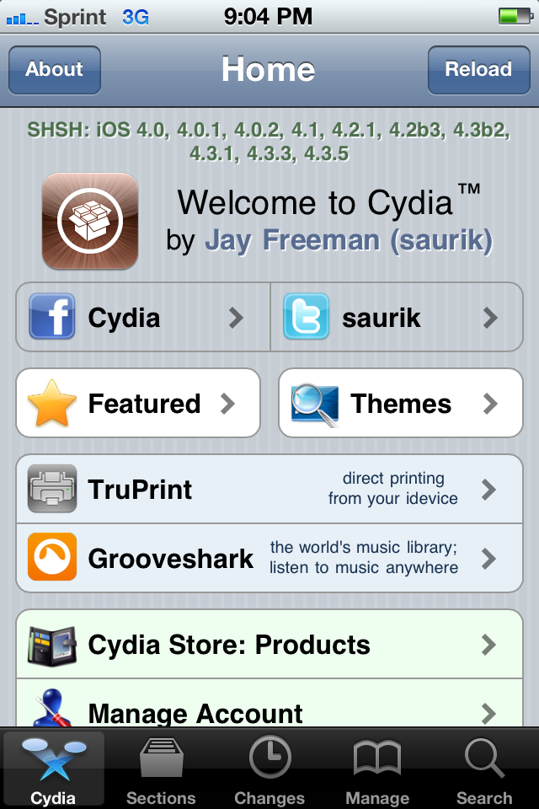
Cydia - The Fun Begins
Once jailbroken just tap Cydia and you are taken to Home Screen seen here. You’ll certainly want to install some of the Featured items.

Slide 8
For Additional Info
http://www.iphone4idiots.com
http://youtube.com/iphone4idiots
http://facebook.com/iphone4idiots

