Slide 1

Guided by :
Internal Guide Name : Dr. Minu Susan Jacob
EMPLOYEE MANAGEMENT SYSTEM
Name : Manisri Venkatesh Digumalla
Reg No : 41611042
Branch : CSE Specialization in Artificial Intelligence and Machine Learning

Slide 2
Presentation Outline
Introduction
Objectives
System Architecture / Ideation Map
Module Implementation
Project Implementation
Software & Hardware Requirements
Results and Discussions
Future Scope
Conclusion
References

Slide 3
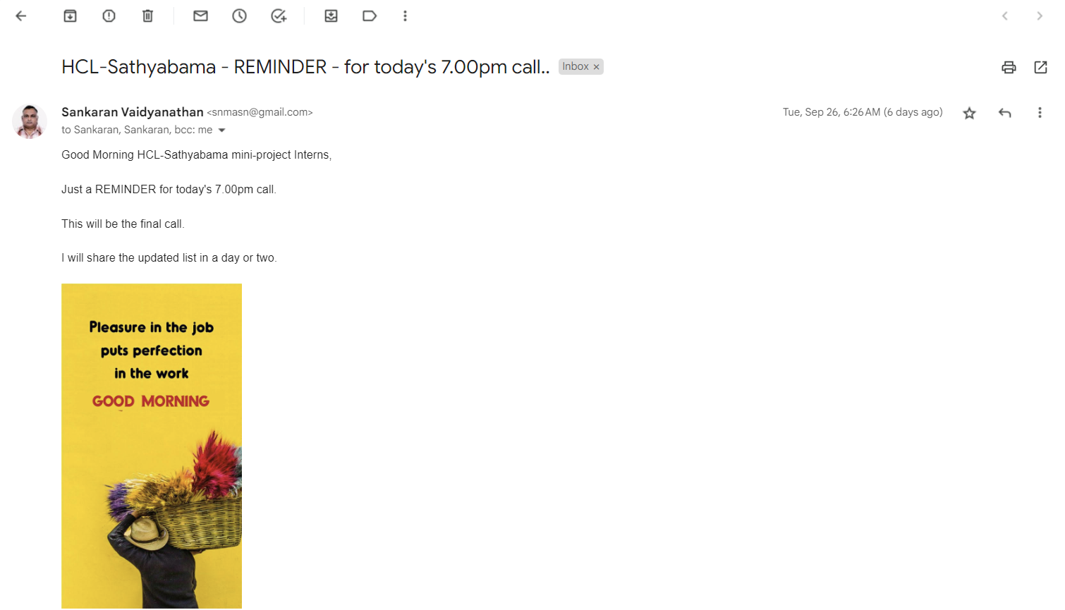
Course Certificate

Slide 4
Introduction
Managing employee records is a crucial task for any organization. An effective system to store, view, update and manage employee data can save time and effort for HR teams
Employee Management System is a distributed application, developed to maintain the details of employees working in any organization.
It maintains the information about the personal and official details of the employees.
The system allows users to perform basic CRUD (Create, Read, Update, Delete) operations to manage employee records. New employees can be added with details like name, ID, salary, work, contact info, and date of joining. All records can be viewed in a tabular format.
Existing records can be searched, updated and deleted as needed. Additional features like sorting by different fields and filtering by salary range or work provide more ways to manage the data.

Slide 5
Objectives
This project aims to simplify the task of maintaining records of the employees of Company.
To develop an well-designed database to store employee information.
Implement sorting algorithms to sort employee records by name, ID or salary
Show how sorting, searching and filtering can be implemented in C
Validate user input and handle errors gracefully.
Allow searching records by employee ID to retrieve specific employee data

Slide 6
Objectives
Filter employee records based on criteria like salary range or department.
Implement CRUD (Create, Read, Update, Delete) functionality for managing employee records.
The objective of this project is to provide a comprehensive approach towards the management of employee information.

Slide 7
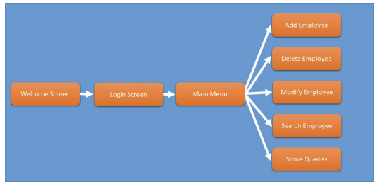
System Architecture
Architecture of Employee Management System

Slide 8
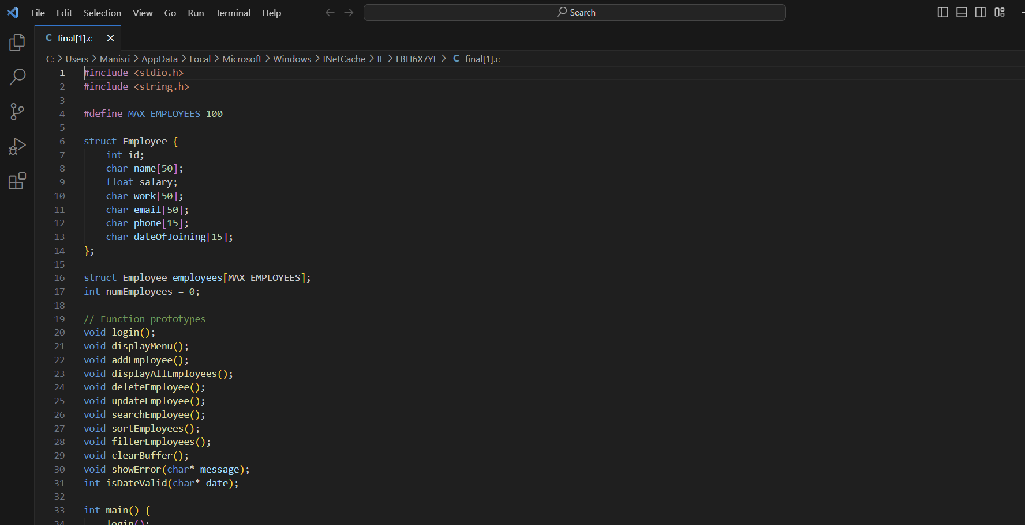
Module Implementation
Main dart

Slide 9
Project Implementation
Design the employee data structure (struct) to hold all the required details like ID, name, salary, etc.
Create an array of employees with MAX_EMPLOYEES capacity to store the records.
Implement a simple user login function with hardcoded username and password.
Create a menu function to display options for user to choose like add, update, delete etc. Use a switch case or if-else ladder for option selection

Slide 10
Project Implementation
Implement all the Functions which are mentioned
Add comments and headers for readability.
Add any additional features like file handling for data persistence.
Visual Studio Code is a source-code editor made by Microsoft for Windows, Linux and macOS.

Slide 11
Software & Hardware Requirements
Software Requirements & Hardware Requirements
C compiler like GCC/G++, Visual Studio etc. to compile the code
C standard library for functions like printf(), scanf(), string operations
Git or any version control system for source code management
x86 or x64 architecture system with minimum 2 GHz processor
2 GB RAM for smooth running of the compiler and tools
100 MB free storage space for installing tools and libraries
Keyboard and monitor for coding and providing user inputs

Slide 12
Results and discussion
Results and discussion
The system was successfully implemented in C using concepts like arrays, structures, sorting algorithms and string functions
Additional features like searching, sorting and filtering of records were implemented
Sample employee data was added, updated, deleted and filtered to test the system
All core functions of the system were thoroughly tested with different test cases
Storing data in memory arrays works for small datasets, but file handling can be added to support disk storage
Additional features like reporting, GUIs can also be added to improve the system
The system meets the primary objectives and requirements of building a basic employee management system

Slide 13
Future Scope
Add a system to create an account
Add printer in future.
Give more advanced programs for the system including more facilities.
Improve the program for more heavy Duties.
Develop a self-service portal for employees to update their personal information, view payslips, and manage their leave requests.

Slide 14
Conclusion
This project demonstrated the implementation of a basic employee management system using core C concepts like arrays, structs, sorting and strings.
Key operations like adding, updating, deleting employee records were implemented along with features like searching, sorting and filtering.
Overall, the project served as a hands-on learning experience for using fundamental C concepts in a practical application
More validations can be added to strengthen input checking. Other improvements like GUIs, authentication and encryption can also be incorporated.

Slide 15
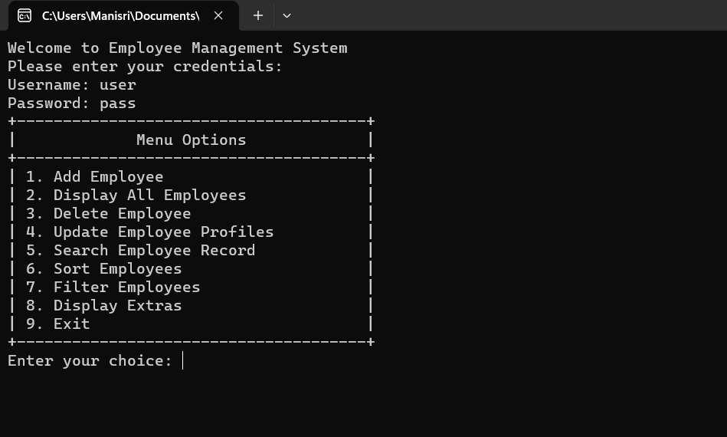
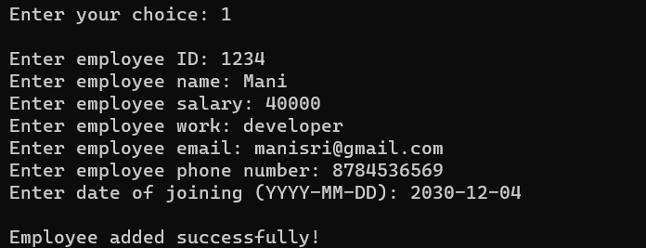
Application - Snapshots
Login And Menu Options
Add Employee

Slide 16
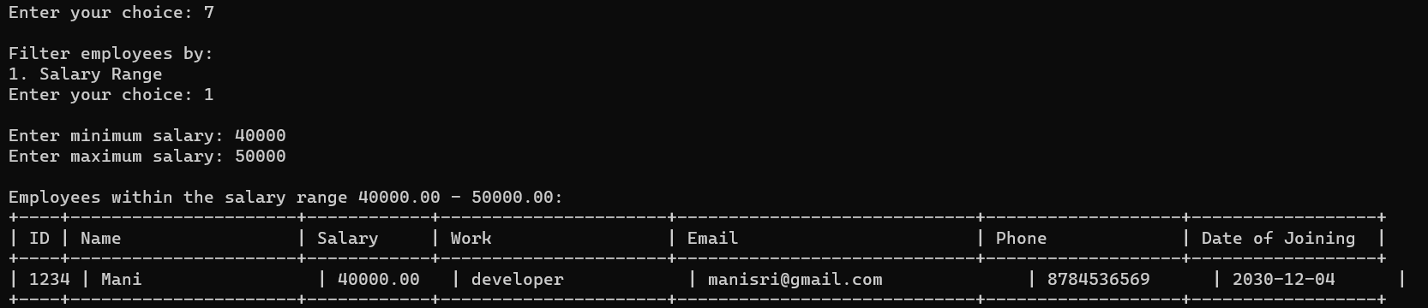
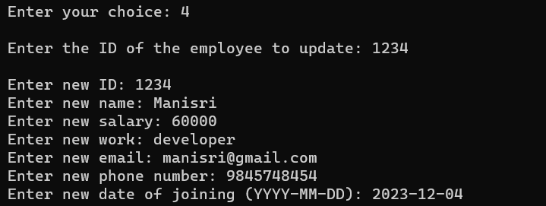
Application - Snapshots
Update Employee Data
Filter Employees

Slide 17
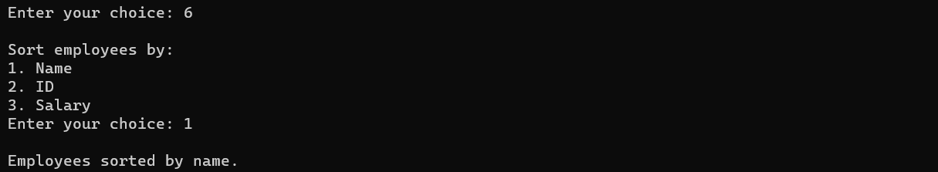
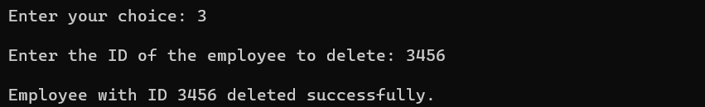
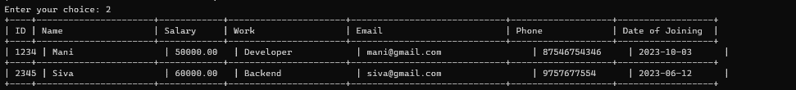
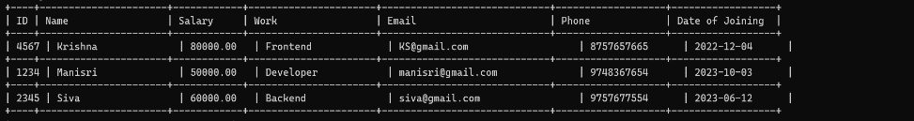
Application - Snapshots
Delete Employee details
Sort Employees

Slide 18
References
Geeksforgeeks: https://www.geeksforgeeks.org/program-for-employee-management-system/
Studytonight: https://www.studytonight.com/c-projects/employee-management-system-project-using-c-language
https://www.youtube.com/watch?v=SR7aiZFz1V8
w3schools: https://www.w3schools.com/c/c_intro.php

