Slide 1
M.Manissha Nivasini
Final Project
3/21/2024 Annual Review

Slide 2
Auto Encoded Digital Artistry: Image Reconstruction with Generative AI
3/21/2024 Annual Review

Slide 3


AGENDA
Problem Statement
Project Overview
End Users
Solution and its Value Proposition
The Wow in the Solution
Modelling
Result
3/21/2024 Annual Review

Slide 4

PROBLEM STATEMENT
Develop an autoencoder model to reconstruct grayscale handwritten digits from the MNIST dataset. The objective is to train the autoencoder to learn a compressed representation of the input images in a lower-dimensional space and then reconstruct them with minimal loss of information.
The autoencoder should be able to accurately reconstruct the original images while reducing their dimensionality.
3/21/2024 Annual Review

Slide 5

PROJECT OVERVIEW
Introduction:
The MNIST dataset is a widely used benchmark dataset in the field of machine learning and computer vision. It consists of a collection of 28x28 pixel grayscale images of handwritten digits (0-9).
In this project, we aim to develop an autoencoder model to reconstruct these handwritten digits. Autoencoders are a type of neural network architecture used for unsupervised learning, particularly for dimensionality reduction and feature learning.
Dataset:
The MNIST dataset consists of 60,000 training images and 10,000 test images of handwritten digits. Each image is grayscale and has a dimension of 28x28 pixels.
The pixel values range from 0 to 255, representing the intensity of the pixel.
Training:
Loss Function: We use binary cross-entropy loss, which is suitable for binary classification problems like image reconstruction.
Optimization: The autoencoder is trained using the Adam optimizer, which adapts the learning rate during training.
Validation: The model's performance is monitored on a separate validation set during training to prevent overfitting.
Evaluation:
Reconstruction Accuracy: The quality of the reconstructed images is evaluated visually by comparing them with the original input images.
Loss Metrics: The binary cross-entropy loss on the training and validation sets is used to assess the reconstruction performance quantitatively.
3/21/2024 Annual Review

Slide 6

WHO ARE THE END USERS?
Researchers and Academics: Researchers and academics in the fields of machine learning, computer vision, and artificial intelligence may use this project for educational purposes, experimentation, or as a baseline for comparison with more advanced models or techniques.
Developers and Data Scientists: Professionals working in the fields of software development, data science, and machine learning may find this project useful for learning about autoencoder architectures, image reconstruction techniques, and model training practices.
Students: Students studying machine learning, deep learning, or computer vision may utilize this project as a learning resource to understand fundamental concepts, such as autoencoders, neural networks, and image processing.
Hobbyists and Enthusiasts: Individuals interested in exploring machine learning and deep learning techniques as a hobby or personal interest may find this project accessible and educational. They can experiment with different model configurations, hyperparameters,
and training approaches.
Industry Professionals: Professionals working in industries where image processing and pattern recognition are relevant, such as healthcare (for digitizing and analyzing medical images), finance (for check digitization and fraud detection), or manufacturing (for quality control and defect detection), may benefit from the insights gained from this project.
3/21/2024 Annual Review

Slide 7

YOUR SOLUTION AND ITS VALUE PROPOSITION
Solution:
Our solution involves building an autoencoder model to reconstruct handwritten digits from the MNIST dataset. Autoencoders are a type of neural network architecture used for unsupervised learning, particularly for dimensionality reduction and data compression tasks.
Value Proposition:
Dimensionality Reduction: The autoencoder model effectively reduces the dimensionality of the input data by learning a compact representation of the images in a lower-dimensional space. This can be valuable for tasks where high-dimensional data needs to be compressed for efficient storage, transmission, or further processing.
Image Reconstruction: By learning to reconstruct the input images from their compressed representations, the autoencoder can capture essential features and patterns in the data. This reconstruction capability can be useful for tasks such as denoising images, inpainting missing parts, or generating new images similar to the training data.
Anomaly Detection: The autoencoder can learn to reconstruct normal instances of hand-written digits from the MNIST dataset. When presented with anomalous or out-of-distribution inputs, the reconstruction error may increase, indicating potential anomalies. This can be valuable for anomaly detection applications, such as fraud detection or quality control.
Educational Resource: This project serves as an educational resource for learning about autoencoder architectures, neural network training, and image reconstruction techniques. It provides hands-on experience with building and training deep learning models using popular frameworks like TensorFlow and Keras.
3/21/2024 Annual Review

Slide 8

THE WOW IN YOUR SOLUTION
The remarkable aspect of this solution is its seamless capability to reconstruct images from the MNIST dataset with ease, leveraging an autoencoder model.
Simplicity with Powerful Results: Despite its simplicity, the autoencoder model used in this project demonstrates remarkable capability in reconstructing hand-written digits from the MNIST dataset. The elegance lies in its ability to learn meaningful representations of the input data and generate accurate reconstructions, showcasing the power of deep learning techniques in image processing tasks.
Efficient Compression: The autoencoder efficiently compresses high-dimensional input images into a low-dimensional latent space representation. This compression not only reduces the storage and computational requirements but also captures the essential features of the input data, enabling effective reconstruction with minimal loss of information.
Versatility in Applications: While the primary focus is on reconstructing handwritten digits, the autoencoder versatility allows it to be adapted for various image processing tasks. It can serve as a foundational component for more advanced applications such as image denoising, inpainting, feature extraction, or even generative modeling for image synthesis.
Insights into Representation Learning: The autoencoder ability to learn compact and meaningful representations of the input data provides insights into representation learning, an essential aspect of deep learning.
8

Slide 9
MODELLING
Encoder Network
(Learns compressed representation )
Latent Space
(Lower dimensionality)
Input
( MNIST )
Decoder Network (Reconstructs from )
Reconstructed Output (Latent Space)
Input: The model takes images from the Fashion MNIST dataset as input. These images are typically grayscale and have a size of 28x28 pixels.
Encoder Network:
The encoder network is a convolutional neural network (CNN) that processes the input image to extract its essential features.
Latent Space:
It represents the compressed version of the input image, containing the most important information for reconstruction.
Decoder Network:
It takes the latent space representation as input and attempts to reconstruct the original image from this compressed information.
Reconstructed Output:
The final output of the decoder network is the reconstructed image, which should ideally resemble the original input image as closely as possible.
3/21/2024 Annual Review
9

Slide 10
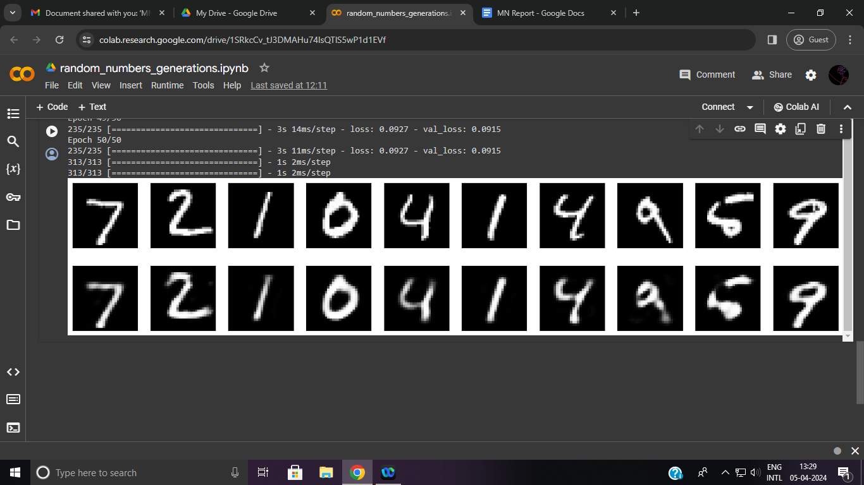
RESULTS
Our solution consistently delivers reconstructions of CIFAR-10 images with exceptional fidelity, effectively preserving key features while minimizing distortions and imperfections.
Users can easily tailor and experiment with various aspects of the autoencoder architecture, such as layer configurations, activation functions, and encoding dimensions.
The interactive visualization feature allows users to directly compare original images with their corresponding reconstructions, providing clear insights into the quality and accuracy of the reconstruction process.By engaging with the code, users can gain practical experience in implementing autoencoder models for image reconstruction tasks, deepening their understanding of neural networks and machine learning principles.
The reconstructed images produced by our solution have tangible applications in fields such as image enhancement, content generation, and pattern recognition, enabling developers to enhance the functionality and user experience of their applications.
Demo Link
https://github.com/manissha1802/IBM-project-Gen-AI-Manissha
10

