Slide 1

Logistics Delivery Time Prediction System
Predict delivery durations more accurately by combining route optimization, real-time traffic, weather, and historical delivery records. Designed for courier, e-commerce, and supply chain teams to improve on-time performance and operational efficiency.
Mr.RELLA MANISURYA DEEP
324129510051

Slide 2

Slide 1 — Executive Summary
Problem: Static schedules and averages fail under dynamic conditions. Solution: A unified prediction system that uses route optimization, traffic feeds, weather data, vehicle status, and historical records to generate accurate delivery time estimates and actionable route plans.

Slide 3



Slide 2 — Business Objectives
Improve On-Time Delivery
Optimize Fleet Utilization
Data-Driven Decisions
Reduce late deliveries and SLA breaches through more accurate ETAs and proactive rerouting.
Maximize vehicle productivity and minimize idle time with demand-aware routing and dispatching.
Centralized analytics and dashboards enable continuous improvement and strategic planning.

Slide 4

Slide 3 — Key Inputs & Data Sources
Essential inputs:
GPS route geometry and distance
Real-time traffic feeds (speed, incidents)
Historical delivery records and timestamps
Weather conditions and forecasts
Vehicle availability, load, and driver schedules
Delivery priority and time windows
These data sources feed feature engineering and model retraining pipelines.

Slide 5
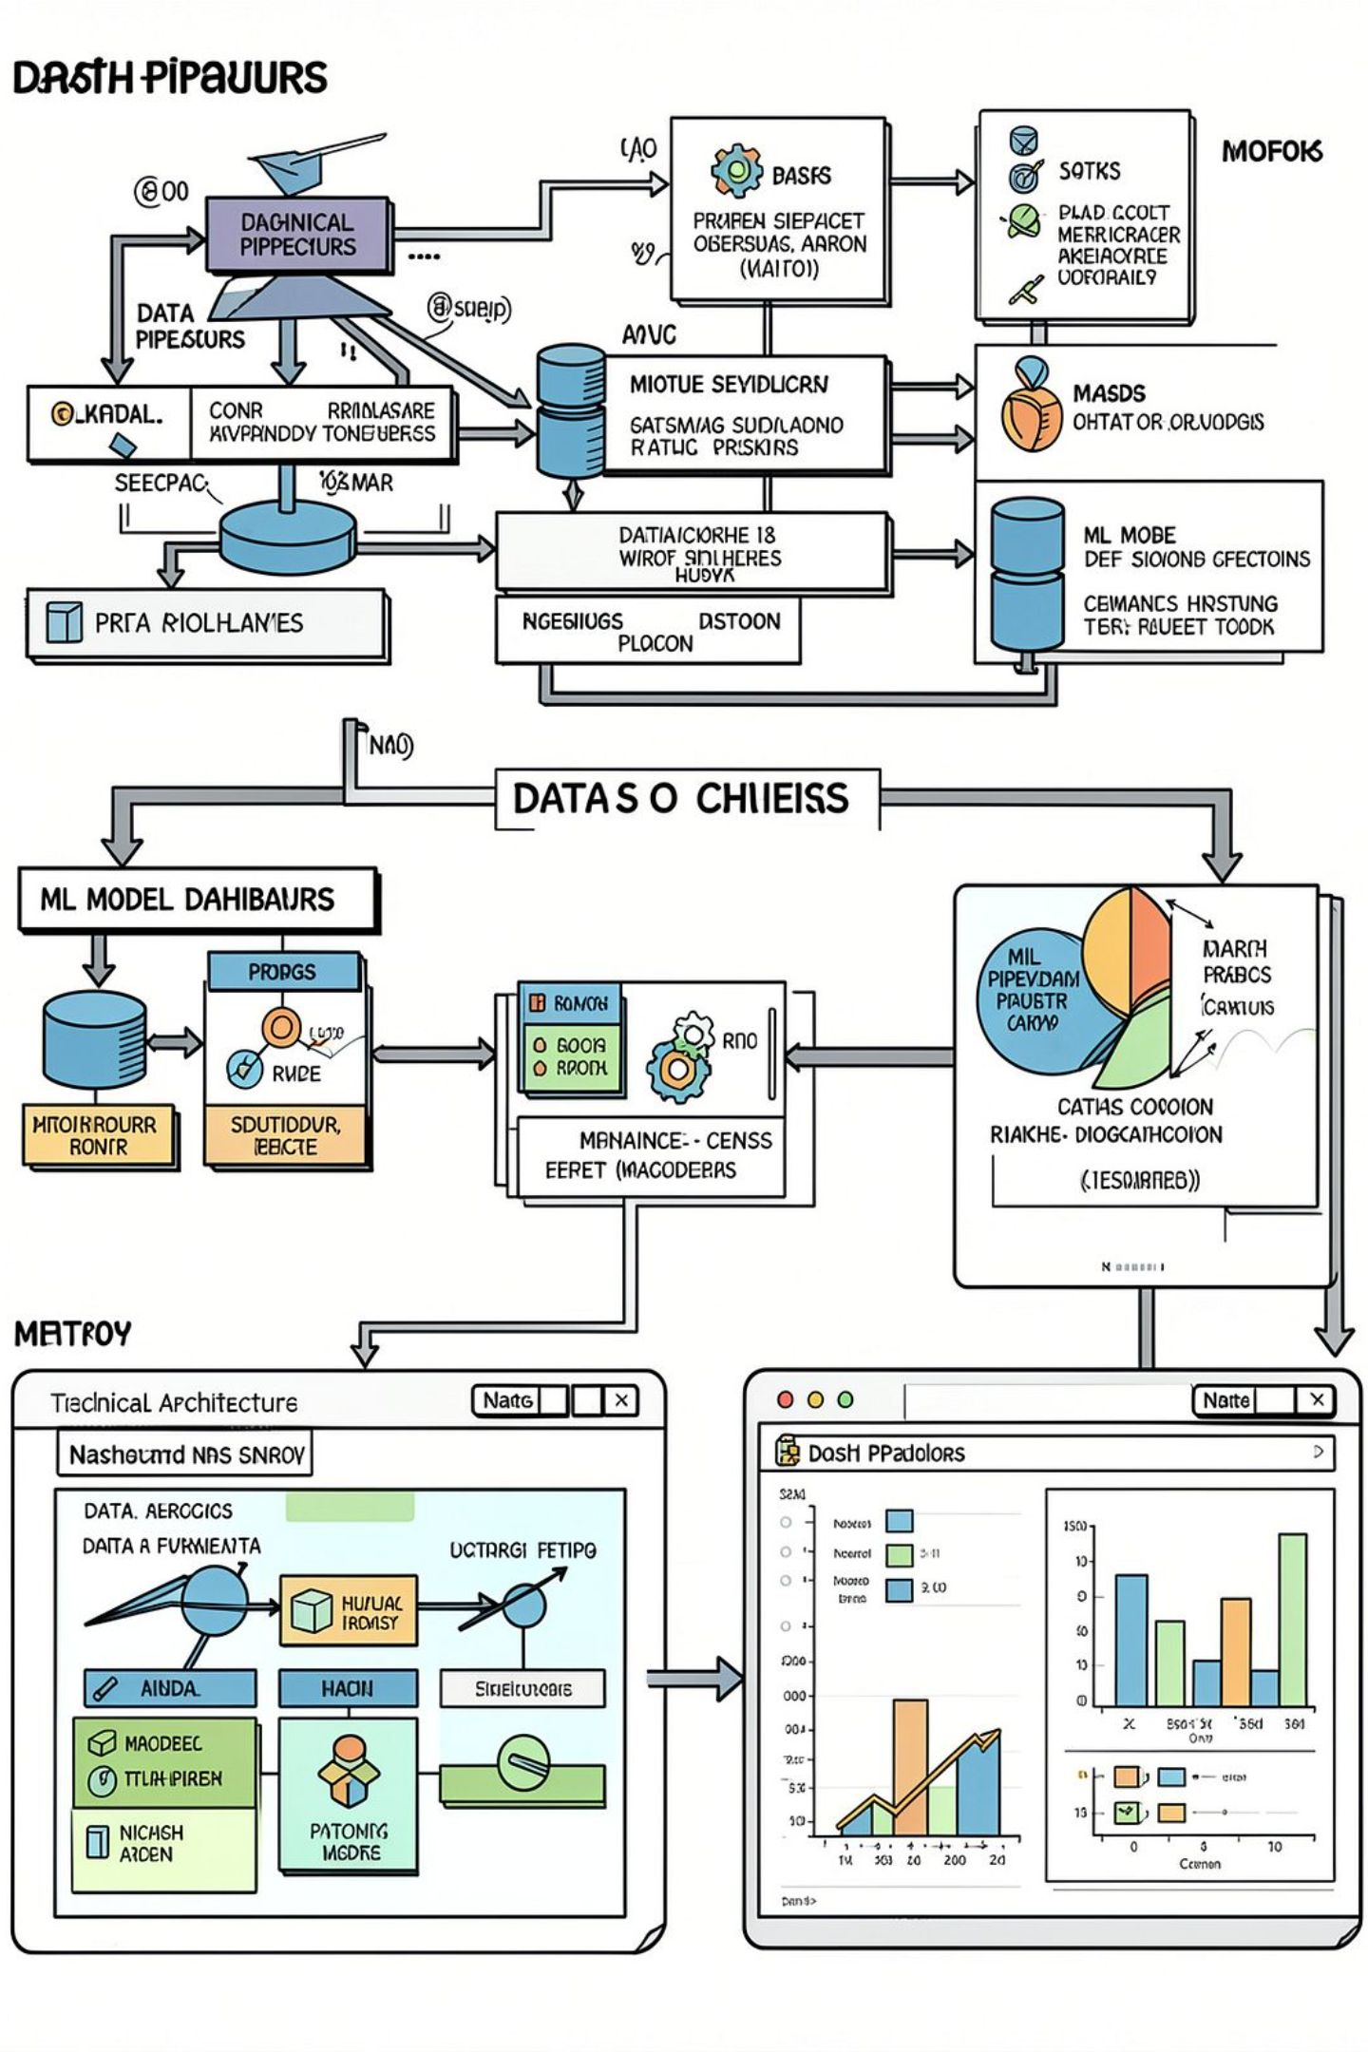
Slide 4 — System Architecture Overview
Data ingestion → feature store → model training (regression/ensemble) → route optimizer → prediction API → interactive dashboard. Scalable cloud-native design supports batch and streaming data.

Slide 6

Slide 5 — Modeling Approach
Techniques: Gradient boosting, random forests, quantile regression for uncertainty, and meta-model ensembles.
Features: route segments, rolling traffic averages, weather flags, driver performance metrics, temporal encodings (hour, weekday, holiday).
Metrics: MAE, RMSE, 90th percentile error, and calibration of predicted windows.
Feature Engineering
Model Training
Deployment

Slide 7
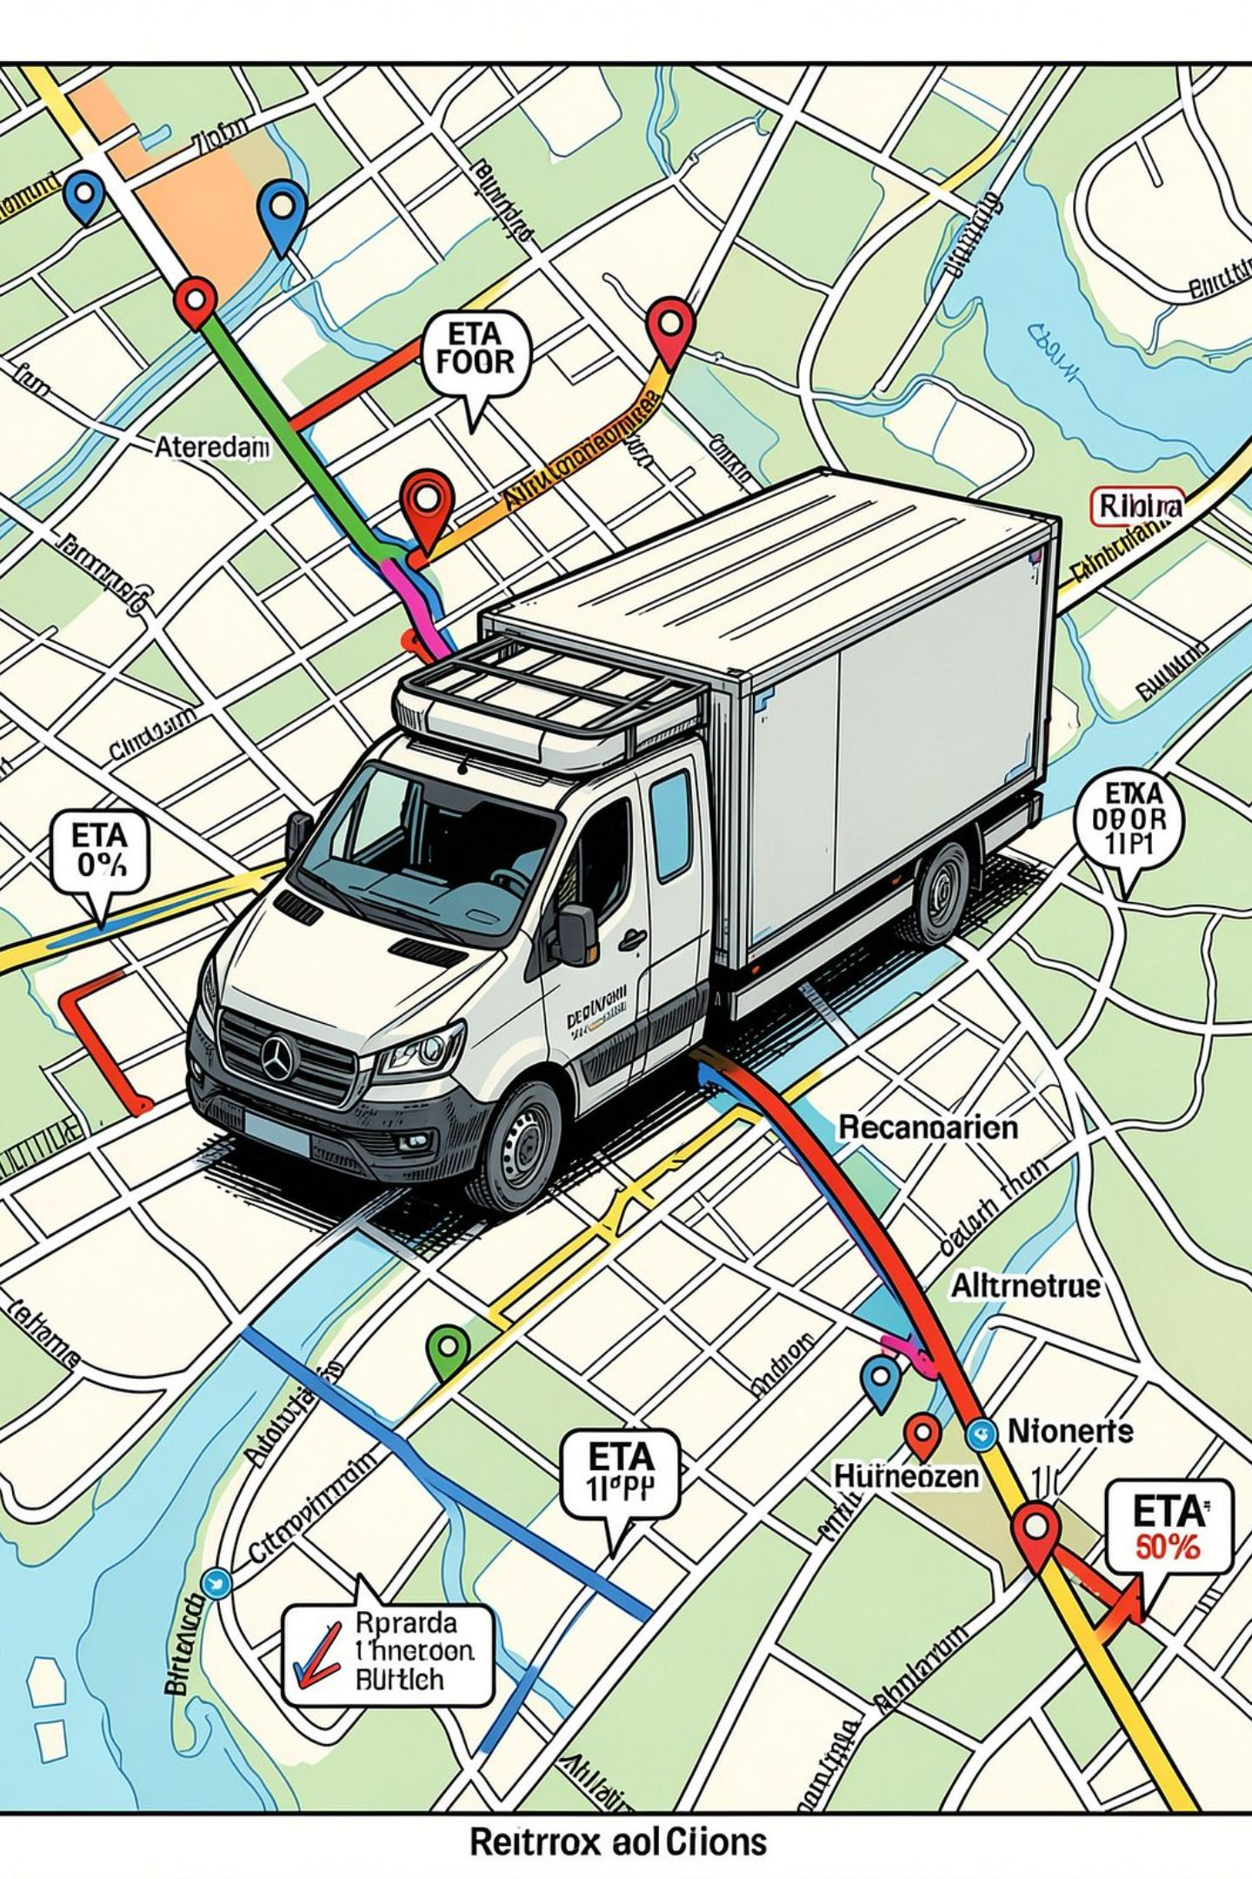
Slide 6 — Route Optimization & Real-Time Adjustments
Constrained Optimization
Dynamic Replanning
Realtime traffic and incident feeds trigger rapid route recomputation with minimal disruption.
Respect time windows, capacities, and driver shifts while minimizing total travel time.
Predictive Buffers
Use quantile predictions to add data-driven slack to schedules and improve on-time rates.

Slide 8
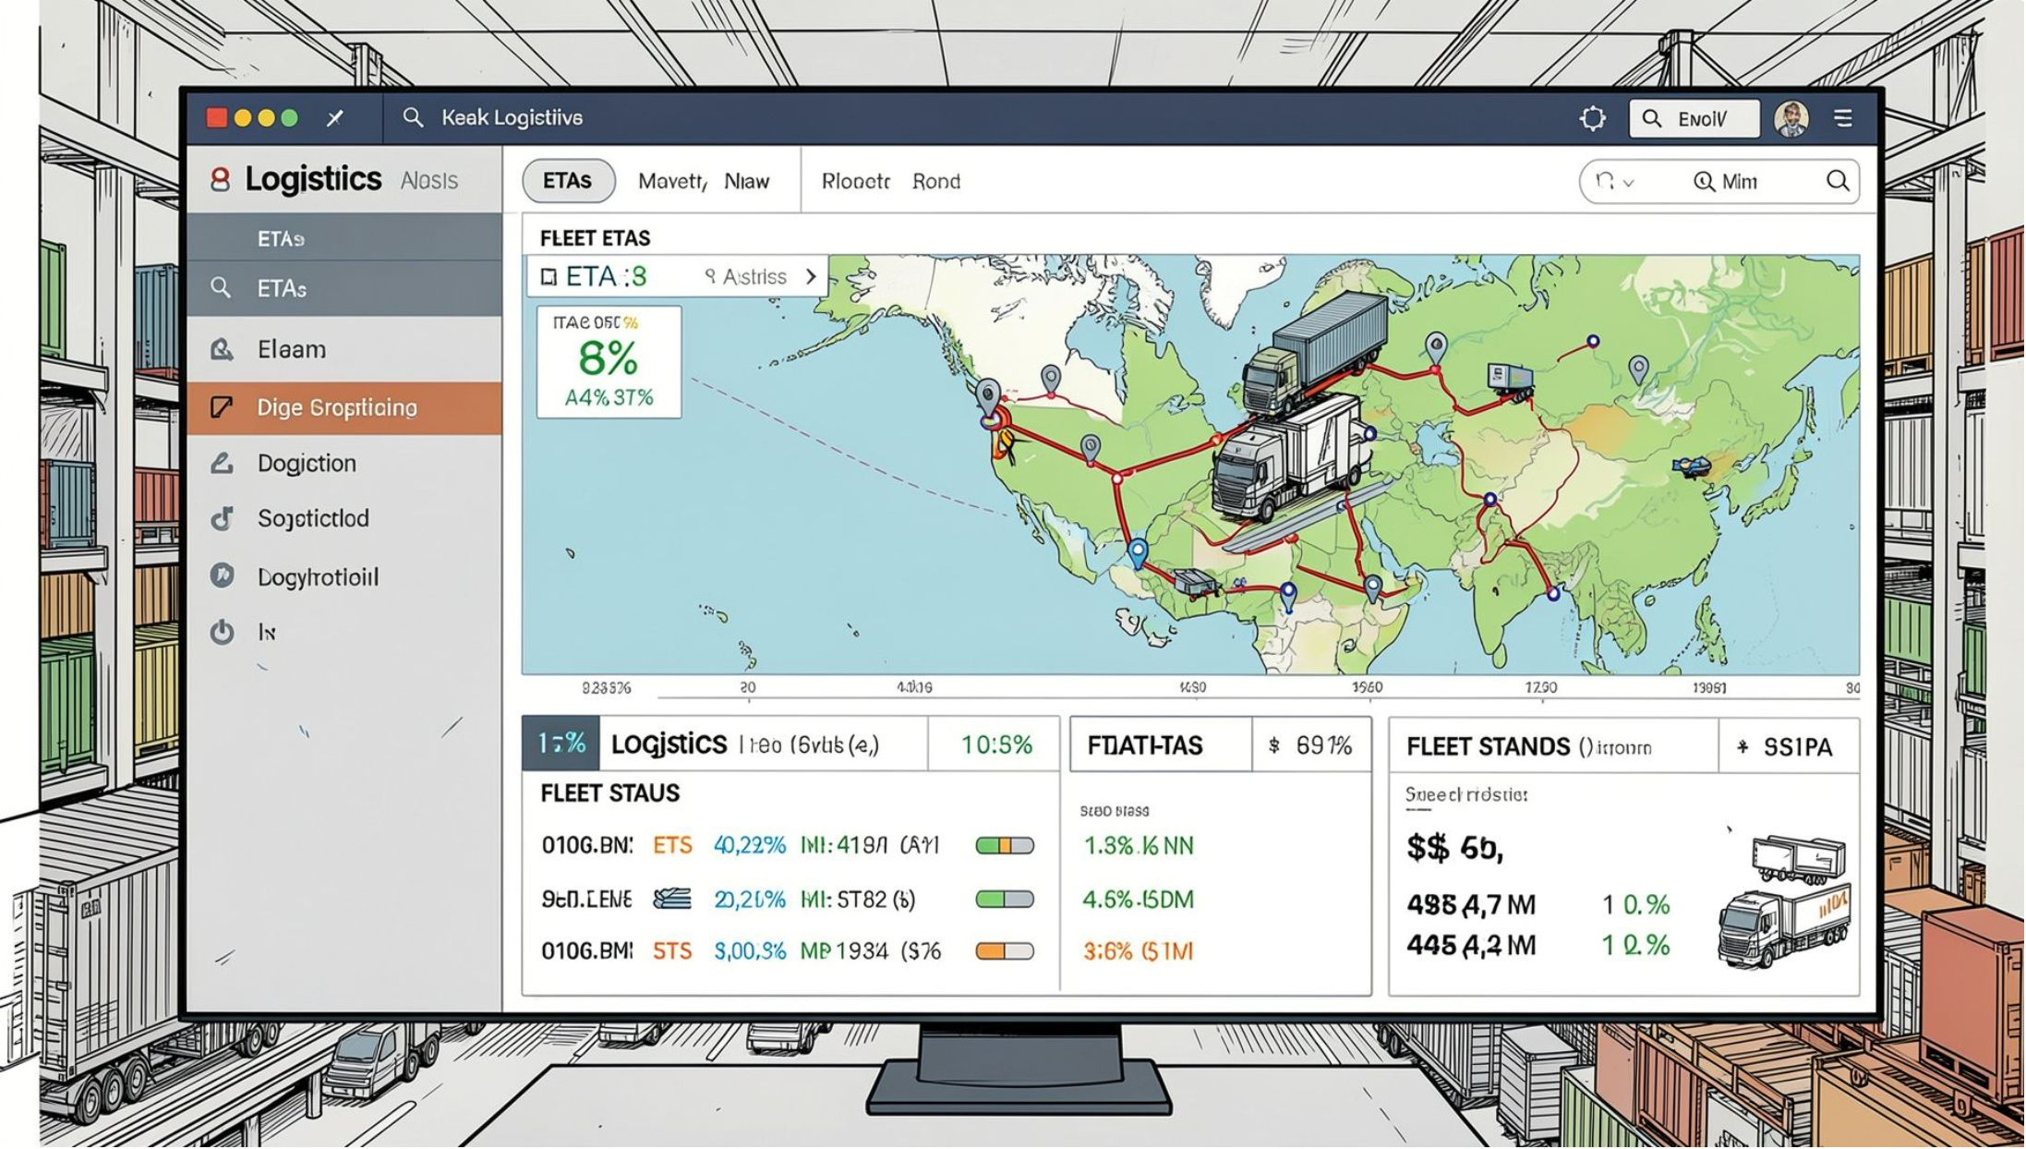
Slide 7 — Dashboards & Operational UX
Views: Live route monitoring, delivery risk alerts, fleet KPIs, and historical trend analysis.
Manager view: SLA compliance, hotspots, and fleet health
Dispatcher view: Re-route suggestions, manual overrides, and ETA confidence
Customer-facing: Estimated delivery windows and proactive notifications

Slide 9

Slide 8 — Security, Scalability, and Integration
Delivered as a secure, multi-tenant service or on-premises deployment. Key considerations:
Encryption at rest and in transit; role-based access control
API-first design for WMS/TMS and telematics integration
Autoscaling pipelines for peak delivery periods and batch reprocessing

Slide 10
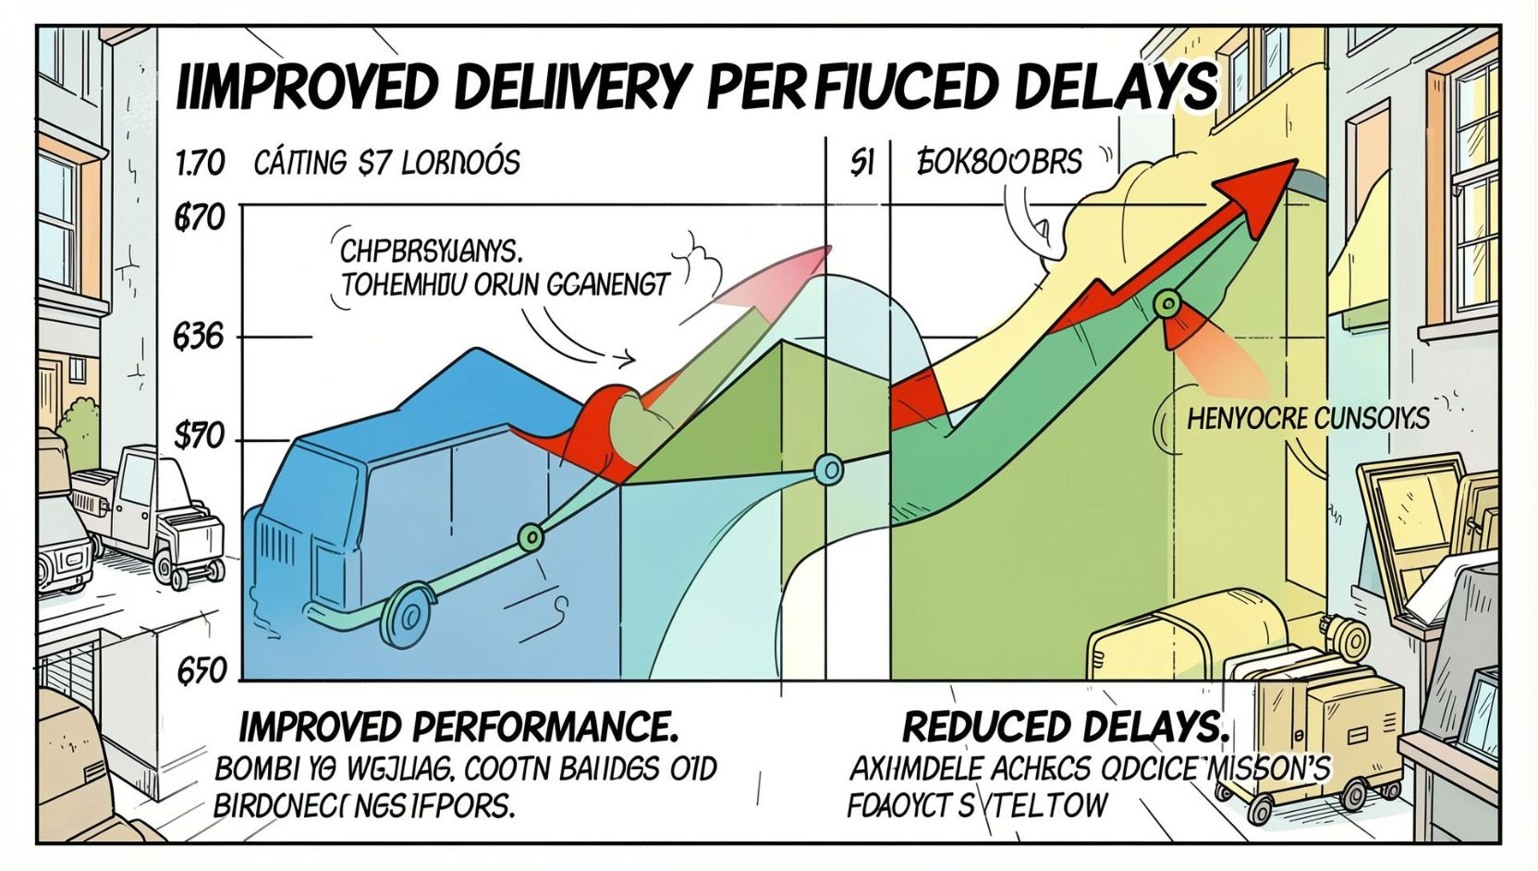

Slide 9 — Business Impact & Next Steps
1
2
Pilot
Scale
Run a 6–8 week pilot on a targeted region to collect training data and baseline performance.
Iterate models and expand to regional fleets; integrate with customer notifications.
3
Optimize
Continuous improvement via A/B testing of routing strategies and model variants.
Next steps: define pilot metrics, secure data feed access, and allocate engineering & operations resources.

