Slide 1
ProjectPilot AI
Iteration 3
Live specialists and review
Team 5 CSE 3311 November 1, 2026
01
Notes:
Team 5, CSE 3311. Iteration 3, November 1, 2026. This update shows live specialist deliverables and a revisable workflow. Play the accompanying captioned live demo at the execution section. Source: November 1 implementation, commits 2114a17 and e1af1d5.

Slide 2
Users and project scope
One student building a small web application
Demo example: a study-session tracker
Current result: approved deliverables and revision history
Next goal: a complete runnable project
02
Notes:
Our target is one student working on a small class or portfolio web application. We selected a study-session tracker as a concrete demo, with course, minutes, add/delete and totals. We also tested a narrow ProjectPilot retry-design task with the real API. The current output is reviewable deliverable text, including code samples. We have not yet generated and executed a complete project directory. Target-user sessions are still pending. Source: docs/ITERATION_3.md and recorded live demo.

Slide 3
Iteration 2 feedback and our response
Feedback | Iteration 3 response
Specialists with retry | Live calls, bounded automatic retry, manual recovery
Feedback must change work | Rewrite outputs and dependent deliverables
Small demo text and screenshots | Larger app text and separate report figures
Localhost-only demonstration | Hosted application on Vercel
03
Notes:
Professor Christoph Csallner provided Iteration 2 feedback on October 26. The major requested next step was specialized agents with retry. We also made feedback change actual live output, increased readable text and deployed the app. Peer review added more specific reliability, privacy and UI findings. Those are tracked separately from target-user interviews. Sources: professor comments supplied by the team and Team 6 Iteration 2 review.

Slide 4
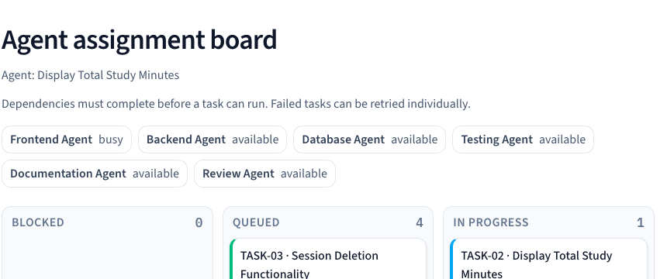
Live specialist execution
04
Notes:
Play ProjectPilot_AI_Iteration3_Demo.mp4 alongside this slide. The recording uses actual hosted OpenAI responses. It starts with access and consent, then clarifies a study-tracker brief, approves requirements and starts the task graph. Workers run serially in dependency order. A worker receives actual prerequisite outputs, which distinguishes this implementation from isolated role prompts. Source: recorded live demo and src/lib/store.tsx.

Slide 5
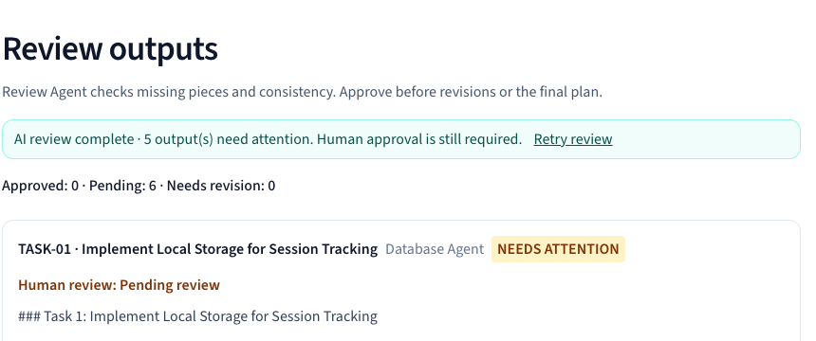
Output review
05
Notes:
The specialist returns structured fields: deliverable summary, assumptions, blockers, confidence and next steps. The review role receives all outputs and checks them against task contracts and approved requirements. Missing or invented review IDs are rejected. Conflicts block approval and final export after the peer-review fix. Missing-item flags remain visible for assessment. Model confidence is not measured accuracy. Source: specialist-schema.ts, workflow.ts and actual hosted screenshot.

Slide 6
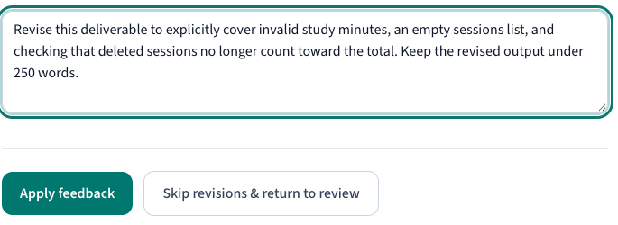
Feedback and regeneration
06
Notes:
This is the actual feedback screen. Selected roots and their transitive dependents return to their specialist roles. Each request includes the previous deliverable and the requested change. Unrelated approvals survive, and new deliverables need fresh approval and another review. Live mode rewrites content. Demo mode clearly replaces its sample output. Source: store.tsx and real hosted recording.

Slide 7
Recovery and human control
One automatic retry, then visible manual recovery
Completed unrelated work stays intact
Conflicts block approval and final export
Revised outputs always need human approval
07
Notes:
Server calls attempt a timeout or invalid output at most twice. Authentication and billing errors return directly. The user can retry a failed task without discarding unrelated completed work. Skipped work stays incomplete and blocks its dependents. Conflicts cannot be approved. Browser persistence restores work, and damaged saves retain a recovery copy when storage is available. Sources: 21 workflow tests and implementation.

Slide 8
Architecture and shared state
Layer | Responsibility
React workflow | Editable scope, task board and approval screens
Browser state | Project, task graph, outputs, feedback and recovery
Next.js API | Access checks, validation and bounded provider calls
OpenAI roles | Manager, specialists and cross-output review
08
Notes:
The browser owns a single saved project, not a shared cloud database. Next.js routes own the model key, input guards and output validation. A signed HttpOnly access session protects production live calls. A private invitation code and data-sharing consent precede paid requests. The app does not execute model-generated code. Source: types.ts, store.tsx, live-access.ts, specialist endpoint.

Slide 9
Verification evidence
Check | Result | What it establishes
Automated workflow tests | 21 passed | Gates, retries, restore and export behavior
Production build and lint | Passed | Compilation and static checks
Keyboard workflow | Chrome and WebKit | Critical screens work without a mouse
Real hosted API demo | Recorded | Actual generation, review and revision
09
Notes:
All 21 automated Node tests pass. The last six specifically cover keyword boundaries, strict conflicts, signed access/consent, damaged saves, delayed timeouts and detailed export contents. The timeout deadline is scaled to 30 milliseconds in the test; we do not claim a full 55-second browser timing test. Keyboard-only flows passed in Chrome and WebKit, including editing, board navigation, review, revision, export and reset cancellation. The hosted demo makes actual live model calls. Sources: tests/workflow.test.cjs; docs/iteration3-evidence/peer-review-browser-results.json; live recording.

Slide 10
Peer review disposition
17 addressed
1 requires real student participants
Added access and consent, conflict gates, input checks, recovery tests, bottom navigation and clearer metrics.
Peer review remains separate from target-user testing.
10
Notes:
Team 6 supplied eighteen findings about Iteration 2. Reviewers were David, Ujjwal Sood and Hardik Kari. They are not Team 5 author names. Seventeen findings are addressed through the implementation, verification and readable submission screenshots. Finding seven requires real target-student sessions and remains open. Peer review is useful feedback, but it is not a usability study. Full issue-by-issue mapping appears in the written deliverable.

Slide 11
Related applications
Application | Existing strength | Our evaluation question
Codex and Claude Code | Codebase work and execution tools | Do students prefer this explicit workflow?
ChatDev | Configurable multi-agent systems | Does our narrow scope reduce confusion?
CrewAI | Agents, tasks, crews and flows | Does the student UI add useful guidance?
No comparative productivity or retention result yet
11
Notes:
The primary sources show that Codex and Claude Code already perform substantial software work. ChatDev supports multi-agent workflows, and CrewAI offers orchestration abstractions. Our proposed value is a narrower classroom workflow with explicit task contracts, approvals and saved revision state. We have not measured an advantage over these tools or over one agent. Sources accessed November 1: https://developers.openai.com/blog/codex-as-a-platform ; https://code.claude.com/docs/en/overview ; https://github.com/OpenBMB/ChatDev ; https://docs.crewai.com/en/introduction .

Slide 12
Five biggest risks
Risk | Probability | Impact | Exposure
Generated files fail to build | 50% | 16 h | 8.0 h
Specialist interfaces disagree | 35% | 18 h | 6.3 h
API interruption or quota | 40% | 10 h | 4.0 h
Scope exceeds iteration | 30% | 12 h | 3.6 h
Students see little added value | 40% | 8 h | 3.2 h
Estimates for planning. Exposure = probability × extra hours.
12
Notes:
These are planning estimates for the next increment, not measured probabilities. Exposure equals probability times extra team hours. Responses: establish a narrow file manifest and build first, pass interface contracts, keep bounded retry and controlled access, restrict the first runnable app, and test with actual students before expanding scope. Full mitigation timing appears in the report.

Slide 13
Updated implementation plan
Period | Result or proposed exit condition
Iterations 1 and 2 | Workflow, live manager and browser persistence
Iteration 3 | Live specialists, review, revisions and deployment
Next milestone A | Assemble actual project files in one supported stack
Next milestones B and C | Run build/tests, offer preview and ZIP, observe students
13
Notes:
Iterations one and two established the workflow, live manager and persistence. Iteration three added real workers, feedback and hosted access. Proposed internal next-iteration targets are November 2 to 3 for file assembly, November 4 to 5 for isolated builds/tests, and November 6 to 8 for preview, ZIP and user evaluation. These are planning targets rather than confirmed course deadlines. Individual ownership still needs team agreement.

Slide 14
Next iteration makes a project
Actual source files with consistent dependencies
A working preview and downloadable ZIP
Real build and test results with bounded repair
Feedback that changes files and reruns verification
14
Notes:
The user selected complete project generation as the next iteration goal. Success means actual assembled files, a working preview, a downloadable package and honest build/test results. Start with one small stack and a study tracker. Model-generated snippets alone do not meet this goal. Feedback must change the generated files and trigger another verification pass. This is planned work, not a claim about Iteration 3.

Slide 15
Demo and references
projectpilot-ai-cse3311.vercel.app
Video: ProjectPilot_AI_Iteration3_Demo.mp4
Implementation and tests: GitHub / manit0700 / projectpilot-ai-cse3311
Feedback: Christoph Csallner, Oct 26, and Team 6 Iteration 2 review
API: OpenAI Structured Outputs documentation
Related tools: Codex, Claude Code, ChatDev and CrewAI
15
Notes:
The video is captioned and silent, approximately two to four minutes depending on real API latency and conflict correction. Open the MP4 alongside the deck. It contains no API key or unmasked reviewer access code. Source citations throughout this deck refer to the implementation, professor comments, Team 6 peer review and official product documentation.

