Slide 1
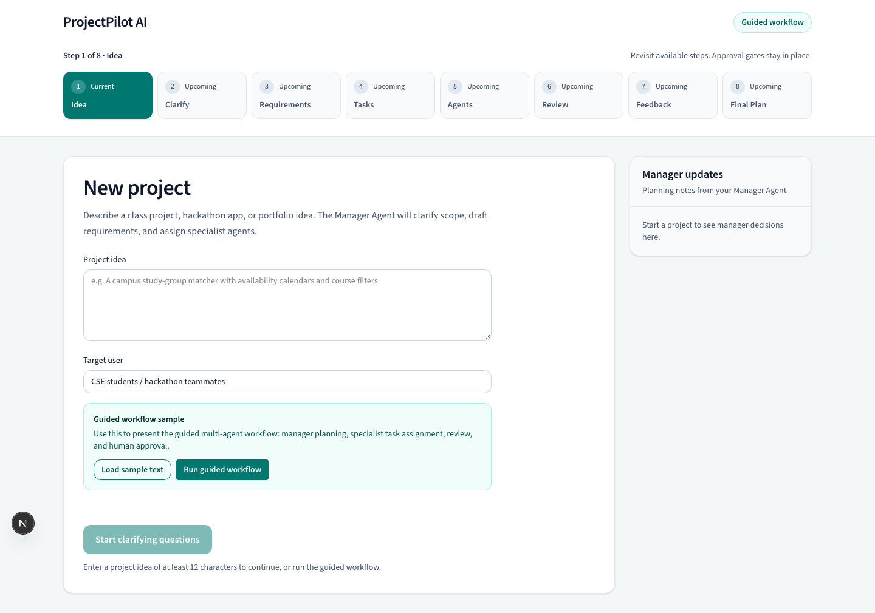
ProjectPilot AI
Iteration 1 presentation starts with the live demo
Repo version: da43cd6
Demo backup: docs/demo-recordings
Open http://localhost:3000
Click Run guided workflow
Show requirements, tasks, agents, review, feedback, and final plan
ProjectPilot AI
1

Slide 2
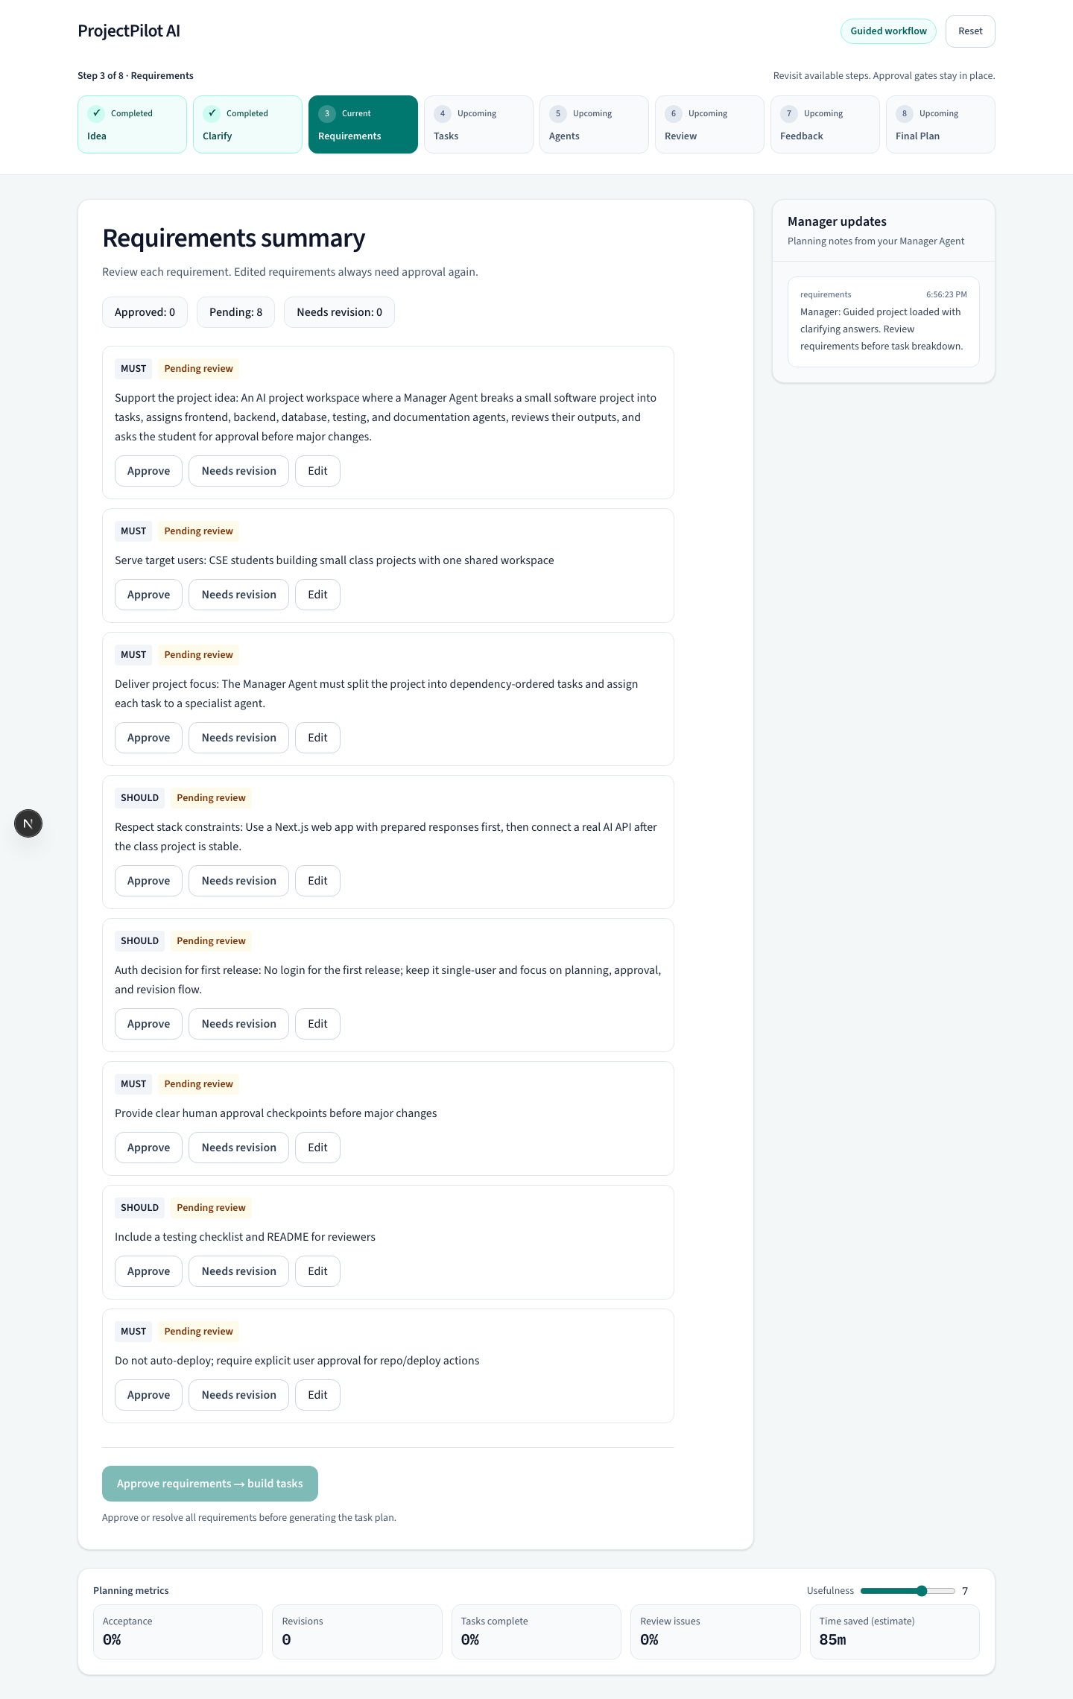
Live Demo Path
What the audience should see before the slides
The manager agent turns one project idea into requirements
The user approves or edits each requirement before task planning
The system keeps visible checkpoints instead of hidden automation
Demo point: human approval before the task plan
ProjectPilot AI
2

Slide 3
What Changed After Feedback
Main fixes from professor and Team 6 review
Feedback | Change in Iteration 1
Target user was unclear | Focused on students building small software projects
Workflow was hard to follow | Added eight-step screen flow and guided demo
Agent communication was unclear | Defined shared context, dependencies, expected output
Risk and competitors were missing | Added risk exposure and competitor comparison
Prototype was shown too briefly | Presentation starts with a live walkthrough
ProjectPilot AI
3

Slide 4
Target User And Problem
Students need help turning ideas into a clear software plan
First users: students building class projects, hackathon apps, or portfolio apps
Problem: project planning requires requirements, task order, dependencies, and review
Common pain: students ask a chatbot for help, then manually coordinate the work
ProjectPilot keeps the plan, task flow, and review checkpoints in one workspace
Scope boundary
Single user
Course-sized software projects
Planning and review first
No full autonomous deployment
ProjectPilot AI
4

Slide 5
Iteration 1 MVP
The prototype now covers the full planning workflow
Project idea input
Clarifying questions
Requirement approval
Task breakdown
Agent assignment
Output review
Feedback loop
Final plan export
Current limitation
Mock agent responses keep the class demo reliable
The MVP does not call a live AI API yet
The app produces a plan, not deployed code
ProjectPilot AI
5

Slide 6
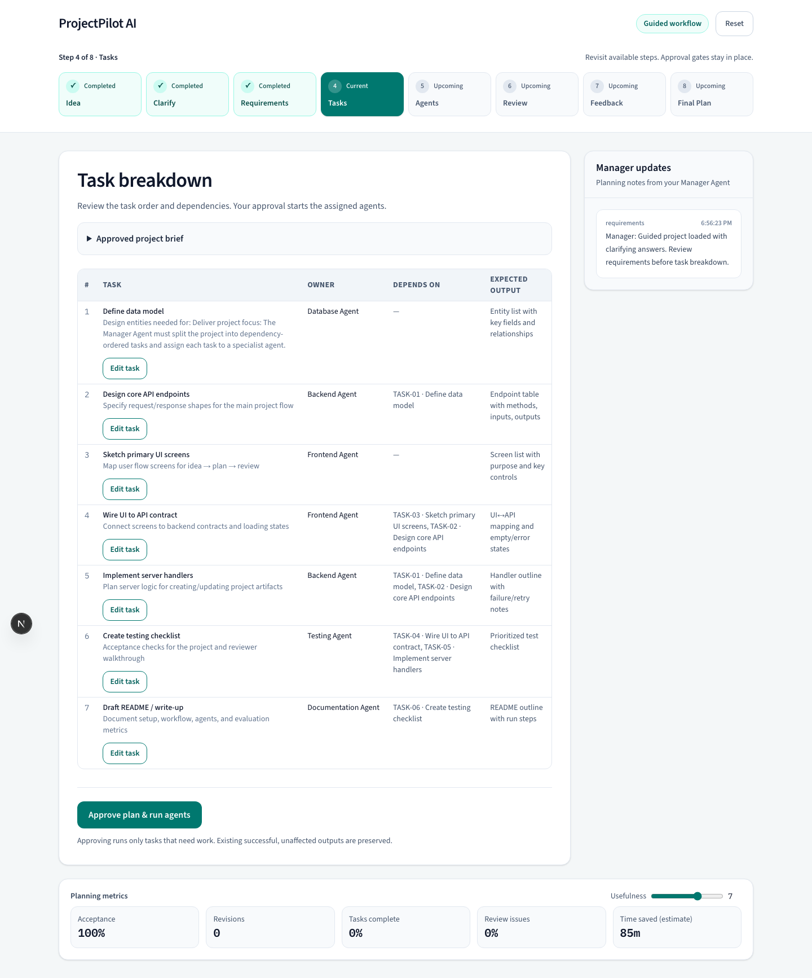
Task Breakdown Screen
Manager agent creates dependency-ordered work
Tasks have an owner agent, dependencies, and expected output
Database and API planning unblock later UI wiring and tests
Users can edit task details before agents run
The plan only runs after approval
Key improvement: screen flow is now visible
ProjectPilot AI
6

Slide 7
Agent Communication Contract
Each specialist receives the same project context
Agent | Responsibility | Returned output
Manager | Requirements, tasks, dependencies, approvals | Plan updates and notes
Frontend | Screens, UI states, client interactions | UI plan and edge cases
Backend | Endpoints, validation, retries | API plan and handler outline
Database | Entities, fields, relationships | Data model
Testing | Acceptance checks and demo cases | Test checklist
Documentation | Setup, workflow, privacy notes | README outline
Review | Missing items and conflicts | Flags and suggestions
Shared input: task id, description, dependencies, expected output, constraints, and approved project context
ProjectPilot AI
7

Slide 8
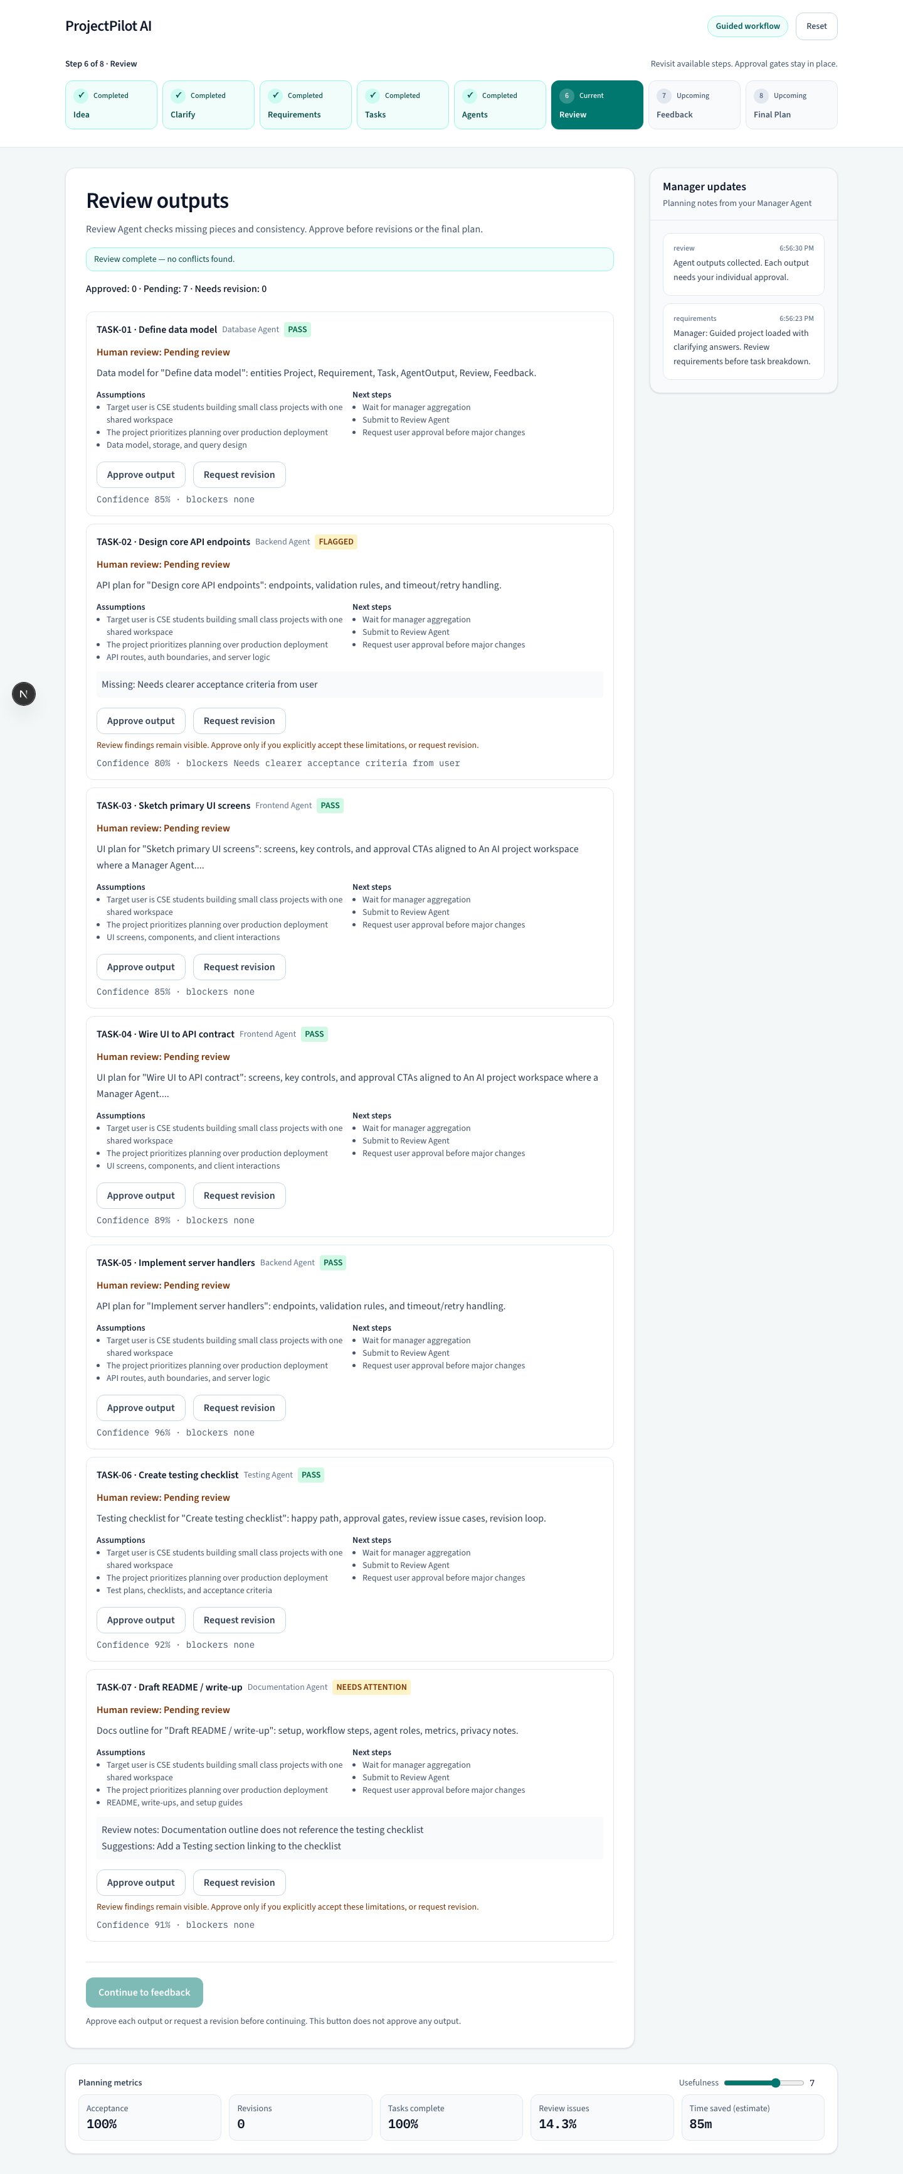
Review And Revision Loop
The prototype keeps user approval after agent output
Review Agent flags missing items and conflicts
Each output needs user approval or revision request
Revised outputs return to pending review
Final plan uses only accepted outputs
Human oversight is part of the workflow
ProjectPilot AI
8

Slide 9
Competitor Comparison
The project stands out by focusing on student workflow and approvals
Tool | Strength | Gap we target
ChatGPT | General help | User coordinates tasks manually
Codex | Strong coding assistant | Less focused on project planning flow
ChatDev | Multi-agent software simulation | Broad and less classroom focused
MetaGPT | Structured agent framework | Complex for beginners
Devika | Autonomous coding agent | Less emphasis on approval checkpoints
CrewAI | Agent framework | Not an end-user student project app
Positioning: a student-facing planning workspace with visible task flow, review, and correction
ProjectPilot AI
9

Slide 10
Risk Exposure
Highest risk is a wrong task breakdown
Risk | Effect | Exposure | Mitigation
Wrong task breakdown | 20 hrs | 8.0 hrs | Approve plan before agents run
Outputs do not integrate | 18 hrs | 6.3 hrs | Shared context and Review Agent
Unclear requirements | 14 hrs | 4.2 hrs | Clarifying questions first
API integration delay | 16 hrs | 4.0 hrs | Mock responses until API works
Scope too broad | 15 hrs | 4.5 hrs | Student project MVP only
Risk exposure uses RE = probability x effect. Effect and exposure are extra team hours.
ProjectPilot AI
10

Slide 11
User Feedback Plan
The next class step is quick feedback on the working prototype
Ask 3 to 5 students to use the guided workflow
Record which screen was confusing
Ask whether task approval should happen before agents run
Ask which output would make the system trustworthy
Use feedback to prioritize Iteration 2 UI and API work
Iteration 2 target
Connect real AI API
Save projects after refresh
Create GitHub issues from tasks
Improve visual agent board
ProjectPilot AI
11

Slide 12
Submission Details
Files are in GitHub with versioned code and demo backup
Repository: github.com/manit0700/projectpilot-ai-cse3311
Version for presentation: da43cd6
Demo backup video: docs/demo-recordings/projectpilot-ai-demo.webm
Written instructions: docs/GITHUB_TEAM_INSTRUCTIONS.md
Sources
Professor lecture guidance from CSE 3311 meeting transcript, September 17, 2026
Team 6 inception review action items
Competitor references: ChatGPT, Codex, ChatDev, MetaGPT, Devika, CrewAI public project/product pages
Q&A
ProjectPilot AI
12

