Slide 1
TO-DO LIST APPLICATION
Presentation by Manit Srivastava
October - 2024

Slide 2

Introduction to JavaScript
Overview of JavaScript features
JavaScript is a dynamic, high-level language essential for web development. It allows interactivity, utilizes objects, and offers an event-driven environment, making it a perfect choice for our application.

Slide 3


Concepts Used
Loops
Loops allow repetition of code execution, crucial for iterating through tasks in our application.
Arrays
Arrays store multiple values in a single variable, which helps in managing a list of tasks efficiently.

Slide 4

Application Workflow
Task Management
Display Outcomes
Tasks are held in arrays that can be manipulated with loops for viewing or updating.
Updated tasks are displayed in real-time, ensuring user engagement and functionality.
User Inputs
Users can add, edit or delete tasks via a simple interface.

Slide 5
Functionality Overview
This table summarizes the main functionalities of the To-Do List application. Each feature plays a key role in user experience.
FUNCTIONALITY | DESCRIPTION | IMPORTANCE
Add Task | Users can add new tasks to their list. | Enhances usability.
Edit Task | Allows modification of existing tasks. | Improves task management.
Delete Task | Users can remove tasks they no longer need. | Keeps the list relevant.
Mark as Complete | Users can mark tasks as done. | Increases productivity.

Slide 6

Common Challenges
Challenges Encountered
While building the application, we faced challenges like managing state, ensuring data persistence, and dealing with asynchronous operations, which are critical to delivering a seamless user experience.

Slide 7
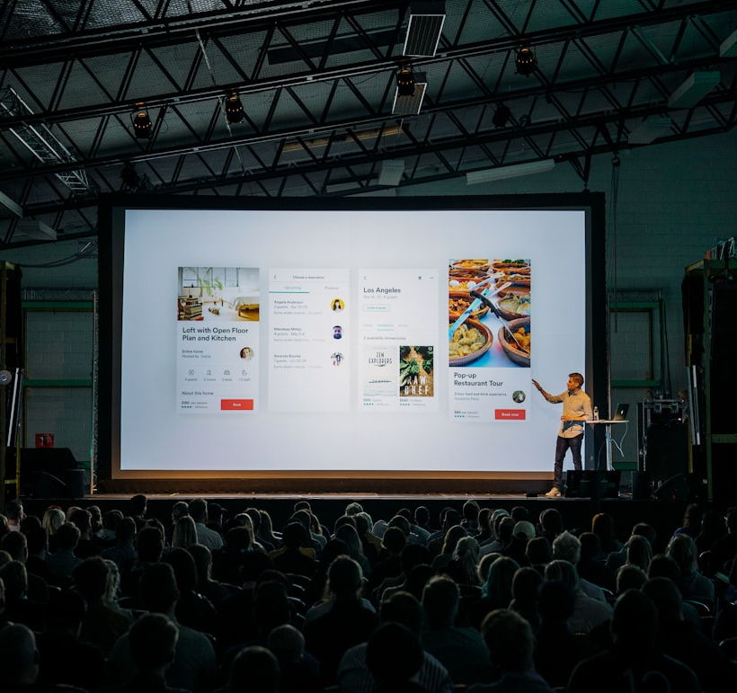


Conclusion and Q&A
Key Takeaways
In summary, our To-Do List application leverages JavaScript’s strengths while addressing key programming challenges. We’ll now open the floor for questions.

Slide 8
DYANAMIC-CONTACT-LIST-APP
NAME: Manit Srivastava DATE: OCTOBER - 2024

Slide 9

SETTING UP REACT
INSTALLATION STEPS
To set up React, begin by installing Node.js, which is crucial for React development. Then, use Create React App to quickly scaffold out a new React project.

Slide 10
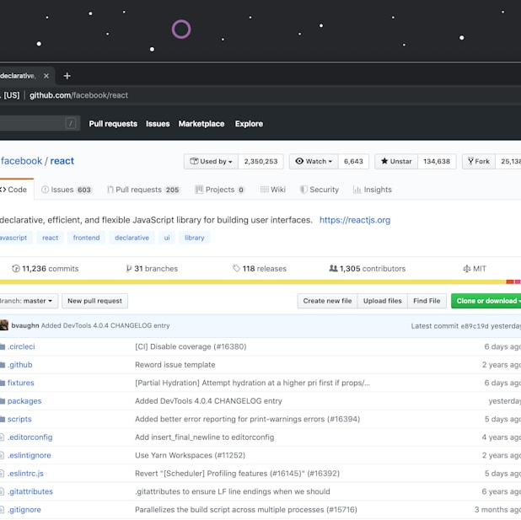
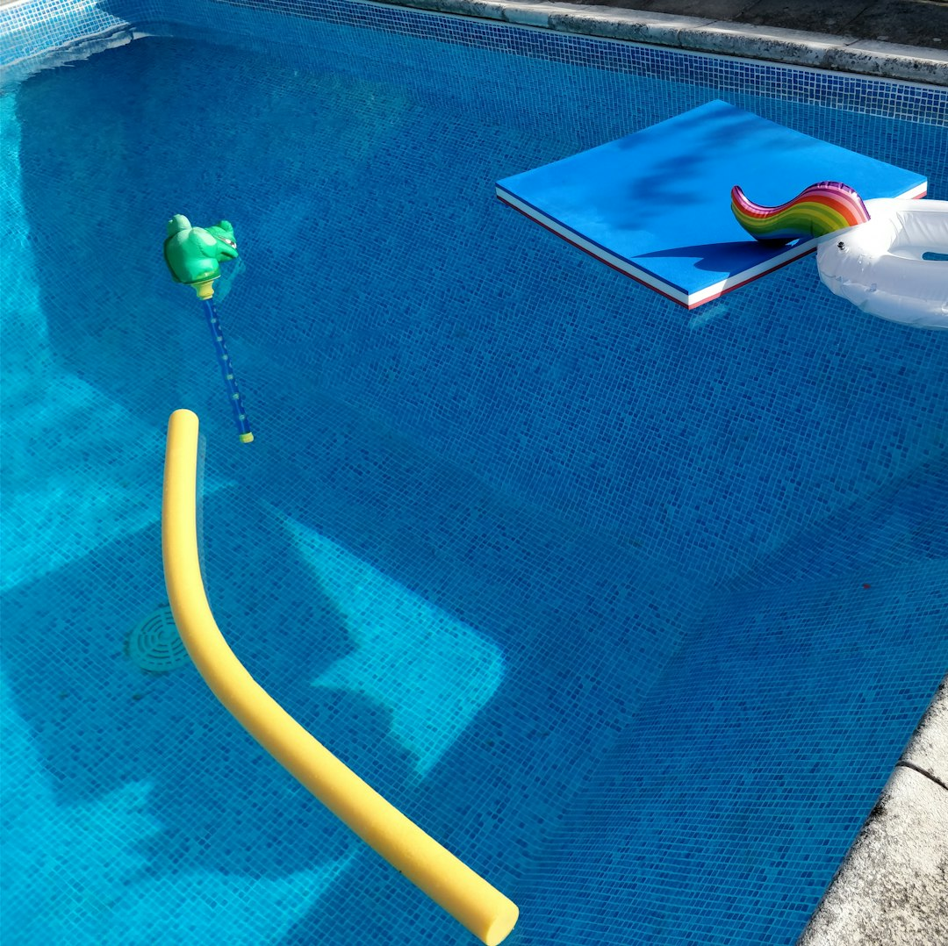
CREATING COMPONENTS
CLASS COMPONENTS
Class components have more features including local state and lifecycle methods. They are more complex and inherit from React.Component, making props available via this.props.
FUNCTIONAL COMPONENTS
Functional components are simpler and leaner. They are essentially JavaScript functions that return JSX. Props are passed as arguments and utilized within the function.

Slide 11
MANAGING STATE
This table summarizes different state management methods in React, detailing their main use cases and functionalities.
METHOD | DESCRIPTION | USE CASE
useState | Hooks for state in functional components | Simple local state
useReducer | State management with complex logic | Advanced state needs
setState | Update state in class components | Component lifecycle

Slide 12
DYNAMIC CONTACT LIST
STATE MANAGEMENT
PASSING PROPS
EVENT HANDLING
State will hold the contacts data. Using useState or setState will allow updating contact details dynamically on user actions.
Props will be used to send data to child components. Each component can receive contacts and display them as needed.
Methods to handle adding, deleting, or updating contacts. Event handlers will access the state and modify it based on user input.

Slide 13
EDITING CONTACTS
40%
30%
30%
FORMS
SUBMISSION
VALIDATION
Forms allow users to edit information. They provide the interface for input.
Actions taken upon submission, such as API calls or local state updates.
Validation is crucial for ensuring data integrity before submission.

Slide 14

FINAL THOUGHTS
KEY TAKEAWAYS
Understanding how to work with data and props in React is essential for building dynamic applications. Mastering these concepts enhances your development skills.

