Slide 1
Certified poisoning size of bagging model
Intrinsic Certified Robustness of Bagging against Data Poisoning Attacks
Jinyuan Jia, Xiaoyu Cao, Neil Zhenqiang Gong
Duke University
Published 9 December 2020

Slide 2
Agenda
Literature review
Paper’s code testing
Experiment on data poisoning attack
Label poisoning attack
Different networks
Conclusion
Future work

Slide 3

Literature review
Certified robustness of bagging against data poisoning attack
The ensemble classifier in bagging predicts the same label for a testing example when the number of poisoned training examples is no larger than certified poisoning size
Addressed 2 major previous limitations
Developed the algorithms to compute the certified poisoning size and then evaluate on MNIST and CIFAR10

Slide 4
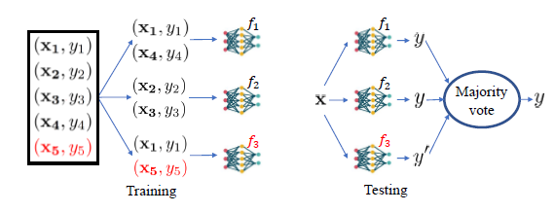
Method
Train model with clean dataset
Bagging with CNN base algorithm
Estimate the probability bounds of Pl and Ps
Compute the certified poisoning size r
Binary search to find the largest r such that the constraint is satisfied
Evaluation metric: Certified accuracy
No matter how the attacker manipulates the r poisoned training examples. (Delete/Insert/Modify),
The classifier’s testing accuracy for D’ is at least certify accuracy

Slide 5
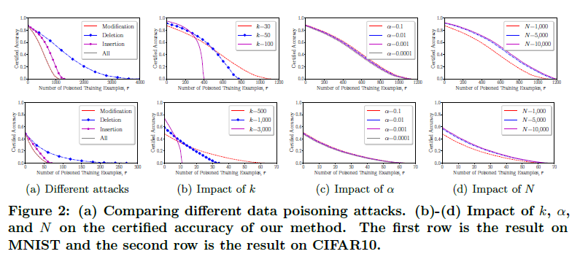
Result
Comparing different data poisoning attacks.
(b)-(d) Impact of k, α, and N on the certified accuracy of our method.
k is the number of subsamples from the training examples
N is the number of base classifiers
α is the confidence level
The best certified accuracy for attacks that only delete training examples
K controls a tradeoff between accuracy under no poisoning and robustness
The certified accuracy is relatively insensitive to α
The certified accuracy increases as or N increases
MNIST
CIFAR10

Slide 6
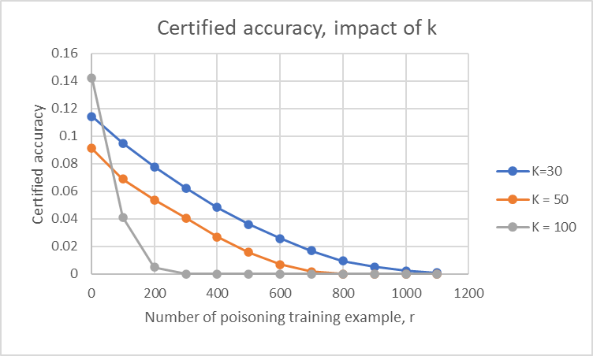
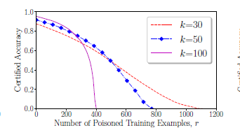
Paper’s code result
N = 1000, α = 0.001
Our result
Paper result
The larger the poisoning size, the lower the accuracy.
Our certified accuracy is equal to 0 at a similar poisoning size.
The same trend is observed. When k is larger, it shows the higher accuracy when there are no data poisoning attacks but the certified accuracy significantly drops as the number of poisoned training examples increase

Slide 7
Our experiment
After we studied the paper’s code and observed that they used the Adadelta optimizer which is not often used with CNN models and provides lower accuracy for the MNSIT dataset (around 20%)
We decided to experiment with the network by adjusting the optimizers, and then continued training with bagging method. In addition, we tested those networks with different data poisoning sizes

Slide 8
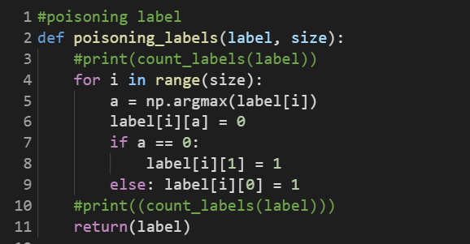
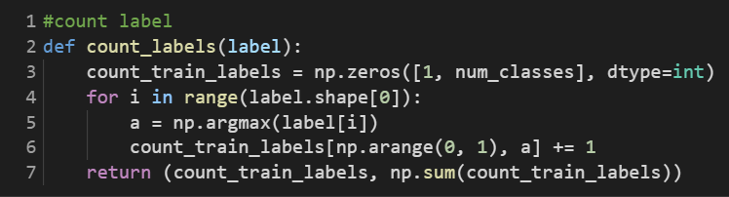
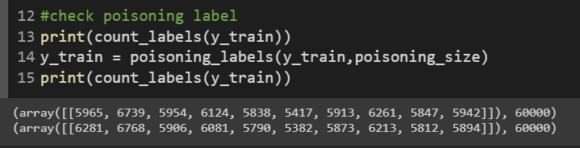
Poisoning attack on label training example
1
2
Set r = 500

Slide 9
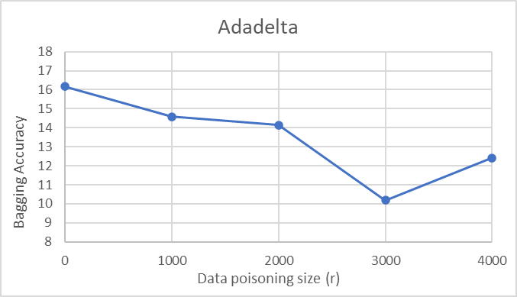
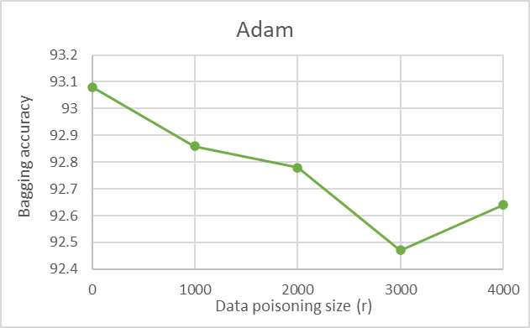
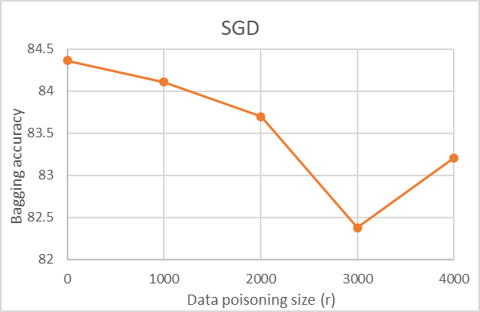
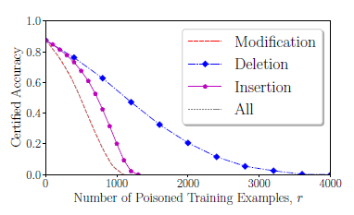
Experiment result – Modification label
Test on different networks with N = 100 and k_value = 30
R | Adadelta | Adam | SGD
0 | 16.18 | 93.08 | 84.36
1000 | 14.59 | 92.86 | 84.11
2000 | 14.14 | 92.78 | 83.7
3000 | 10.18 | 92.47 | 82.38
4000 | 12.41 | 92.64 | 83.21

Slide 10
Conclusion
Although our certified accuracies are not similar to their paper’s result, we observe some similar trends.
When N is lower than 1000, the CA is fluctuated, I recommend using N ≥ 1000
When N = 1000, it requires training time around 5 hours/model setting
Observed the expected trend that the larger the poisoning size, the lower the accuracy. However, our accuracy markedly decrease after different poisoning size

Slide 11
Future work
Investigate between our result and paper
Investigate our code experiment after poisoning size 3000
Experiment more on
Different data poisoning attack method
Bigger size of bagging classifier – small N is too sensitive
Different dataset

