Slide 1
Sports Ontology
By: Manitej Ankam

Slide 2
Outline
Data sources - Web Scraper (Parsehub)
Ontology Creation – Protégé
Data Modeling – Karma data integration tool
Data publishing - RDF triple store creation (Open RDF)
Data Extraction – Using Open RDF for SPARQL Query

Slide 3

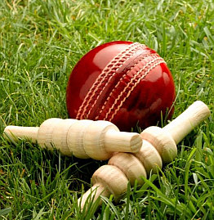
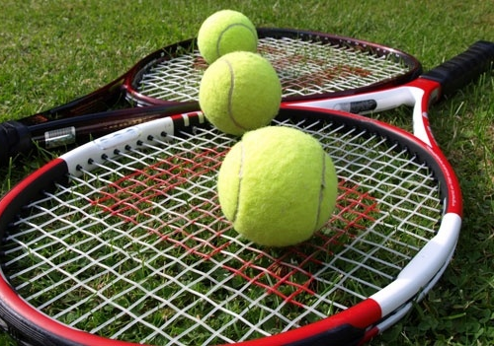
Scope of the project
Soccer
Players
Leagues
Cricket
Players
Matches
Rankings
Tennis
Players
Tournaments

Slide 4

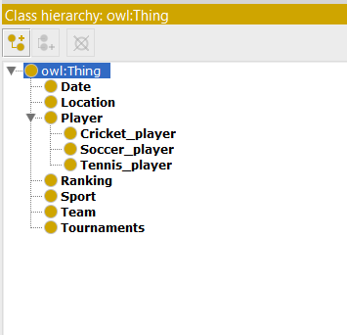
Ontology :Class hierarchy
The classes are of different types, namely, subclass, superclass, intersection class, union class, and complement class.

Slide 5
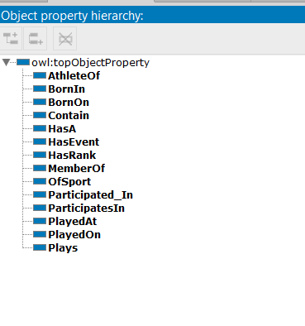
Object properties
Describes the relationship between two classes or two instances.

Slide 6
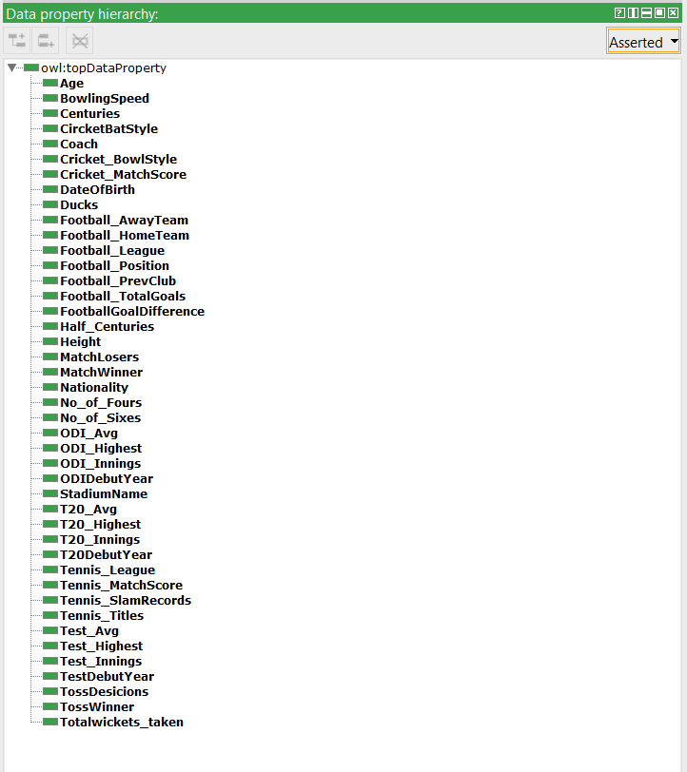
Data Properties
Describes relationships between instances and data values.
For ex:
Domain of Age: Players
Range of Age: xsd:integer

Slide 7
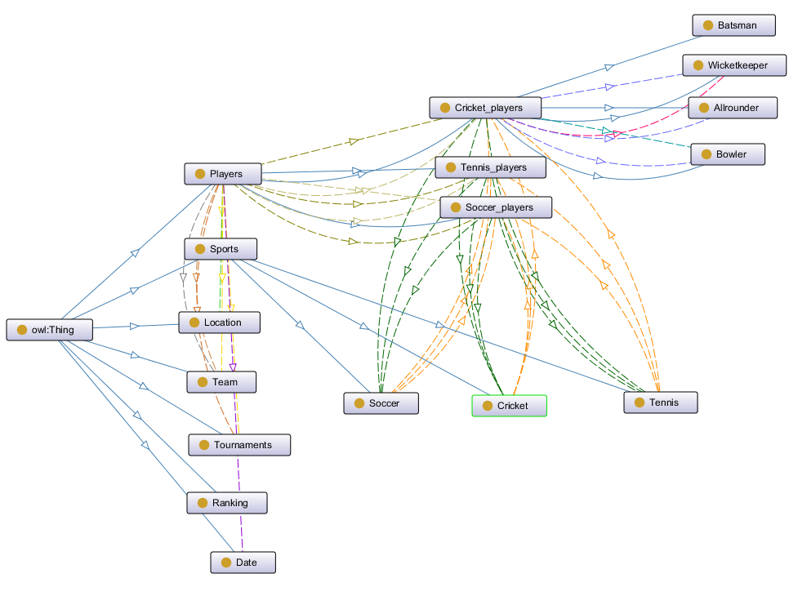
Ontology GRAPH

Slide 8
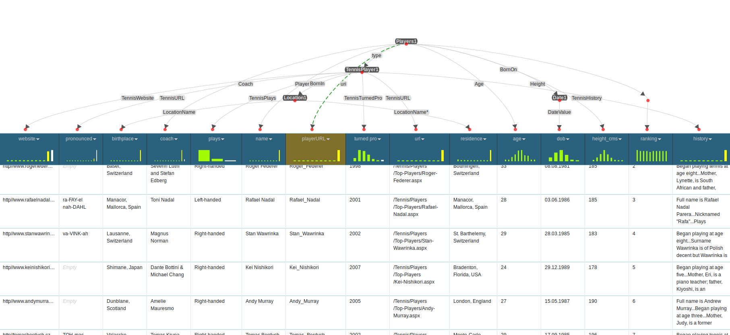
DATA MODELING

Slide 9

DATA PUBLISHING
OpenRDF :
Browser based framework
Integrated with KARMA
Publish each Data set
Create Triple Store for RDF
Load RDF into OpenRDF Triplestore

Slide 10
Data extraction Using SPArQL
SELECT DISTINCT ?pl ?Pname
WHERE
{
?pl CS592:PlayerName ?Pname;
dcterms:type ?p.
?p CS592:CricketBatStyle ?batstyle.
?p rdf:type <http://www.semanticweb.org/CS592#CricketPlayer>.
FILTER(regex(?batstyle,"Left-hand"))
}

Slide 11
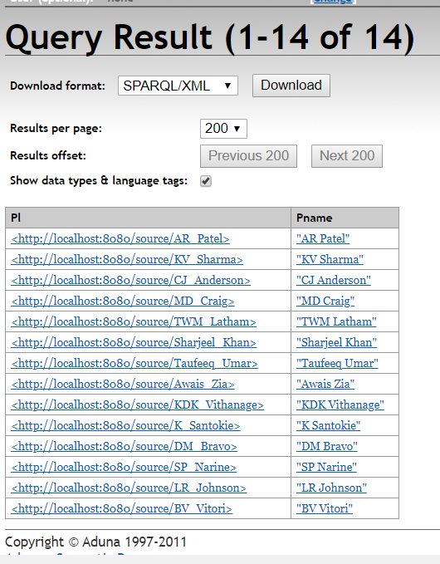
Number of Left handed batsman

Slide 12

Thank you

