Slide 1
Warehouse Management System

Slide 2
Topics
Warehouse
Types of Warehouses
Warehouse Management System
Inbound Operations
Pre-Receiving
Receiving
Immediate needs
Putaway
Inventory Management
Outbound operations
Waving Processes
Shipping
Invoicing

Slide 3
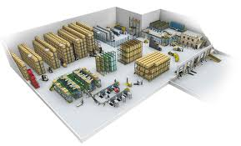
Warehouse
A warehouse is a commercial building for storage of goods.
Warehouses are used by manufacturers, importers, exporters, wholesalers, transport businesses, customs, etc.
It is a large building for storing things before they are sold, used, or sent out to shops.

Slide 4
Types of Warehouse
Based on imported goods warehouses are classified into:
Bonded warehouse
Bonded warehouses are licensed by the government to accept imported goods for storage until the payment of custom duty. They are located near the ports, railways, dockyards etc.
Non Bonded warehouse
Non Bonded warehouse are also licensed by government, but the goods are not subjected to custom duty. This includes public , private, contract and 3PL warehouses.

Slide 5
Types of Warehouse
Based on ownership warehouses are classified into:
Private warehouse
Private warehouses are constructed and owned by the business enterprises in order to store the products produced by them.
Public warehouse
A public warehouse is a specialized business establishment that provides storage facilities to the general public for a certain charge.
3PL
A third-party logistics provider, sometimes called a 3PL or 3PL company, is a firm that provides outsourced logistics services to client companies for part, or all of their supply chain management functions.

Slide 6
Types of Warehouse
Warehouses can be classified based on the level of technology used.
There are three types of warehouses:
Manual warehouse: Here workers move to a pick location, pick the goods, and then move to the delivery dock.
Mechanized warehouse: These facilities aren’t necessarily completely manual; they might employ forklifts and conveyors in certain locations in the warehouse.
Automated warehouse: Material movement is performed in parts or in full by machine or robotics.

Slide 7
Warehouse management system
Warehouse Management system (WMS) provides flexible automated support in processing all goods movements and in managing stocks in the warehouse complex.
The system supports scheduled and efficient processing of all logistics processes within the warehouse.
WMS is classified into 3 types:
Retail – Business to business flow
Wholesale – Business to customer flow
E-commerce – Business to customer flow

Slide 8
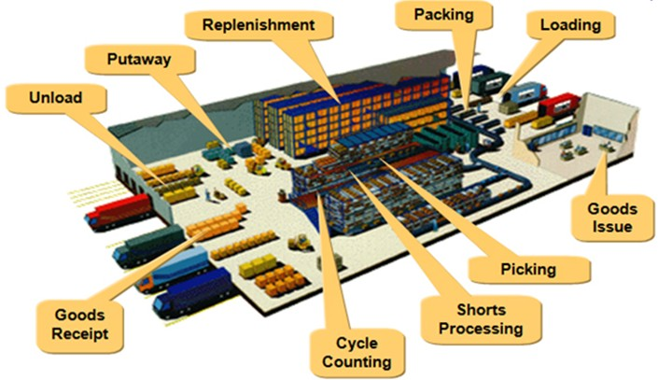
WMS Processes
The warehouse management system deals with storage, processing and delivery of products.
WMS can be broadly divided into 3 stages. Namely,
Inbound operations
Inventory management
Outbound operations

Slide 9
Inbound Operations
Inbound operation is the process of receiving the inventories which are coming into the warehouse.
It contains four parts:
1. Pre – Receiving
2. Receiving
3. Immediate Needs
4. Put away

Slide 10
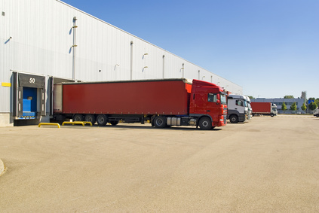
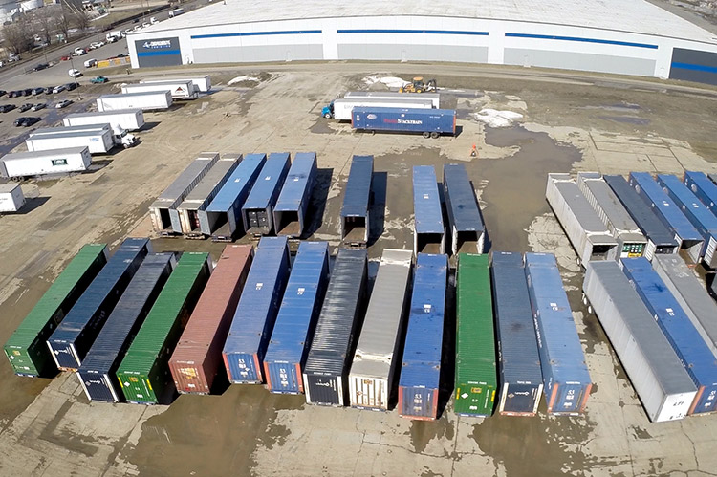
Pre-Receiving
Pre-receiving allows warehouse systems to process the functionalities before an inventory is received.
In Pre-receiving the vendor will send ASN which contains the details of purchase order , Items , quantity of the items, etc.
Pre-receiving comes with Appointment scheduling and Yard management.

Slide 11
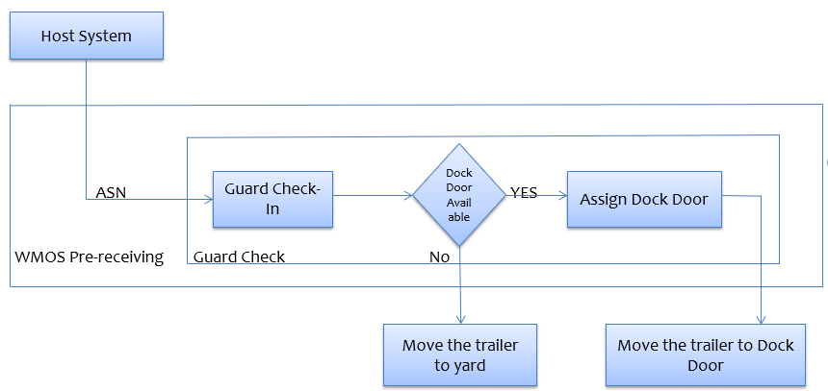
Yard management Flow

Slide 12
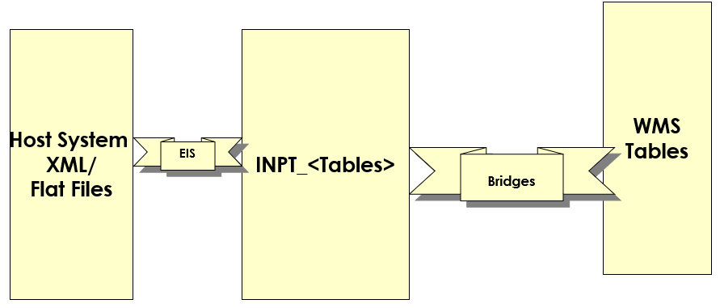
Ways of Appointment Scheduling
UI Appointment Scheduling: We can schedule the appointment through the user interface.
Guard check in: The appointment is scheduled by guard while check in the inventories which are coming into the warehouse.
Through ASN Bridge: In this option an appointment is scheduled within ASN. In this scheduling asn_hdr table is used and it contains flag. If flag is Y then appointment is scheduled by ASN bridge and if flag is N then appointment is scheduled by supervisor.
Through Appointment Bridge: We have appointment table, where host will separately schedule the appointment(2004)

Slide 13
Receiving
Receiving is the process of unloading the inventory from the trailer.
Types of Receiving:
Pallet Level:
In pallet level the whole pallet is scanned and we get all the information of item and cases.
Case Level:
Case level contains ASN header, Case header and Case details and after bridging the ASN details will be added. The asn_hdr contains ship_via, shpmnt_nbr, trlr_nbr, case_hdr contains case_nbr, create_date_time, trlr_nbr, case_dtl contains actl_qty, case_nbr,sku_id and asn_dtl contains sku_id, cases_rcvd, units_rcvd.

Slide 14
Receiving
SKU Level:
SKU level contains only ASN header and ASN details and there will be no case information. The asn_hdr contains ship_via, shpmnt_nbr, trlr_nbr and asn_dtl contains sku_id, cases_rcvd.
Blind level:
In Blind level, the vendor will send only ASN header and no other details. The asn_hdr contains ship_via, shpmnt_nbr and trlr_nbr.

Slide 15
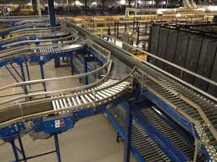
Receiving
Receiving process is done in two methods:
Manual Unload: In manual unload the cases are manually unloaded from the trailer.
Conveyor Unload: In conveyor unload the cases from the trailers are unloaded onto the conveyor. From the conveyor, the operators unload the cases onto pallets using the RF-Receive palletize option in WM.

Slide 16
Receiving Flow
Verify Case: It involves verifying/checking the cases.
Receive Inventories: After verifying the case, receive the inventories.
Immediate Needs: If audit check and other checks are needed then it will go to immediate needs or if the requested order is with inventory and if it is immediately needed then it will go to immediate needs.
Sorting: Collecting the similar types of cases or items in SKU’s.
Build Pallet: Pallet is flat transport structure that supports cases or items while lifted by forklift, so build pallet, once the items/cases are sorted to place them in proper location.

Slide 17
Inbound VAS
Inbound Value Added Service (VAS) enables clients to initiate multi-step processing for LPNs.
For example, inventory may be diverted to a QA area so that warehouse personnel can perform a quality audit on the LPN.
After the quality audit, the LPN may be sent to a re-packaging area to be broken-down or packed into a specific standard LPN quantity.
And lastly, the inventory may be directed to a reserve location for final putaway.
The Inbound VAS functionality sequentially directs the inventory through each step of the VAS path.

Slide 18
Putaway
Put away is the process of storing the goods to the specified location in the warehouse.
WM uses the configured, user defined rules. The UI – Putaway Type Determination Rules option allows the user to specify a specific putaway type based on an attribute of the case .
WM uses the putaway type from the Item Master. Item_Master contains information like sku_id, unit_ht, unit_vol, unit_wt,etc.
WM uses the default putaway type in the Warehouse Master.

Slide 19
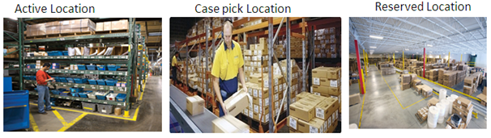
Types of location
Active Location: Active location are near to the Dock door and individual items will be picked.
Case Pick Location: Case pick location is used to store entire cases.
Reserved Location: Reserved location is used to store the inventories in bulk quantities.

Slide 20
Putaway
Staging Location: It is the temporary location near the dock door where the items are stored so that it doesn’t block the incoming items.
Transitional Location : Any cancelled items are stored here.
Types of Putaway
User Directed Putaway: In User Directed Putaway the warehouse users manually determine the put away location.
System Directed Putaway: In System Directed Putaway the WM will suggest the put away location based on the configuration.

Slide 21
Putaway
Types of System Directed Put Away:
Direct to Active/Case Pick: Cases will be directly moved to active or Case Pick location.
Direct to Reserve: Cases will be directly moved to reserve location.
Radial: In radial approach the location for put away will be the location which has nearest radius from the picking area.
Suggested: If the location where you want to store the inventory has some problems then we can put that inventory to the other location by overriding that location , so that location is suggested location.
LPN Consolidation: In this approach two similar cases will be consolidated into one to use the warehouse space efficiently.

Slide 22
Inventory management
Advanced Lot Management: Advanced Lot Management allows the client to track inventory throughout the warehouse by the lot number and the Item with which it is associated.
Cycle Count - Cycle counting is used to verify the accuracy between the Warehouse Management (WM) inventory and physical inventory. Cycle Counts are used to perform to a smaller set of Active, Case Pick, or Reserve locations.
Physical Count - Physical Counts are used to verify the accuracy between the Warehouse Management (WM) inventory and physical inventory. Physical Counts are performed once or twice a year to verify the entire inventory in a building or storage area.
PIX - Perpetual Inventory Transactions (PIX) are used by Warehouse Management (WM) to provide real time updates to the host's perpetual inventory system. The OMS is Synchronized with the WMS through PIX. When ever there is any change in inventory then automatically Pix are generated

Slide 23
Inventory management
Replenishment - Replenishment is the process of filling inventory into active or case-pick locations to ensure that inventory is available at the location when the picker arrives to pick inventory.
Lean Time replenishment: WM perform the minimum/maximum analysis for each location in the specified range to determine how much inventory is needed. WM then allocates inventory to satisfy the requirements, and generates priority pull tasks accordingly.

Slide 24
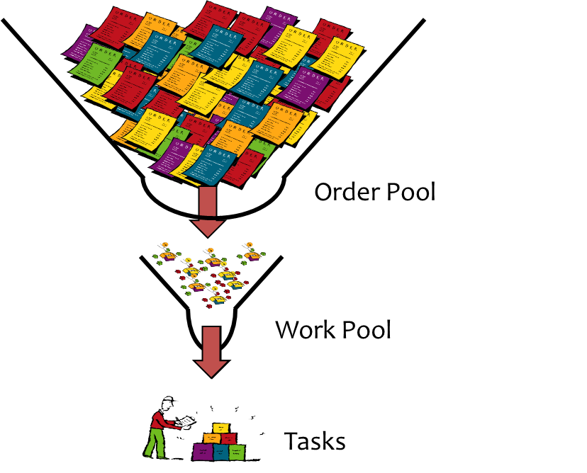
Outbound Processes
Outbound processing comprises of the preparation of goods to be delivered from a warehouse to a receiving location.
The outbound processes aid the movement of the goods from the warehouse to the customer.

Slide 25
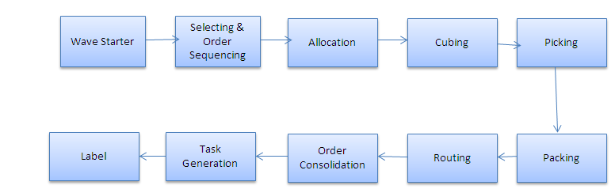
Waving Process
Waving is the process of grouping the orders from order pool and processing them to fulfill the order.

Slide 26
Waving Process
Waving Process involves the following tasks:
Wave Starter
In wave starter, the order from the host is sent to the WMS.
Selection and Order Sequencing
In this task, the orders are selected from the order pool and determines the sequence in which orders to be picked.
Allocation
Inventory allocation is the process of allocating an inventory to a specific order. Inventory need type (INT) indicates why the inventory is needed. INT’s identify the inventory needs for allocation and to perform the tasks such as picking, replenishment, cycle count and so on.

Slide 27
INT Types
INT | Description
1 | Replenish Active from Reserve
2 | Full iLPN to Shipping
11 | Putaway LPN
40 | Slot Move A to A
42 | Slot Move A to R
43 | Slot Move C to R
50 | Pick oLPN from Active
53 | Retail Allocation from Reserve
54 | Retail Allocation from Active
100 | Cycle Count Reserve
101 | Cycle Count Active
303 | Recall
503 | Rework

Slide 28
Allocation Methods
FIFO (First In First Out) : WM searches for the oldest inventory first as it is first in first out.
FEFO (First Expire First Out) : WM searches expiry date of the item, it will look for the earliest expiry date item first.
LIFO (Last In First Out) : WM searches for newest inventory first as it is last in first out.
Serial Number & Batch Number: WM allocates the inventory based on serial number and batch number.
Item Substitution: It is used if WM can not find the inventory for the item to assign, so in this case the substitute item will be checked if it is available and there is inventory to assign then that substitute item is used.
Shelf days: It will be mentioned in pick ticket details based on this WM allocates inventory which has expiry > current date + Shelf days.

Slide 29
Waving Process Types
A Wave Processing Type (WPT) determines from which location(s) WM allocates inventory for a distribution order.
Stockbridge uses the following WPTs:
WPT 1 - ‘All from Active’
WPT 2 - ‘Full Case Bulk from Reserve’
WPT 3 - ‘Bulk Processing from Active’
WPT 5 - ‘Full Cases from Reserve, Balance from Active’
WPT 6 - ‘Bulk from Reserve Cube to capacity’
WPT 7 - ‘Rework from Reserve’
WPT 9 - ‘Retail Bulk from Reserve’

Slide 30
Cubing
Cubing
Cubing is process that determines the optimal contents to be packed into Cartons. Cubing can either be a manual one or the system.
WM initiates cubing after inventory allocation has occurred and WM has determined the quantities to be fulfilled from the different inventory buckets (Active, Case Pick, or Reserve).
All inventory that is cubed into shipping containers is cubed using item weight, volume, and critical dimensions.

Slide 31
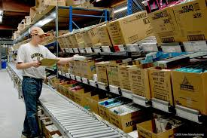
Picking
Picking
Picking is the process of picking the items from the inventory and physically moving them to the proper location to fulfill the customer order.
Picking can be dynamic and static.
Types of Picking:
Pick to Carton: Picking the items from the inventory to carton.

Slide 32
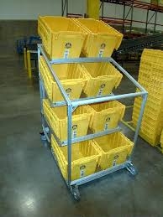
Picking
Pick to Tote: Picking the items from the inventory to tote.
Piece Picking: Picking an item for specific one order.

Slide 33
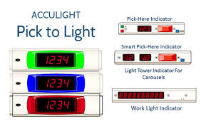
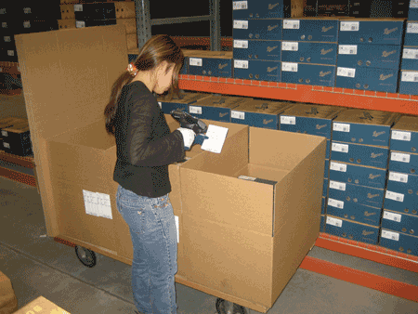
Picking
Pick to Light: Pick to light systems position the lights on storage shelf. These lights signal the location and quantity of an item to be picked for an order.
Pick To Box: In pick to box the number of picking stations are connected by conveyor. The order picker fills the box with the items from his station and the box moves to the other picking stations until the customer order is complete.

Slide 34
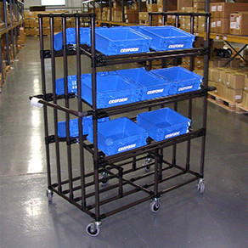
Picking
Pick Carts: Pick Carts are a good solution for operations with a large number of SKUs that are small in size, and have a relatively low pick rate per SKU.
Light Directed Pick Cart
A display on the Pick Cart directs the operator to picking locations in a logical sequence. The operator confirms the correct location using an onboard scanner.

Slide 35
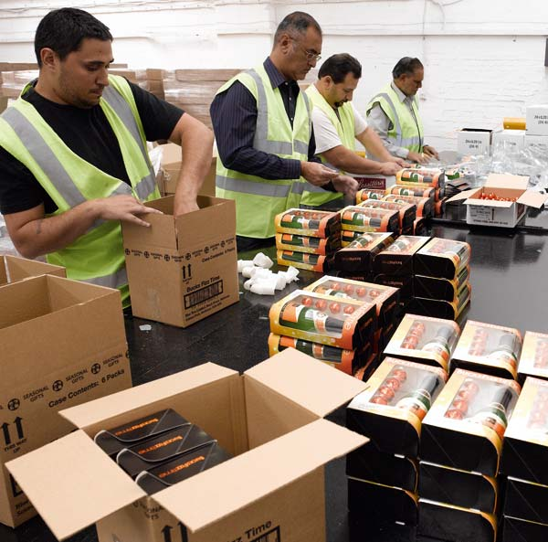
Packing
Packing
Packing is the process of packing inventory into appropriate cartons for distribution or transportation. Packing should be done in the compatible box based on the size of an item.
Types of Packing:
Discrete Order Packing: In discrete order packing a single carton is packed for cubed or non-cubed order.
Batch Packing: In batch packing multiple cartons are packed at the same time.

Slide 36
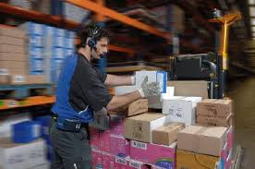
Packing
Voice directed packing: Supports both single carton packing and batch packing. In voice directed packing workers have a headset connected to a small wearable computer, which tells them where to go and what to do using verbal prompts. Workers confirm their tasks by speaking pre-defined commands and reading confirmation codes printed on locations or items throughout the warehouse.

Slide 37
Packing
Pack and Hold
Pack and hold is a method used to store cartons that are not going to ship immediately.
This functionality gives distribution personnel the flexibility to pack orders in advance of shipment to take advantage of excess capacity during slow times in the shipping cycle.
RF Pull Carton is used to pull cartons down from pack and hold. If a pallet was allocated, then the pallet is pulled down. The user is directed to pack and hold locations to get cartons on the task.

Slide 38
Routing
Routing
For distribution orders that are routed through WM, the wave process next initiates the routing process, or carrier determination.
In order to perform routing WM accesses the routing lane.
Two types of Routing:
Static Routing : Static routing involves routing goods according to a static routing guide that is updated by the retailer on a regular basis. To communicate updates to suppliers, retailers must send a new routing guide to each supplier.
Dynamic Routing: Dynamic routing is a retailer initiative in which the routing guide resides in the retailer's hands, which allows it to be updated as often as desired.

Slide 39
Routing
The main steps involved in Dynamic Routing include:
Running a routing wave, which in turn calls Dynamic Routing
Creation of a Routing Request (RRN)
Sending of the Routing Request to a retailer
Receipt of the Routing Response from the retailer
Updating picktickets with response data
Assignment of picktickets to shipments / loads based on response information

Slide 40
Order Consolidation and Task Management
Order Consolidation
Order Consolidation is merging of Pick tickets
Order Consolidation is the assignment of an outbound location to cartons of similar characteristics.
The purpose of order consolidation is two-fold: 1) to consolidate multiple cartons of a single order 2) to combine like orders together for lower shipping charges.
Task Management
Tasking is a system directed or Manual process, which assigns tasks to operators, based on task group, priority, and current location. Task groups are typically defined by job function and/or equipment type. Task groups are defaulted in the user master or entered by the user when first logging in.

Slide 41
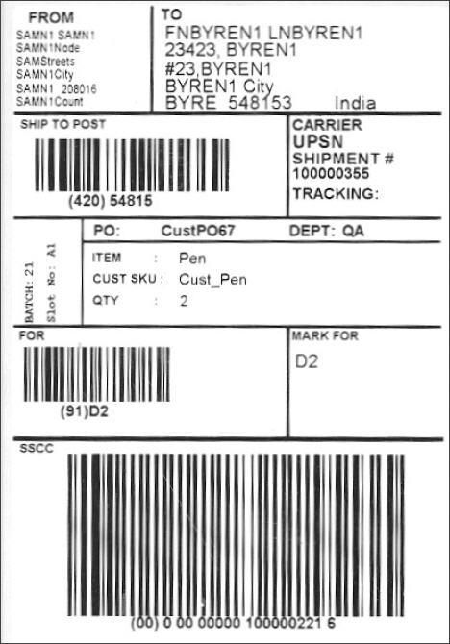
Label
Label
For full case pulls from reserve and picks from active, WM generates both a shipping label (includes a bar-coded tracking number) as well as, an oLPN label (includes bar-coded oLPN number) for each oLPN created during the cubing process.

Slide 42
Outbound VAS
A Value Added Service (VAS) is a task performed on a SKU to customize it or enhance its value in some way.
There are two modes in which Warehouse Management (WM) supports VAS:
VAS Pickticket
In the VAS Pickticket model, picktickets may be bridged with multiple SKU's, some of which do not require VAS. The VAS processes typically take a long time to complete, and clients do not want to tie up non-VAS inventory waiting for companion inventory that requires VAS when it could instead be used to satisfy other needs.
VAS Carton
Like the VAS Pickticket model, the VAS Carton model consists of picktickets that may be bridged with multiple SKUs where not all the SKU's require VAS. However in this model, VAS processes normally take minimal time to complete so clients do not worry about tying up non-VAS inventory. The VAS processing should go quickly and other needs should not experience fulfillment problems

Slide 43
Shipping
Shipping is the final process of order fulfillment process.
Shipping is the physical process of transporting the goods.
Shipments should be loaded onto the right trailers, then tracked until they reach the customer in good condition.
Shipping can be done in two ways:
Load Invoicing
Load Invoicing is the process of generating customer invoices for all completed shipments.
An invoice is a document which contains the details of invoice date and number, customer order number, item name, quantity shipped, a price per unit of measure and a subtotal for the items shipped.
Once the shipment is done the confirmation of shipment is provided through invoice to the customer.

Slide 44
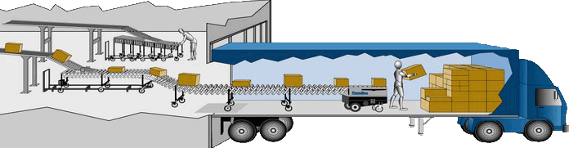
Shipping
Manifest:
Shipping can be done through the carrier services like FedEx, UPS and USPS.

Slide 45
Issues

Slide 46
Issues
Title:- iLPN does not exist
RCA:- Two or more users picking the same task line which causes the cntr_nbr to become null
Resolution:- xyz,……..

