Slide 1



Warehouse Management System
IGATE is now a part of Capgemini

Slide 2
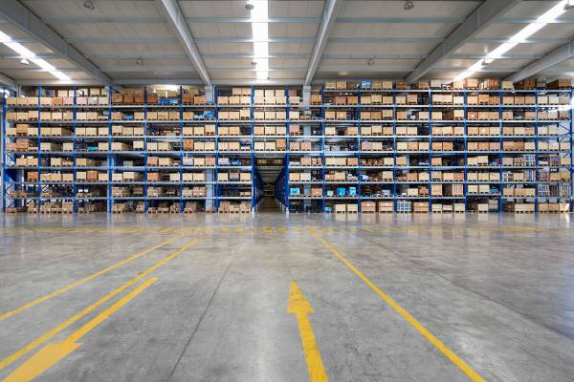
Introduction to WMS
A warehouse is a commercial building for storage of goods. WMS controls and manages the inventories, space within the warehouse.
They usually have loading docks to load and unload goods from trucks.
They facilitate management in their daily planning, organizing, staffing, directing, and controlling the utilization of available resources, to move and store materials into, within, and out of a warehouse.

Slide 3
User friendly process driven workflows supported by enhanced screen navigation for setup and transaction processing.
▪ WMS support 2 versions
DC 33
DC 44 OPEN SYSTEMS developed in 2004 [C , C++]
DC 70
DC 12 Developed in 2011 [Java]
Location of distribution centers are
• DC 33 – Stockbridge
• DC 70 – Hong Kong
• DC 44 – Shanghai
• DC 12 – Braselton

Slide 4
Types of Warehouse
Private warehouse
Private warehouses are constructed and owned by the business enterprises
in order to store the products produced by them.
Public warehouse
A public warehouse is a specialized business establishment that provides storage facilities to the general public for a certain charge. It may be owned and operated by an individual or a cooperative society. It has to work under a license from the government in accordance with the prescribed rules and regulations.
3PL
A third-party logistics provider, sometimes called a 3PL or 3PL company, is a
firm that provides outsourced logistics services to client companies for part,
or all of their supply chain management functions and also provide space to store their products.

Slide 5
Types of Business Flow
Types of Business flow are:
Retail:
Business to Business flow.
Wholesale:
Business to customer flow.
E-commerce:
Business to customer flow.

Slide 6
Types of operations
The operations of WMS are as follows
Inbound operations
Inventory Management
Outbound operations

Slide 7
Inbound Operation
IGATE is now a part of Capgemini

Slide 8
Inbound operation
The process of getting the inventory into warehouse from the vendors is called
Pre-Receiving.
It contains four parts:
1. Pre – Receiving
2. Receiving
3. Immediate Needs
4. Put away

Slide 9
Pre – Receiving
Pre-Receiving allows warehouse systems to prepare for the reception of incoming materials and goods.
Vendors will send ASNs (Advance Shipment Notice) which includes Purchase Order, item, case and quantity information and also has appointment schedule.
ASN (Advance Shipment Notice) is a notification of pending deliveries, similar to a packing list. It is usually sent in an electronic format and is a common EDI document.
Upon successful receipt of the ASN, a guard will be able to check the trailer in during receiving.
Pre-Receiving comes with appointment scheduling and yard management.

Slide 10
Appointment Scheduling
Appointment Scheduling/ Check In/ Check Out:
Here the Appointment is bridged via ASN then the carters will schedule the appointment when the trailer is physically arrived at the DC using the CHECK IN option. Once the trailer is unloaded and operators will check out the appointment using CHECK OUT option.
Appointment scheduling includes
UI Appointment Scheduling – Operators can schedule an appointment through UI
Guard Check – guard will schedule an appointment when the trailer is physically on Yard
Through ASN bridge –In this option system will automatically assign dock door for unloading when the ASN flag is set to Y.
Through Appointment – Host will schedule an appointment

Slide 11
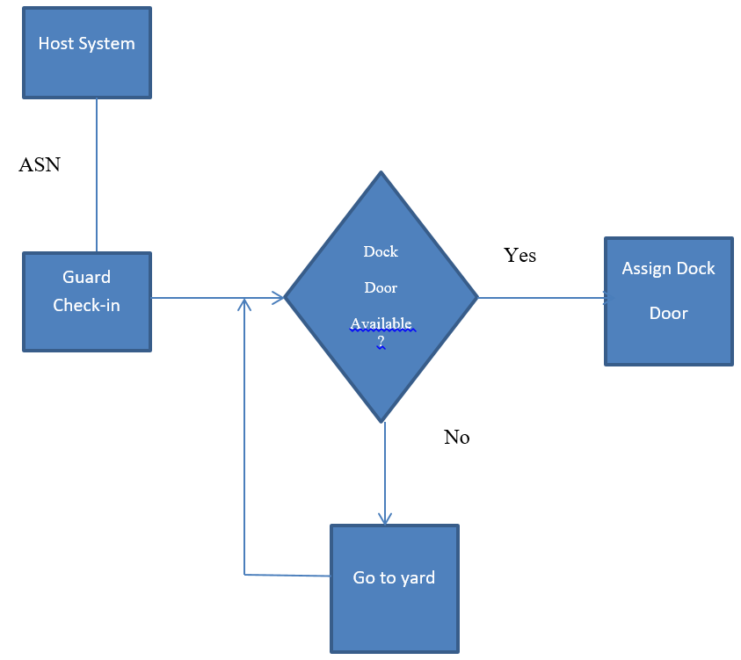
Yard Management

Slide 12
Receiving
Receiving:
This is the process of receiving inventory into warehouse.
Process flow:
Once a trailer arrives at a dock door cases are unloaded from the trailer onto a conveyor. From the conveyor, the operators unload the cases onto pallets using the RF – Receive Palletize option in WM.
Types of Receiving Level:
Case Level/Pallet level:
The person who receives the cases will have a manual document with him. He will scan all the case numbers, it will be verified from our end and items will be unloaded from the truck.
Item Level:
The items will be received individually and will be scanned. Once verified, the items will be unloaded and moved to a particular case (A particular case number will be given to the items).
Blind level:
Here no details of items or case will be present. It contains only trailer no, ASN no and load no).

Slide 13
Receiving Flow
The receiving process has following steps:
1. Verify Case: It involves verifying/checking the cases.
2. Receive Inventories: After verifying the case, receive the inventories.
3. Immediate Needs: If audit check and other checks are needed then it will go to immediate needs or if the requested order is with inventory and if it is immediately needed then it will go to immediate needs.
4. Sorting: Collecting the similar types of cases or items or SKU’s.
5. Build Pallet: Pallet is flat transport structure that supports cases or items while lifted by forklift, so build pallet, once the items/cases are sorted to place them in proper location.

Slide 14
Unloading Types of Receiving :
Manual Unload:
Cases (iLPNs) are unloaded from the truck. User receives the case within the WM RF.
Cases are then manually palletized and sent to the pallet reserve area
Conveyor Unload:
In conveyor unload the cases from the trailers are unloaded onto the conveyor.
From the conveyor, the operators unload the cases onto pallets using the RF-Receive palletize option in WM.

Slide 15
Immediate Needs
Immediate needs are bridged by the host system (e-SPS) into WMOS.
The needs are used to identify cases that need to undergo quality inspection.
WM uses the Immediate Needs messages to notify receiving personnel to divert product to where it is needed
All inbound product that qualifies for this immediate need is diverted to a QA location with a quality lock code

Slide 16
Putaway
It is the process of placing or storing the inventory at the specified locations in warehouse is called Putaway.
WM uses the configured, user defined rules. The UI – Putaway Type Determination Rules option allows the user to specify a specific putaway type based on an attribute of the case .

Slide 17
Types of location’s
Different types of location includes:
Active location
This is the location near to the dock door.
Case Pick location
Case Pick location is used to store entire cases.
Reserved location
Reserved location is used to store bulk quantities
Staging Location
It is the temporary location near the dock door where the items are stored so that it doesn’t block the incoming items.
Transitional Location
Any cancelled items are stored here.

Slide 18
Types Of Put Away
Put Away Types:
1. User Directed Put Away: In User Directed Put Away the warehouse users manually determine the put away location.
2. System Directed Put Away: In System Directed Put Away the WM will suggest the put away location based on the configuration.

Slide 19
System Directed Put Away Types:
1. Direct to Active/Case Pick: Cases will be directly moved to active or Case Pick location.
2. Direct to Reserve: Cases will be directly moved to reserve location.
3. Radial: In radial approach the location for put away will be the location which has nearest radius from the picking area.
4. Suggested: If the location where you want to store the inventory has some problems then we can put that inventory to the other location by overriding that location , so that location is suggested location.
5. LPN Consolidation: In this approach two similar cases will be consolidated into one to use the warehouse space efficiently.

Slide 20
Inventory Management
Inventory control
Manages the warehouse space efficiently. The goal of inventory control is to generate the maximum profit from the least amount of inventory investment without intruding upon customer satisfaction levels.
Replenishment
Replenishment is the process of filling inventory into active or case-pick locations to ensure that inventory is available at the location when the picker arrives to pick inventory.
Lean Time replenishment:
WM perform the minimum/maximum analysis for each location in the specified range to determine how much inventory is needed. WM then allocates inventory to satisfy the requirements, and generates priority pull tasks accordingly.
Recall Inventory
Recall Inventory allows the warehouse to identify, lock and allocate inventory based on specific criteria.

Slide 21
Cycle Count
Cycle counting is used to verify the accuracy between the Warehouse Management (WM) inventory and physical inventory. Cycle Counts are used to perform to a smaller set of Active, Case Pick, or Reserve locations
Physical Count
Physical Counts are used to verify the accuracy between the Warehouse Management (WM) inventory and physical inventory. Physical Counts are performed once or twice a year to verify the entire inventory in a building or storage area.
Inventory Tracking/ Advanced Lot Management
Tracking the entire inventories in the Warehouse system. They can be tracked using the lot number and the Item with which it is associated.
Work Order
A Work Order is an internal Order that describes to a worker how to combine one or more Items to create another Item and in what quantities.

Slide 22
Inventory Synchronization:
Whenever there is any change in the order WMS send the acknowledgment to OMS through PIX(Perpetual Inventory Transaction).
There are two types of PIX-
1. Inventory PIX:
PIXs are generated for all inventory adjustments performed within the DC.
This includes adjustments due to cycle counts, manual LPN or location adjustments via RF or UI, and tracking of product in a transitional state (cancelled oLPN or damaged inventory).
2. Informational PIX:
This is the PIX where we can communicate the quantities to HOST by a specific type as 605.
It can be generated through UI using “Generate 605 PIX option” in WM.
The PIX includes snapshot information for allocable and unallocable inventory.
WM generates an order status change PIX transaction when the status is updated to Special Processing Pending, Printed, In Packing, Pack Complete, Weighed, Manifested, Loaded on Truck, Shipped/Invoiced, Cancelled.
At the end of the Inventory Synchronization process, the host system can generate a variance report that shows inventory discrepancies along with the supporting details.

Slide 23
Outbound Operation
IGATE is now a part of Capgemini

Slide 24
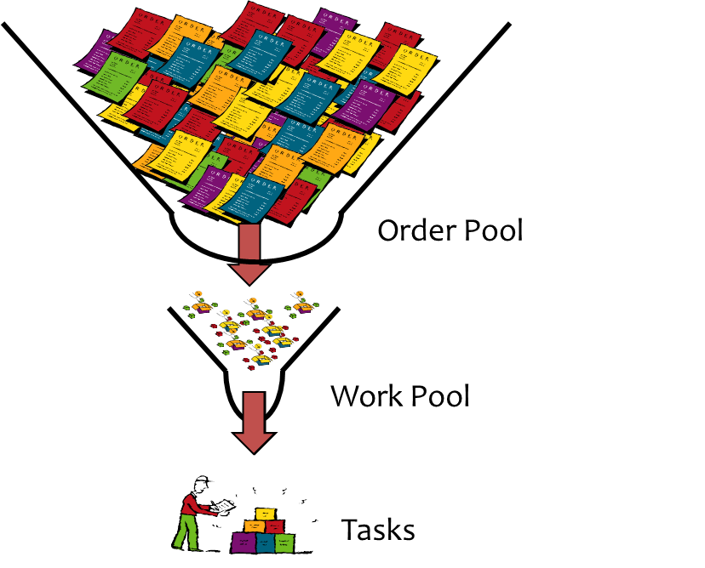
Outbound operation
Waving is the process of grouping the orders from order pool and processing them to fulfill the order.

Slide 25
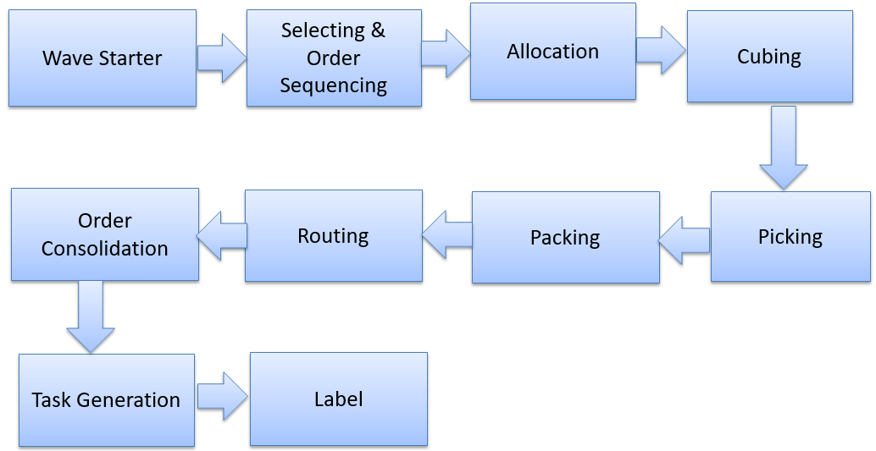
Waving Process

Slide 26
Waving Process involves the following tasks:
Wave Starter
In wave starter, the order from the host is sent to the WMS.
Selection and Order Sequencing
In this task, the orders are selected from the order pool and determines the sequence in which orders to be picked.
Only distribution order in status ‘110’ (Released) is eligible for selection during a shipping wave.
Selection rules are configured based on any field or fields in the distribution order header, distribution order detail, or item master.
Inventory Allocation
It is the process of allocating an inventory to the specific order for an wave.
Inventory need type (INT) indicates why the inventory is needed.
INT’s identify the inventory needs for allocation and to perform the tasks such as picking, replenishment, cycle count and so on.

Slide 27
Allocation Configuration
A Wave Processing Type (WPT) determines from which location(s) WM allocates inventory for a distribution order. The WPT can be defaulted in the wave template or on the distribution order. Stockbridge uses the following WPTs:
WPT 1 ‘All from Active’ - WM allocates as many units as possible from active locations to fulfill the need for the wave.
WPT 5 ‘Full Cases from Reserve, Balance from Active’ – WM allocates as many full case quantities from reserve locations and the remaining balance from active locations.
WPT 3 ‘Bulk Processing from Active’ – WM allocates all inventory (pallets or cases) from reserve to dynamic active locations in Pick Module 1. Cases are allocated in full quantities to fill dynamic active, with the potential to exceed the need by one LPN, if required.
WPT 2 ‘Full Case Bulk from Reserve’ – WM allocates entire cases being pulled from reserve to go straight to shipping without having to go through the packing area.
WPT 7 ‘Rework from Reserve’ – Rework wave processing type. WM allocates exact quantity cases that are locked with a lock code.
WPT 9 ‘Retail Bulk from Reserve’ - Retail distro’s going to a bulk location with inventory being pulled from reserve.
WPT 5 is used for the majority orders and WPT 3 is used when there are a large number of distribution orders requiring the same subset of items. A need has not yet been identified for WPT 1, although it is expected that some distribution orders may require this in the future.

Slide 28
Inventory Need Types

Slide 29
Allocation Methods
Allocation methods defines how inventories are sequenced when searching it for during the allocation.
Here the rules will set like FIFO,LIFO,FEFO, Serial Number & Batch Number, Item Substitution, Shelf Days.
1. FIFO (First In First Out) :
WM searches for the oldest inventory first as it is first in first out.
2. FEFO (First Expire First Out) :
WM searches expiry date of the item, it will look for the earliest expiry date item first.
3. LIFO (Last In First Out) :
WM searches for newest inventory first as it is last in first out.

Slide 30
Serial Number & Batch Number:
WM allocates the inventory based on serial number and batch number.
Item Substitution:
It is used if WM can not find the inventory for the item to assign, so in this case the substitute item will be checked if it is available and there is inventory to assign then that substitute item is used.
Shelf days:
It will be mentioned in pick ticket details based on this WM allocates inventory which has
expiry > current date + Shelf days.

Slide 31
Cubing (Cartonization)
It will determine how the order should be separated into oLPNs during the cubing process.
WM initiates cubing after inventory allocation has occurred and WM has determined the quantities to be fulfilled from the different inventory buckets (Active, Case Pick, or Reserve).
All inventory that is cubed into shipping containers is cubed using item weight, volume, and critical dimensions. (OLPN Cubing Indicator ‘51’ – Cube to Capacity).
Examples of Cubing indicators that are used –
Cubing Indicator | Description
51 | Cartonize to Capacity
61 | Single item, Cartonize to Capacity

Slide 32
Types of Cubing
Types of Cubing:
Full Case Cubing:
WMS determines the capacity of inventories in the cube.
Cube to Capacity:
The cube is filled to full capacity based on the dimensions i.e. weight , volume, size.
An order can be cubed or non cubed order.
1. In a cubed environment, WM pre-determines the contents of each carton for the order. The user then verifies the items and quantities packed into each carton.
2. In a non-cubed environment, the user tells the system what was packed into cartons as WM verifies the items and quantities at the order level.

Slide 33
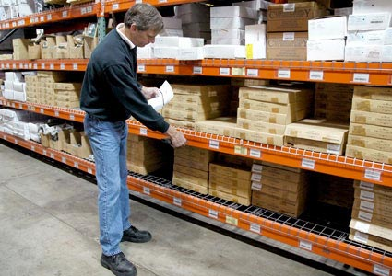
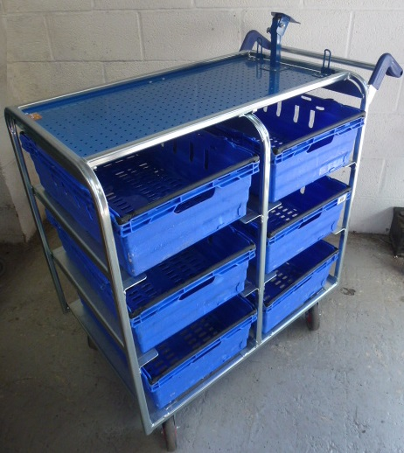
Picking
Picking is the process of picking the items from the inventory and physically moving them to the proper location to fulfill the customer order.
Types of picking:
Pick to Carton: Picking the items from the inventory to carton.
Pick to Tote: Picking the items from the inventory to tote.

Slide 34
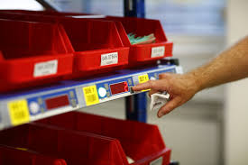
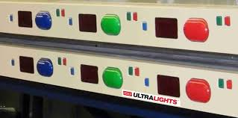
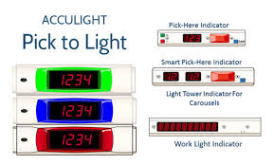
Piece Picking : Picking an item for specific one order.
Pick to Light: Pick to light systems position the lights on storage shelf. These
lights signal the location and quantity of an item to be picked for an order.

Slide 35

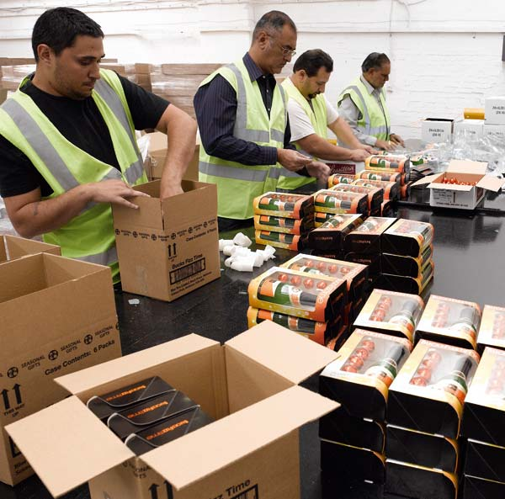
Packing
Packing is enclosing or protecting the items for distribution or transportation.
Packing should be done in the compatible box based on the size of an item.

Slide 36
Packing Types
Discrete Order Packing:
In discrete order packing a single carton is packed for cubed or non-cubed order.
Batch Packing:
In batch packing multiple cartons are packed at the same time.
Voice directed packing:
Supports both single carton packing and batch packing. In voice directed packing workers have a headset connected to a small wearable computer, which tells them where to go and what to do using verbal prompts. Workers confirm their tasks by speaking pre-defined commands and reading confirmation codes printed on locations or items throughout the warehouse.

Slide 37
Packing
Put to zone
Put to Zone provides a higher level of consolidation prior to PTS.
Items are brought to Zone and some other worker put these items to available bins.
Put to Zone (PTZ) is then the process of sorting the inventory, within the pulled LPNs from reserve, onto carts based on the specific requirements within each specific store pack zone.
These carts are then eventually distributed to the store pack locations in the zone.
This is used for big retail orders from stores.
Due to warehouse layout or physical constraints, clients may opt to use the PTZ environment as a way to improve travel efficiency.
Put to Store
Store pack locations are used in the PTS functionality and they are dedicated either to a store
Here in PTS has a group of locations already assigned to a Store. When you need to Ship to a Store, need pick from the Store’s locations and ship directly.
When multiple stores or orders require inventory from one LPN, the LPN is sent to a put to store area where the user splits the inventory into cartons that are designated for individual stores.
Here totes are broken and packing will be done.

Slide 38
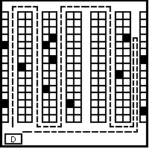
Routing
For distribution orders that are routed through WM, the wave process next initiates the routing process, or carrier determination.
In order to perform routing WM accesses the routing lane.
Lane meaning is moving the package from warehouse to store. So routing lane (Path) is needed.

Slide 39
Routing Types
Static Routing :
Static routing involves routing goods according to a static routing guide that is updated by the retailer on a regular basis.
This route has predefined rules
To communicate updates to suppliers, retailers must send a new routing guide to each supplier.
Dynamic Routing :
The suppliers select their own route path(Service).
Dynamic routing is a retailer initiative in which the routing guide resides in the retailer's hands, which allows it to be updated as often as desired.

Slide 40
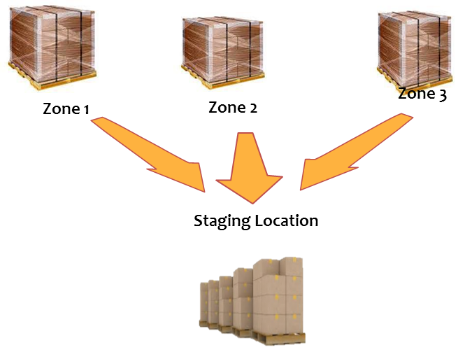
Order Consolidation
It is the assignment of Outbound location to cartons of similar characteristics.
The purpose of OC is to consolidate the multiple cartons of single order that were packed in various areas of the WH.
To combine like orders together for lower shipping chargers

Slide 41
Task Management
It is defined as a piece of work required to be done.
Tasking is a system directed process, which assigns tasks to operators, based on task group, priority, and current location.
Task groups are typically defined by job function and/or equipment type.

Slide 42
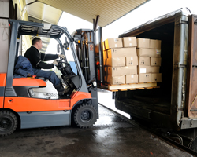
Shipping
Shipping is the final process of order fulfillment process.
Shipping is the physical process of transporting the goods.
Shipments should be loaded onto the right trailers, then tracked until they reach the customer in good condition.

Slide 43
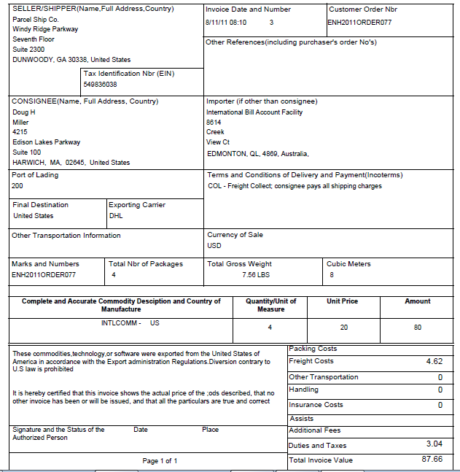
Invoicing
Invoicing is the process of generating customer invoices for all completed shipments.
Once the shipment is done the confirmation of shipment is provided through
invoice to the customer.

