Slide 1
Text detection using ML
2410030140 -
2410030339 -
2410030337 -
2410030148 -
2410030241 -
Ch. Jaswanth Reddy
B. Karthik Reddy
K. Mani Vardhan Reddy
Svv. Rithvik
S. Mukunda

Slide 2
Table of Contents
Introduction | Introduction to this project
Objectives of the project | Aim of the project
Methodology | Approach towards the project
Implementation details | How we will complete the project
Dataset References | All the datasets included in the project
Conclusion | Final conclusion of the project

Slide 3
Introduction
Our Project merges six types of datasets starting —from social media and encyclopedia entries to book reviews and various AI outputs—into a balanced human vs. AI dataset stratified by length. Using HLTK, we extract linguistic features like n-gram diversity and parse-tree depth, and model prompt-response patterns to catch AI artifacts. A hybrid ensemble of Transformer embeddings and feature-based classifiers then delivers reliable detection across all content types.
Multi-Domain Data Fusion:
Consolidated six heterogeneous datasets—Reddit comments, Wikipedia articles, UCSD book reviews, ChatGPT/GPT-4 outputs, GPT-3 generations, and specialized AI documentation—to cover casual, professional, creative, and technical domains
Enhanced Linguistic Profiling:
Leveraged HLTK (Human Language Tool Kit) to extract over 30 linguistic and stylistic metrics, including advanced n-gram entropy, parse-tree depth distributions, and citation-style patterns.

Slide 4
Objectives of the Project
Objective-2
Validate and improve detection accuracy across casual, professional, creative, and technical text categories.
Objective-1
Objective-3
Develop a detection model that accurately distinguishes AI-written text from human writing using advanced linguistic features.
Develop a comprehensive data pipeline to collect and preprocess text samples representing a variety of writing styles and domains.

Slide 5
Methodology
Data Collection Strategy:
Human Sources (50%):
Reddit Dataset (20%), Wiki Text (20%), UCSD Book Graph (10%)
AI Sources (50%):
Modern LLMs (30%), Older Models (15%), Specialized AI (5%)
Feature Engineering Pipeline:
->Use HLTK to measure how predictable and logically connected the text is, and to find repeating phrases.
->Check how complex the sentence structures are, see if the text stays on topic, and examine how consistent the feelings or tone are.

Slide 6
Implementation details
Gather text datasets from a variety of human and AI sources (Wikipedia, new and old LLMs).
Preprocess and organize the data to ensure balance and consistency across all domains.
Use HLTK to extract important linguistic features like perplexity, coherence, and repetition.
Train a hybrid detection model combining Random Forest and Transformer algorithms.
Evaluate model accuracy and reliability using key metrics (accuracy, precision, recall).

Slide 7
Dataset References:
Casual/Social (20%): https://www.kaggle.com/datasets/pavellexyr/the-reddit-dataset-dataset
Professional/Academic (20%): https://huggingface.co/datasets/Salesforce/wikitext
Creative/Personal (10%): https://sites.google.com/eng.ucsd.edu/ucsdbookgraph/home
Modern LLMs (30%): https://www.kaggle.com/datasets/sunilthite/llm-detect-ai-generated-text-dataset
Older Models (15%): https://arxiv.org/html/2403.07321v1
Specialized AI (5%): https://github.com/iamjr15/Ensemble-AI-Text-Detection

Slide 8
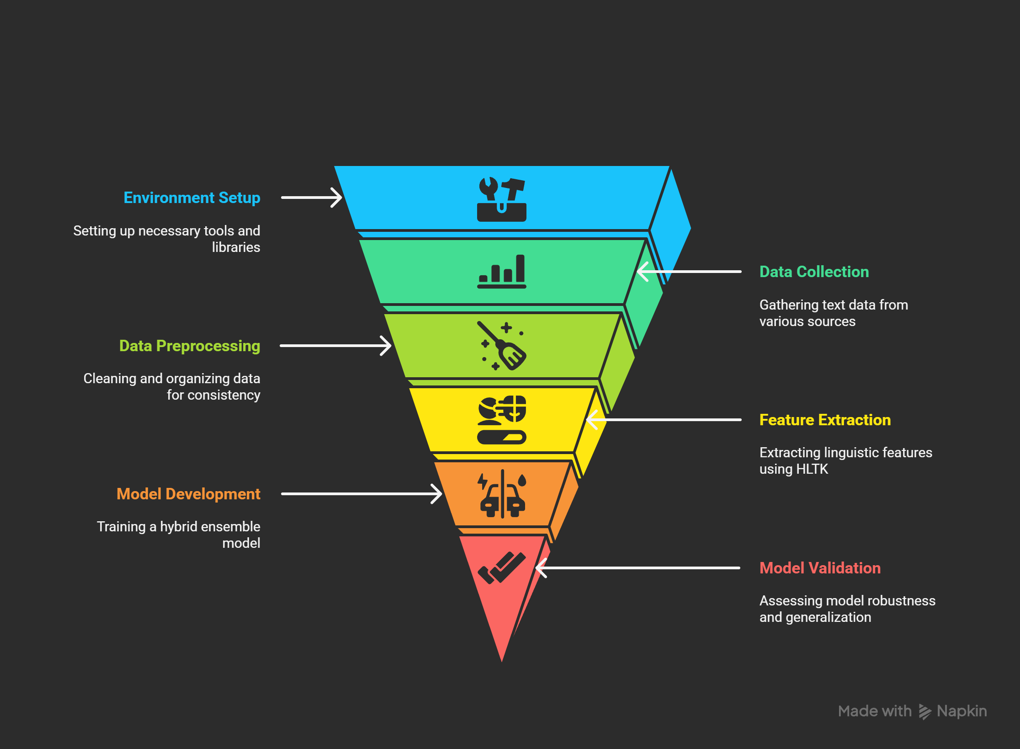

Conclusion
This project builds an effective AI Text Detection system using diverse human and AI datasets. Leveraging HLTK features and a hybrid model, it accurately distinguishes AI-generated from human text across multiple domains. Balanced data and strong validation ensure robust performance. This foundation supports future improvements for real-time and evolving AI detection.

Slide 9

Thank You!

