Slide 1
Text Detection using ML
2410030140 -
2410030339 -
2410030337 -
2410030148 -
2410030241 -
Ch. Jaswanth Reddy
B. Karthik Reddy
K. Mani Vardhan Reddy
S. Rithwik
Svv. Mukunda

Slide 2
Introduction
Text Analysis:
The system reads any text input and examines patterns in how words are used, how sentences are structured, and the overall writing style
Smart Detection:
Uses trained algorithms that have learned to recognize the differences between how humans write versus how AI writes
The project " Text Detection Using ML" is a machine learning system that analyzes text to determine whether it was written by AI or a human. With the rise of AI writing tools like ChatGPT and Claude, it has become difficult to tell the difference between AI-generated content and human writing. This project solves that problem by creating a tool that can identify the source of any text.

Slide 3
Methodology
BERT Fine-tuning Approach:
BERT is a language model developed by Google that is used for “Natural Language processing” (NLP).
BERT (Bidirectional Encoder Representations from Transformers) is a pre-trained language model that reads text in both directions to capture full context.
It’s pre-trained using Masked Language Modeling (randomly masks words and predicts them) and Next Sentence Prediction (learns sentence relationships).
BERT is composed of multiple Transformer encoder layers, each learning its own set of weights to detect different linguistic patterns and relationships in text.

Slide 4
Optimization Technique
Adam Optimizer with Learning Rate Scheduling:
Adam optimizer is similar to Gradient Descent Optimization technique.
The learning rate is reduced over time to fine-tune performance as training progresses.
Adjusts the learning rate for each model parameter based on past gradients, improving convergence stability.
A small weight decay (e.g., 0.01) is used alongside AdamW to regularize model weights and reduce overfitting.

Slide 5
evaluation metrics to check the performance of model
Accuracy:-
What it measures: Overall correctness of the model Simple definition: Out of 100 texts, how many did the model classify correctly (both AI and human)? Formula: (Correct predictions) / (Total predictions) Example: If model correctly identifies 94 out of 100 texts → 94% accuracy Good for: Getting overall performance picture
F1-Score:-
What it measures: Balance between finding AI texts and being accurate Simple definition: Combines precision with recall (ability to find all AI texts) into one number Formula: 2 × (Precision × Recall) / (Precision + Recall) Example: If precision = 90% and recall = 85% → F1-score = 87.4% Good for: Overall model quality when you need both accuracy and completeness
[Where Precision = (Correctly identified AI texts) / (All texts labeled as AI) ]

Slide 6
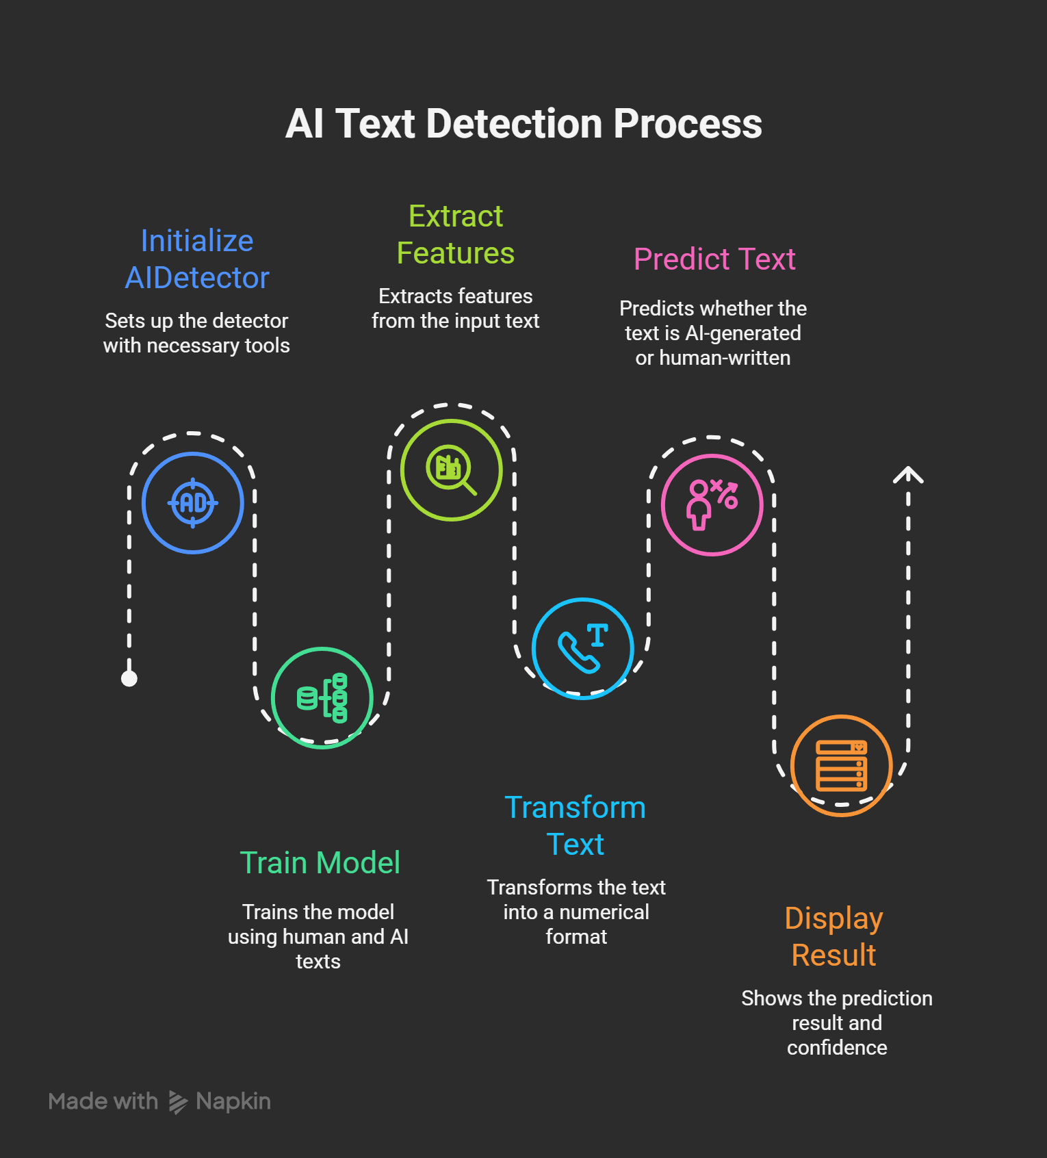
Conclusion
The project aims to create a simple and accurate tool that can tell whether any text was written by AI or a human. This will provide a reliable solution for distinguishing between artificial and authentic content in various situations.

Slide 7

Thank You!

