Slide 1
Medical Record Gallery
2410030140 -
2410030339 -
2410030337 -
2410030143 -
2410030148 -
Ch. Jaswanth Reddy
B. Karthik Reddy
K. Mani Vardhan Reddy
T. Dipak Reddy
Svv. Rithvik

Slide 2
Table of Contents
Introduction | Introduction to this project
Objective of the project | Objectives of the project
Novelty and Adaptability of Methodology | Idea and approach
Dissemination and Accessibility | Requirements to use this project

Slide 3
INTRODUCTION
Medical Record Gallery is an application program intended for use by hospitals and clinics to view related patient medical documents like reports, scans, and prescriptions in a simple, visual format. Users can easily enter a patient ID and review all related images via an easy-to-use interface. This project fills a requirement for streamlined retrieval and review of patient records in a digital format, which will improve access for medical staff and assist in improved patient care.
Image Display:
The system efficiently loads and presents all medical images associated with a patient ID, including reports, scans, and prescriptions.
Easy Retrieval:
This streamlined process reduces time spent searching for documents and supports better patient care through rapid information access.

Slide 4
Objective of the Project
The system eliminates reliance on physical medical records by providing centralized digital access to all patient documents.
It streamlines clinical workflows by ensuring that patient images and reports are quickly retrievable through a standardized digital repository.
Healthcare professionals can efficiently review comprehensive patient histories without delays caused by manual file handling.
The solution enhances record accuracy and availability, reducing the risk of lost or misplaced documents and supporting improved patient care.

Slide 5
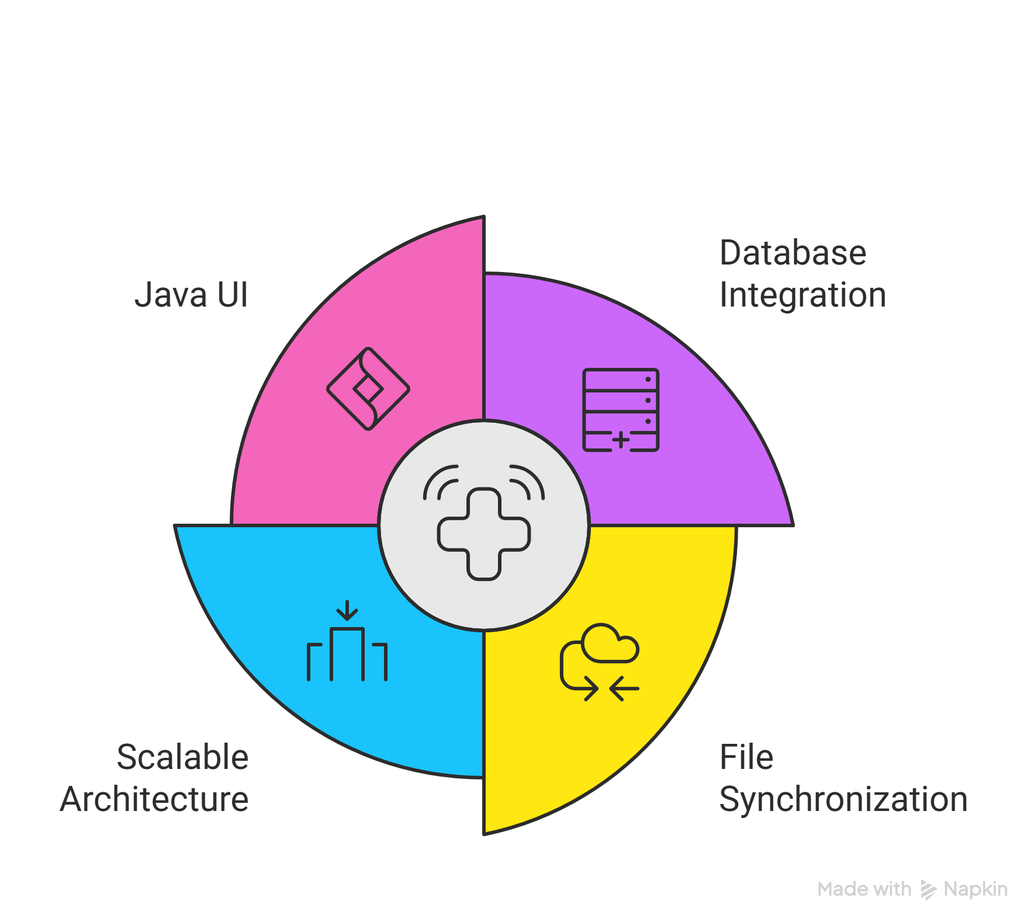
Novelty and Adaptability of Methodology
Integrates a database backend for managing patient records and images.
Synchronizes file storage with database metadata.
Supports multi-hospital deployment through scalable architecture.
Combines desktop Java UI with database for efficiency.
Modular code structure allows easy integration with hospital systems.

Slide 6
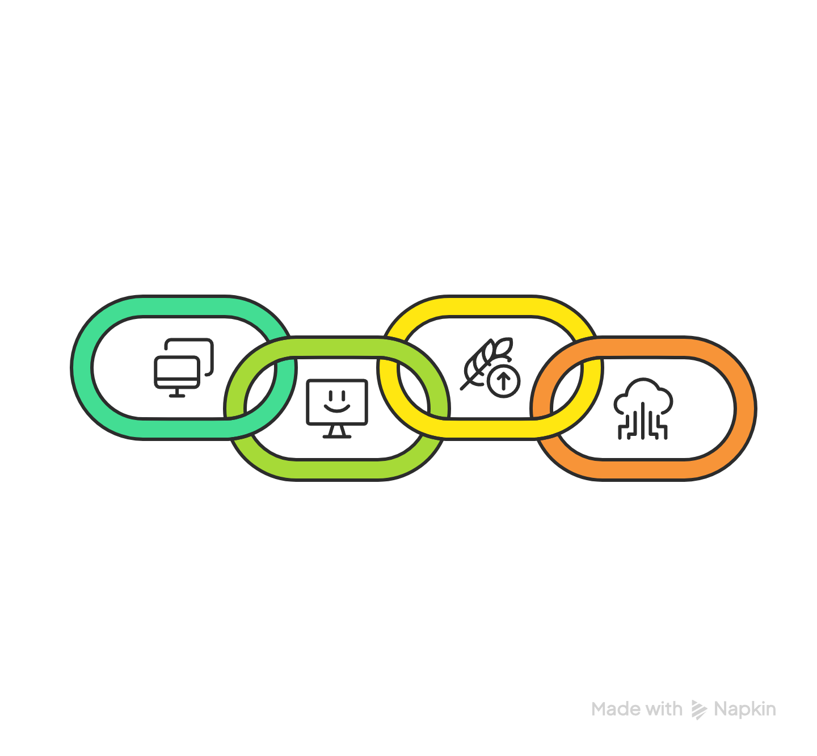
Dissemination & Accessibility
Designed to work efficiently on any machine with Java installed, regardless of operating system.
User interface is simple and intuitive for quick adoption by hospital staff.
The system is lightweight, ensuring good performance even on limited hardware.
Supports easy data backup and transfer through standard file and database management techniques.

Slide 7

Thank You!

