Slide 1
Medical Record Gallery
2410030140 -
2410030339 -
2410030337 -
2410030143 -
2410030148 -
Ch. Jaswanth Reddy
B. Karthik Reddy
K. Mani Vardhan Reddy
T. Dipak Reddy
Svv. Rithvik

Slide 2
Table of Contents
Introduction | Introduction to this project
Feasibility analysis | Technical requirements and resources
Literature survey table | Related information about the project
Approach | Approach to this project
Objective of the project | Workflow and some of the objectives of the project
Conclusion | The final result and output expected from the project

Slide 3
Introduction
Medical Record Gallery is an application program intended for use by hospitals and clinics to view related patient medical documents like reports, scans, and prescriptions in a simple, visual format. Users can easily enter a patient ID and review all related images via an easy-to-use interface. This project fills a requirement for streamlined retrieval and review of patient records in a digital format, which will improve access for medical staff and assist in improved patient care.
Image Display:
The system efficiently loads and presents all medical images associated with a patient ID, including reports, scans, and prescriptions.
Easy Retrieval:
This streamlined process reduces time spent searching for documents and supports better patient care through rapid information access.

Slide 4
Feasibility Analysis
Storage
Images are stored in organized folders, accessible by patient ID.
Java
Interface
Uses robust, beginner-friendly tools (Java, Eclipse IDE, Java Swing).
Provides a simple visual design for fast gallery viewing and easy navigation.

Slide 5
Literature Survey Table
Year |  | Title |  | Techniques |  | Accuracy | Limitations
2023 |  | MedView System |  | Java Swing, File I/O, Image Gallery |  | 95% | No cloud sync, desktop only
2022 |  | ClinicSnap |  | Python Tkinter, Directory Scanning |  | 93% | Limited image formats supported
2022 |  | HealthDocs Viewer |  | Web (HTML/JS), REST API, Local Storage |  | 97% | Needs modern browser

Slide 6
Literature Survey Table
Year |  | Title |  | Techniques |  | Accuracy | Limitations
2021 |  | DocuGallery |  | C#, WPF, Folder Listening, Image Viewer |  | 94% | Windows OS only
2021 |  | PatientFile Explorer |  | JavaFX, SQLite DB, Drag-and-drop Upload |  | 96% | Higher system requirements
2020 |  | MedImage Organizer |  | PHP, Bootstrap, Simple Web Uploader |  | 92% | Requires manual server setup

Slide 7
References to Research papers
https://www.ncbi.nlm.nih.gov/pmc/articles/PMC3043954/
https://weasis.org/en/index.html
https://www.open-hospital.org/
https://github.com/adarshjoshi/Hospital-Management-System-Java
https://www.freeprojectz.com/free-java-spring-boot-reactjs-project-source-code-download/image-gallery-management-system
https://www.javacodegeeks.com/2013/08/file-upload-example-in-servlet-and-jsp.html

Slide 8
Approach
Patient ID Input:
Prompts user for a patient’s unique identifier and validates the entry.
Folder Scanning:
Locates the corresponding directory on disk (e.g., C:/hospital_data/reports/{ID}/).
Image Retrieval:
Reads all supported image files (.jpg, .png) from the folder.
Gallery Display:
Uses Java Swing components (JPanel, JScrollPane) to present images in a scrollable gallery.
Error Handling:
Shows clear messages if the folder is missing or contains no images.

Slide 9
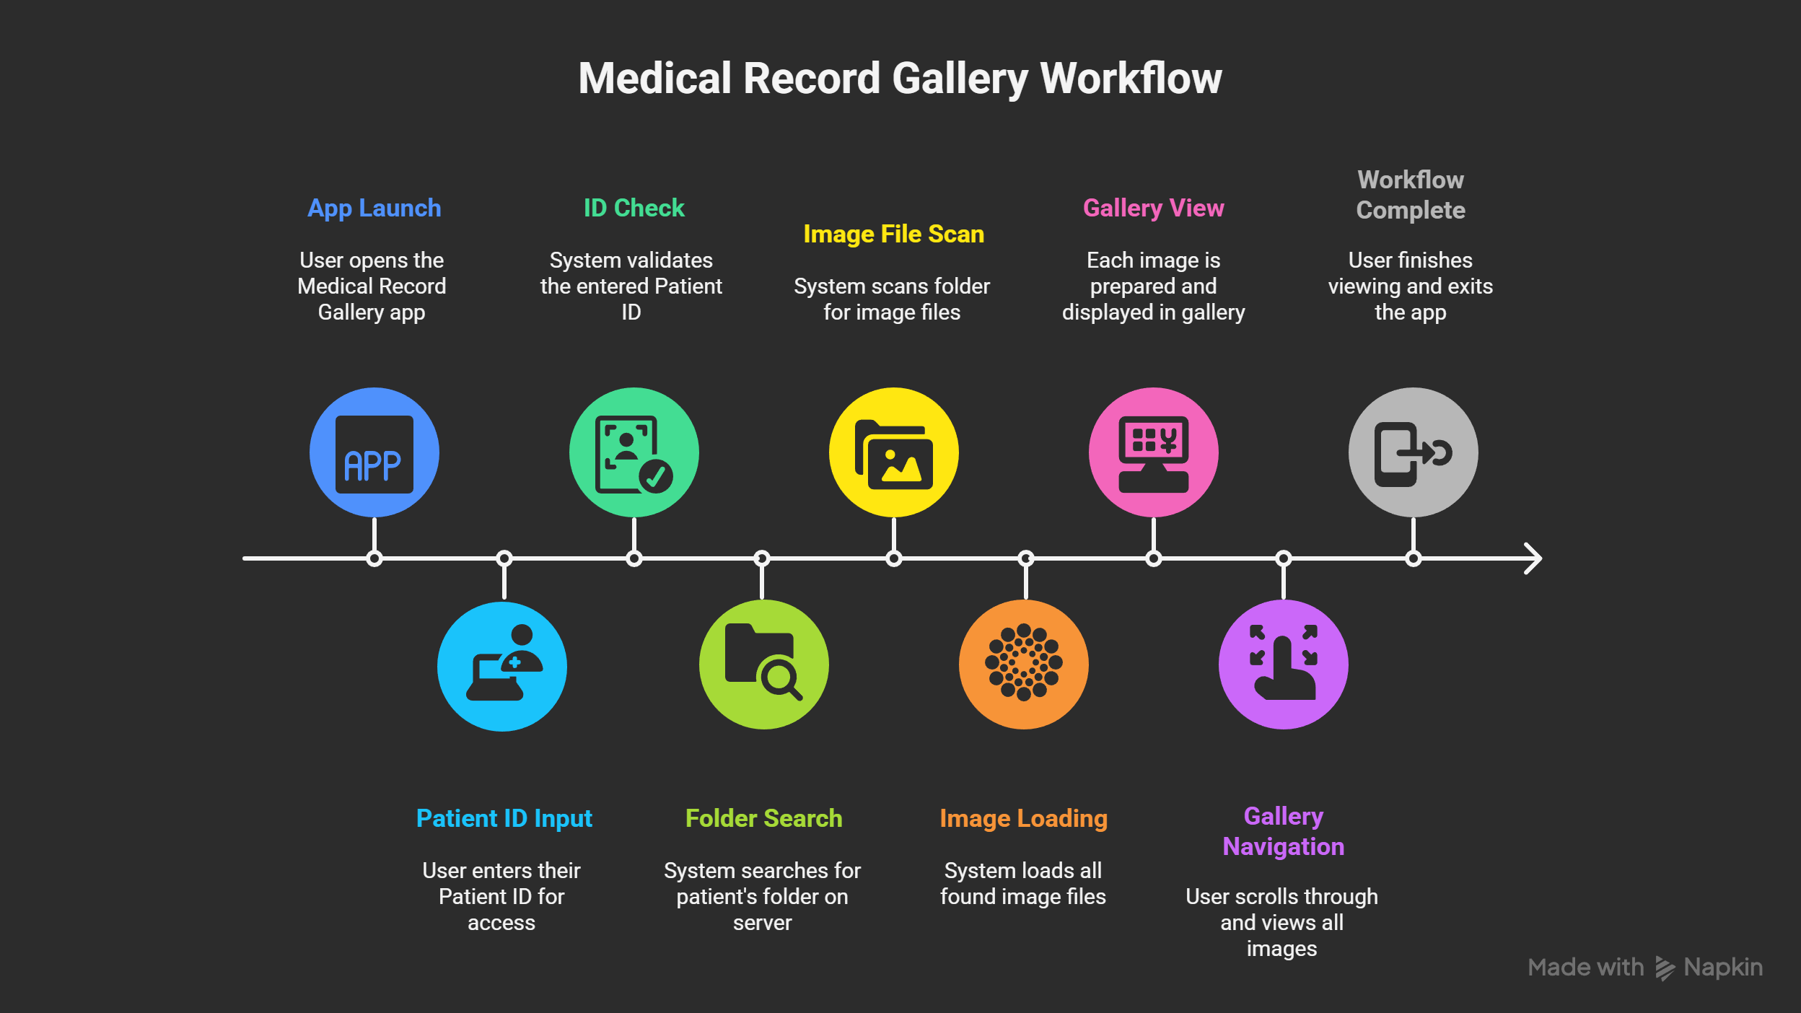

Workflow

Slide 10
Objective of the Project
-> Enable hospital staff to quickly retrieve and view patient reports, scans, and prescriptions using a simple patient ID input.
->Provide a visual gallery that organizes medical images efficiently by patient, reducing errors and search time.
->Support better decision-making and care by giving healthcare professionals instant access to comprehensive patient documentation.
Conclusion:
The project aims to create a simple and accurate tool that can tell whether any text was written by AI or a human. This will provide a reliable solution for distinguishing between artificial and authentic content in various situations.

Slide 11

Thank You!

