Slide 1
Agentic RAG Chatbot with MCP Integration A Streamlit-based Multi-Agent System for Document QA
Name: Mani Varun Arivini
Education: Master of Science in Scientific Instrumentation and Deep Learning, Germany
University: Ernst-Abbe-Hochschule Jena, Germany
Date: July 25, 2025
Current Location: Hyderabad

Slide 2
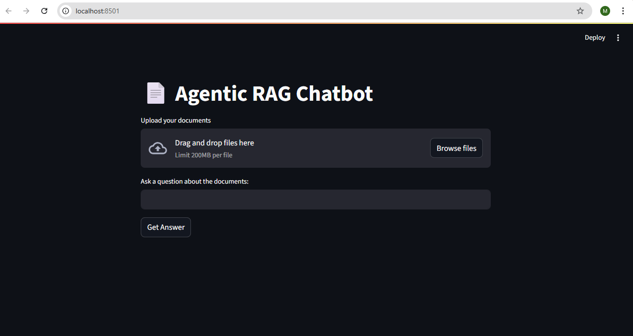
Project Overview
Objective
Build a Retrieval-Augmented Generation (RAG) chatbot supporting multi-format document question-answering using an agentic architecture and Model Content Protocol (MCP) for inter-agentic communication
Key Features:
Supports PDF, PPTX, CSV, DOCS, TXT
Multi-agent system with MCP
Streamlit-based interactive UI

Slide 3
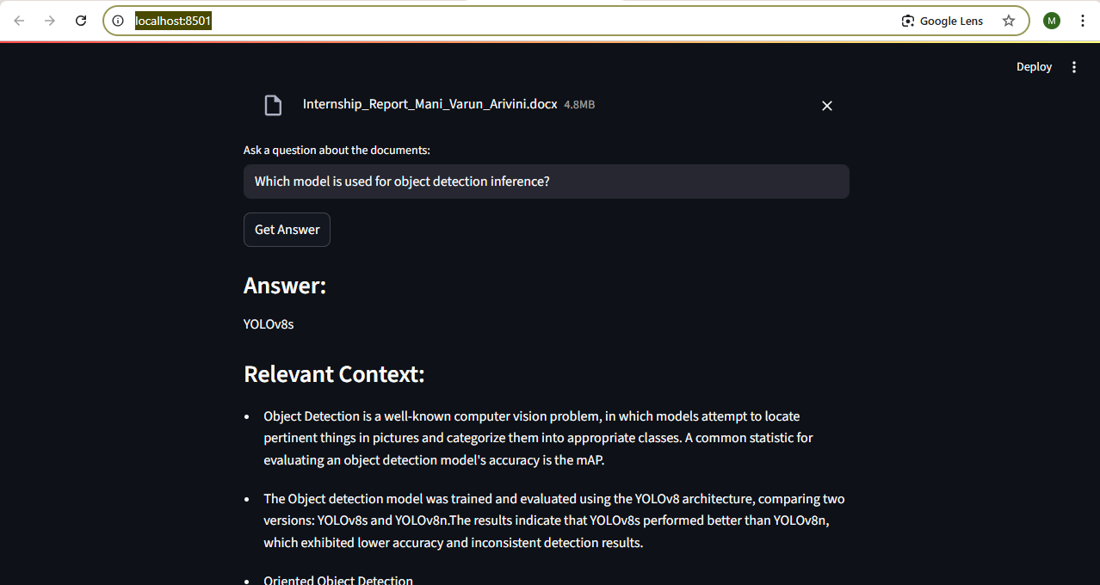
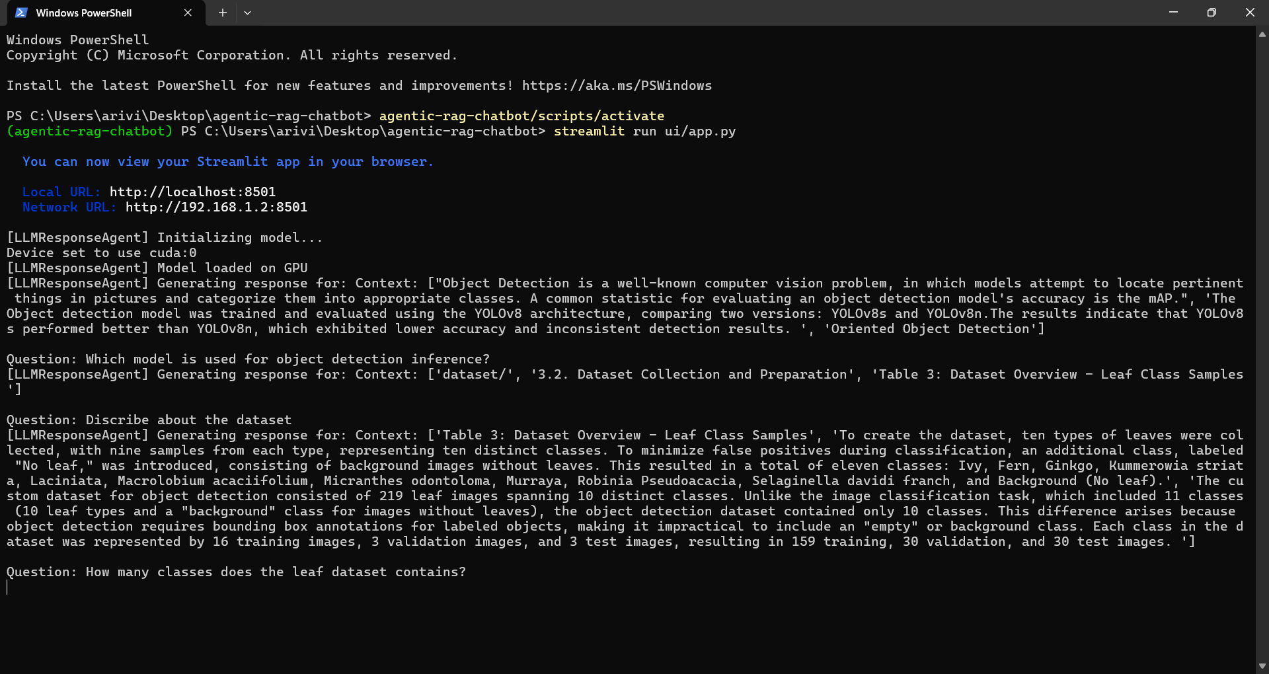
Agentic Architecture with MCP
Core Agents
Ingestion Agent: Splits and prepares text chunks from documents.
Retrieval Agent: Finds relevant document chunks using semantic search (FAISS).
LLM Response Agent: Uses query and context to generate answers.
MCP: Dashed lines showing structured messages passing between agents.
Coordinator Agent: Manages message passing using model context protocol.
Images: Chatbot overview Multi-turn conversation

Slide 4
System Flow Diagram with Message Passing
Ingestion Agent
(Uploads Document)
After User uploading the PDF via Streamlit UI, Ingestion Agent splits the PDFs into smaller text chunks and
MCP message sent to Retrieval Agent
Retrieval Agent
(Sends Chunks + query)
Finds the most relevant chunks based on the user’s question using embeddings.
MCP message sent to LLM Response Agent
LLM Response Agent
(Sends query + context)
Takes the relevant chunks and the question, the uses a language model to generate the answer and
answer is displayed in UI.

Slide 5
Tech Stack Used
Component | Details
Frontend | Streamlit (UI for document upload and question answering)
Agents | Python-based modular agents using MCP (Model Context Protocol)
Embeddings | sentence-transformers (all-MiniLM-L6-v2) for semantic text embedding
Vector Store | FAISS for efficient similarity search over embedded document chunks
LLM Model | Hugging Face Transformers (google/flan-t5-small) for generating responses
Environment | Python, torch, transformers, faiss, venv, accelerate
Device | GPU-enabled system (fallback to CPU if unavailable)

Slide 6
Challenges Faced
Initially used a very large LLM (tiiuae/falcon-7b-instruct), which caused long download times and high memory usage. So switched to a lightweight model (google/flan-t5-small) for faster inference and lower usage.
Multi-turn conversation failed after the first query (due to missing chunk storage or relevant index errors) later fixed state handling by storing and reusing chunks across user queries using global variables and session state.
Slow response time on CPU only devices. Configured the system to use GPU when available, speeding up inference significantly.
Answers were not always satisfying due to the limited reasoning capability of smaller models.

Slide 7
Future Scope
Speech to Speech Interface: Integrate speech recognition (e.g., Whisper) and Speech synthesis (e.g., TTS) to build a fully voice-enabled chatbot for natural conversions.
Multilingual Q&A Support: Enable users to ask questions and receive answers in multiple languages by integrating translation APIs alongside the LLM pipeline. This would make the system accessible to a global audience such as German, Telugu, Hindi etc.
Using Larger LLM models: Explore quantized versions of larger LLMs for better answers.
Feedback Loop: Implementing feedback scoring to improve answer quality over time.
Cloud Integration: Deploying on cloud platforms for broader access and scalability using GPU backed instances.

Slide 8
Thank You

