Slide 1
Appraisal Presentation
Evaluating performance to foster growth and improvement
Notes:
AI-generated content may be incorrect. ---

Slide 2
Executive Summary
Notes:
--- This slide references information from the following file: https://eyindia-my.sharepoint.com/personal/manivel_m_in_ey_com/_layouts/15/Doc.aspx?sourcedoc=%7B1320EA83-170E-4454-9AA8-268E9A9A5C6C%7D&file=Lead_feedback_data_2026.xlsx&action=default&mobileredirect=true Leadership Impact Summary

Slide 3

Leadership Impact Summary
Cloud and DevOps Transformations
Successfully executed multiple cloud and DevOps programs across strategic accounts, delivering measurable business value.
DevSecOps and Governance Leadership
Led adoption of DevSecOps, observability, and governance platforms to enhance delivery efficiency and client satisfaction.
Team Growth and Development
Expanded team size from two to six members, focusing on capability building and people development.
Client Relationships and Pipeline
Strengthened client relationships and built forward-looking pipeline opportunities for future engagement expansion.
Notes:
--- This slide references information from the following file: https://eyindia-my.sharepoint.com/personal/manivel_m_in_ey_com/_layouts/15/Doc.aspx?sourcedoc=%7B1320EA83-170E-4454-9AA8-268E9A9A5C6C%7D&file=Lead_feedback_data_2026.xlsx&action=default&mobileredirect=true This slide provides an overview of the key leadership contributions made throughout the year. It highlights the successful execution of multiple Cloud and DevOps transformation programs across various strategic accounts, demonstrating an ability to deliver measurable business value. The summary emphasizes leadership in driving end‑to‑end adoption of DevSecOps practices, observability frameworks, and governance platforms, all of which contributed significantly to improving delivery efficiency and client satisfaction. The content also reflects team growth, expanding from two to six members, showcasing capability building and people development. Additionally, this section showcases strengthened client relationships and forward‑looking pipeline opportunities, reinforcing ongoing strategic alignment and positioning for future engagement expansion.

Slide 4
Revenue Performance
Notes:
--- This slide references information from the following file: https://eyindia-my.sharepoint.com/personal/manivel_m_in_ey_com/_layouts/15/Doc.aspx?sourcedoc=%7B1320EA83-170E-4454-9AA8-268E9A9A5C6C%7D&file=Lead_feedback_data_2026.xlsx&action=default&mobileredirect=true Business Revenue Outcomes

Slide 5

Business Revenue Outcomes
Generative Revenue Overachievement
Achieved ₹3.57 Cr versus planned ₹2 Cr, showcasing strong sales influence and technical leadership.
Managed Revenue Excellence
Reported ₹3.18 Cr in managed revenue, demonstrating delivery excellence and sustained client trust.
Total Revenue from Key Engagements
Collected ₹2.55 Cr from DevOps, GenAI, and infrastructure assessment projects.
Strong Sales Pipeline
Pipeline valued at ₹3.03 Cr with opportunities in cloud optimization, observability, and GenAI.
Notes:
--- This slide references information from the following file: https://eyindia-my.sharepoint.com/personal/manivel_m_in_ey_com/_layouts/15/Doc.aspx?sourcedoc=%7B1320EA83-170E-4454-9AA8-268E9A9A5C6C%7D&file=Lead_feedback_data_2026.xlsx&action=default&mobileredirect=true This slide summarizes financial achievements aligned to organizational revenue objectives. It outlines the over‑achievement in generative revenue, reaching ₹3.57 Cr against a planned ₹2 Cr target, reflecting a strong sales influence and technical leadership in driving deal conversions. The section also reports ₹3.18 Cr in managed revenue, demonstrating continued delivery excellence and sustained client trust. A total revenue collection of ₹2.55 Cr is documented across multiple engagements including DevOps transformation, GenAI development, and infrastructure assessments. Additionally, a strong pipeline worth ₹3.03 Cr is highlighted, consisting of high‑value opportunities in cloud optimization, observability, and GenAI development. These financial results collectively reinforce the strategic impact made during the review period and provide confidence in continued revenue growth.

Slide 6
Key Clients
Notes:
--- This slide references information from the following file: https://eyindia-my.sharepoint.com/personal/manivel_m_in_ey_com/_layouts/15/Doc.aspx?sourcedoc=%7B1320EA83-170E-4454-9AA8-268E9A9A5C6C%7D&file=Lead_feedback_data_2026.xlsx&action=default&mobileredirect=true Client Portfolio Overview

Slide 7
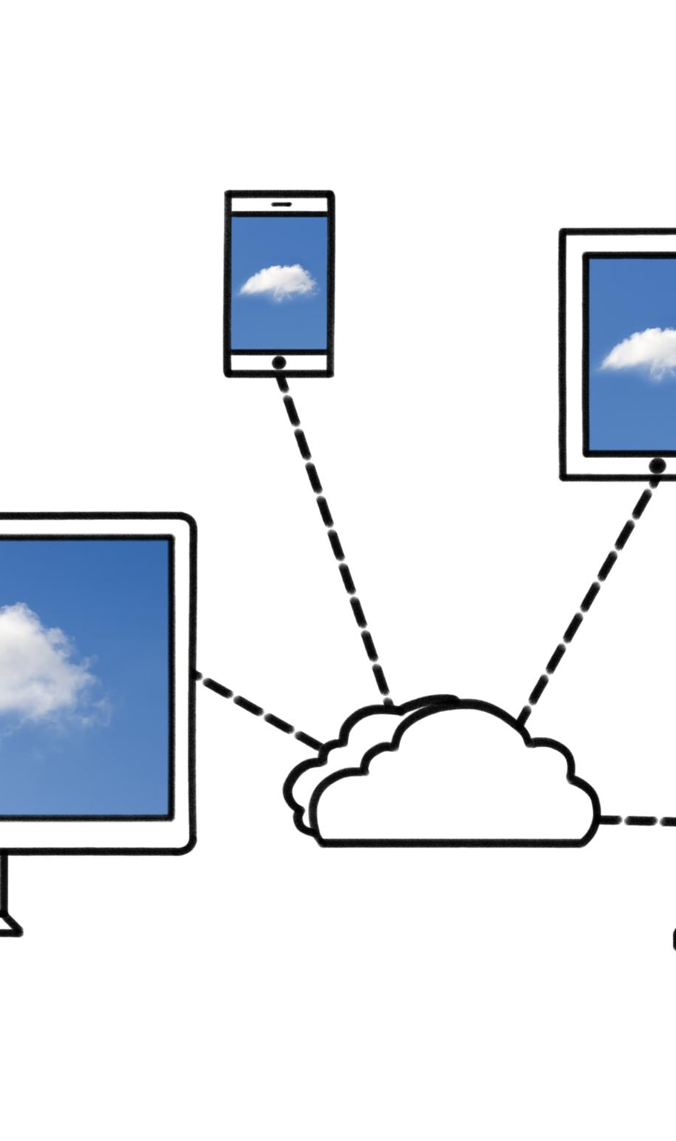
Client Portfolio Overview
Unilever Engagement
Executed Cloud Infrastructure and DevOps Architecture with leadership roles enhancing optimization and governance.
GCPL GenAI Design
Designed GenAI infrastructure on Azure supporting modern AI workloads for advanced technological solutions.
MSIL Cloud Assessments
Delivered Dataverse GenAI architecture on AWS and performed DevOps environment assessments for cloud modernization.
Diverse Portfolio Strength
Demonstrates broad technical capabilities and strong relationship building across multiple platforms and industries.
Notes:
--- This slide references information from the following file: https://eyindia-my.sharepoint.com/personal/manivel_m_in_ey_com/_layouts/15/Doc.aspx?sourcedoc=%7B1320EA83-170E-4454-9AA8-268E9A9A5C6C%7D&file=Lead_feedback_data_2026.xlsx&action=default&mobileredirect=true This slide outlines the key clients supported during the review period, focusing on roles and engagement maturity levels. The portfolio includes Unilever, where Cloud Infrastructure and DevOps Architecture responsibilities were executed alongside engagement leadership roles, contributing to optimization and governance improvements. Work for GCPL involved designing GenAI infrastructure architectures on Azure, supporting modern AI‑driven workloads. Engagements with MSIL included Dataverse GenAI architecture on AWS and DevOps environment assessments. The diversity of clients and project types demonstrates broad technical capability, the ability to adapt across platforms, and value creation across different industries. This breadth of portfolio also reinforces strong relationship building and the ability to drive cloud modernization across client landscapes.

Slide 8
Key Project 1: CI/CD Pipeline
Notes:
--- This slide references information from the following file: https://eyindia-my.sharepoint.com/personal/manivel_m_in_ey_com/_layouts/15/Doc.aspx?sourcedoc=%7B1320EA83-170E-4454-9AA8-268E9A9A5C6C%7D&file=Lead_feedback_data_2026.xlsx&action=default&mobileredirect=true ACS Unified CI/CD Pipeline Delivery

Slide 9

ACS Unified CI/CD Pipeline Delivery
Scalable DevSecOps Framework
Designed and implemented a scalable DevSecOps framework integrating code quality and security scanning in Azure DevOps.
Standardized Image Model
Introduced a standardized image model ensuring consistency across development, testing, and production environments.
Improved Deployment Efficiency
Reduced deployment time by 50%, significantly improving release velocity and operational efficiency.
Enhanced Pipeline Stability
Achieved 100% pipeline availability, enhancing stability, predictability, and audit readiness.
Notes:
--- This slide references information from the following file: https://eyindia-my.sharepoint.com/personal/manivel_m_in_ey_com/_layouts/15/Doc.aspx?sourcedoc=%7B1320EA83-170E-4454-9AA8-268E9A9A5C6C%7D&file=Lead_feedback_data_2026.xlsx&action=default&mobileredirect=true This slide highlights the end‑to‑end delivery of the ACS Unified CI/CD pipeline for Unilever. The work focused on designing and implementing a scalable DevSecOps framework within Azure DevOps, integrating code quality, security scanning, and governance practices directly into the pipeline. A standardized image model was introduced to ensure consistency across development, testing, and production environments. Deployment time was reduced by 50%, significantly improving release velocity and operational efficiency. Pipeline availability was brought to 100%, enhancing stability and predictability. Additionally, all artifacts were stored in a structured repository, improving audit readiness and compliance visibility. The project delivered strong business value through risk mitigation, enhanced governance, improved delivery speed, and improved release quality, thereby contributing to both operational excellence and regulatory assurance.

Slide 10
Key Project 2: Observability
Notes:
--- This slide references information from the following file: https://eyindia-my.sharepoint.com/personal/manivel_m_in_ey_com/_layouts/15/Doc.aspx?sourcedoc=%7B1320EA83-170E-4454-9AA8-268E9A9A5C6C%7D&file=Lead_feedback_data_2026.xlsx&action=default&mobileredirect=true ACS & RPA NewRelic Observability Program

Slide 11
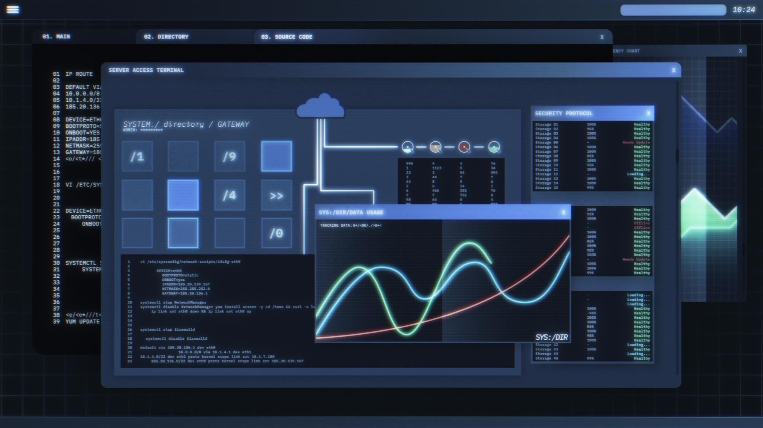
ACS & RPA NewRelic Observability Program
Unified Monitoring Dashboard
NewRelic observability integrates ACS and RPA bots with Azure cloud for centralized monitoring.
Executive Insight Dashboards
Custom dashboards provide leadership with real-time insights and actionable metrics.
Proactive Alerts and Optimization
Color-coded alerts and trend analysis help teams identify issues and optimize workloads proactively.
Business Value Delivered
Enhances risk mitigation, cost transparency, and operational control with predictive insights.
Notes:
--- This slide references information from the following file: https://eyindia-my.sharepoint.com/personal/manivel_m_in_ey_com/_layouts/15/Doc.aspx?sourcedoc=%7B1320EA83-170E-4454-9AA8-268E9A9A5C6C%7D&file=Lead_feedback_data_2026.xlsx&action=default&mobileredirect=true This slide details the implementation of NewRelic observability for ACS and RPA bots in the Unilever ecosystem. The initiative enabled a unified monitoring dashboard integrated with Azure cloud environments, offering deep visibility into bot health, performance patterns, and operational trends. Custom executive dashboards were designed to provide leadership with actionable insights and real‑time metrics. Alerts, color‑coded KPIs, and trend analysis empowered teams to proactively identify issues, optimize workloads, and reduce operational blind spots. The project established a consolidated monitoring capability for multiple bot technologies, creating a single source of truth. Business value delivered includes enhanced risk mitigation through proactive alerts, improved cost transparency via utilization dashboards, and greater operational control with predictive trend insights.

Slide 12
Key Project 3: Launchpad
Notes:
--- This slide references information from the following file: https://eyindia-my.sharepoint.com/personal/manivel_m_in_ey_com/_layouts/15/Doc.aspx?sourcedoc=%7B1320EA83-170E-4454-9AA8-268E9A9A5C6C%7D&file=Lead_feedback_data_2026.xlsx&action=default&mobileredirect=true HAP Launchpad Governance Platform

Slide 13

HAP Launchpad Governance Platform
Unified Approval Workflow
The platform consolidates Gate 1, Gate 1.5, and Gate 2 approvals into a seamless, traceable workflow.
Leadership Dashboards
Dashboards provide visualization of approval timelines, SLA performance, and governance status for leadership.
Centralized Documentation
All evidence and documentation are stored centrally, improving compliance and reducing manual efforts.
Enhanced Governance Impact
The platform reduces approval timelines, improves SLA adherence, and strengthens client confidence.
Notes:
--- This slide references information from the following file: https://eyindia-my.sharepoint.com/personal/manivel_m_in_ey_com/_layouts/15/Doc.aspx?sourcedoc=%7B1320EA83-170E-4454-9AA8-268E9A9A5C6C%7D&file=Lead_feedback_data_2026.xlsx&action=default&mobileredirect=true This slide describes the successful delivery of the HAP Launchpad 2.0 platform, built using PowerApps to streamline governance processes. The application consolidated critical gate approvals—Gate 1, Gate 1.5, and Gate 2—into a unified workflow, improving traceability and audit readiness. Leadership‑oriented dashboards were created to visualize approval timelines, SLA performance, and overall governance status. The centralized platform enabled all evidence and documentation to be stored in a single location, improving compliance and reducing manual effort. The project demonstrated strong impact by reducing approval timelines from weeks to days, improving SLA adherence for delivery leads, and enhancing overall governance maturity. It strengthened client confidence by providing transparency, structure, and measurement across operational processes.

Slide 14
Value Created
Notes:
--- This slide references information from the following file: https://eyindia-my.sharepoint.com/personal/manivel_m_in_ey_com/_layouts/15/Doc.aspx?sourcedoc=%7B1320EA83-170E-4454-9AA8-268E9A9A5C6C%7D&file=Lead_feedback_data_2026.xlsx&action=default&mobileredirect=true Organizational Value Delivered

Slide 15

Organizational Value Delivered
Cost Efficiency Improvements
Optimized infrastructure use and deployment efforts reduce overall operational costs significantly.
Accelerated Deployment Speed
Release cycles shortened from days to hours enable faster product delivery and market responsiveness.
Enhanced Risk Mitigation
Improved governance, security, and monitoring strengthen risk control in CI/CD and automation pipelines.
Quality Assurance Gains
Higher reliability, improved code quality, and adherence to SLAs boost deployment success and client trust.
Notes:
--- This slide references information from the following file: https://eyindia-my.sharepoint.com/personal/manivel_m_in_ey_com/_layouts/15/Doc.aspx?sourcedoc=%7B1320EA83-170E-4454-9AA8-268E9A9A5C6C%7D&file=Lead_feedback_data_2026.xlsx&action=default&mobileredirect=true This slide consolidates the impact delivered across core value dimensions—Cost, Speed, Risk, and Quality. Cost improvements include better infrastructure utilization and optimized deployment efforts across environments. Speed value is demonstrated through significant reductions in release cycles, often converting multi‑day deployment processes into streamlined hours. Risk mitigation stems from improved governance in CI/CD pipelines, strengthened security posture, and enhanced monitoring capabilities across ACS and RPA environments. Quality improvements include increased reliability of application deployments, better code quality through governance tools, and stronger SLA adherence in critical gate processes. Collectively, these outcomes contributed to measurable client satisfaction, operational excellence, and technology modernization strategies.

Slide 16
Leadership & Contributions
Notes:
--- This slide references information from the following file: https://eyindia-my.sharepoint.com/personal/manivel_m_in_ey_com/_layouts/15/Doc.aspx?sourcedoc=%7B1320EA83-170E-4454-9AA8-268E9A9A5C6C%7D&file=Lead_feedback_data_2026.xlsx&action=default&mobileredirect=true Technical & Strategic Contributions

Slide 17
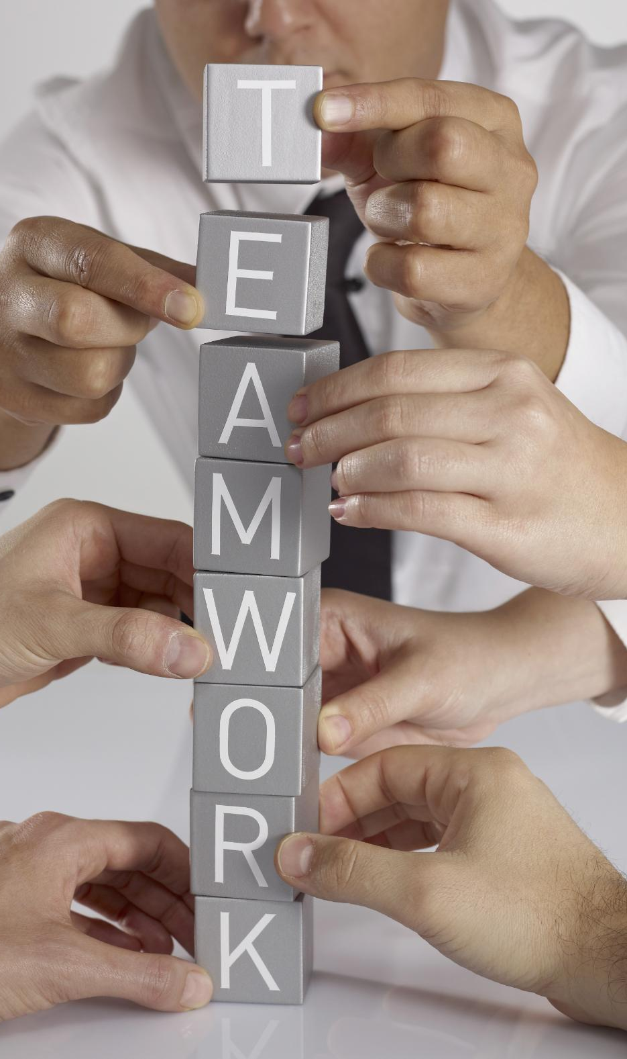
Technical & Strategic Contributions
Mentorship and Capability Building
Mentored an intern to develop three functional solutions, enhancing internal capabilities and team growth.
Strategic Project Participation
Contributed to four major RFP initiatives, supporting pipeline creation with significant revenue potential.
Audit and Compliance Contributions
Supported internal and client-facing audits ensuring compliance readiness and risk management.
Leadership and Certification Achievements
Guided project teams through dependencies and stakeholder interaction while achieving four professional certifications.
Notes:
--- This slide references information from the following file: https://eyindia-my.sharepoint.com/personal/manivel_m_in_ey_com/_layouts/15/Doc.aspx?sourcedoc=%7B1320EA83-170E-4454-9AA8-268E9A9A5C6C%7D&file=Lead_feedback_data_2026.xlsx&action=default&mobileredirect=true This slide summarizes contributions made beyond project delivery, demonstrating leadership maturity and organizational impact. Key highlights include mentoring an intern and guiding them in developing three functional solutions, contributing to internal capability upliftment. Participation in four major RFP initiatives supported pipeline creation valued at significant revenue potential. Contributions to internal and client‑facing audits such as ESE and GCC ensured compliance readiness. Additional leadership actions included helping multiple project teams resolve dependencies, conducting stakeholder interactions, and guiding them toward smooth delivery. Achieving four professional certifications further strengthened domain expertise. These contributions underscore a strong combination of technical depth, collaboration, thought leadership, and capability building.

Slide 18
Challenges & Mitigation
Notes:
--- This slide references information from the following file: https://eyindia-my.sharepoint.com/personal/manivel_m_in_ey_com/_layouts/15/Doc.aspx?sourcedoc=%7B1320EA83-170E-4454-9AA8-268E9A9A5C6C%7D&file=Lead_feedback_data_2026.xlsx&action=default&mobileredirect=true Operational Challenges and Responses

Slide 19

Operational Challenges and Responses
Challenges in Project Execution
Key challenges included client dependency delays, resource shortages in specialized skills, and unclear project scope early on.
Managing Multiple Engagements
Coordinating multiple simultaneous projects increased complexity requiring careful prioritization and resource management.
Mitigation Strategies
Mitigation involved stakeholder alignment meetings, requirement workshops, optimized resource allocation, and prioritization models.
Ensuring Continuity and Quality
These strategies ensured continuous progress, upheld delivery quality, and improved stakeholder communication.
Notes:
--- This slide references information from the following file: https://eyindia-my.sharepoint.com/personal/manivel_m_in_ey_com/_layouts/15/Doc.aspx?sourcedoc=%7B1320EA83-170E-4454-9AA8-268E9A9A5C6C%7D&file=Lead_feedback_data_2026.xlsx&action=default&mobileredirect=true This slide outlines key challenges encountered during the review cycle and the mitigation approaches used to overcome them. Challenges included dependency on client decisions that impacted execution timelines, resource shortages in niche skill areas such as Observability and DevOps, and unclear scope definitions during early project stages. Additionally, managing multiple engagements in parallel posed coordination complexities. Mitigation strategies included conducting recurring alignment discussions with stakeholders, proactively engaging in requirement clarification workshops, optimizing internal resource allocation, and applying structured prioritization models for multi‑project delivery. These mitigation measures ensured continuity of progress, maintained delivery quality, and supported effective stakeholder communication.

Slide 20
H2 Commitments
Notes:
--- This slide references information from the following file: https://eyindia-my.sharepoint.com/personal/manivel_m_in_ey_com/_layouts/15/Doc.aspx?sourcedoc=%7B1320EA83-170E-4454-9AA8-268E9A9A5C6C%7D&file=Lead_feedback_data_2026.xlsx&action=default&mobileredirect=true Future Roadmap and Priorities

Slide 21

Future Roadmap and Priorities
Revenue and Transformation Goals
Achieve ₹2 Cr revenue by expanding high-value transformation initiatives focused on sustainable growth.
Cloud-Native Modernization
Focus on cloud-native modernization and critical cloud migrations including ACS bot migration to GCP.
DevOps and DevSecOps Advancements
Advance DevOps maturity and scale Phase 3 of unified DevSecOps pipeline implementation for key clients.
Security and Observability Enhancements
Expand observability with NewRelic and improve security by addressing vulnerabilities and strengthening network security.
Notes:
--- This slide references information from the following file: https://eyindia-my.sharepoint.com/personal/manivel_m_in_ey_com/_layouts/15/Doc.aspx?sourcedoc=%7B1320EA83-170E-4454-9AA8-268E9A9A5C6C%7D&file=Lead_feedback_data_2026.xlsx&action=default&mobileredirect=true This slide presents strategic commitments for the second half of the year. The primary objective is achieving ₹2 Cr in generative revenue by expanding high‑value transformation initiatives. Future focus areas include cloud‑native modernization across workloads, advancing DevOps maturity for key clients, and scaling Phase 3 of the unified DevSecOps pipeline implementation. Observability expansion through NewRelic for ACS bots is a planned priority, along with critical cloud migration activities such as ACS bot migration to GCP. Additionally, the roadmap includes Azure infrastructure modernization efforts, addressing security vulnerabilities, and strengthening network security. These commitments reflect a strong alignment with organizational goals and position the team for continued growth.

