Slide 1

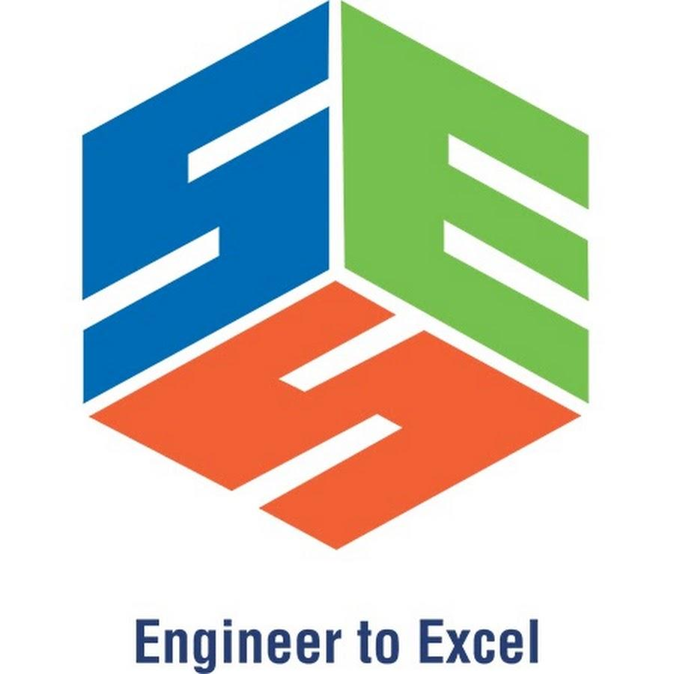
Serverless Computing: Reducing Infrastructure Management in the Cloud
Presented by:
M AYESHA(192324207)
CSA1511 :CLOUD COMPUTINGAND BIG DATAANALYTICS
Date: 15/07/2026
Technical Presentation

Slide 2
INTRODUCTION
What is Serverless Computing?
A cloud computing model where developers write code without managing servers.
The cloud provider automatically handles servers, scaling, and maintenance.
Applications run only when triggered.
Users pay only for the resources they use.
Popular Platforms
AWS Lambda
Microsoft Azure Functions
Google Cloud Functions

Slide 3
Core Technical Explanation
How Does Serverless Computing Work?
Step 1: A user sends a request (such as opening an app or uploading a file).
Step 2: The request reaches the Cloud Provider (AWS, Azure, or Google Cloud).
Step 3: The cloud provider automatically starts the required Function (code execution).
Step 4: The function processes the request and accesses databases or storage if needed.
Step 5: The result is sent back to the user.
Step 6: Once the task is complete, the function stops automatically, and you are charged only for the execution time.

Slide 4
Core Technical Explanation
How Does Serverless Computing Work?
Step 1: A user sends a request (such as opening an app or uploading a file).
Step 2: The request reaches the Cloud Provider (AWS, Azure, or Google Cloud).
Step 3: The cloud provider automatically starts the required Function (code execution).
Step 4: The function processes the request and accesses databases or storage if needed.
Step 5: The result is sent back to the user.
Step 6: Once the task is complete, the function stops automatically, and you are charged only for the execution time.

Slide 5
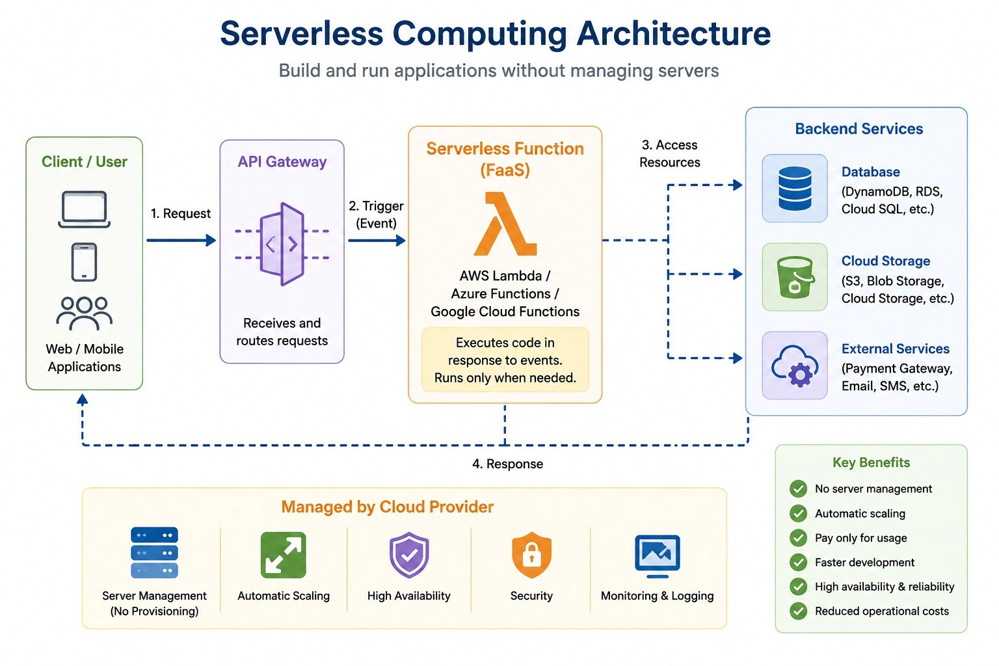
Architecture Diagram

Slide 6
Benefits
1. No Server Management
The cloud provider manages servers, maintenance, and updates.
Developers can focus only on writing application code.
2. Automatic Scaling
Resources automatically scale up or down based on user demand.
Ensures smooth performance during high traffic.
3. Cost-Effective
Pay only for the time your code runs.
No cost for idle or unused servers.

Slide 7
Real-World Applications
1. E-Commerce
Handles online orders, payments, and order notifications.
Example: Amazon
2. Video Streaming
Processes video uploads, streaming, and recommendations.
Example: Netflix
3. Mobile & Web Applications
Supports user authentication, chat, and push notifications.
Example: Airbnb

Slide 8
Example Use Case
Online Food Delivery Application (Swiggy/Zomato)
Process Flow:
Customer Places Order
⬇️
API Gateway Receives Request
⬇️
Serverless Function (AWS Lambda)
⬇
Stores Order in Database
⬇
Sends Notification to Restaurant & Delivery Partner
⬇️
Order Confirmation Sent to Customer
Advantages
✔ No server management
✔ Automatically handles thousands of orders
✔ Pay only when orders are processed
✔ Faster order processing and high scalability

Slide 9
Conclusion and Key Takeaways
Conclusion
Serverless Computing simplifies application development by removing the need to manage servers.
It provides automatic scaling, cost efficiency, and high performance.
Businesses can focus on innovation while the cloud provider manages the infrastructure.
Key Takeaways
✅ No server management required
✅ Pay only for actual usage (Pay-as-you-go)
✅ Automatically scales based on demand
✅ Widely used in modern cloud applications like AWS Lambda, Azure Functions, and Google Cloud Functions

Slide 10
Limitations and Future Scope
Limitations
Cold Start Delay – Functions may take slightly longer to start after being idle.
Vendor Lock-in – Applications may become dependent on a specific cloud provider.
Execution Time Limits – Serverless functions have maximum execution time restrictions.
Debugging & Monitoring – Troubleshooting distributed serverless applications can be more challenging.
Future Scope
AI & Machine Learning Integration – More intelligent cloud applications using AI services.
Growth of IoT Applications – Better support for real-time IoT data processing.
Improved Performance – Reduced cold start times and faster function execution.
Wider Enterprise Adoption – More businesses will use serverless computing for scalable and cost-effective applications.

Slide 11
THANK YOU

