Slide 1


Slide 1
PROJECT MODULE-2
VISUALIZING DATA FOR DIFFERENT TEAM

Slide 2


Slide 2
STARTBUCKS DRINK DEPARTMENT
NUTRITIONAL FACT : Caffeine, Sodium, and Sugar

Slide 3
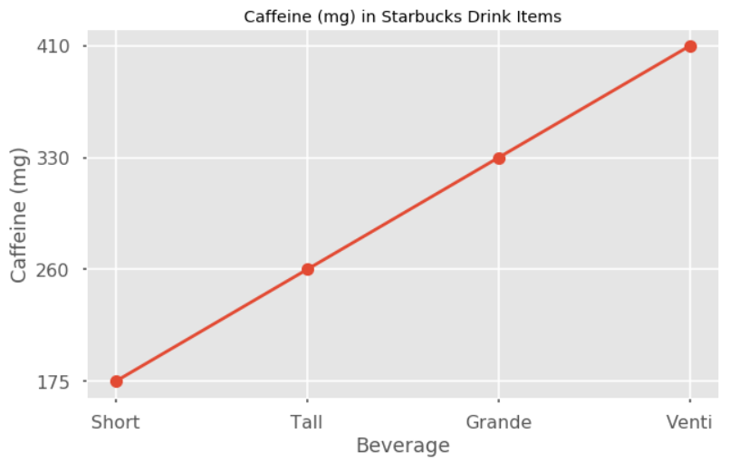
Slide 8
STARBUCKS DRINKS
Most asked "Caffeine", "Sodium", and "Sugar" nutritional facts
Caffeine (mg) in Starbucks Beverages

Slide 4
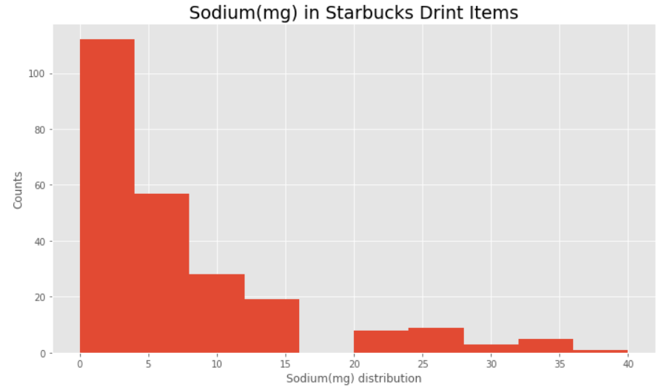
Slide 8
STARBUCKS DRINKS
Most asked "Caffeine", "Sodium", and "Sugar" nutritional facts
Sodium(mg) in Starbucks Beverages

Slide 5
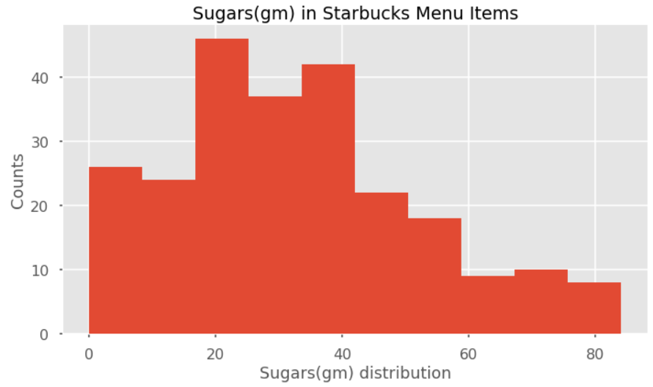
Slide 8
STARBUCKS DRINKS
Most asked "Caffeine", "Sodium", and "Sugar" nutritional facts
Sugars(gm) in Starbucks Beverages

Slide 6

Slide 15
THANK YOU!

