Slide 1


Slide 1
PROJECT MODULE-2
VISUALIZING DATA FOR DIFFERENT TEAM

Slide 2


Slide 2
STARTBUCKS FOOD DEPARTMENT
Visualization for the max nutritional items

Slide 3
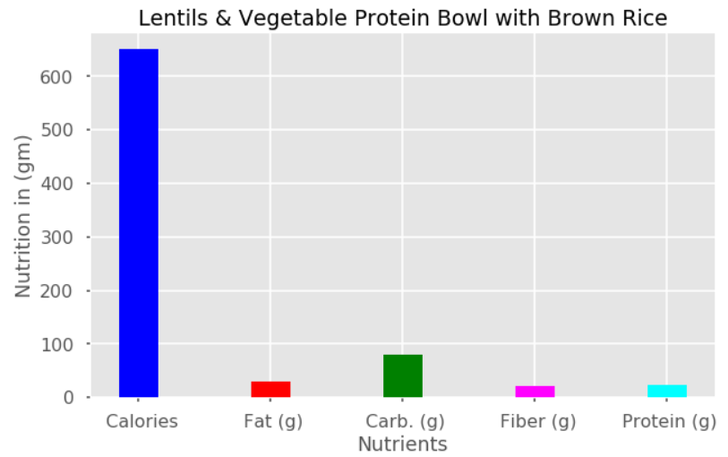
Slide 8
STARBUCKS FOOD
The Nutation Facts : Max nutrients for the items
Lentils & Vegetable Protein Bowl with Brown Rice

Slide 4
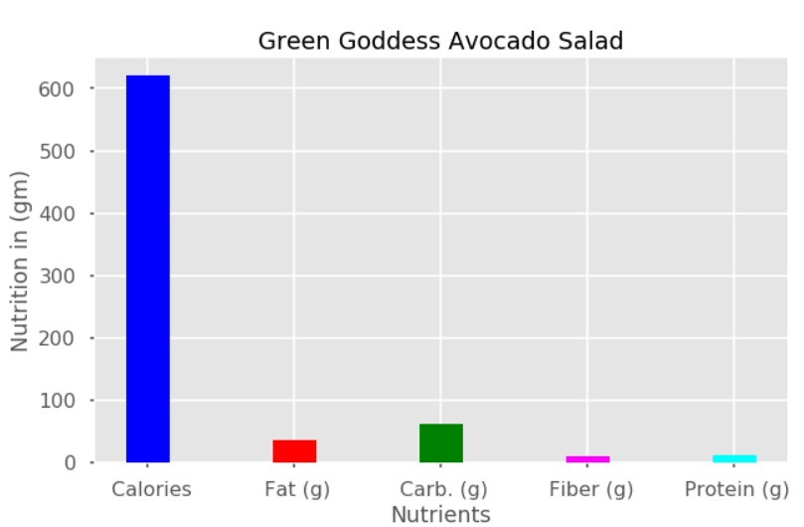
Slide 8
STARBUCKS FOOD
The Nutation Facts : Max nutrients for the items
Green Goddess Avocado Salad

Slide 5
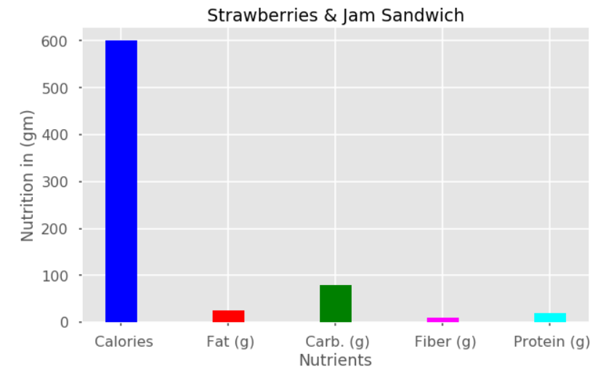
Slide 8
STARBUCKS FOOD
The Nutation Facts : Max nutrients for the items
Strawberries & Jam Sandwich

Slide 6

Slide 15
THANK YOU!

