Slide 1
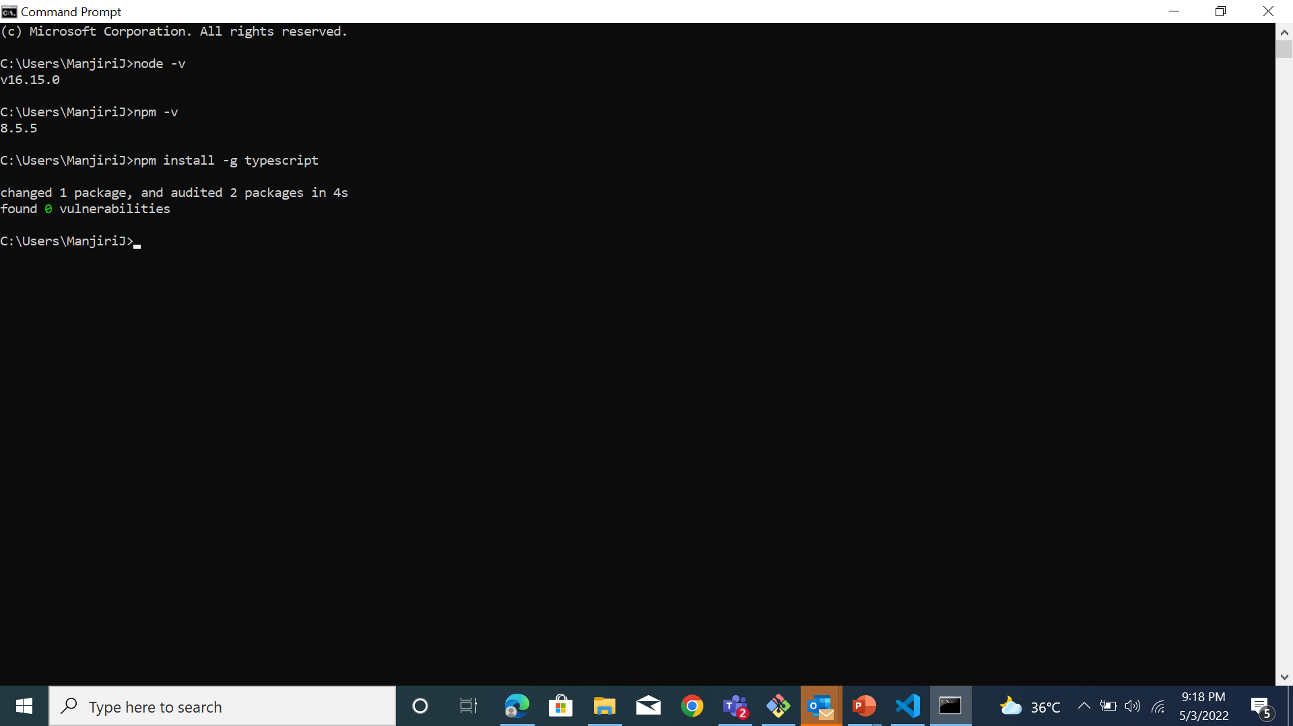
Task 1:

Slide 2
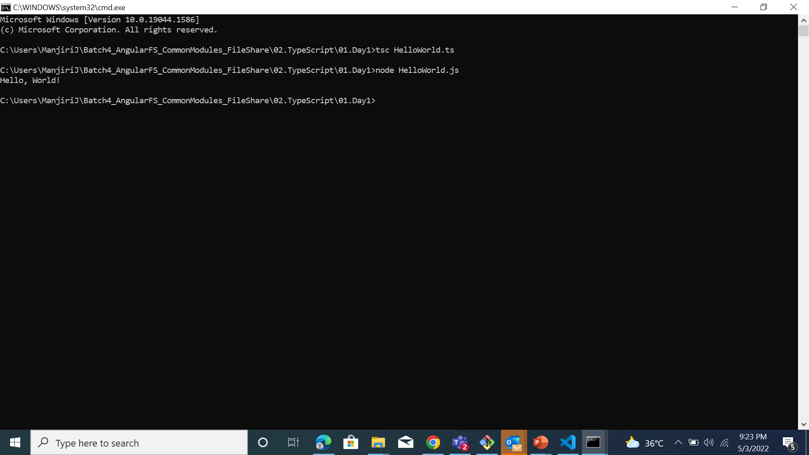
Task 2: Prepare typescript program as follows in a file using VS Code. (Eg: Demo1.ts)

Slide 3

Task 3: Create a typescript program to display the employee details as follows. Declare the required number of variables by using datatypes available in typescript. Use string templates to preset all details in single line.

